Slide 1
Personal project
Applying the skills
Notes:
This presentation is focused on the second stage of the personal project – Objective B: Applying the skills.

Slide 2
Applying approaches to learning (ATL) skills: How will you achieve your goal?
Select and apply ATL skills to work towards your learning goal
In this stage of the project you will ...
Gather evidence showing how you have used the ATL skills
Select and apply ATL skills to work towards your product goal
Notes:
In this stage, you will select and apply ATL skills to work both towards your learning goal and your product goal.
As you do so, you will gather evidence showing how you have used the ATL skills in your project. This evidence will be crucial for the report writing.

Slide 3
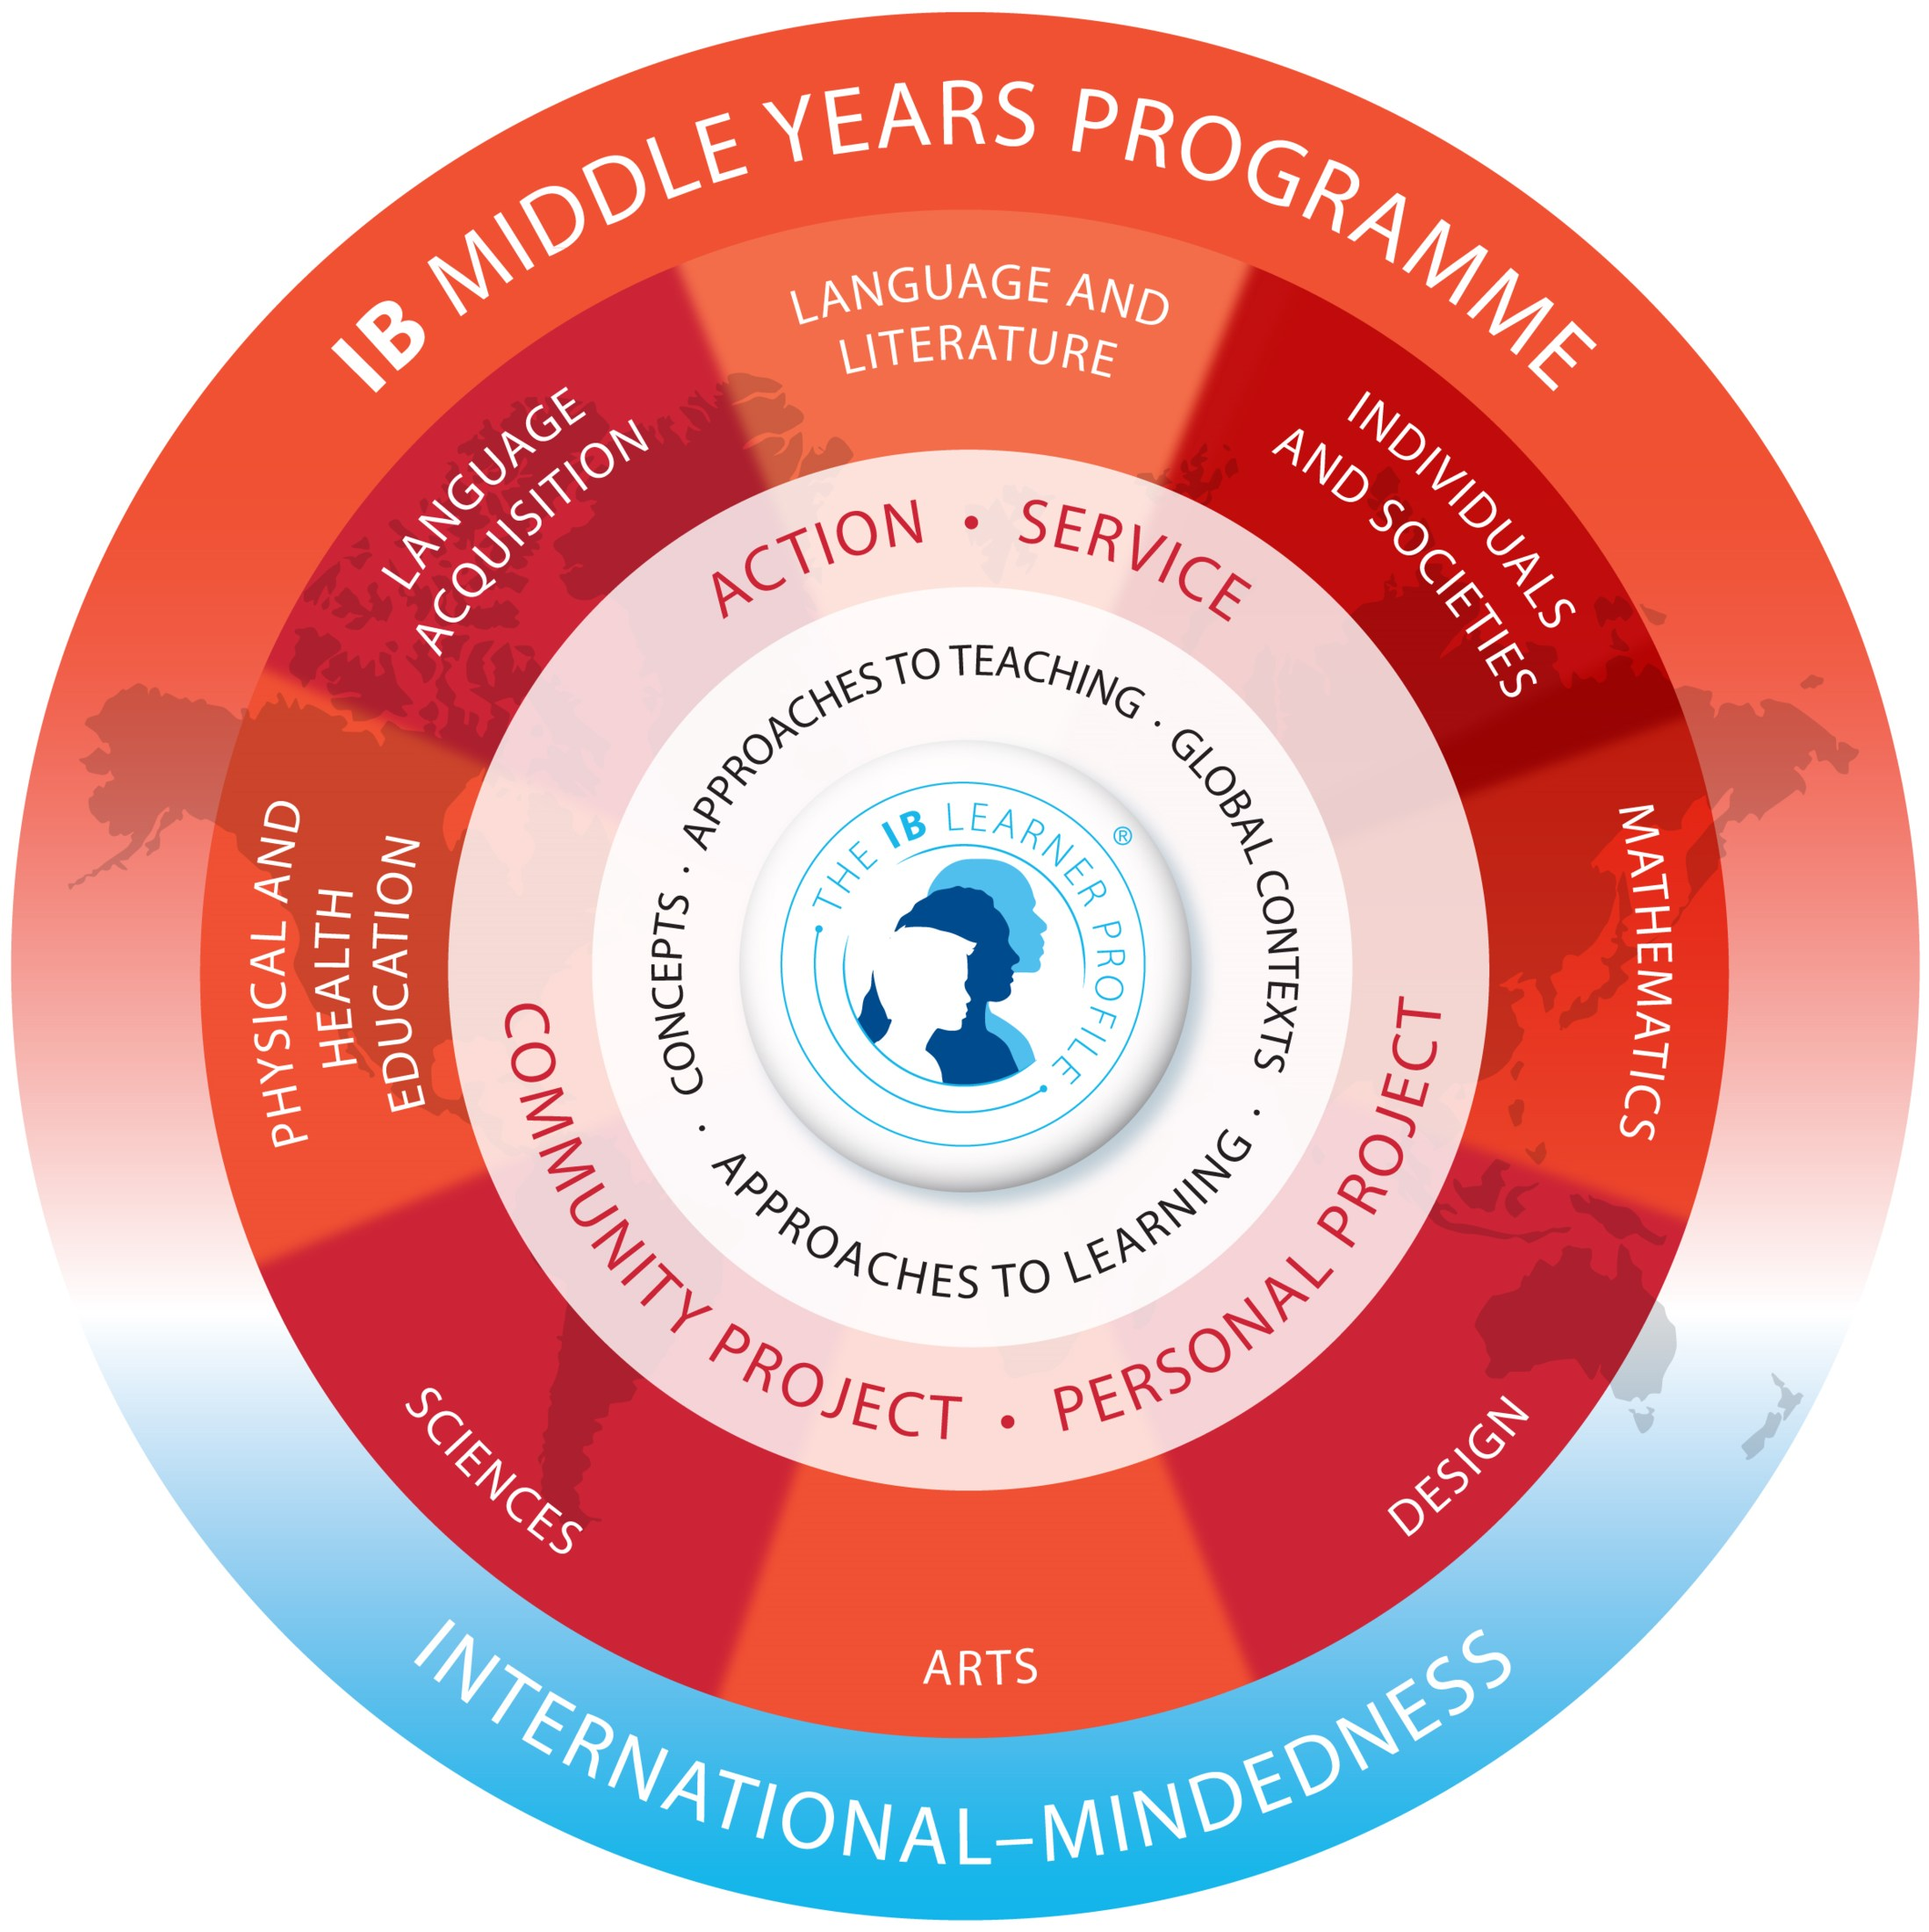
Approaches to learning
Through ATL in IB programmes, you develop skills that have relevance across the curriculum that help you “learn how to learn”.
You will use these skills during your personal project, document them, and finally reflect on them in the report.
Notes:
As the personal project is an opportunity for you to demonstrate your learning throughout the MYP, the approaches to learning are at the core of the project.
Through the ATL skills you develop skills that help you "learn how to learn".
You use these skills during the personal project, documenting them and reflecting on them in the report.

Slide 4
Applying the skills: How will you achieve your goal?
Select and apply ATL skills to work towards your learning goal
Gather evidence showing how you have used the ATL skills
In this stage of the project, you will ...
Select and apply ATL skills to work towards your product goal
Notes:
We will look at two aspects of the project process: applying ATL skills and gathering evidence.
Note that you should select one ATL skill for the learning goal and one for the product goal.
For each, you need to collate evidence that shows the application of the respective ATL skill.

Slide 5
Applying the skills: How will you achieve your goal?
Gather evidence showing how you have used the ATL skills
Select and apply ATL skills to work towards your learning goal
Learning goal: I want to learn about the health aspects of fitness for teenagers, what constitutes a healthy fitness level, and how to attain and maintain it during adolescence.
Notes:
Let's take the learning goal as an example. [click for learning goal to appear]
Here, the student wants to learn about the health aspects of fitness for teenagers.
They are tasked to select and apply ATL skills to work towards this learning goal.
How should they select a relevant ATL skill?

Slide 6
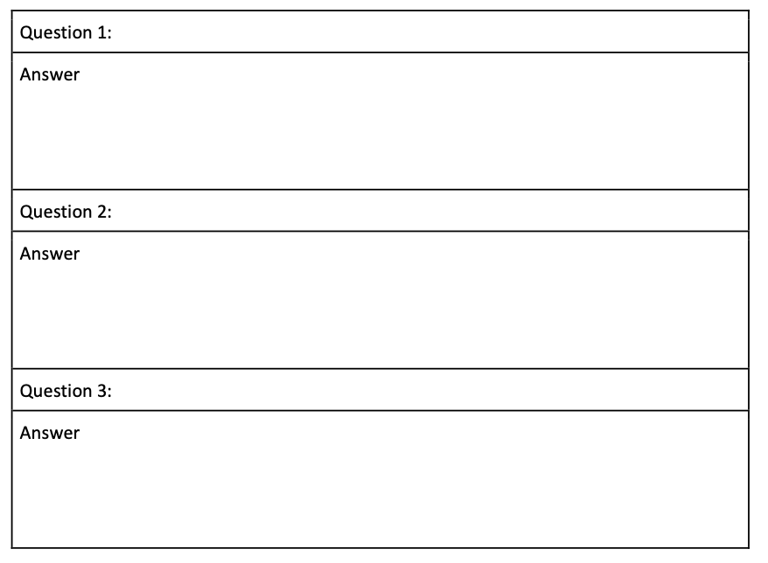
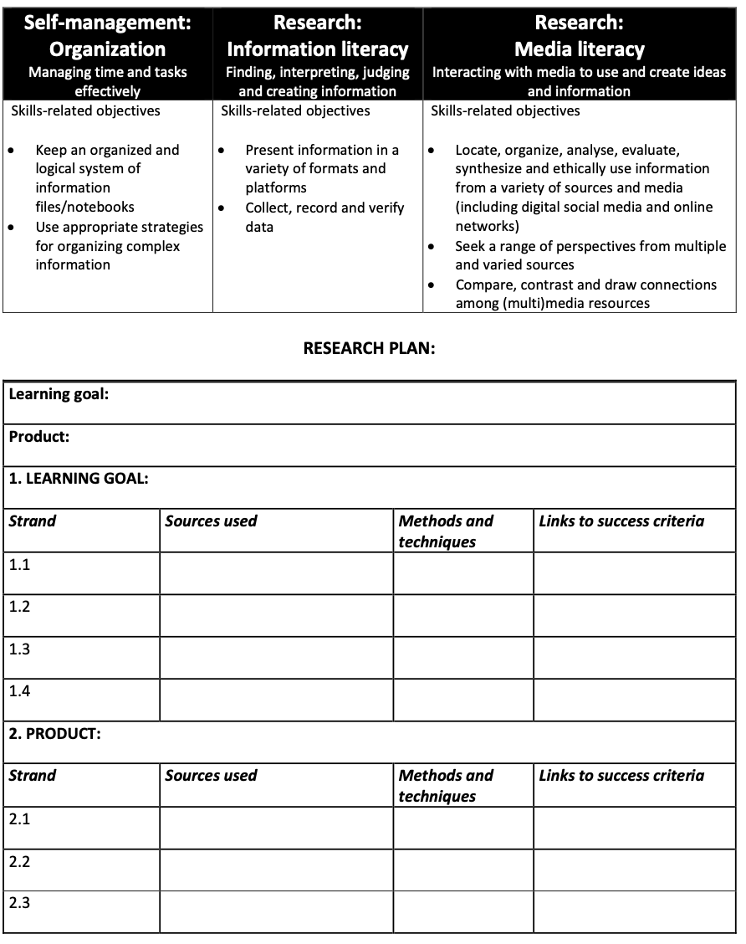
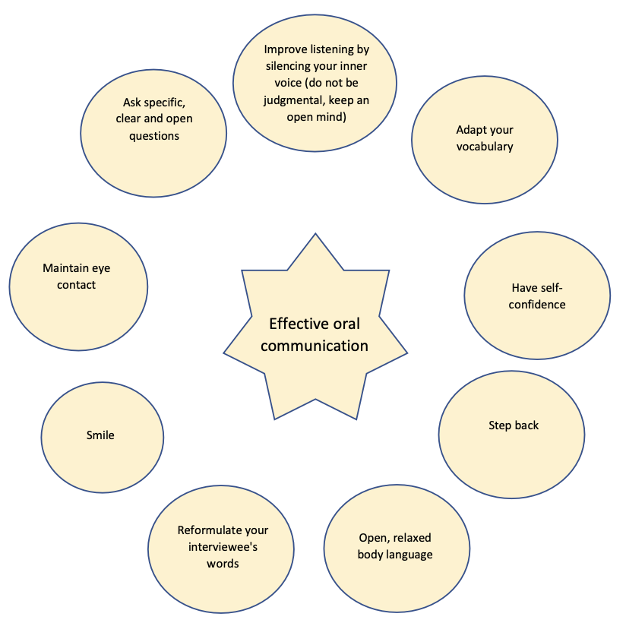
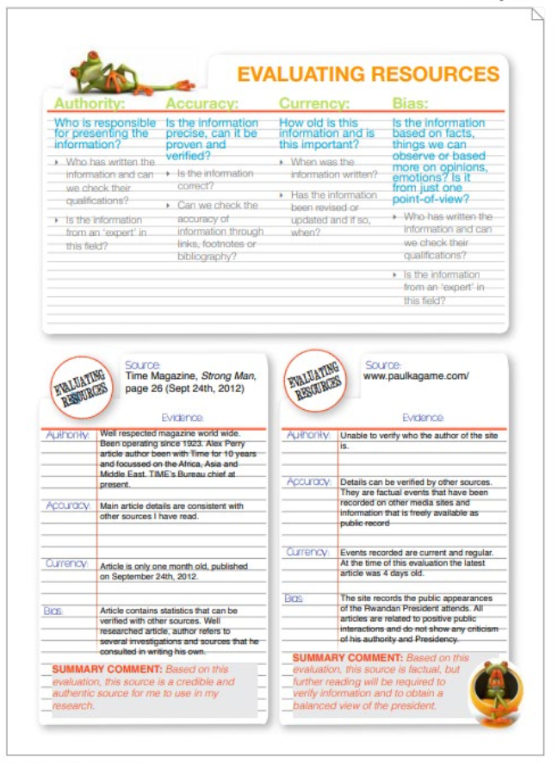
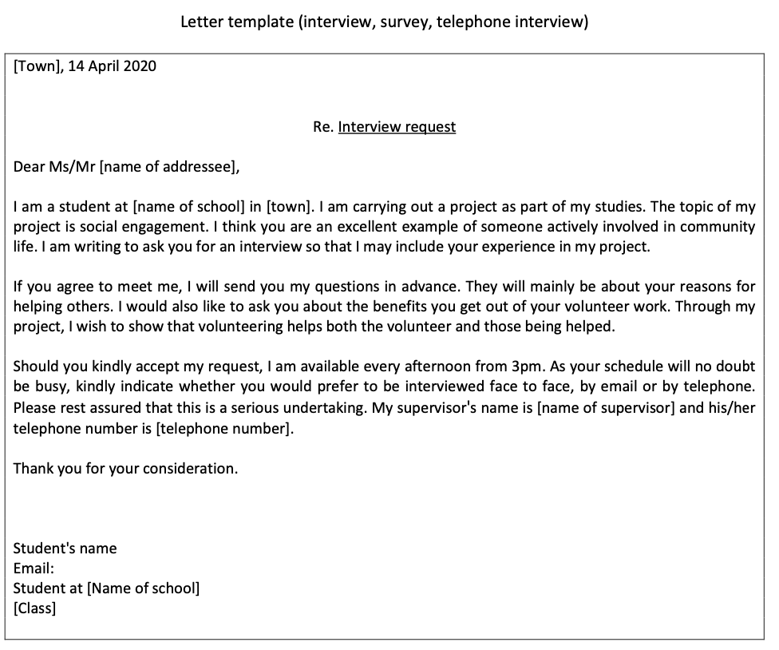
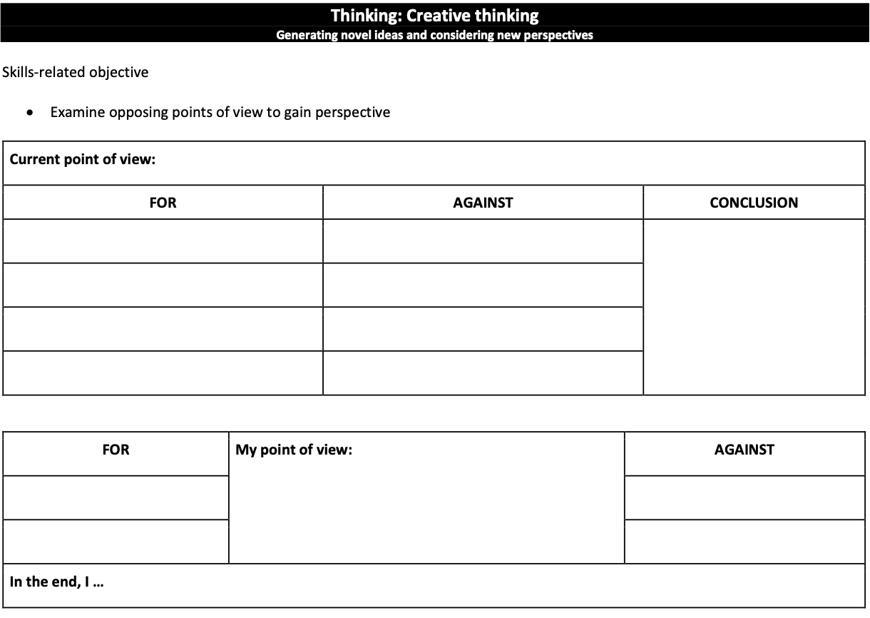
Selecting ATL Skills
Notes:
You could start by mapping out the ATL categories and skills you have developed in MYP courses.
For example, speaking and writing techniques, surveys, interviews, research questions, source evaluation, evaluating different perspectives ...
There are many categories and skills to choose from. The ATL toolkit provides a wide range of tools to develop your ATL skills and help you work towards your project goals.

Slide 7
Self-management skills: Organization
Managing time and tasks effectively
ATL skill(s) clusters | How have you developed these skills? Give specific examples of how you have used them in your project (before/after).
Information literacy
Media literacy
Organization
Affective skills
Collaboration
Communication
Critical thinking
Creative thinking
Transfer
Notes:
The following table can help with three things:
Organizing project actions in ATL skill categories
Recording project activities and your link to a specific ATL skill
Linking evidence to project actions and ATL skills
The chart can be used to document the use of ATLs throughout the project, providing examples.
This is a useful tool to help you select the ATL skills you want to include in your report.

Slide 8
Self-management skills: Reflection
Develop new skills, techniques and strategies for effective learning
Use new ATL skills and evaluate your effectiveness
Consider ATL skills development
Choose the ATLs to inform the report wisely.
ATL skill(s) clusters | How have you developed these skills? Give specific examples of how you have used them in your project (before/after).
Information literacy
Media literacy
Organization
Affective skills
Collaboration
Communication
...
Explain how the ATL skills were applied
Describe the link between the ATL skill and the learning goal/product
Give reasons why they were applied
Provide examples or evidence
Explain how they helped in achieving the learning goal and product
Give reasons why the ATL skills helped you to achieve your learning goal/product
Notes:
When it comes to report writing, it will be easy for you to reflect and explain how the ATL skills were applied and helped in achieving the learning goal or product.

Slide 9
ATL skills
Record the ATL skills that match project tasks
ATL skill(s) clusters | How have you developed these skills? What steps did you take? How did you use these skills? | Evidence of this step
Information literacy
Media literacy
Organization
Affective skills
Collaboration
Communication
...
Survey teenagers on their lifestyle, health and fitness
Notes:
The left column lists the 10 ATL skill clusters. To save space, we see only 6 of the 10.
In the middle column, you will list the actions you take to achieve your learning goal or product.

Slide 10
Plan what evidence to collect
Plan what evidence to record to inform the report wisely.
ATL skill(s) clusters | How have you developed these skills? What steps did you take? How did you use these skills? | Evidence of this step
Information literacy | Collect and verify data on fitness for teenagers Decide on useful sources to reach learning goal using research table | Bibliography research table
Media literacy | ...
Organization | Make a to-do list Keep all project-related work, sources and data in a process journal | To-do list Process journal entries
Affective skills | ...
Collaboration | ...
Communication | Use appropriate forms of writing Receive meaningful feedback Use a variety of media to communicate | Survey questions ... … Answers received Invitations to survey
Notes:
This student has so far identified three areas.
The column on the right provides space to write down the kind of evidence that is being collected for the respective step.
Note that you may include any or all of the 10 ATL clusters in your table.

Slide 11
Collecting evidence
Notes:
For Objective B, you also need to provide evidence showing how you have used the ATL skills.

Slide 12

"When teaching and learning are visible there is a greater likelihood of you reaching higher levels of achievement" John Hattie
Notes:
[Read the slide]
you are advised to collect all evidence created during the project in a process journal.

Slide 13
Gathering evidence
The ATL skills will help you reach your product goal and your learning goal. Gathering evidence of how you used the ATL skills will also support your reflection at the end of the project.
Here are some tips:
Use any format (or formats) that work for you.
Reflect regularly about what ATL skills you have used recently.
Keep a record of your reflections and include supporting evidence and examples.
Notes:
Formats can be digital or hard copy, written, visual or verbal, and may be gathered in notebooks, portfolios, folders, blogs, social media feeds or voice memos.
Please refer to the MYP Personal project guide for more details.

Slide 14
Gathering evidence
Examples of supporting evidence could include:
a series of inquiry questions (research skills)
sample correspondence with the project supervisor (communication skills)
screenshots of daily reminders or alerts to complete personal project tasks (self-management skills)
reflections about resolving a conflict (social skills)
a summary of prior learning that is relevant to the project (thinking skills)
Notes:
Examples of supporting evidence could include:
• a series of inquiry questions (research skills)
• sample correspondence with the project supervisor (communication skills)
• screenshots of daily reminders or alerts to complete personal project tasks (self-management skills)
• reflections about resolving a conflict (social skills)
• a summary of prior learning that is relevant to the project (thinking skills).

Slide 15
Writing the report
Notes:
At the end of the personal project, you will submit a report with a section about this phase of the project.

Slide 16
In the report
At the end of the personal project, you will submit a report with a section about this phase of the project.
You will need to: | Check
explain how the ATL skill(s) was/were applied to help achieve your learning goal | √
explain how the ATL skill(s) was/were applied to help achieve your product | √
support your explanations with detailed examples and evidence. | √
Notes:
In a good report, every description of how an ATL skill was applied will include an example or evidence.
Every explanation of why the ATL skill helped in achieving the goals will also include an example or evidence to substantiate the explanation.
Evidence is crucial and can be photographs, screenshots or text directly copied and properly referenced.
Also remember that “less is more”. You should report only on one ATL for the learning goal and one for the product goal.

Slide 17
Definitions: Explain
You should explain how the ATL skill(s) was/were applied to help achieve your learning goal
You should explain how the ATL skill(s) was/were applied to help achieve your product.
Describe the link between the ATL skill and the learning goal
Describe the link between the ATL skill and the product
Give reasons why this helped you to achieve the learning goal
Give reasons why this helped you achieve the product
Provide examples/ evidence
Provide examples/ evidence
Notes:
It is not enough to state or outline which ATL skill(s) was applied. You also have to describe and explain how they were applied.
For higher achievement levels, you need to describe the link between the ATL skill and your learning goal or product, but also give reasons why this helped you to achieve the specific learning goal or product.
Each such description or explanation needs to be substantiated with examples or evidence. This needs to be included in the main part of your report.

Slide 18
What could the evidence look like?
ATL skill cluster | Possible evidence
Communication | Correspondence with supervisor, social media posts
Collaboration | Essential agreement for group work, feedback to (or from) peers
Organization | Action plans, calendar reminders, lists, timelines
Affective skills | Lessons learned from setbacks, routines to enhance focus
Reflection | Self-evaluations, status updates
Information literacy | Lines of inquiry, annotated bibliography
Media literacy | Annotated research, Venn diagrams to compare and contrast sources
Critical thinking | Pros/cons lists, data analysis
Creative thinking | Prototypes, concept sketches, visible thinking diagrams
Transfer | Lists of relevant prior learning, mind maps that connects ideas
Notes:
Examples of supporting evidence could include:
a series of inquiry questions (research skills)
sample correspondence with the project supervisor (communication skills)
screenshots of daily reminders or alerts to complete personal project tasks (self-management)
reflections about resolving a conflict (social skills)
A summary of prior learning that is relevant to the project (thinking skills).
These are just a few possibilities.
The ATL toolkit is full of inspiration on how to create pieces of evidence.
It comprises a wide range of tools for every ATL skill category, such as templates for mind maps, interviews, research tables, methods for collecting feedback and evaluating the product, and more.

Slide 19
Applying the skills: How will you achieve your goal?
Select and apply ATL skills to work towards your learning goal
Bi
Gather evidence showing how you have used the ATL skills
In this stage of the project, you will ...
Select and apply ATL skills to work towards your product goal
Bii
Notes:
In the report, you need to be very clear about whether you are addressing ATL skill(s) that helped achieve the learning goal or the product goal.
You need to address both of these in your report. When writing Bi [click] and Bii [click], your use of these ATL skills must be clearly addressed for each.
You are advised to label the different ATL skills used for the different goals: for example, by mentioning them in headings in the different sections of the report.

Slide 20
Checklist for Criterion B
Objective | Checklist
i. The student should explain how the ATL skill(s) was/were applied to help achieve their learning goal. | I have named the ATL skill cluster and specific ATL skill that helped me achieve my learning goal. I explicitly explained how the ATL skills were applied and why they helped achieve the learning goal. I gave examples of how I applied the skill and provided evidence in the form of screenshots or images.
ii. The student should explain how the ATL skill(s) was/were applied to help achieve their product. | I have named the ATL skill cluster and specific ATL skill that helped me achieve my product goal, and I gave examples of how I applied the skill. I explicitly explained how the ATL skills were applied and why they helped achieve the product. I have included evidence (product evidence, mind maps, research tables, etc.)
Notes:
You can use this list to develop Criterion B of your report and check whether you have included everything.

Slide 21
Questions?

Slide 22
Acknowledgements
Photo by Daniel Chekalov on Unsplash (https://unsplash.com/photos/OxU08SFhPbI)

