Slide 1

Personal Project??
In your table groups share what you learnt about the personal project through your conversations with G10 students
Notes:
Feedback to whole group

Slide 2
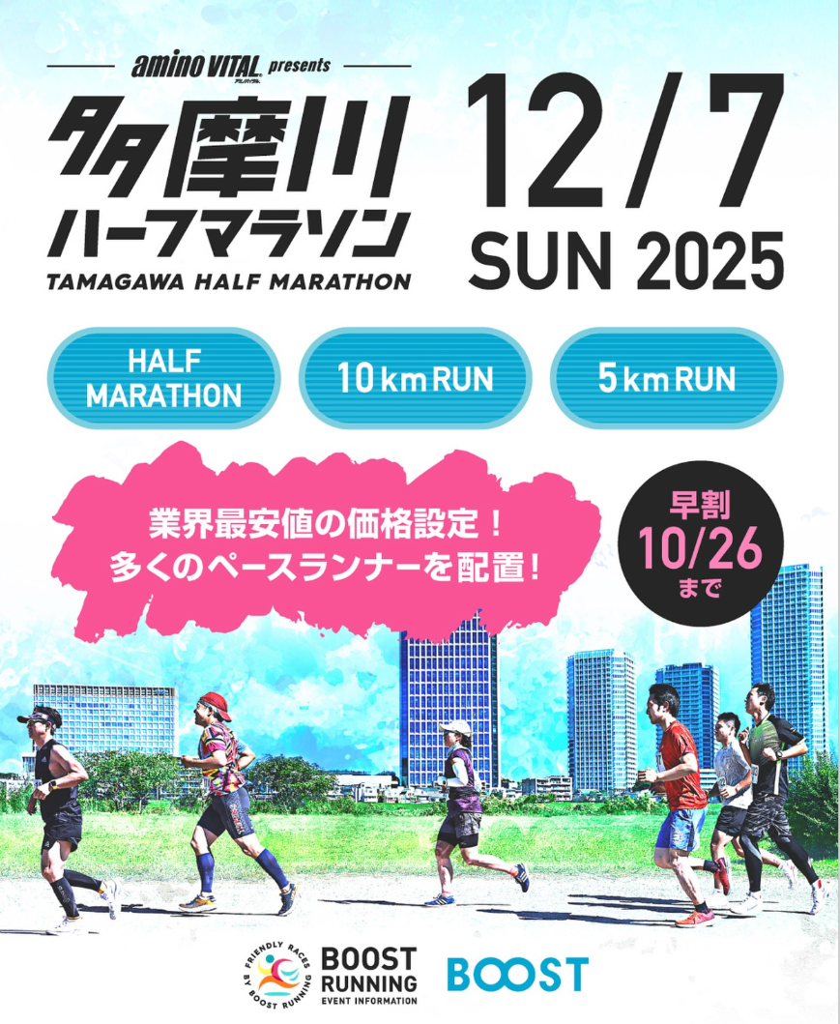
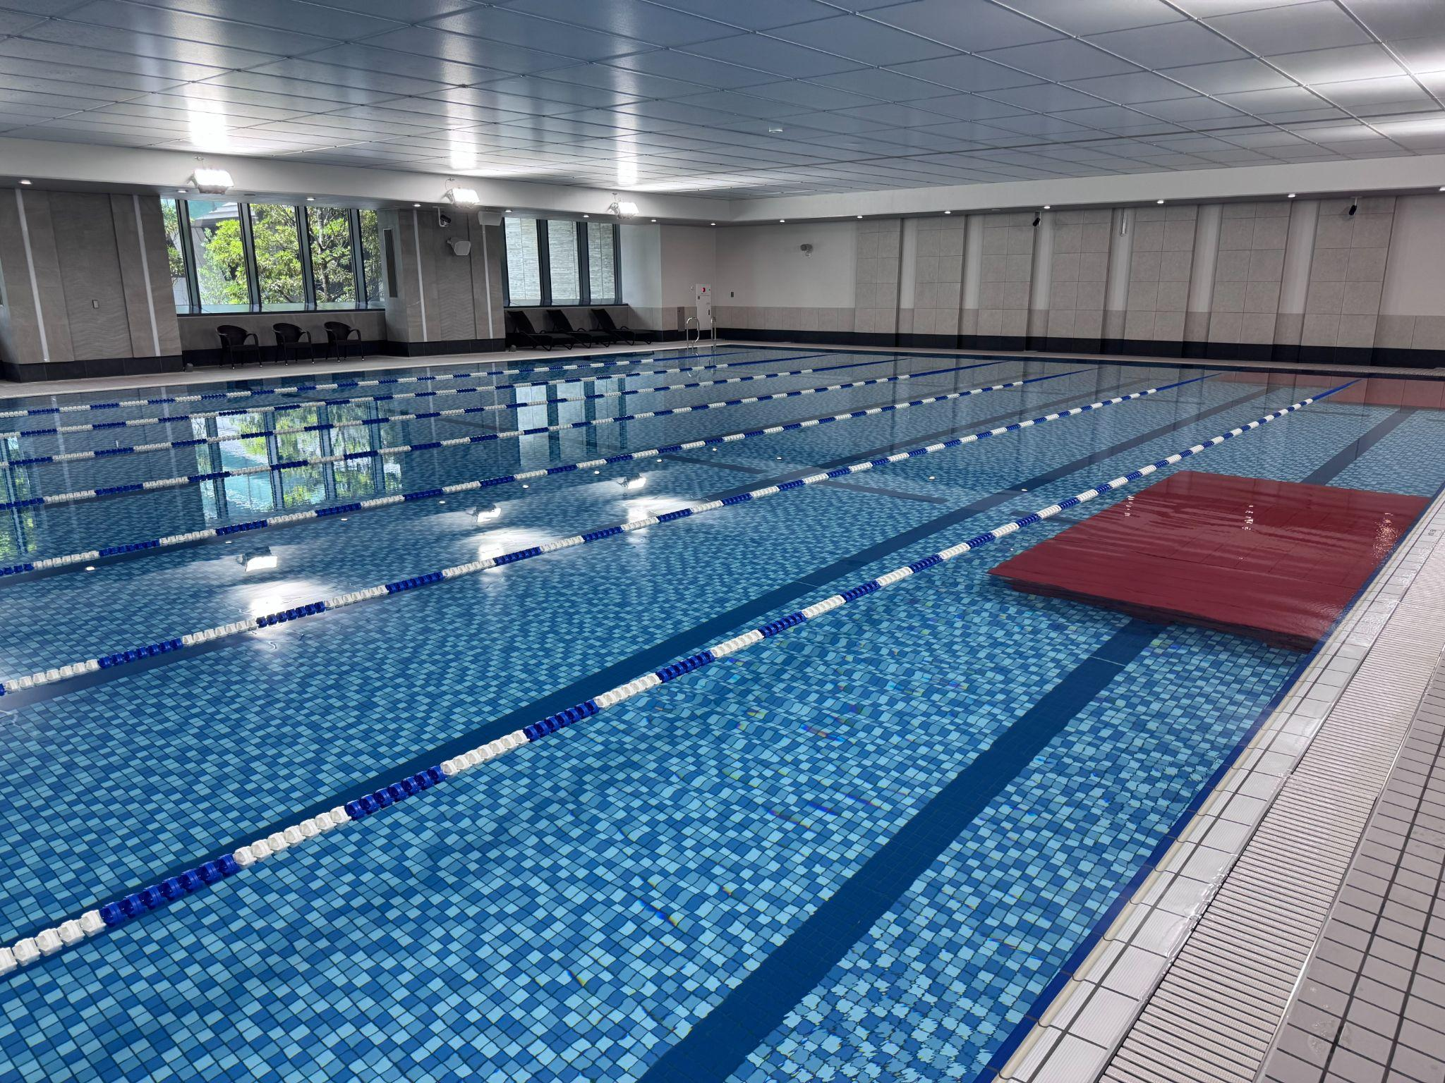
Anya’s personal project: Half Marathon training plan
Chris’s personal project:
Planning for a TIS Aquatics program
Notes:
Researched - read articles, spoke to expert, researched apps and sports watches, social and communication skills - running with others, revised and reviewed my plan based on performance

Slide 3
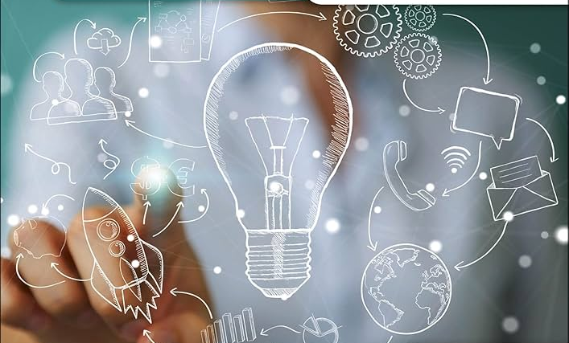
Starter Question: If you were given 6 months to learn and create/organise/develop/design anything what would it be?
Why is this important to you?
Notes:
Pair discussion - feedback to group

Slide 4
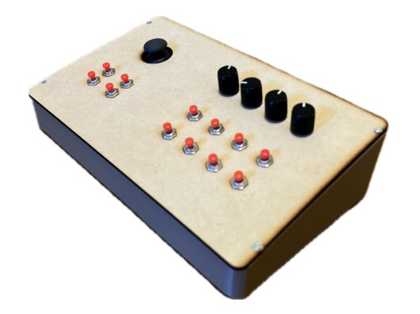
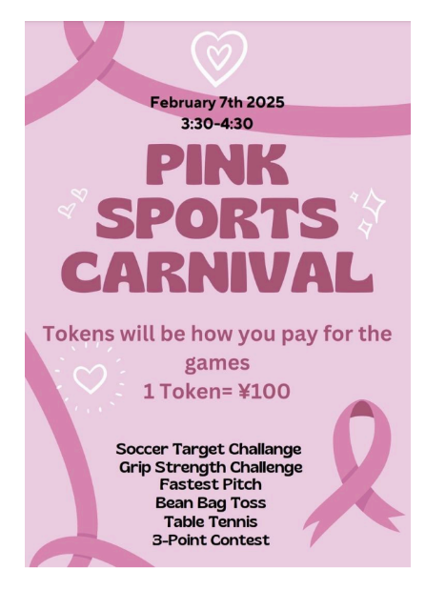
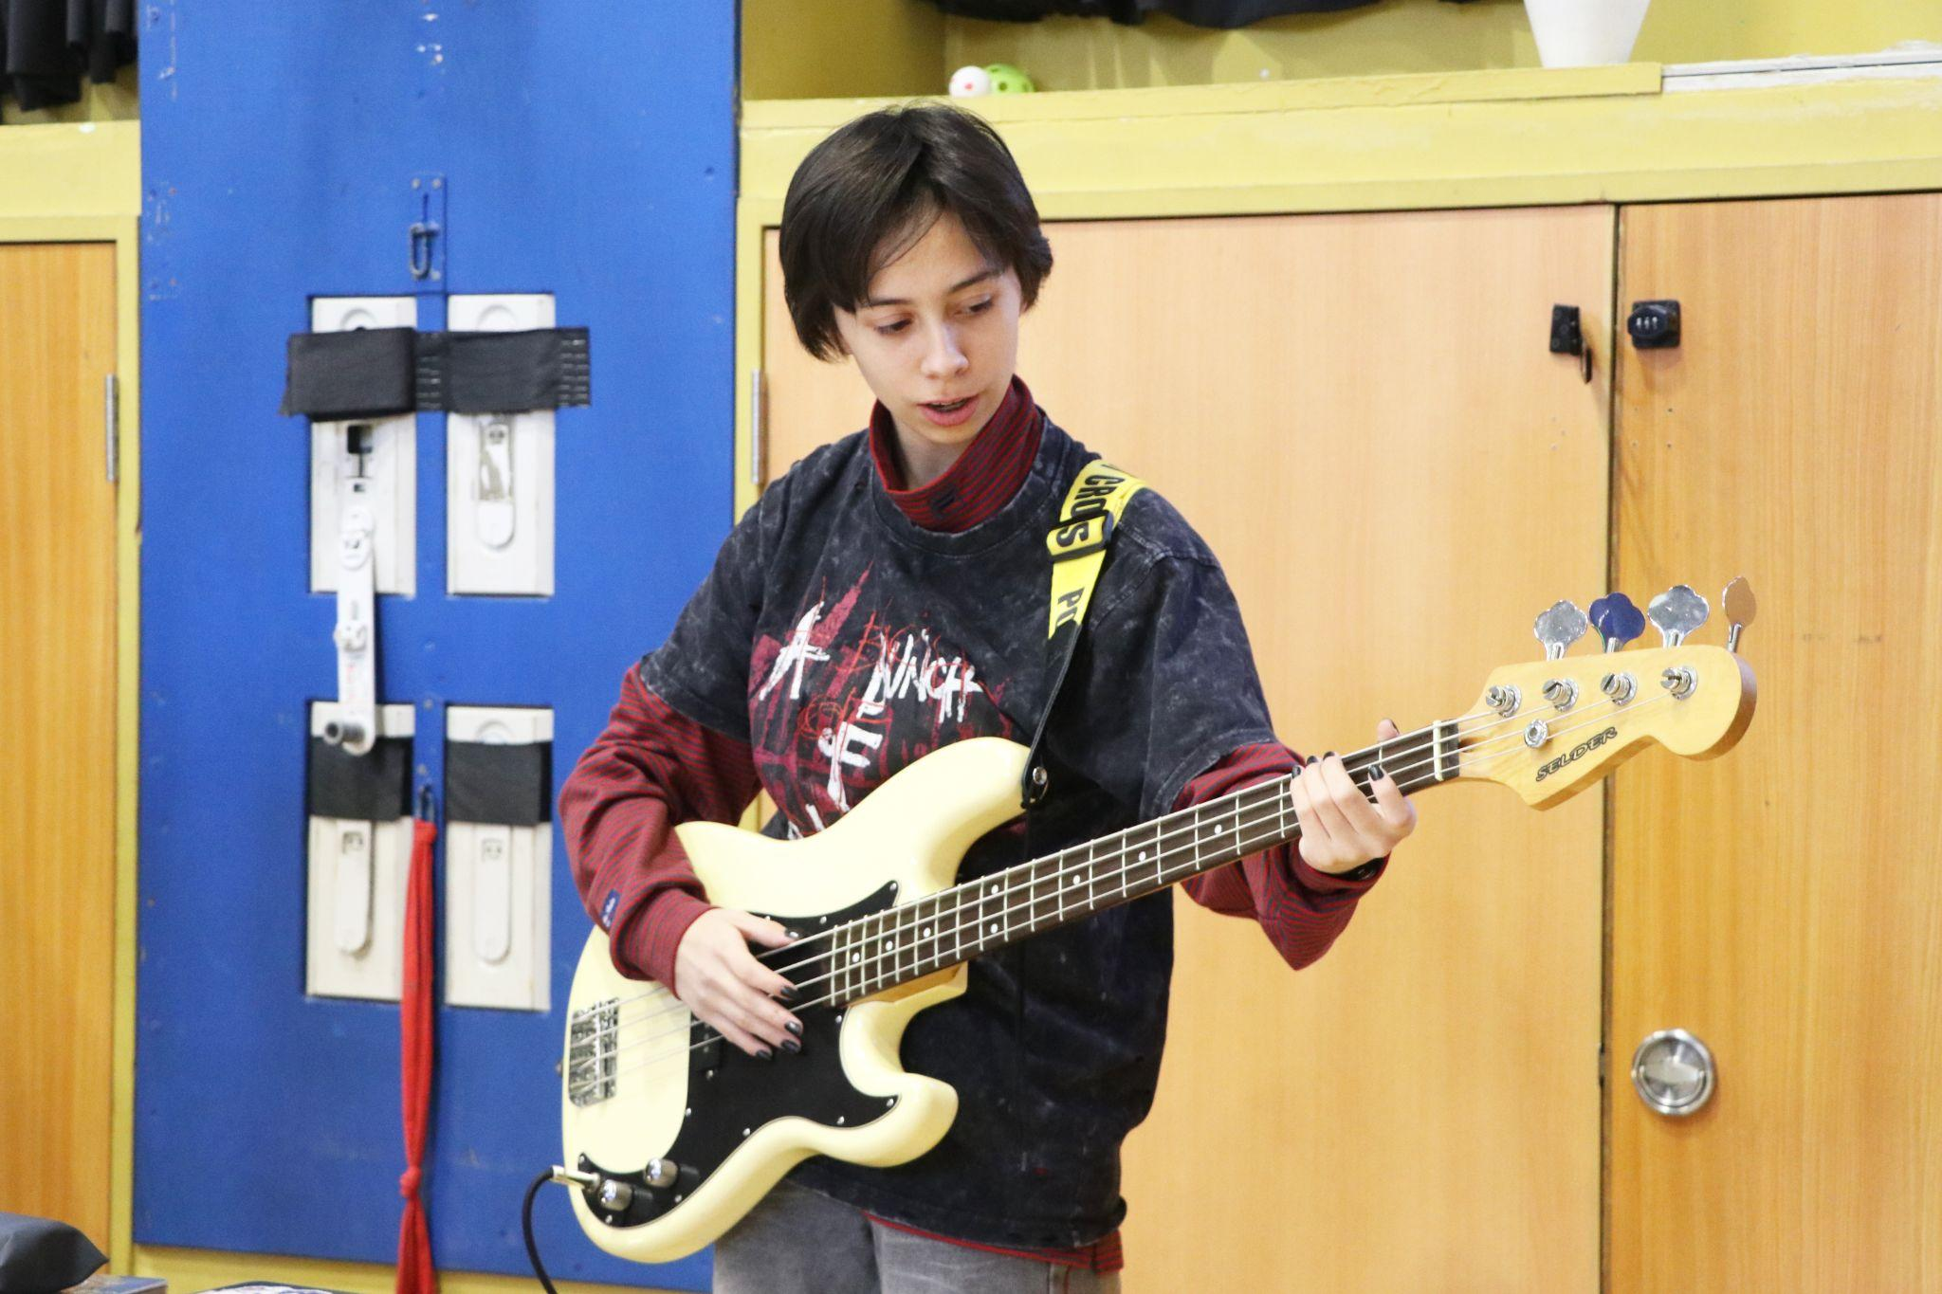
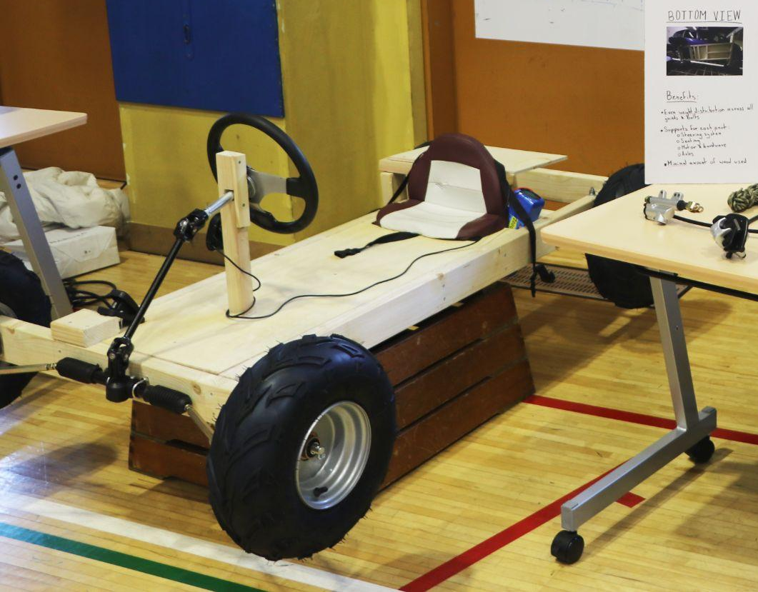
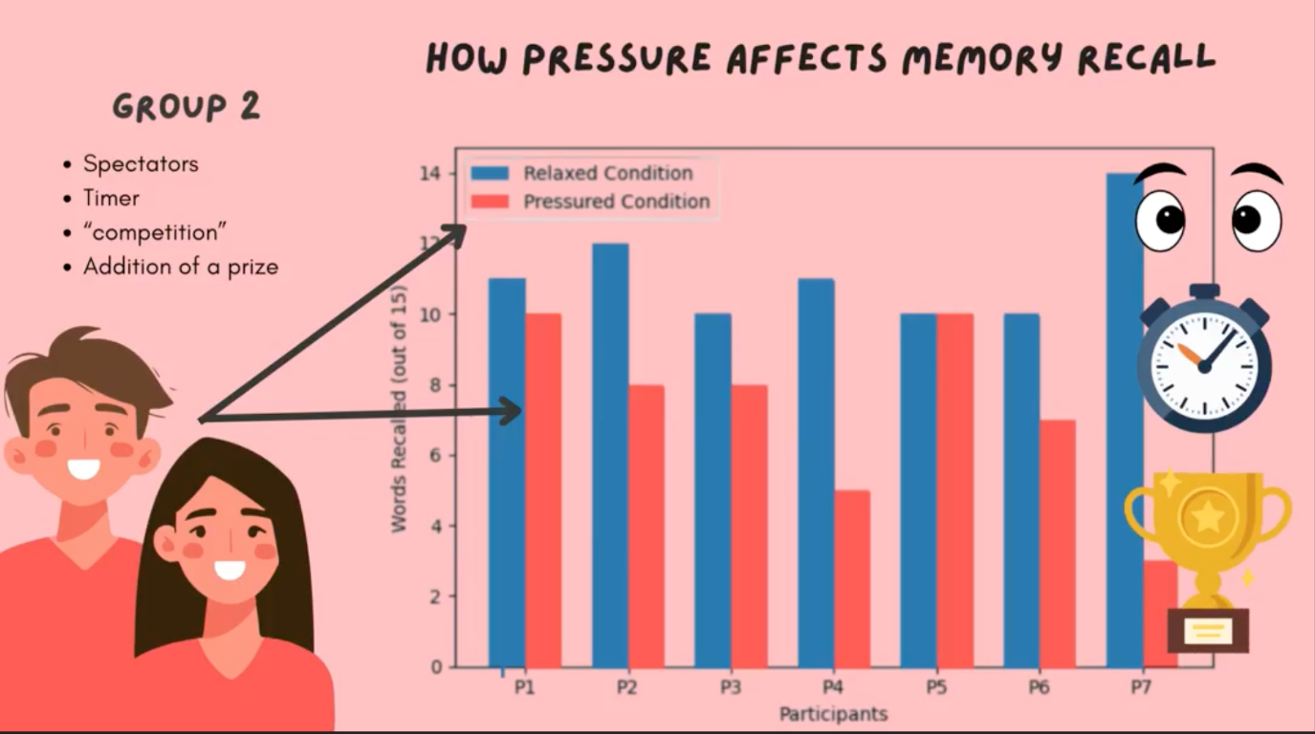
Learning to Code using C++ to make a MIDI Controller
Learning an instrument
Sports fundraising event - raising awareness and money for breast cancer charity
Making an educational video to help students manage stress
Making a Go-Kart

Slide 5
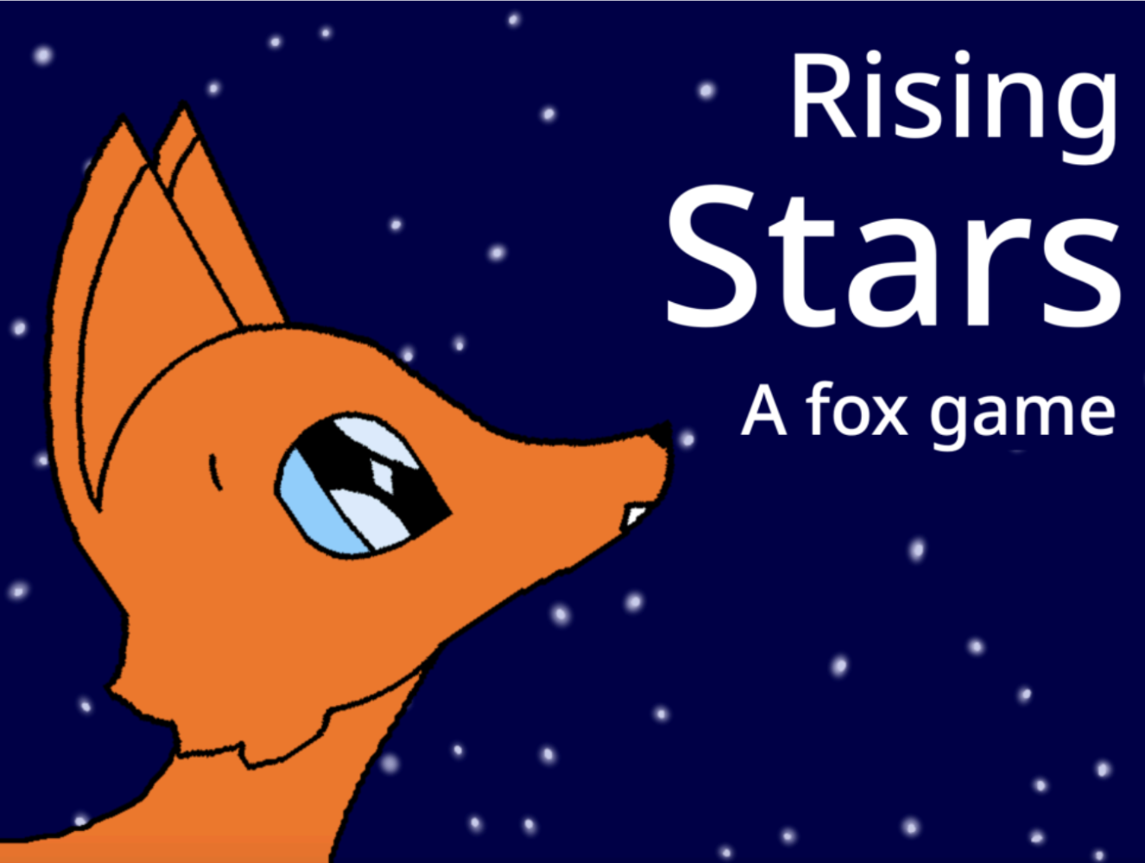
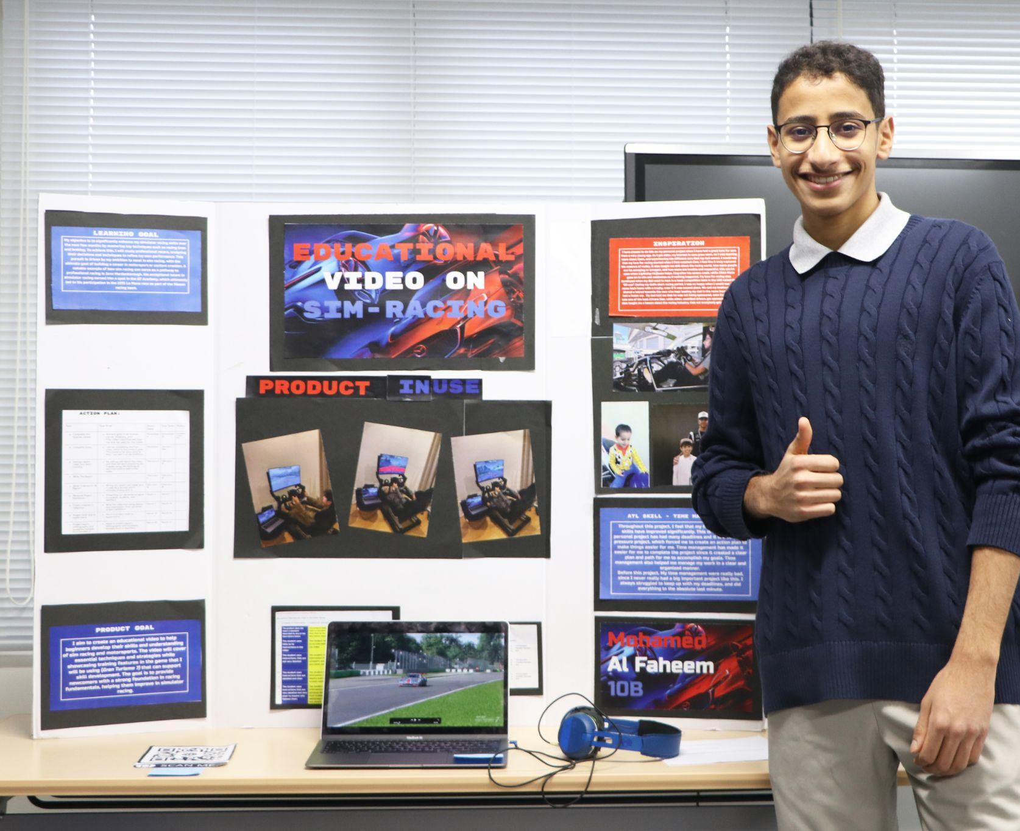
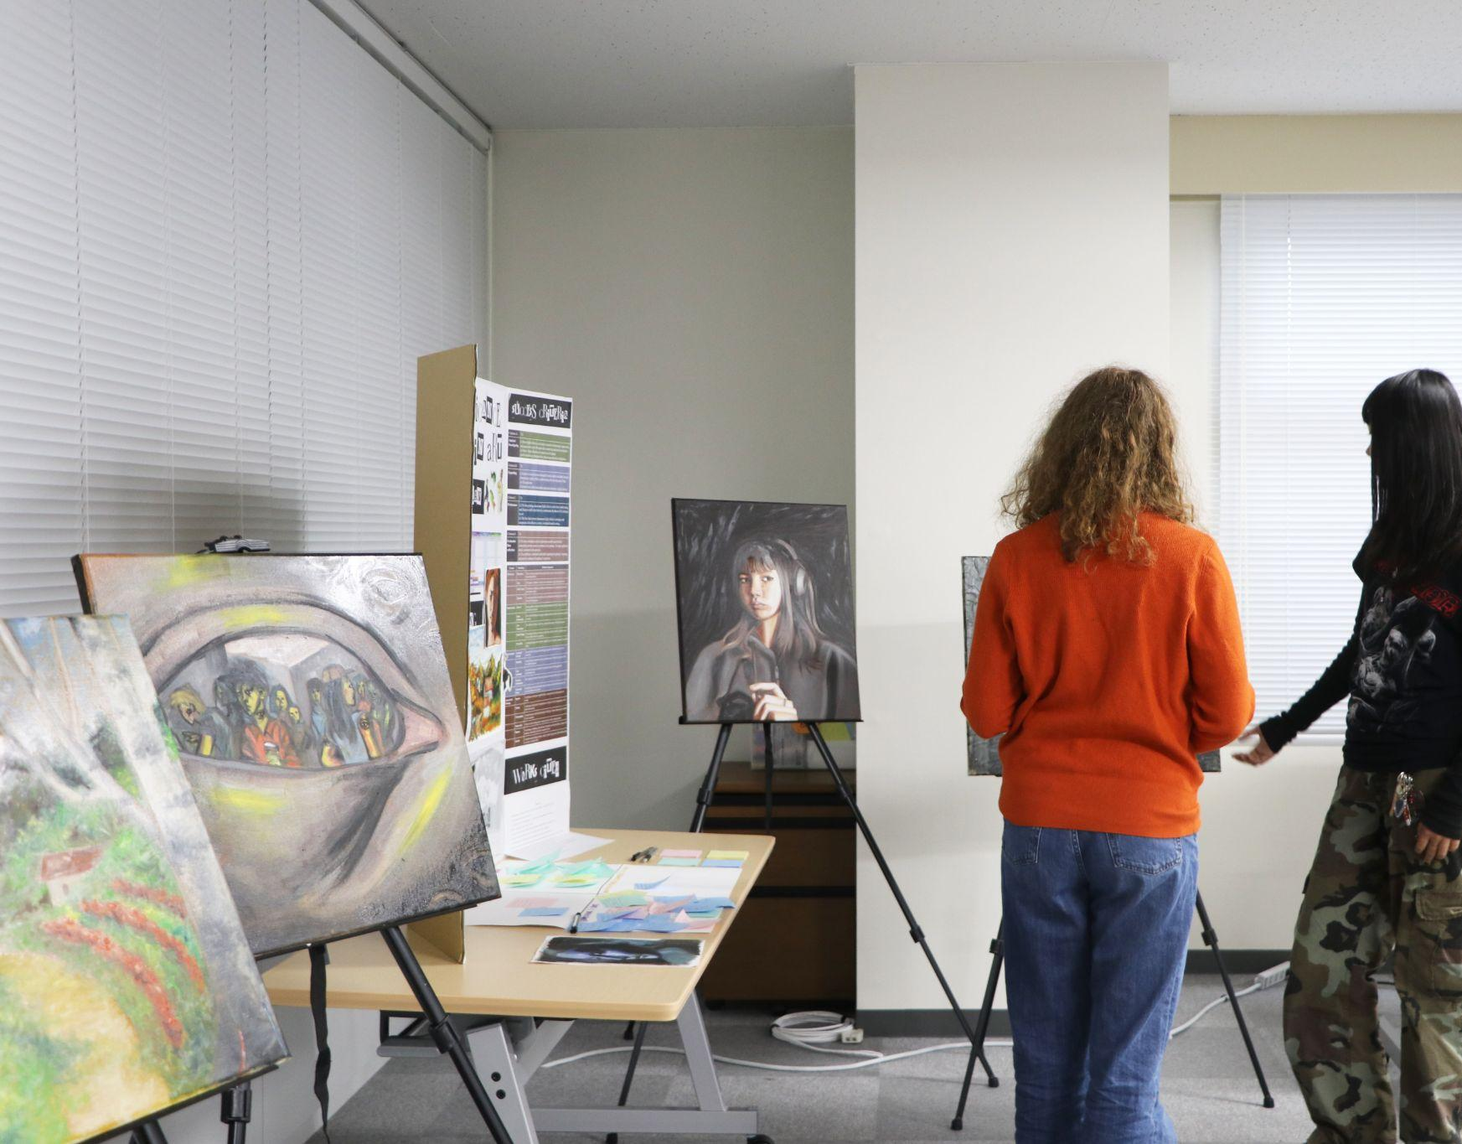
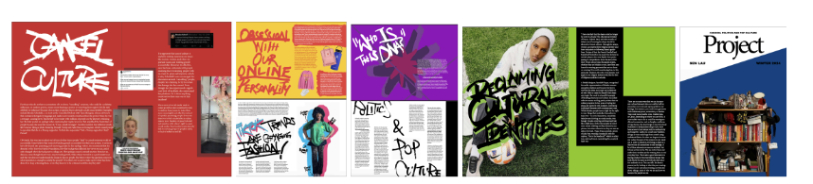
Creating an animated video game
Educational video on SIM-Racing
Creating a zine about Gen Z fashion and culture
What do these personal projects have in common?
Curating an art exhibition

Slide 6
Task: Create a mindmap using the prompts provided, coming up with initial ideas for your own personal project
What am I curious about learning?
How could I do something to help other people?
What are my favourite school subjects - how could I develop my learning in this area?
Have I been involved in any community engagement projects that I could develop further?
My Personal Project
What is something I have always wanted to try?
What are my hobbies and interests?
How could I develop these further?

Slide 7
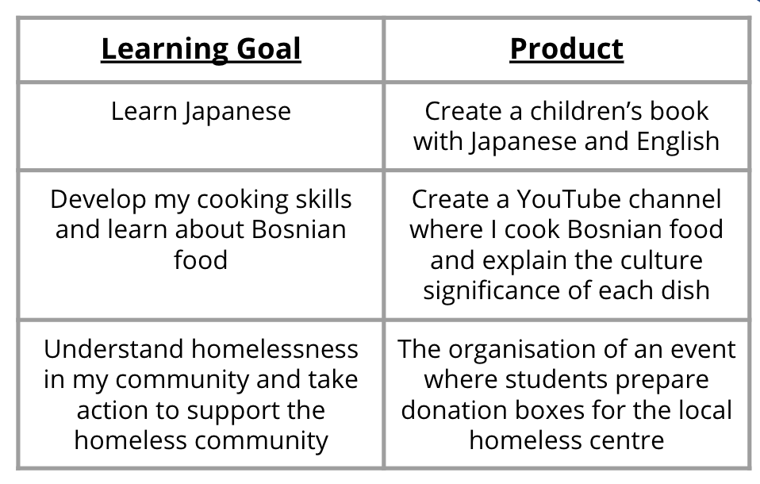
Personal Project - Key Terminology
The project consists of two interrelated parts:
- a learning goal (what the student wants to learn)
- a product (what the student wants to create).
Citation: guide.fariaedu.com/myp-personal-project/setting-a-goal/learning-goal-and-product

Slide 8

Mindmap gallery walk
Leave one sticky note that answers one of these questions:
What could be a possible learning goal for this student?
What could be a possible product goal for this student?

Slide 9
What to do over the summer break:
. Complete this initial idea document on Toddle. Deadline August 25th
. Ask someone you trust for advice
. Practise a skill linked to your idea.

