Slide 1

Academic Integrity
What is Academic Integrity?
Academic integrity in the Personal Project means:
Producing original work that represents your own efforts, thoughts, and understanding.
Acknowledging all sources of information, ideas, and creative works that are not your own.
Academic Integrity TIS US Policy

Slide 2
Academic Integrity - AI
. You must not use AI to write any part of your report - this includes using grammarly
. Your supervisor will be asked to sign an academic honesty form - if they do not believe that all of your report is written by you they will not sign off on this.
. Keep drafts, notes and planning of your report so that we can look back at these and see how your ideas have developed. It is up to you to prove your work is your own.

Slide 3

Citing sources - Why and How to do it

Slide 4
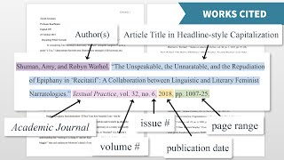
Introduction to MLA Citation style

