Slide 1

Criteria A: Planning
Students should be able to:
i. state a learning goal for the project and explain how a personal interest led to that goal
ii. state an intended product and develop appropriate success criteria for the product
iii. present a clear, detailed plan for achieving the product and its associated success criteria.

Slide 2
Criterion A: Setting a goal
Learning goal
What do you want to learn about?
The goal consists of two interrelated components.
Product goal
What do you want to create?
Notes:
Please note that the product may be a tangible artifact such as a sculpture, film, story or model, or it could be a non-tangible result such as an awareness-raising campaign, learning to play a new piece of music or improving athletic performance.

Slide 3
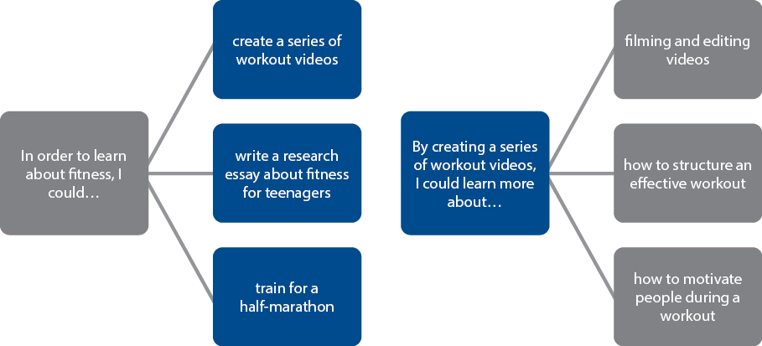
Learning goal ↔ Product goal

Slide 4
Task:
1. Write your learning goal and product goal in Toddle
2. Complete the section (under title and learning goal) ‘What is the inspiration behind your personal project?’ (Ai. state a learning goal for the project and explain how a personal interest led to that goal)
.

Slide 5
Success Criteria for product - Due October 8th
Success criteria are a list of specifications that your product needs to have to be successful. Template ideas have been uploaded to Toddle to help you develop appropriate success criteria for your product. Make sure you are adjusting the success criteria templates to make it relevant to your product. You can also create your own original template.

Slide 6
Success Criteria:
In order to set your personal project goal in motion, it is important to have detailed success criteria for how you will create your product.
You should:
Develop criteria that are specific, rigorous, realistic, testable
Develop criteria that are directly related to the product goal, Global Contexts (optional) and research
Develop measurable criteria (SMART goals)
Explain & justify criteria based on the transfer of research to product (optional: learning goal + Global Contexts)
When you set a goal and make your personal project, you will need to think about how to know if it is successful. To do this, we look at two ways of checking:
Source: ICSZ Library Guides, International Community School Zurich, n.d., https://icsz.libguides.com/c.php?g=721995&p=5248418. Accessed 1 October 2025.

Slide 7
Quantitative evaluation (things you can measure with numbers or facts):
This means looking at parts of your project that you can count, measure, or see clearly.
Examples:
the size of your project
how long or wide it is
how many materials you used
how much of something you made
Source: ICSZ Library Guides, International Community School Zurich, n.d., https://icsz.libguides.com/c.php?g=721995&p=5248418. Accessed 1 October 2025.

Slide 8
Qualitative evaluation (things you cannot measure with numbers):
This means looking at the quality of your project and how it affects people. These are things that are harder to measure but are still important.
Examples:
the message or meaning behind your work
how it is designed for a specific audience
how it makes people feel
By thinking about both types—numbers (quantifiable) and qualities (qualitative)—you will have a clearer picture of what makes your project successful
Source: ICSZ Library Guides, International Community School Zurich, n.d., https://icsz.libguides.com/c.php?g=721995&p=5248418. Accessed 1 October 2025.

Slide 9
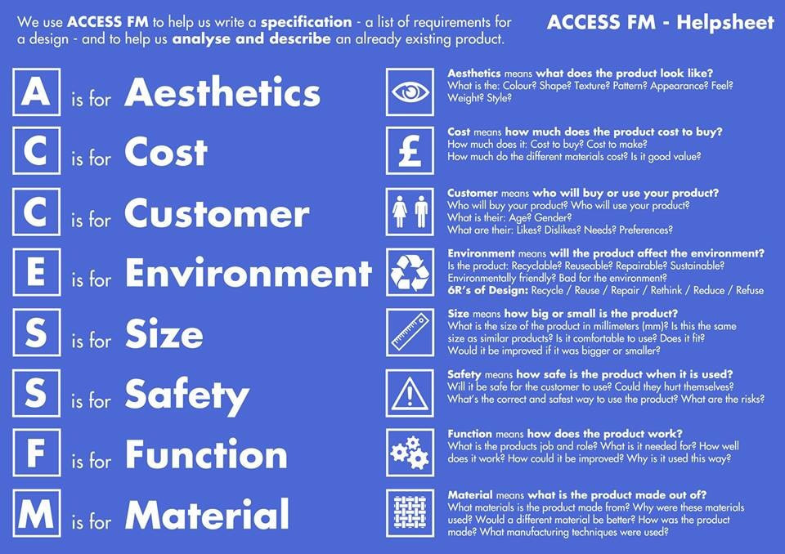

Slide 10
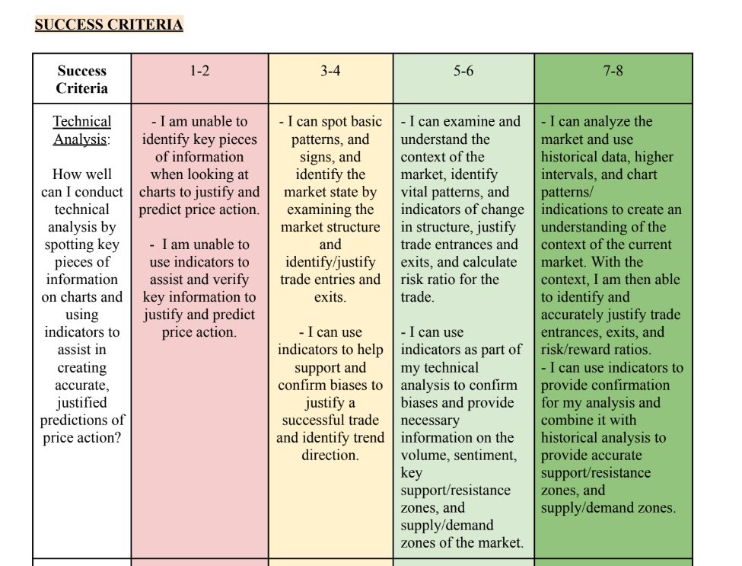
A section of a success criteria taken from a student example:

Slide 11
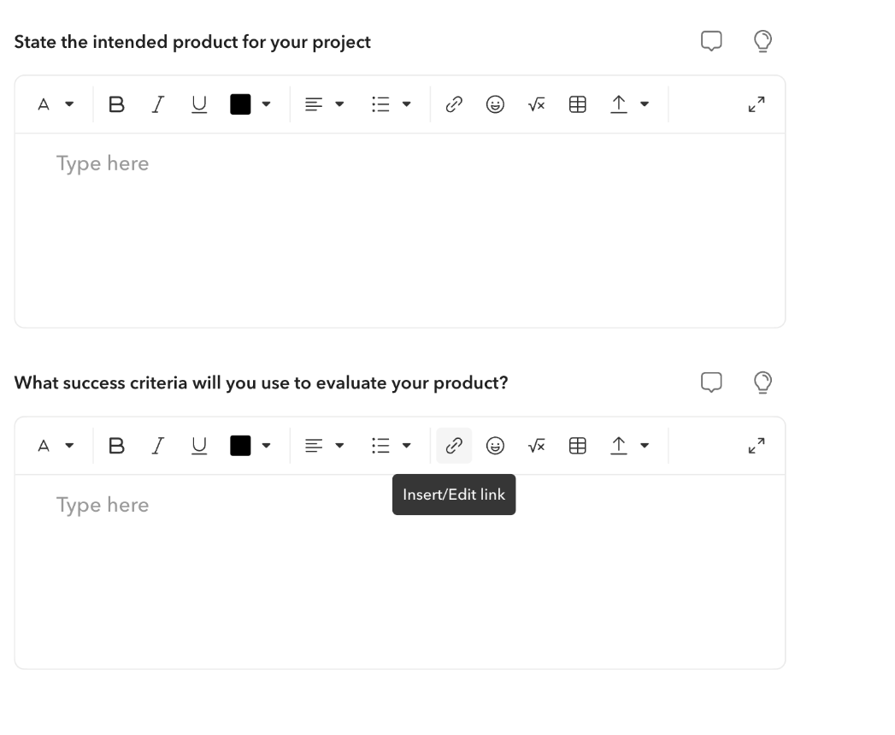
Success Criteria - Due October 8th
Copy and paste or link your success criteria/action plan to the tab in Toddle

Slide 12
Action Plan - Deadline 2nd November
iii. present a clear, detailed plan for achieving the product and its associated success criteria.
Using the success criteria that you created, you will design an action plan to help you create your product.
You might choose to make a GANTT chart, flow chart, to-do list, timeline, calendar, or any other method to create your action plan. A detailed action plan may include a description of each step, resources needed, the time needed and/or deadlines.
Check on Toddle resources for Action Plan templates.
Keep updating your action plan throughout the project - this will help you with your planning and staying on track

Slide 13
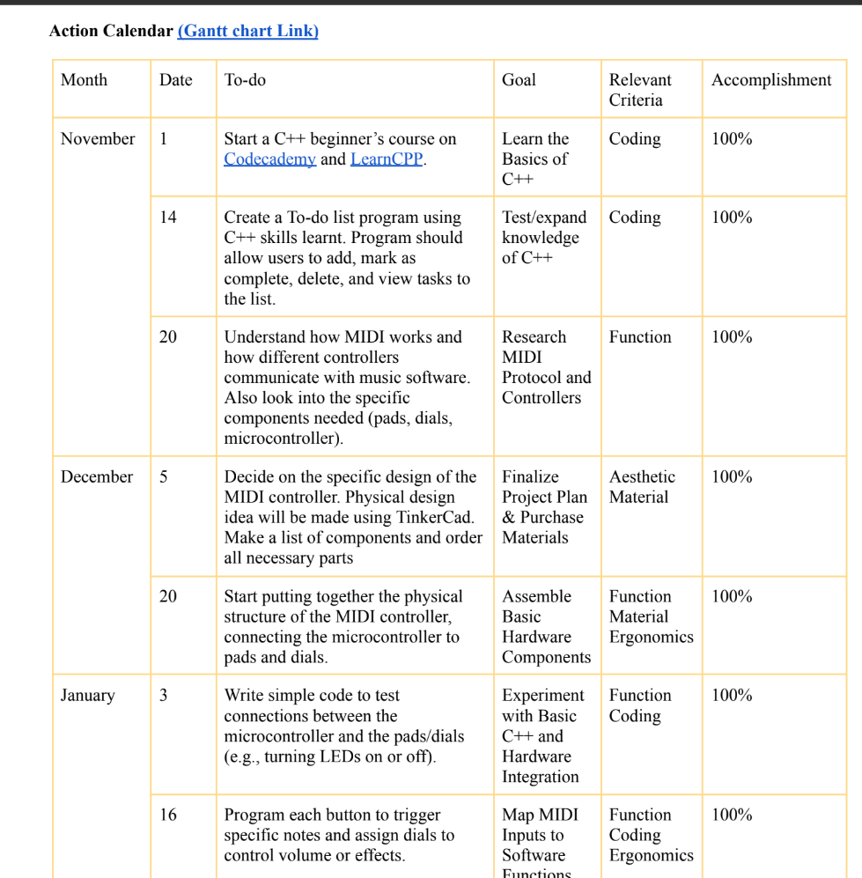
Student Example:

Slide 14

Action plan top tips
You should take into consideration the time needed to complete the project (25 hours) and may wish to record timings in your action plan.
Consider your approaches to learning (ATL) skills and make a plan that works for you. For example, if you struggle with time-management, you may wish to make an action plan that ensures you complete work early or allows for flexibility.
Different types of projects require research at different stages. Think about when research will be needed in your project.

Slide 15

In the report
At the end of the personal project, you will submit a report with a section about this phase of the project. You will need to:
i) state a learning goal for the project and explain how a personal interest led to that goal
ii) state an intended product and develop appropriate success criteria for the product
iii) present a clear, detailed plan for achieving the product and its associated success criteria
Support your planning with detailed examples and evidence.
Notes:
Examples of supporting evidence could include:
a list and/or diagram of interests and related learning goals
a list of possible strategies to achieve personal and academic goals
a diagram showing the connections between the learning goal and the product
a series of steps leading to the completion of the product
a timeline for completing short- and long-term tasks.

