Slide 1

Learning goals templates
These templates will enable you to state a learning goal for your project and explain how a personal interest led you to that goal.

Slide 2
SMART goals
Describe your goal and explain how it meets each of the heading requirements.
Aspect |  | Description of my goal | Yes | No
S | Specific: Answer the following questions: 1. What do I want to do? 2. Why do I want to do it? 3. Who is involved? 4. Where am I going to achieve my goal? 5. What resources do I need?
M | Measurable: How will I know if my goal has been achieved?
A | Achievable: 1. How will I achieve my goal? 2. What limitations may I face? 3. Why is my goal realistic?
R | Relevant: Why is my goal important? What need is driving my goal?
T | Time-based: Can I achieve my goal within the timeframe? How?

Slide 3
Learning goal
You can choose your product goal first and then decide on the learning goal if that makes sense for you. This table can help you to create the goal and link it to the success criteria.
Relevance* | Who cares? Why do they/you care?
Scope | Is it too broad? Is it too narrow? Is it just right?
Practicality | Is it practical/achievable? It’s a wish but impractical Is it innovative? It is challenging?Innovative but workable
Trackable | Will you be able to complete this in given time as per the timeline?
Knowledge | Do you know enough about the subject matter? Do you know where, how or from who I can learn more about the subject matter?
Authentic | Is it personal? Does this represent your idea or passion?
Measurable | Can you measure the outcome? How will you test the product to prove the success?

Slide 4

Success criteria templates
Success criteria are a list of specifications that your product needs to have to be successful. These templates will help you develop appropriate success criteria for your product.

Slide 5
Single point rubric
Write down the criteria that your product should meet if it’s successful in the middle column of the rubric.
Advanced Evidence of exceeding standard | Criteria Standard for the product goal | Approaching Areas that need improvement

Slide 6
Specifications
Thinking about your product, design specifications that describe what the product will be. Give as much detail as you can so you can easily explain whether you’ve met the specification at the end.
My Product:
 | Fully met? | Partially met? | Description
Specification:
Details:
Specification:
Details:
Specification:
Details:
Specification:
Details:

Slide 7
Specifications
Thinking about your product, design specifications that describe what the product will be. Give as much detail as you can so you can easily explain whether you’ve met the specification at the end. With this table you can also rank the specifications by priority and include details on how you will test the success.
My product:
 | Priority | Testing Method: | Success?
Criteria: | High Priority Low Priority |  | Full Success Partially Success N/A
Details:
Criteria: | High Priority Low Priority |  | Full Success Partially Success N/A
Details:
Criteria: | High Priority Low Priority |  | Full Success Partially Success N/A
Details:

Slide 8









Specifications
Design your specifications in as much detail as possible. You can include the evidence that supports your evaluation of success at the end.
Criteria types to consider:
Appearance: What should the finished product look like? Style, colours, texture, theme, finish, shape, patterns…
Delivery: When will the product be complete?
Safety: How will I be safe when making my product? How will others be safe when using my product?
Environment: Where will the product be used/shown?
Budget: What will the cost be to make the product? How much will people think my product is worth?
Size: What size will my product be? For some products, like a video or a song, size might refer to time.
Function: What will the product do?
Client: How is the product tailored to the customer/client/ target audience?
Resources: What tools, materials and people do I need to make the product?
Continued on next page...

Slide 9
Success criteria for:
Success criteria ABCs
Type | My product will: | Because: | The proof will be:
 | Specific description | Reasons should be based on initial research | The way you will test the product to prove its success
Appearance
Budget
Client
Delivery
Environment
Function

Slide 10
Specifications
Design your specifications in as much detail as possible. You can include the evidence that supports your evaluation of success at the end.
Criteria types to consider:
Appearance: What should the finished product look like? Style, colours, texture, theme, finish, shape, patterns…
Delivery: When will the product be complete?
Budget: What will the cost be to make the product? How much will people think my product is worth?
Environment: Where will the product be used/shown?
Client: How is the product tailored to the customer/client/ target audience?
Function: What will the product do?
Continued on next page...

Slide 11
Personal project product success criteria
My product:
 | Criterion A: | Criterion B: | Criterion C: | Criterion D:
0 | The product does not reach a standard described by any of the descriptors below. | The product does not reach a standard described by any of the descriptors below. | The product does not reach a standard described by any of the descriptors below. | The product does not reach a standard described by any of the descriptors below.
1-2
3-4
5-6
7-8

Slide 12
Specifications
Design a checklist in as much detail as possible under the headings in this template.
Specification type | My Specification
Aesthetic
Cost
Customer
Environment
Size
Safety
Function
Material

Slide 13

Action plans templates
These templates are designed to help you present a clear, detailed plan for achieving the product and its associated success criteria.

Slide 14
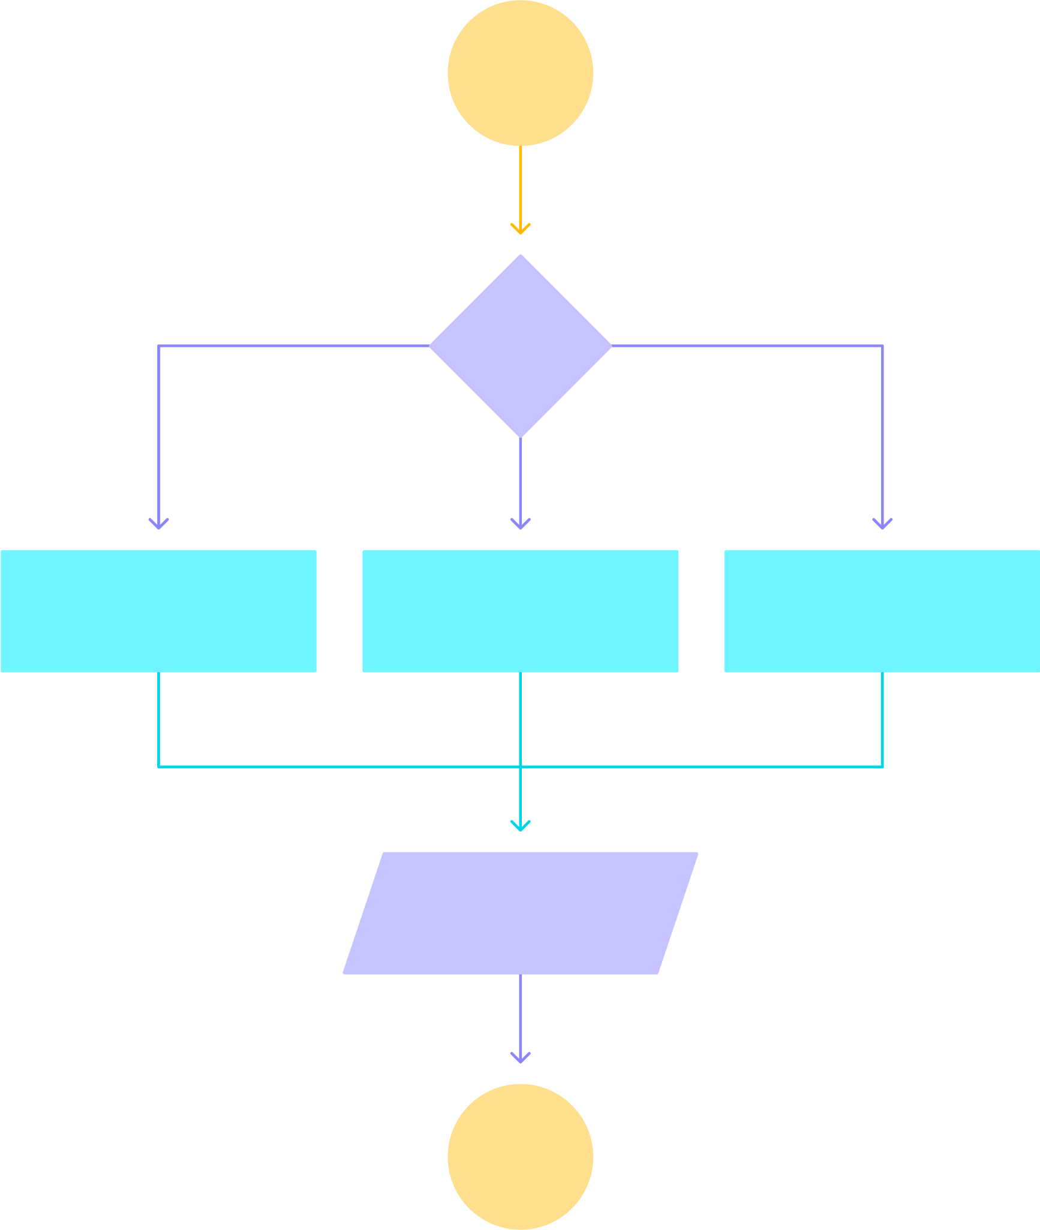
Action plan
Using the success criteria that you created, you can design an action plan to help you create your product.
You might choose to make a GANTT chart, slippage chart, flow chart, to-do list, timeline, storyboards, wireframes, calendar, scrum board, kanban board or any other method. A detailed action plan may include a description of each step, resources needed, the time needed and/or deadlines.
Start
Decision
Process 1
Process 2
Process 3
Action
End

Slide 15
Use this template to lay out the key components of your project that need to be completed and give each a specific deadline. You can also include strategies or resources that may help you to complete the task and evidence that will demonstrate completion.
Action plan
Date | Action | Strategies to help me achieve my goal | Deadline | Evidence | Justification of any changes made

Slide 16
Tasks and milestones
Use this template to lay out the tasks needed to complete your project as well as interim tasks or milestones that can help you to meet your goals. You can tick off the tasks once you’ve completed them.
Task | Milestones | Complete
Describe the main task you want to complete, for example, ‘Create recipe’. | Describe the smaller steps you need to do to complete the task, for example, ‘buy ingredients’

Slide 17
GANTT chart
Use this GANTT chart to lay out the steps you will take to complete your project. Include the resources that you might need and the approximate dates that you will begin and complete each step.
Personal Project GANTT Chart
Step | Description | Resources | Aug | Sep | Oct | Nov | Dec | Jan | Feb | Mar
1
2
3
4
5
6
7
Personal Project GANTT Chart
Step | Description | Resources | Aug | Sep | Oct | Nov | Dec | Jan | Feb | Mar
1
2
3
4
5
6
7
8
9
10

Slide 18
Action plan
Use this chart to lay out the actions you will take to complete your project. You can include the current status of each item and the due dates that you set. Once you’ve filled in the completion date, it’s a good idea to add any comments that you have about the process.
Personal Project Action Plan
Action item | Status | Due date | Date complete | Comments

Slide 19
Action plan
Use this chart to lay out the task that you need to complete for the personal project. You can indicate the purpose of each task (linked to your product or the assessment criteria). Include the resources that you might need and the indicators that you will see when you have been successful.
Personal project action plan
Number | Task | Purpose | Time and place | Resources | Indicator of success
1
2
3
4
5
6

