Slide 1

Through the process of inquiry, action and reflection, you will demonstrate and strengthen your approaches to learning (ATL) skills.
Personal Project Introduction:
Through the personal project, you will:
explore an interest that is personally meaningful to you
take ownership of your learning by undertaking a self-directed inquiry
transfer and apply skills in pursuit of a learning goal and the creation of a product
recognize and evidence personal growth and development.

Slide 2

. You will have 1 personal project lesson per cycle
. You will produce a product and a report and a bibliography.
. The completion date for the product is: Feb 2nd. Hand in date for the report is March 16th.
. Report is made up of 3 criteria: Criteria A: Planning, Criterion B: Applying (ATL) Skills Criterion C: Reflection
. Report is a max of 15 pages (including visual evidence)
. All work will be submitted on Toddle
. Guidance and support will be on Toddle
. You will be allocated a supervisor who will support you through the PP journey
. You will be presenting your product to our community in our Personal Project Showcase on March 11th.
. Your work will be assessed and moderated by TIS staff members before being externally assessed by the IB for final grading.
Personal Project Nuts and Bolts:

Slide 3
Expectations:
. Meet all deadlines: these are all on Toddle for you
. Every lesson bring: pencil case, laptop, planners
. Independent work: you have lessons once a cycle but most of the work for personal project will need to be completed outside of this class time
. Professional communication and conduct with supervisors
. Reach out for help - Anya, Chris, your supervisor
. Academic Integrity
. Regularly update your process journal on Toddle.

Slide 4
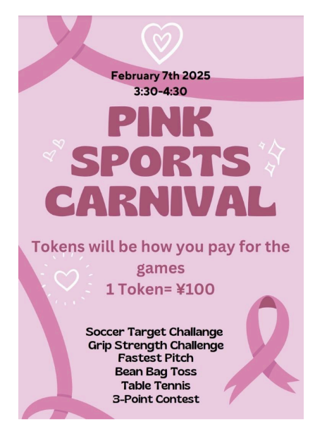
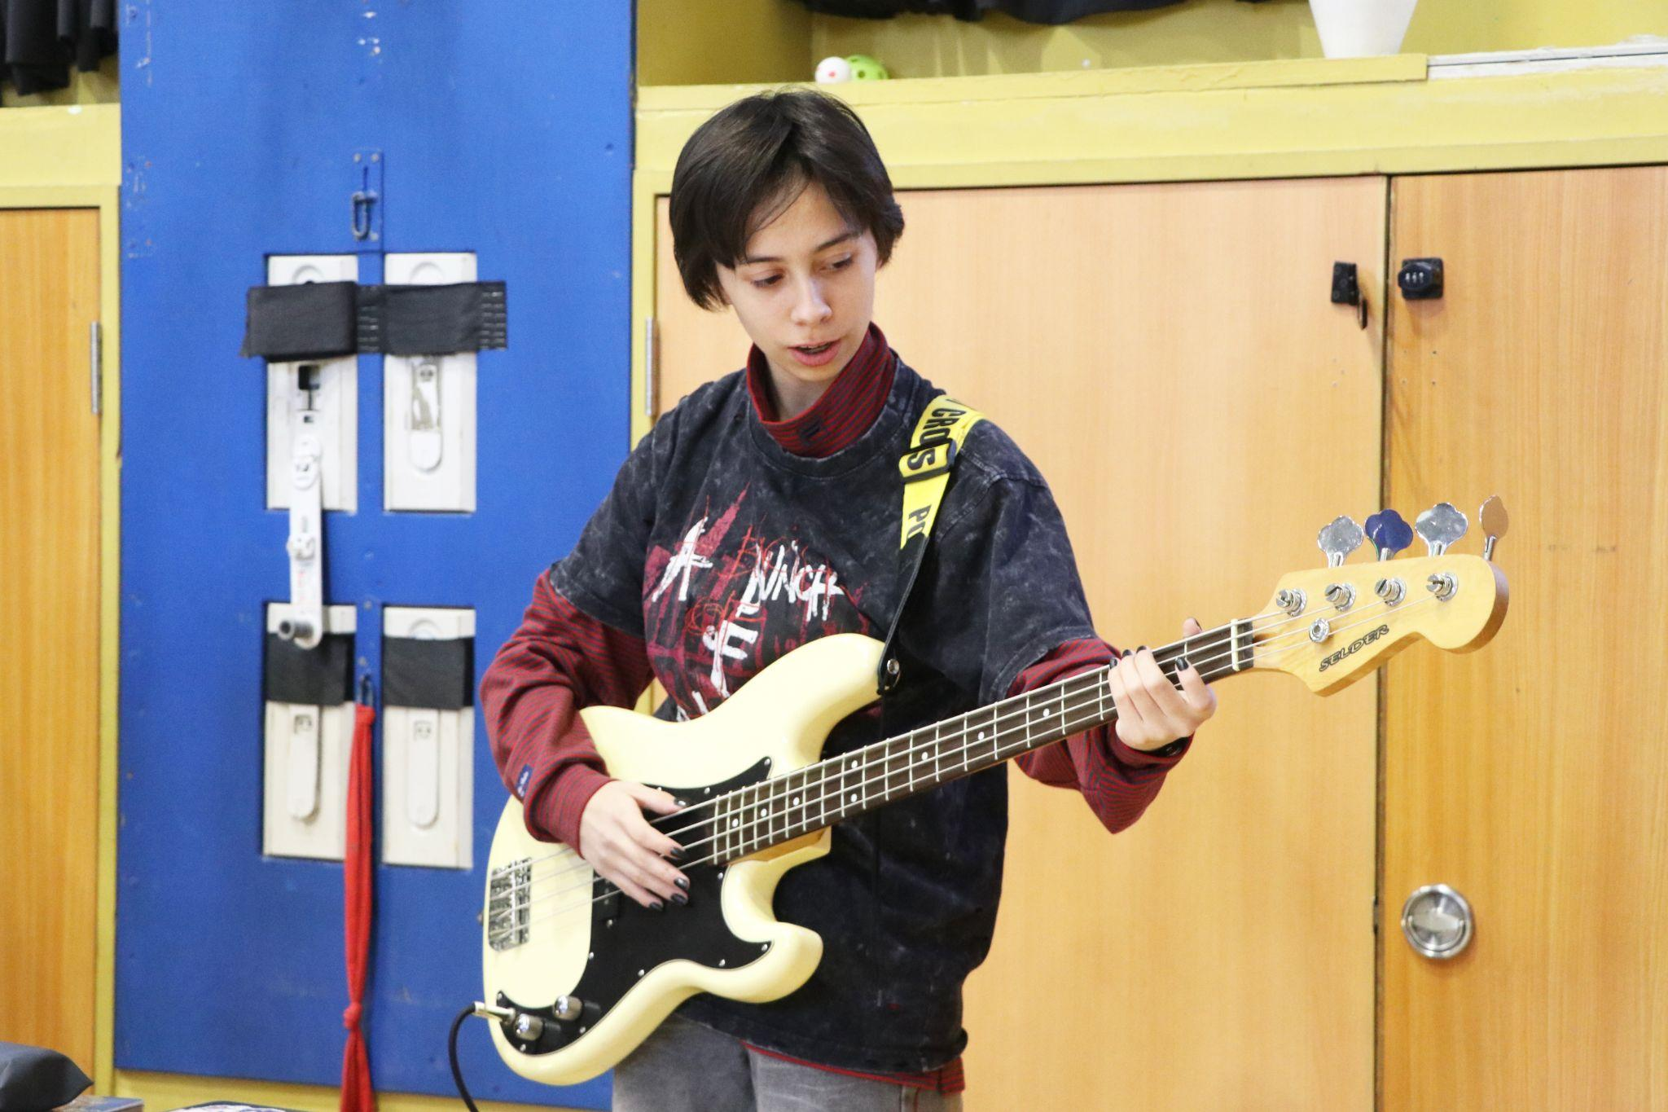
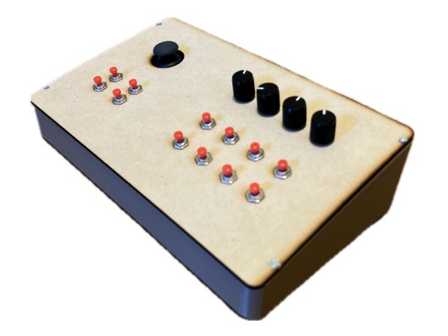
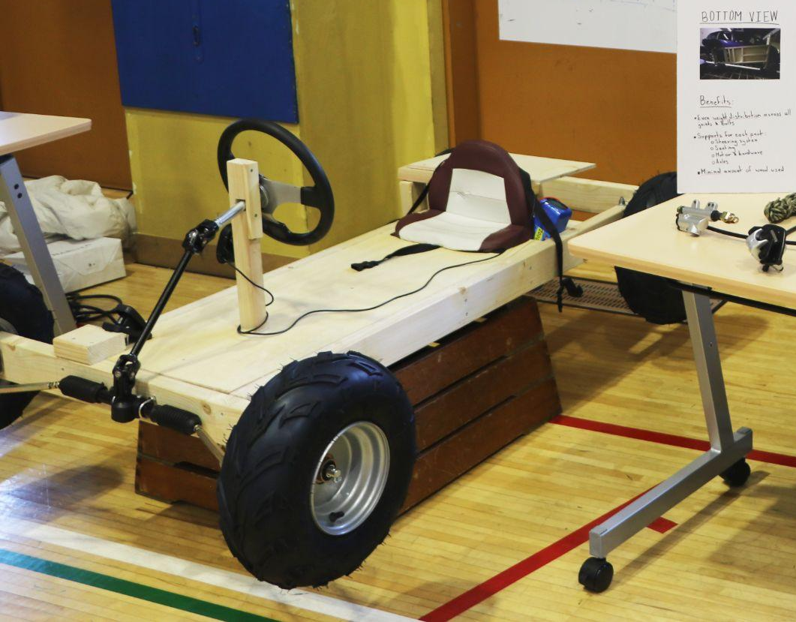
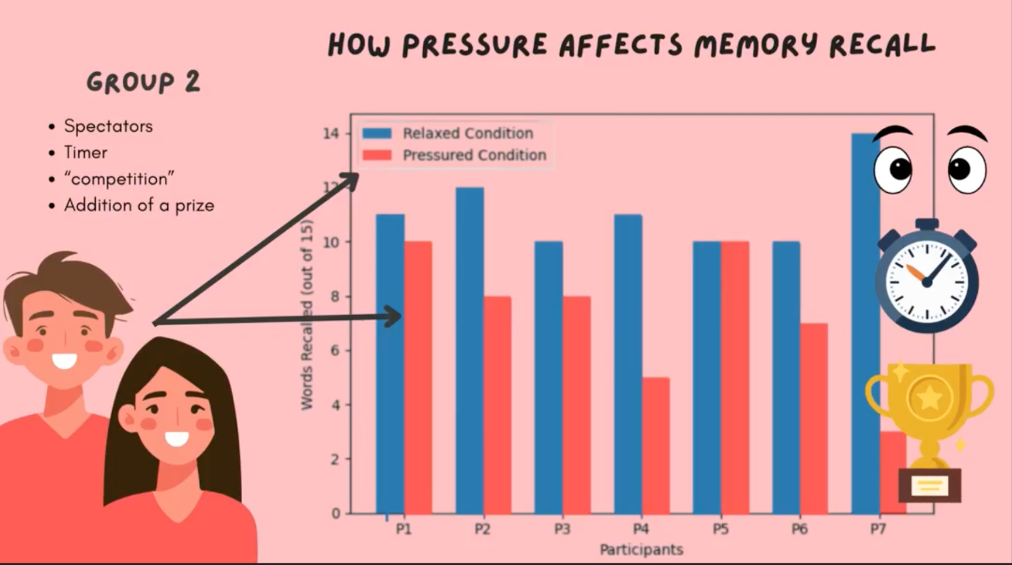
TIS past student Personal Project Inspiration:
Learning an instrument
Learning to Code using C++ to make a MIDI Controller
Sports fundraising event - raising awareness and money for breast cancer charity
Making an educational video to help students manage stress
Making a Go-Kart

Slide 5
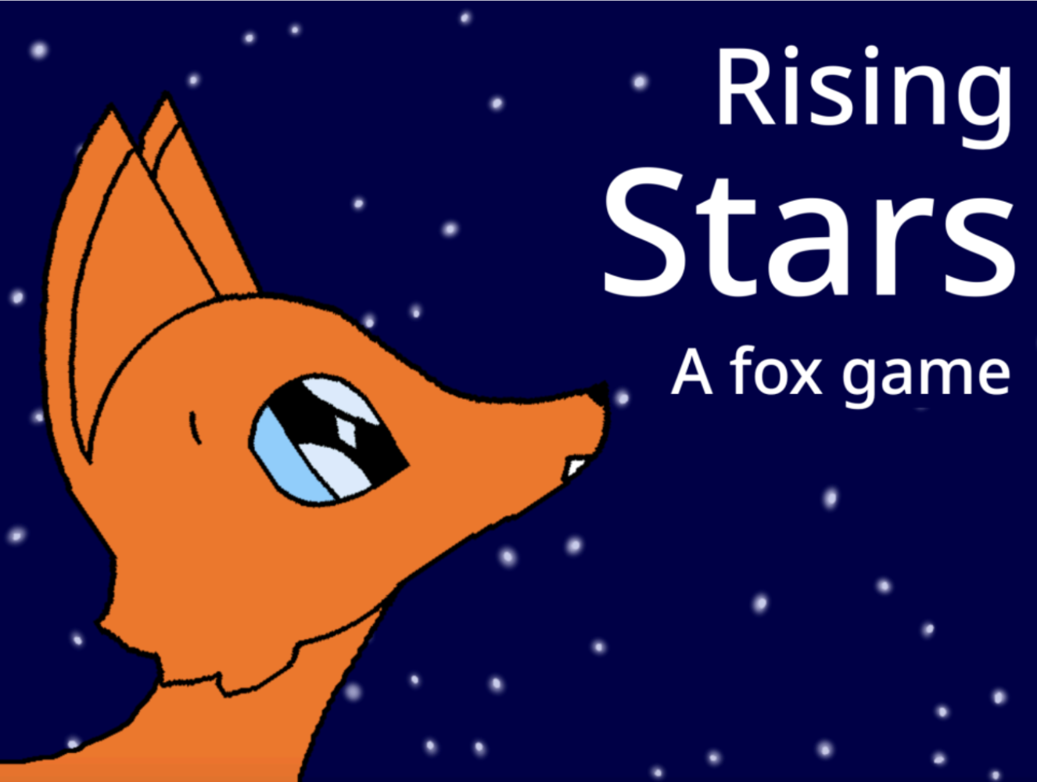
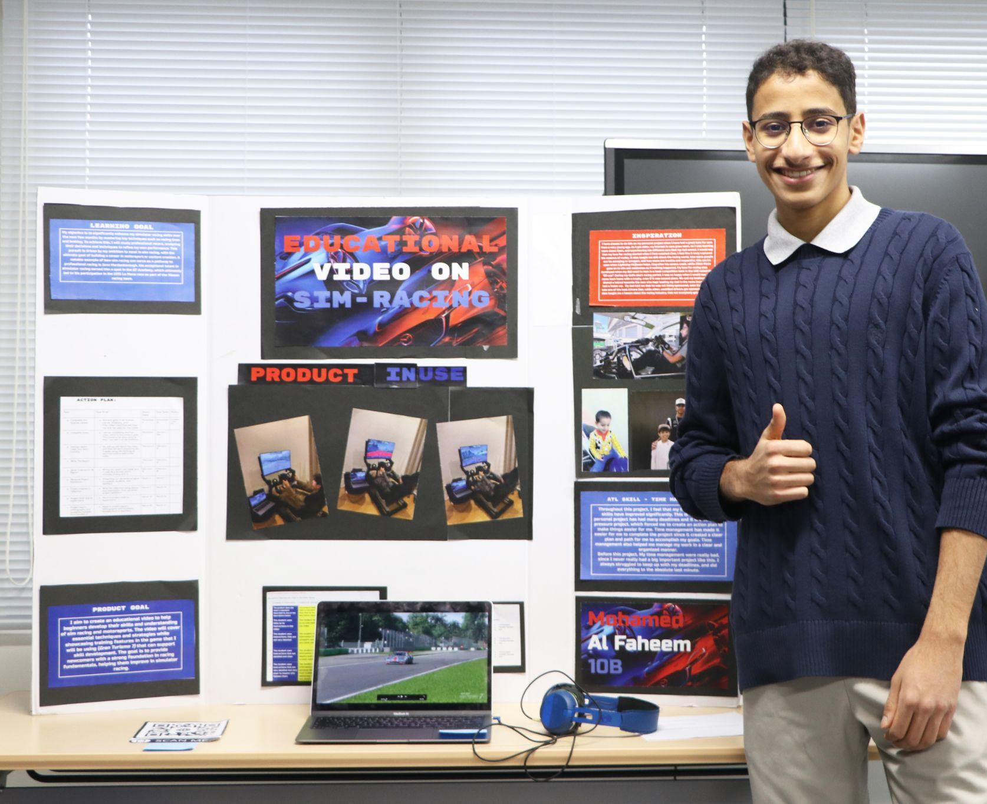
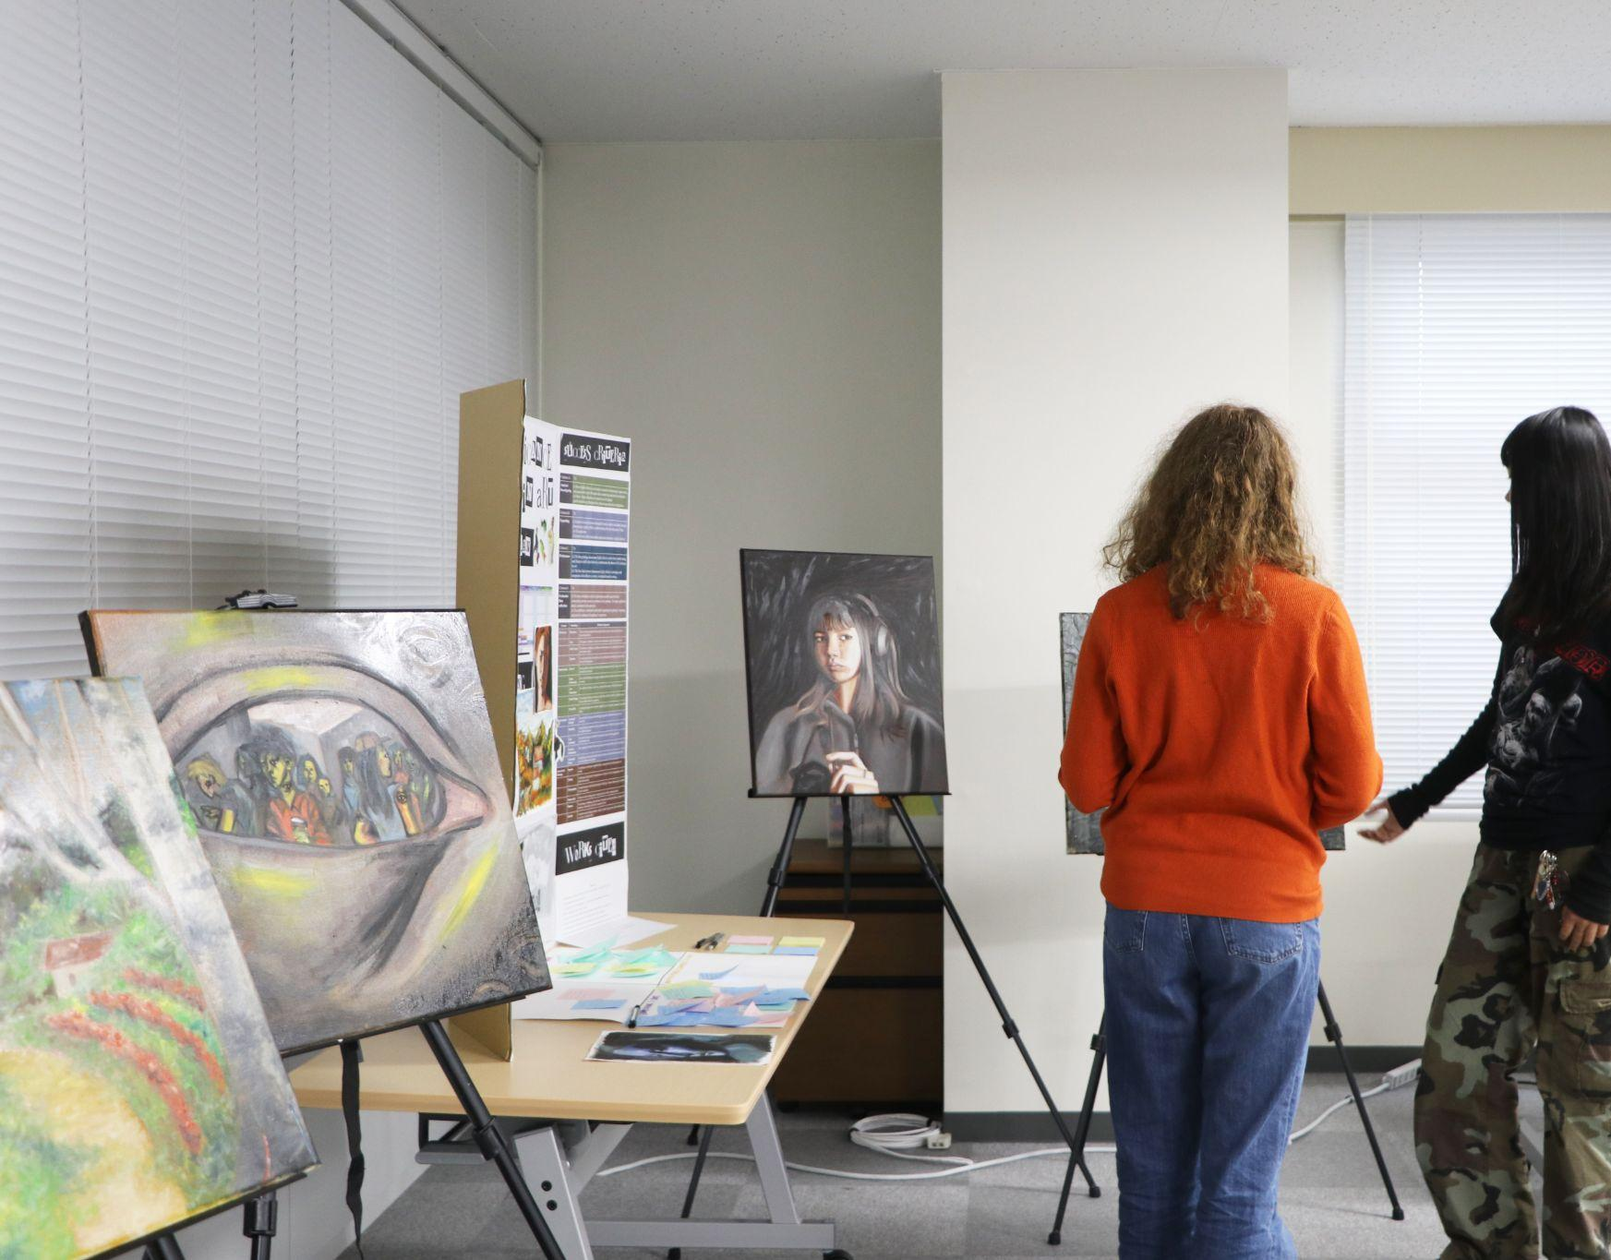
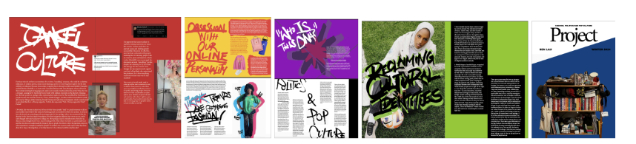
TIS past student Personal Project Inspiration:
Creating an animated video game
Educational video on SIM-Racing
Creating a zine about Gen Z fashion and culture
Curating an art exhibition

Slide 6
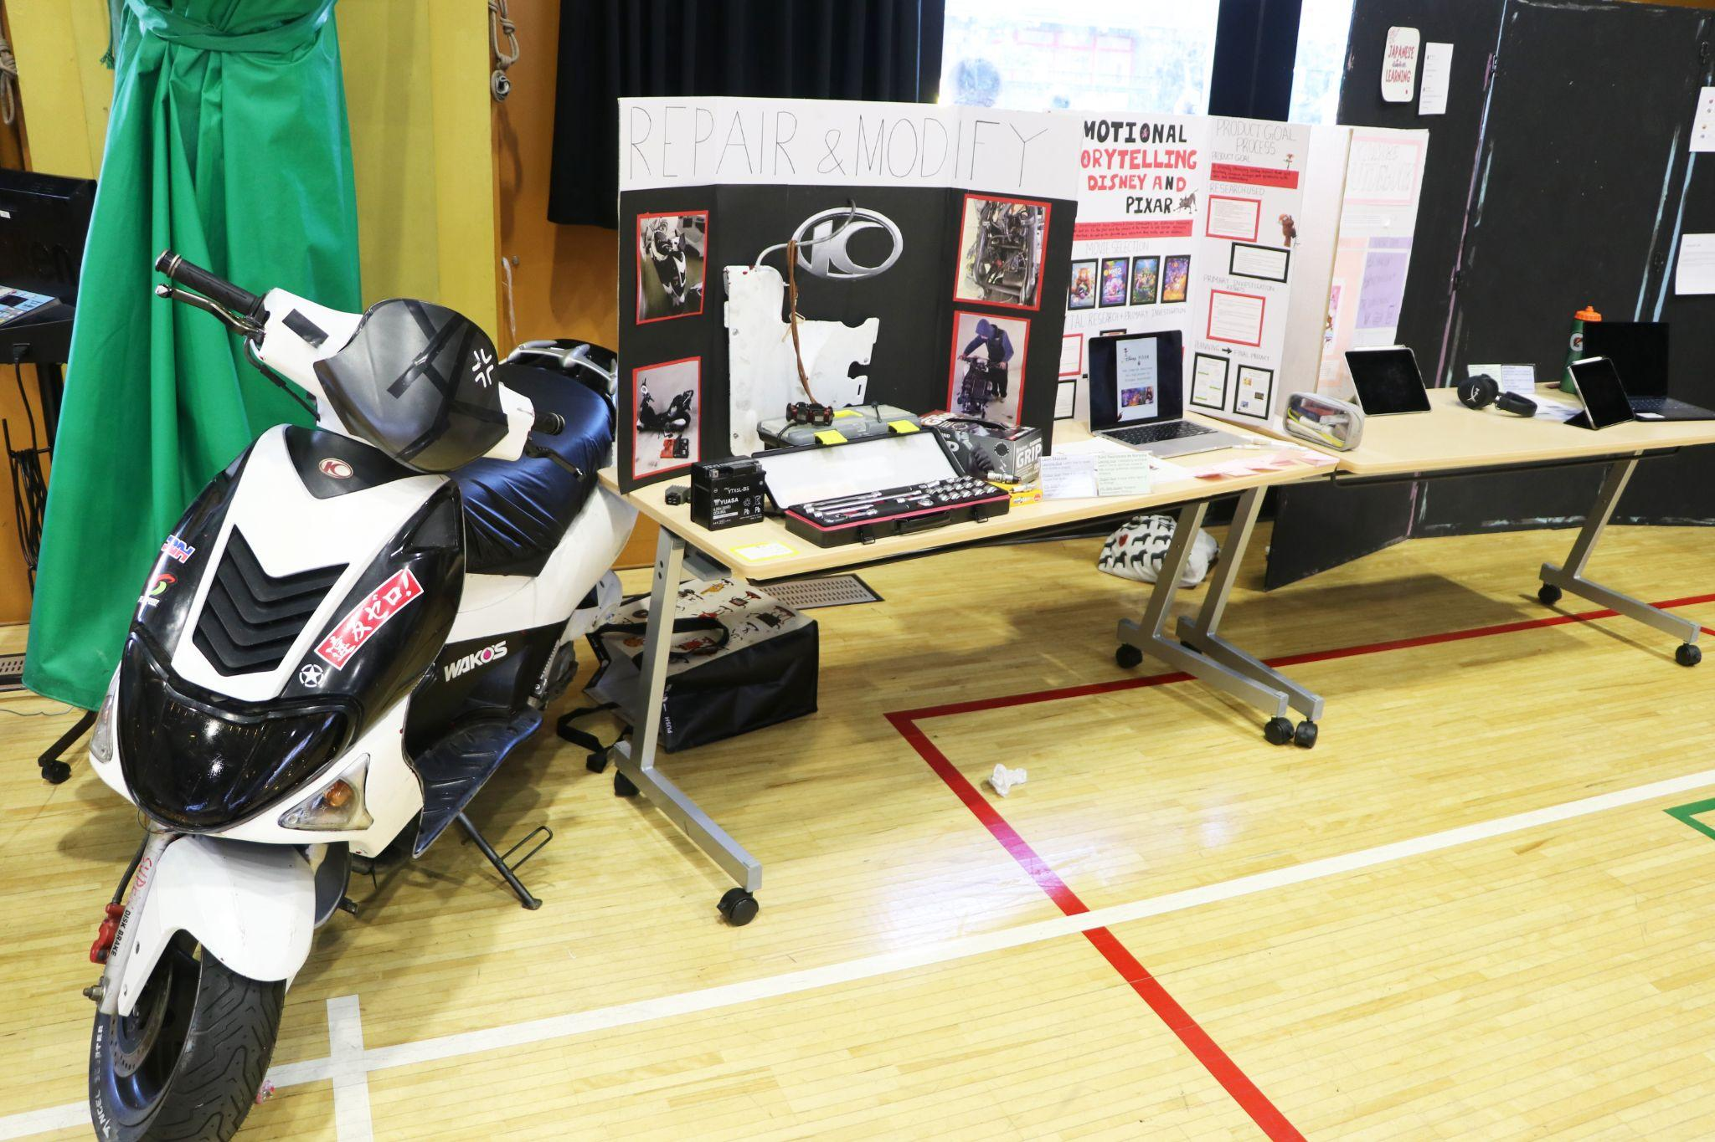
Share with the person next to you an initial idea that you have for your personal project (think back to your homework initial ideas document).

Slide 7


Task: Toddle Navigation
. Find Personal Project on Toddle
. Locate deadlines for the personal project: Add them to your planner!
. Find your process journal
. Find the personal project guide
. Find this presentation

Slide 8
In your planners write down
Learning & Product Goal- Deadline September 10th
Complete the following sections in Toddle. This will later be used in Criterion A of your report.
1) State the title and learning goal of your project
2) What is the inspiration behind your personal project?
3) State the intended product for your project
Personal Project Proposal Panel
Starting from our lesson on September 10th you will be presenting your learning goal and product goal to a panel of 2-3 teachers/experts. These teachers will ask you questions about your goals and offer feedback.
You will need to be able to justify and explain your goals confidently verbally. You can have your device with your Toddle entry to help you with this.

Slide 9
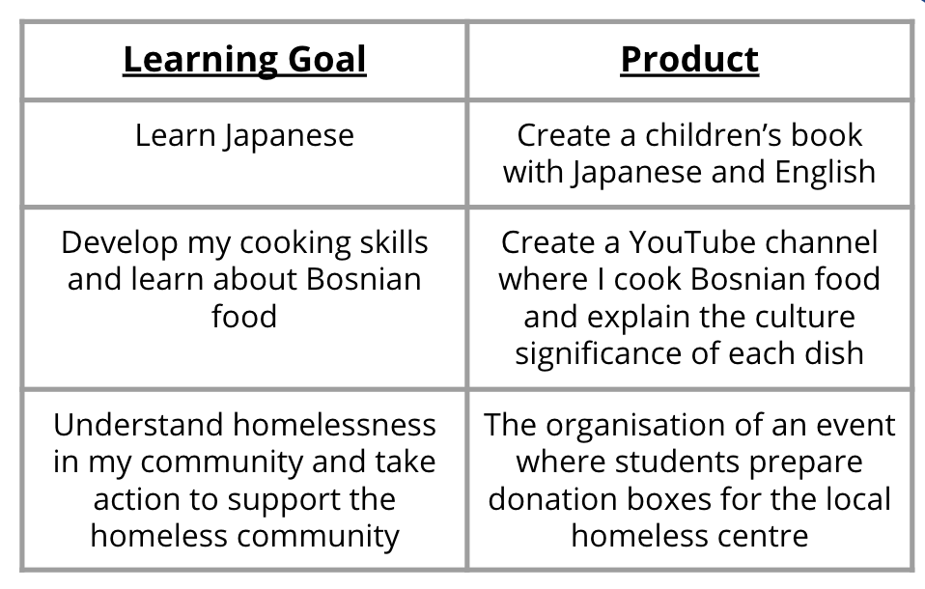
Define and refine your Project:
This week you will be working independently on…
The project consists of two interrelated parts:
- a learning goal (what you want to learn)
- a product (what you want to create).
Citation: guide.fariaedu.com/myp-personal-project/setting-a-goal/learning-goal-and-product

Slide 10
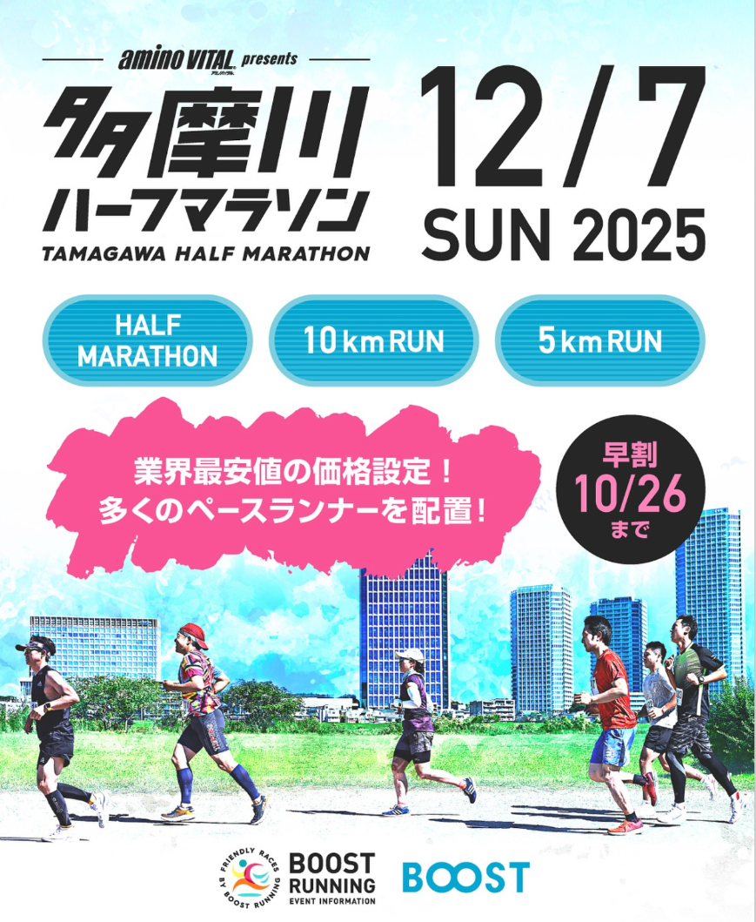
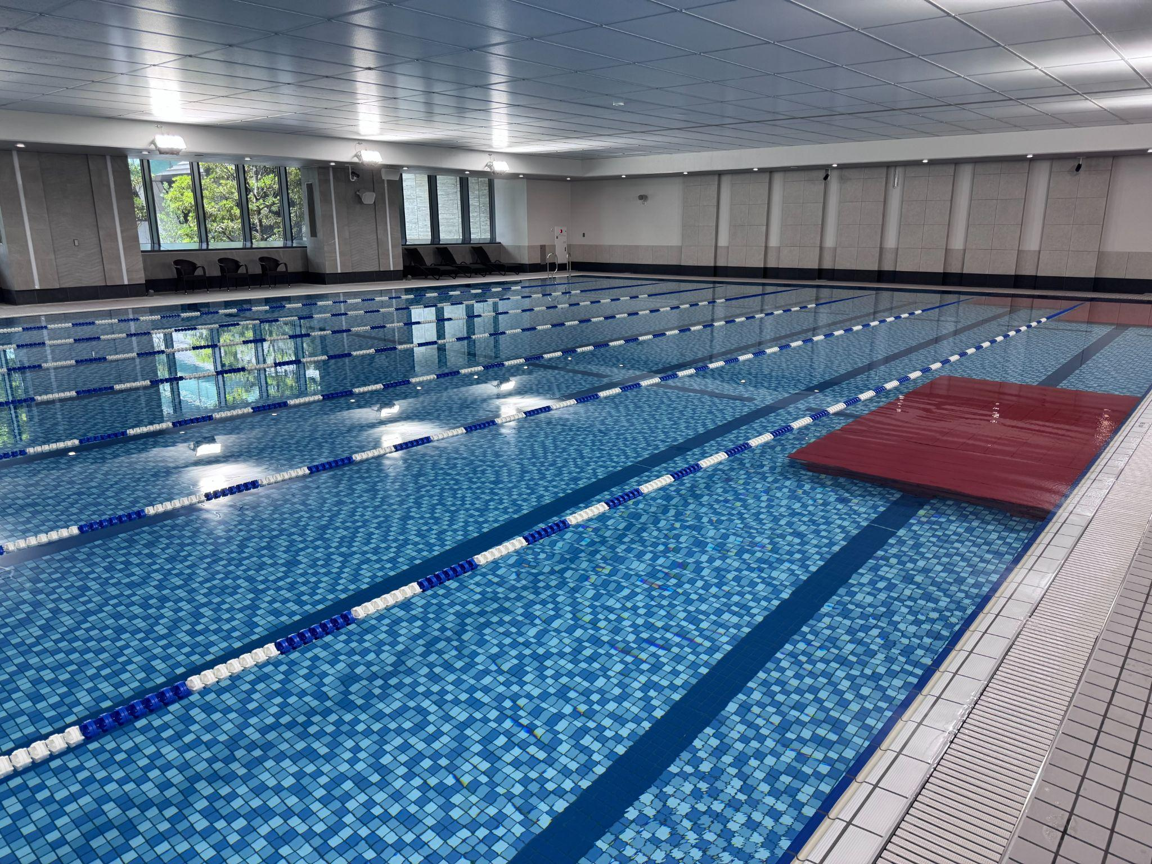
Anya’s personal project: Half Marathon training plan
Chris’s personal project:
Planning for a TIS Aquatics program
Notes:
Researched - read articles, spoke to expert, researched apps and sports watches, social and communication skills - running with others, revised and reviewed my plan based on performance

Slide 11
Learning and Product goal
Share your learning goal and product goal with the person sitting next to you.
Give feedback:
Is the goal ambitious - could it be developed further?
Is the goal specific?
Is there a personal connection?
Is the goal realistic/achievable in the timeframe.

Slide 12
Criterion A: Setting a goal
Learning goal
What do you want to learn about?
The goal consists of two interrelated components.
Product goal
What do you want to create?
Notes:
Please note that the product may be a tangible artifact such as a sculpture, film, story or model, or it could be a non-tangible result such as an awareness-raising campaign, learning to play a new piece of music or improving athletic performance.

Slide 13
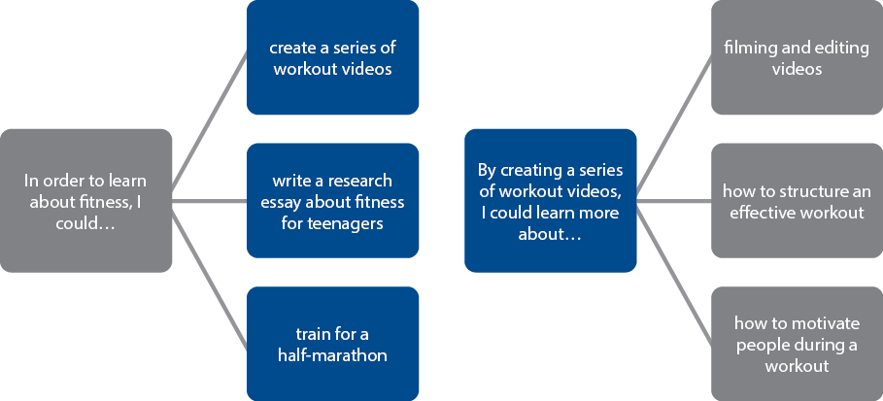
Learning goal ↔ Product goal

Slide 14
Your turn to discuss…
If your learning goal is to
find out more about making a personal computer
What kinds of product goals could you set?
Notes:
Some possible products:
Sourcing components to make a PC
Producing an instruction manual on how to build a PC
Developing affordable PCs for a local community

Slide 15
Your turn to discuss …
If your product goal is to
Write, record and produce an original song
What kinds of learning goals could you set?
Notes:
Some possible learning goals:
Learn about agriculture and nutritional content of plants
Learn about how to grow plants sustainably
Learn about how to create hydroponic plants for eating
Learn about how to develop rooftop gardens for nutrition

Slide 16
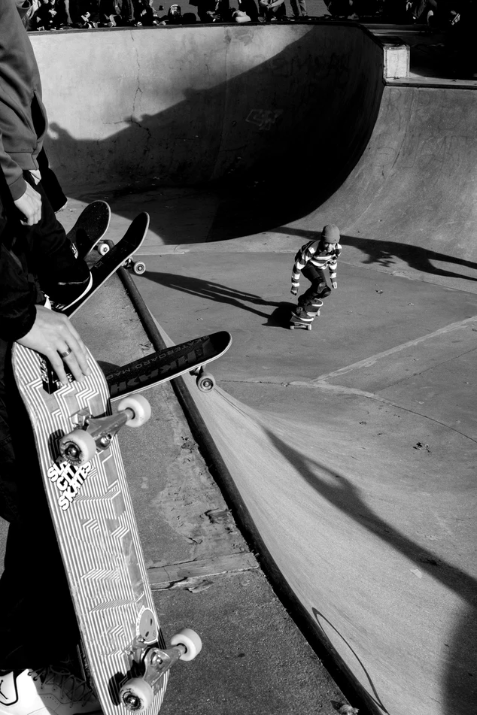
Curiosity
“I have been wondering about ...”
Notes:
Photo by Jay Clark on Unsplash (https://unsplash.com/photos/ud1MTV9_Llg)

Slide 17

Challenge
“I have always wanted to try ...”
Notes:
Photo by x ) on Unsplash (https://unsplash.com/photos/N4QTBfNQ8Nk)

Slide 18

Passion
“I would love to …”
Notes:
Photo by Florian Schneider on Unsplash (https://unsplash.com/photos/2sgELHMCC-0)

Slide 19

Impact
“I can make the world a better place by …”
Notes:
Photo by Shane Rounce on Unsplash (https://unsplash.com/photos/DNkoNXQti3c)

Slide 20
Exit Ticket:
On a post-it-note write down 1 question that you have about personal project.
We will make sure to answer these over our coming lessons.

