Slide 1

Sui Overflow 2026 · Walrus track
WalDrive
A desktop drive for the data your AI agents store on Walrus.
The human interface layer for agent data — the screen you operate it from. Live on testnet, no mock.
Tauri desktop · macOS / Windows / Linux
Metadata on Sui
Blobs on Walrus
Encrypted · Seal
No backend
waldrive.flacier.com

Slide 2
THE PROBLEM
Agents produce real data. Where does it live?
Artifacts, memory, generated files. Today that output lands on someone else's server.
01
02
03
04
Behind a login
Deletable by someone else
Not verifiable
Not owned
Access depends on an account you don't control. Lock-out ends access.
A provider can revoke, expire, or wipe the data without your say.
No proof the bytes are intact or unchanged. You take it on trust.
It's a row in their database, not an asset you hold.
Verifiable, owned agent data has no home.
WalDrive
02 / 12

Slide 3
THE SOLUTION
A desktop console where agent data is owned and verifiable
Desktop console
browse · preview · search · share
Bytes live on Walrus — content addressed. Metadata lives on Sui as Move objects. No backend in between.
↓
Sui — Move objects
FileRecord metadata, verifiable on-chain
“Verifiable data”
↓
On-chain Sui metadata over content-addressed Walrus blobs. The blob ID is the cryptographic fingerprint of the bytes — anyone can re-fetch and check it.
Walrus — blobs
content-addressed bytes, immutable
WalDrive
no backend · no server in between
03 / 12

Slide 4
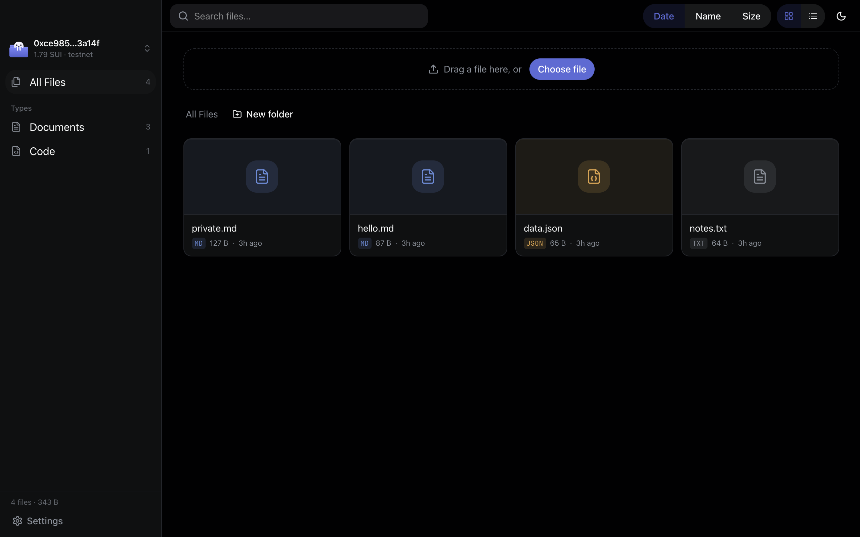
PRODUCT · THE CONSOLE
Fluid by design
Drag to upload
Drop one file or many. It appears live, then confirms on-chain.
Instant preview
Images, markdown, json, pdf and video render inline.
Client-side search
Filter across loaded files with zero latency.
In-process signing
A local keypair signs. No wallet extension, no popup.
WalDrive
04 / 12

Slide 5
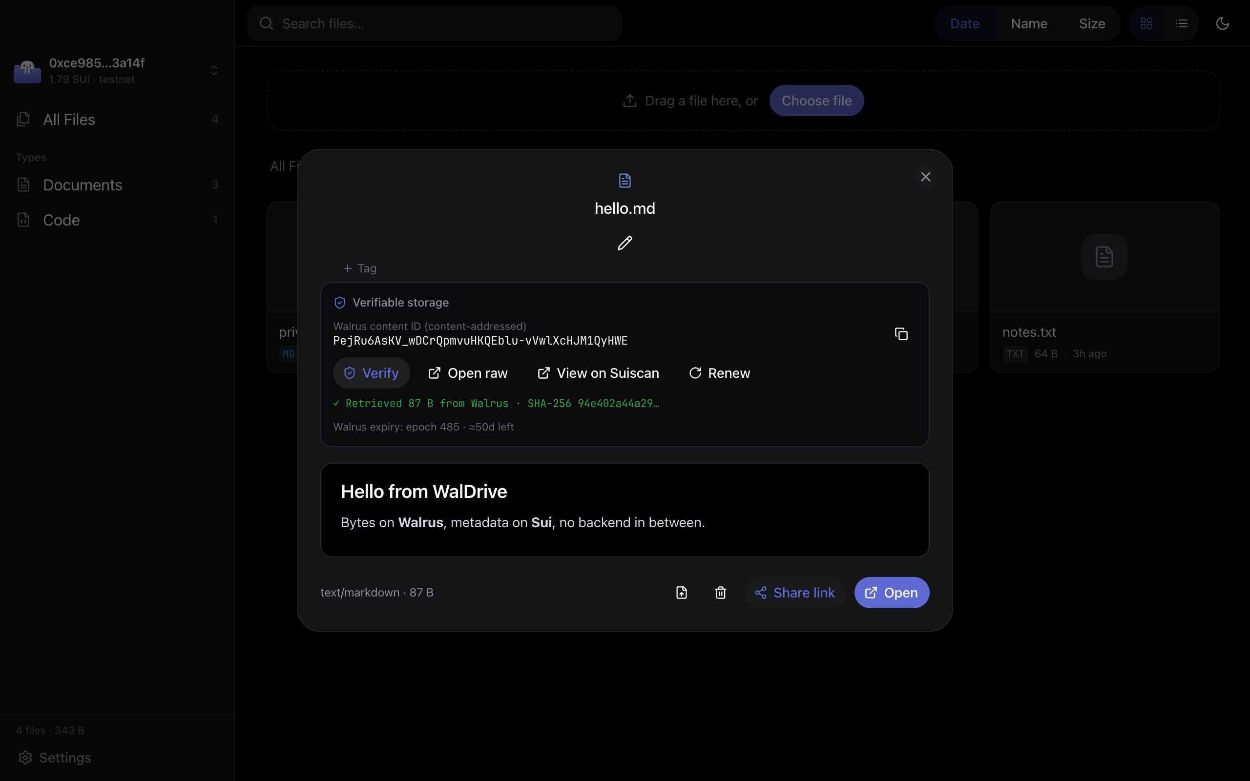
VERIFIABLE STORAGE
Don’t trust us — verify
The blob ID is the cryptographic fingerprint of the bytes. One click re-fetches from the public aggregator and hashes it on screen.
Content ID the address is the hash
Verify in place re-fetch + SHA-256, live
Open raw public aggregator, no wallet
GET /v1/blobs/{blobId} → SHA-256
WalDrive
05 / 12

Slide 6
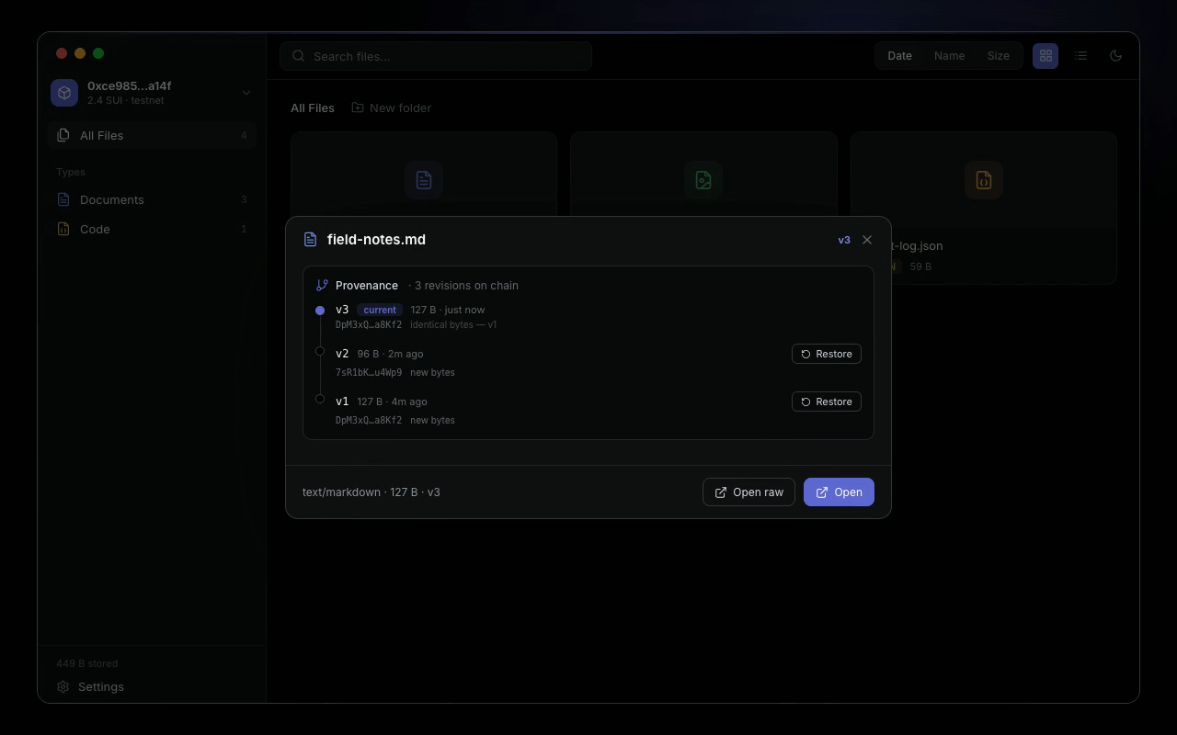
PROVENANCE · ROLLBACK
Every revision, on chain
Each version is its own FileRecord, linked by parent_version_id and content-addressed — so a restore that re-points at an old blob is provably identical. Roll back in one transaction, no re-upload.
Linked history parent_version_id chain
Content-addressed identical bytes provable
One-tx rollback restore any revision
FileRecord.version · parent_version_id
WalDrive
06 / 12

Slide 7
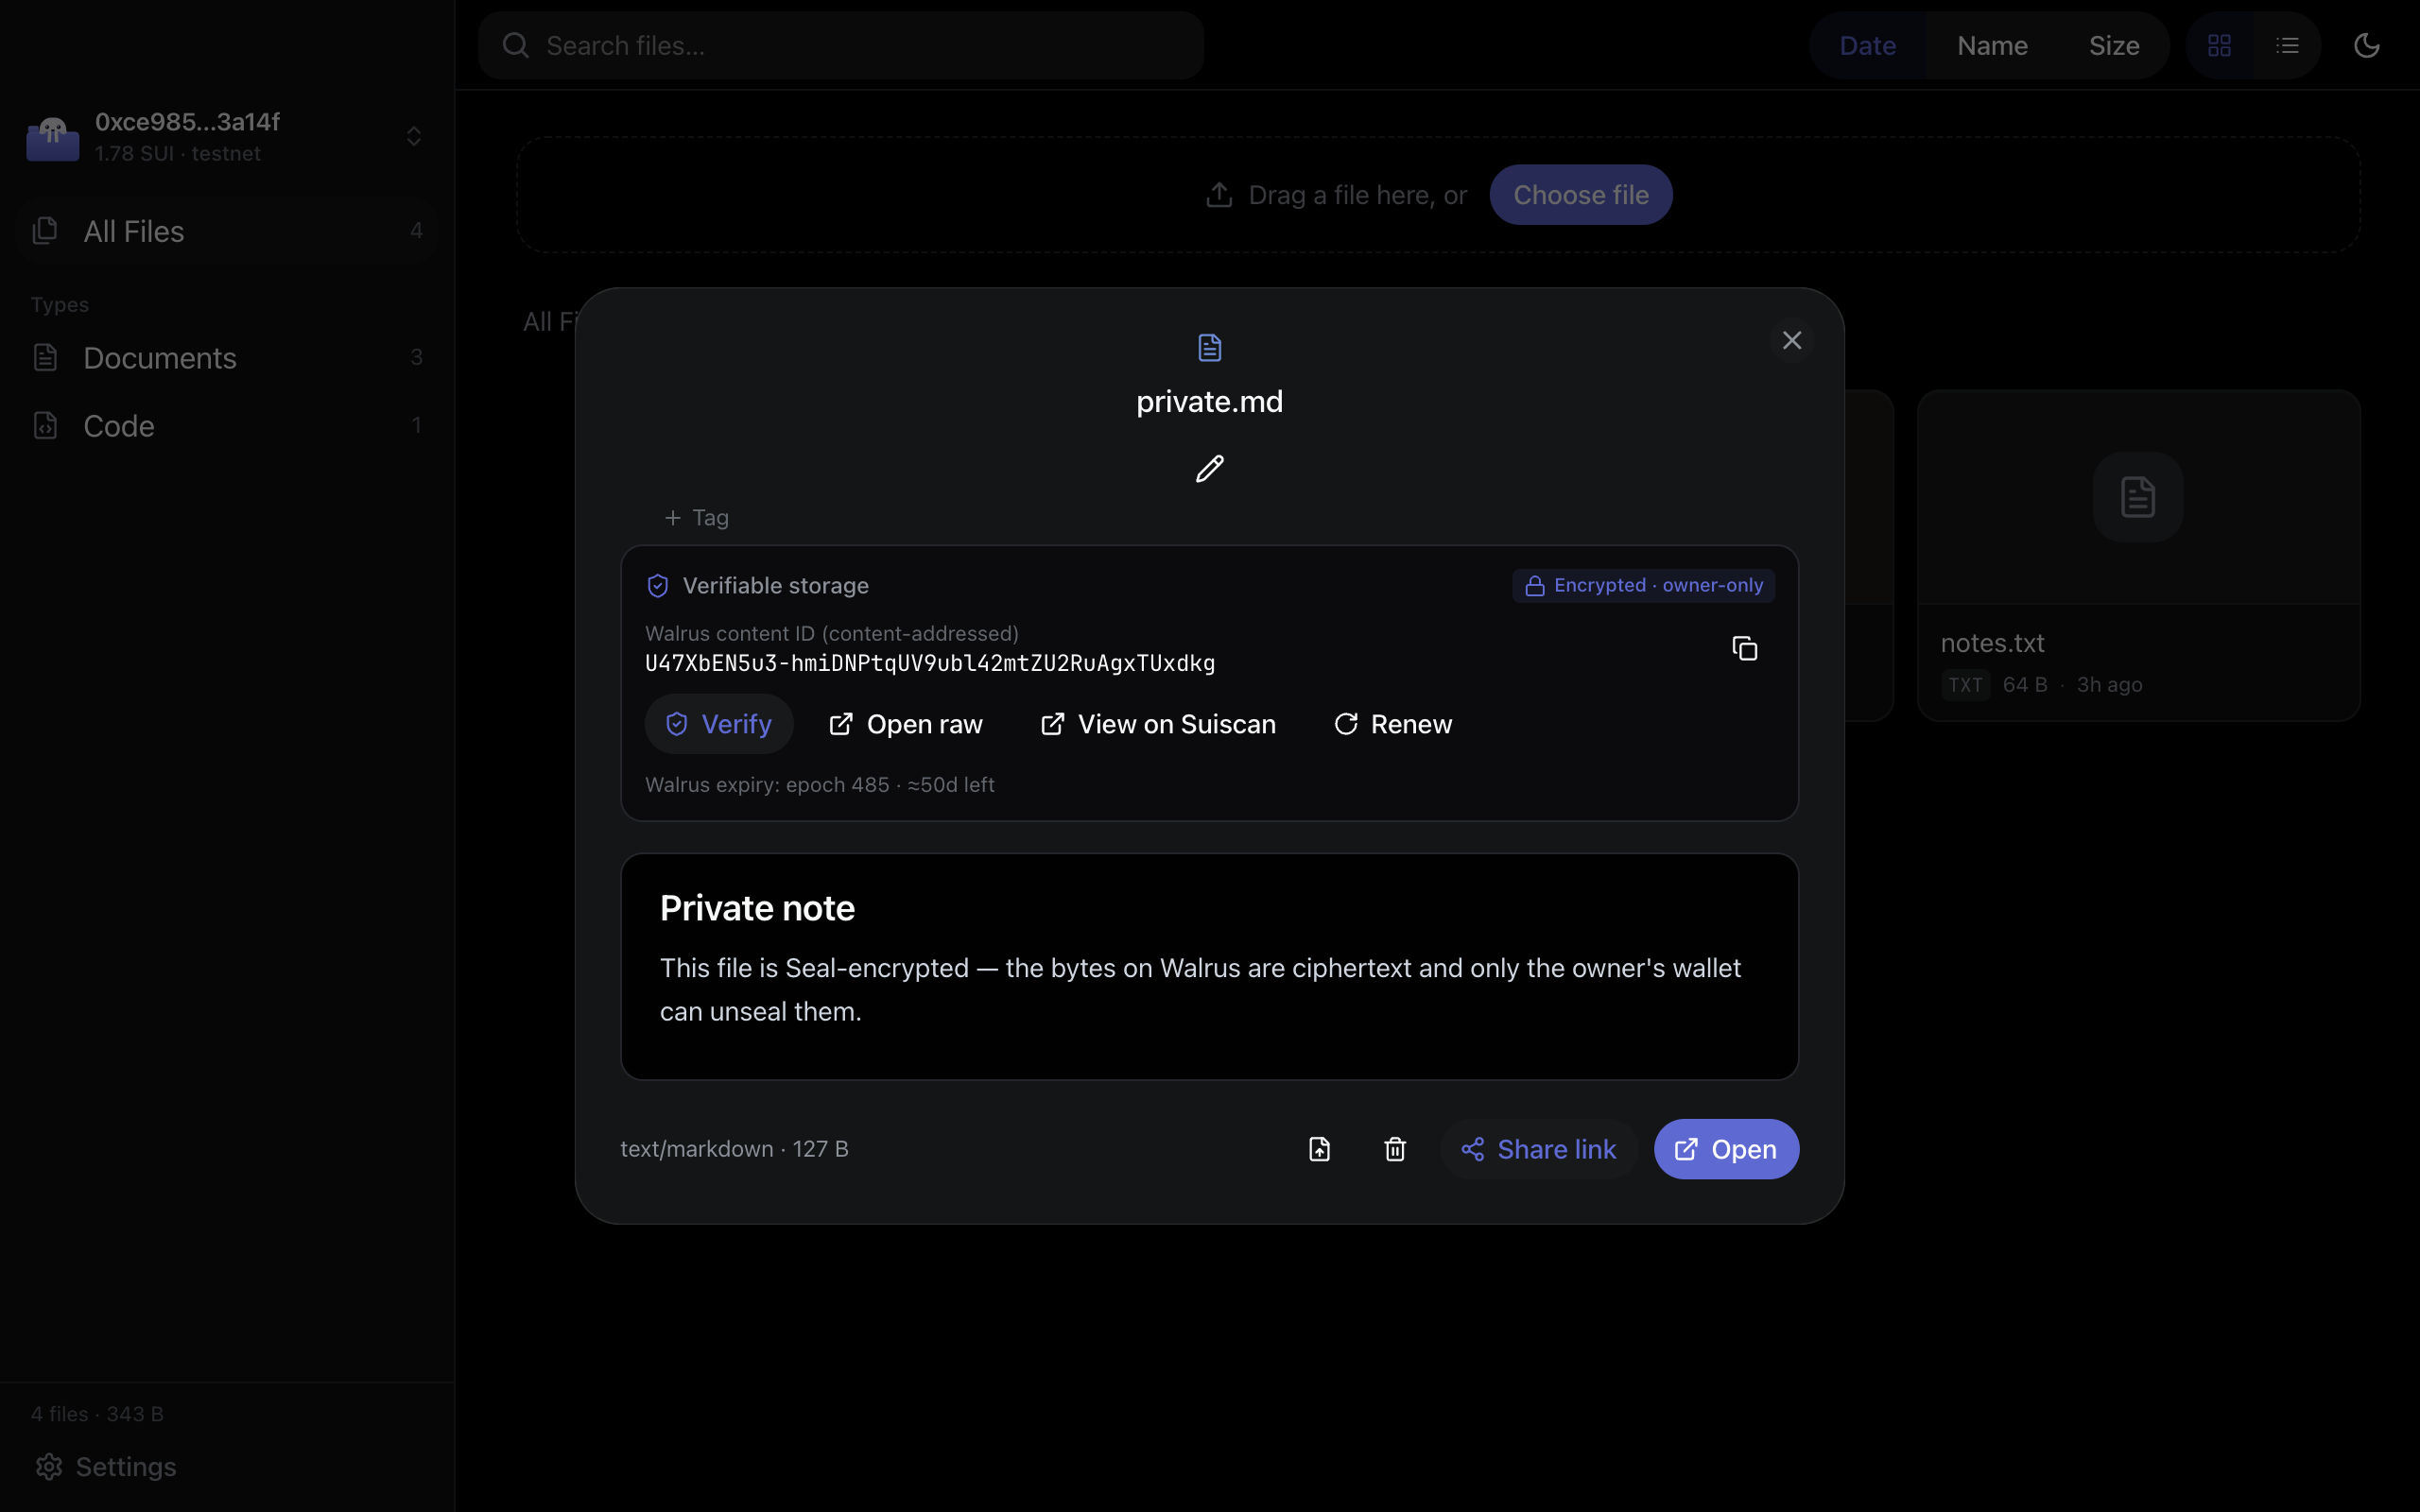
ENCRYPTION · OWNERSHIP
Sealed to your wallet
Turn on Seal and the bytes on Walrus are ciphertext only your wallet can unseal. The Blob object lands in your wallet too — renew it before expiry, or delete to reclaim.
Your wallet, your key
A local keypair you generate or import — self-custodial.
Renew or reclaim
Extend the blob before expiry, or delete it.
Gas in one click
Built-in faucet tops up SUI.
WalDrive
07 / 12

Slide 8
ARCHITECTURE · THREE PIECES
One data layer, three surfaces
HUMAN SURFACE
AGENT WRITE-PATH
VERIFIABLE ON-CHAIN
Desktop console
MCP · CLI · skill
Move contracts
Browse, preview, search, version and share agent data on Walrus. The fluid surface for people.
Agents write the same Walrus data three ways — an MCP server, a waldrive CLI, and an installable skill.
File metadata as Sui Move objects — owned, queryable, verifiable.
Tauri 2.0 desktop
Vite + React 19
in-process signing
upload_file
waldrive upload
npx skills add
FileRecord
ShareLink
deployed on testnet
WalDrive
08 / 12

Slide 9
HOW IT WORKS
Console signs, Walrus stores, Sui records
Two steps on upload. Reads are public. No backend anywhere.
→
→
CLIENT
STEP 1
STEP 2
Desktop console
Walrus publisher
Sui
local Ed25519 keypair
signs in-process
① PUT bytes
→ blobId
② register(blobId, …)
FileRecord object
no wallet popup
publisher fronts WAL
you pay SUI gas
Read / preview GET aggregator /v1/blobs/{blobId} — public, no wallet. List getOwnedObjects(FileRecord) via Sui RPC.
The MCP server runs the same two-step write-path locally — the agent entry point.
WalDrive
09 / 12

Slide 10
WHY IT FITS THE TRACK
The file-management UI for agent data on Walrus
idea #032
Official Walrus track prompt — “Walrus file-management UI.” WalDrive is built directly to it.
✓
Verifiable data platform for agents
On-chain Sui metadata over content-addressed Walrus blobs — verify on screen.
✓
History + rollback
Linked FileRecord versions, one-transaction restore — what the prompt asks for.
✓
Agent write-path included
An MCP server, a waldrive CLI, and an installable skill let agents write to the same data.
✓
Shipped, not slideware
Cross-platform Tauri app on testnet, with a full mac / win / linux release CI.
WalDrive
10 / 12

Slide 11
BUSINESS MODEL
The drive that pays for itself
Agents are about to generate more data than humans ever have — and all of it needs a home that's owned, verifiable, and persistent. Free on testnet today.
METERED
SUBSCRIPTION
MARKETPLACE
Pay per upload
Persistence & privacy
Monetize your data
On mainnet each write costs WAL storage + SUI gas, on a public ledger. WalDrive fronts the publisher; the FileRecord is the receipt — meter or bill an agent by reading its files.
Agent data must outlive the run. A paid tier auto-renews Walrus blobs before they expire, and unlocks private, encrypted (Seal) storage for sensitive data.
A share-link paywall: other agents and humans pay on-chain to read your dataset or artifact, and WalDrive takes a small cut. Agent output becomes an asset, not a cost.
Free on testnet today · the model lands on mainnet
WalDrive
11 / 12

Slide 12
Try it
Browse the live console, or download the desktop app for your OS.
Website
Live demo
waldrive.flacier.com
waldrive.flacier.com/app
GitHub
Downloads · all platforms
github.com/Fldicoahkiin/WalDrive
the v0.1.0 release
Contract 0x2fc345…b5f6 testnet
WalDrive · Sui Overflow 2026 · Walrus track

