Slide 1
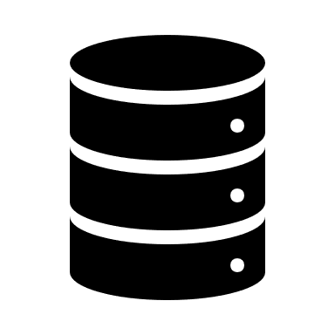


Store time series
AWS IoT Core
AWS
Cloud Database
Certificate
AWS Lambda FaaS
Subscribe alarm
Wi-Fi Router
LoRa Gateway
Get time series
Publish over MQTT
Publish over
TheThingsNetwork
FlaskServer
VM
Multi-Capteur 1
Multi-Capteur 2
- Notifications
- Data
- Application
Client
WeatherApp
National weather data
OpenWeatherMap

