Slide 1
Web Scraping, Data Cleaning, EDA & Visualization
/Flipkart/Televisions
Fleena Christy

Slide 2
Contents
Problem Statement
Web Scraping
Data cleaning
EDA
Data Visualization

Slide 3
Problem Statement
Using BeautifulSoup & Request, Webscrap “Top Rated 4K HD Televisions in Discounts” list of data from Flipkart.
Cleanse the data and Analyse the data for Extracting Best Tv under Specifications.
Perform Data Visualization techniques over the Specifications to produce visual summary of information which makes it easier to indentify patterns & trends

Slide 4
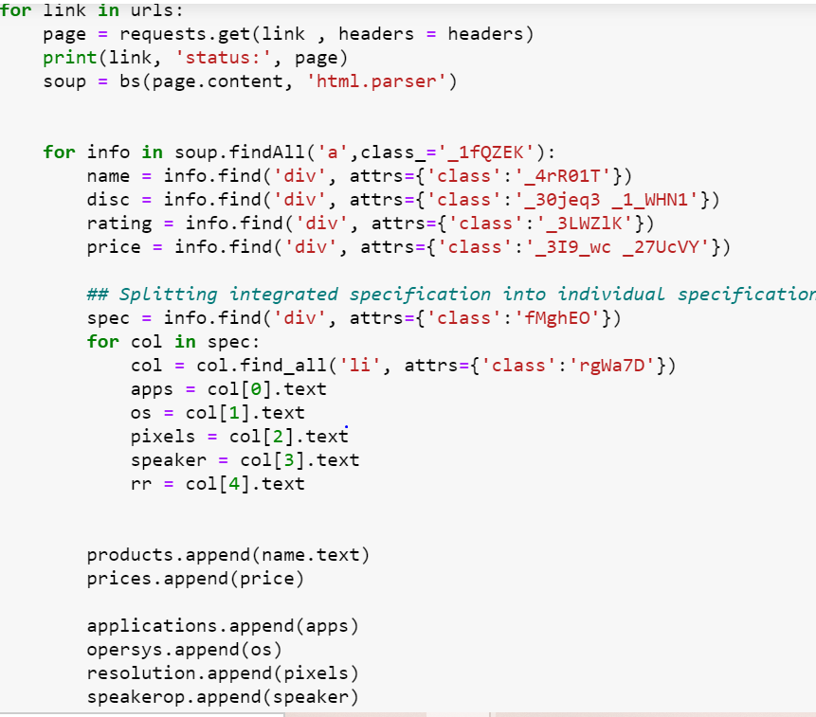
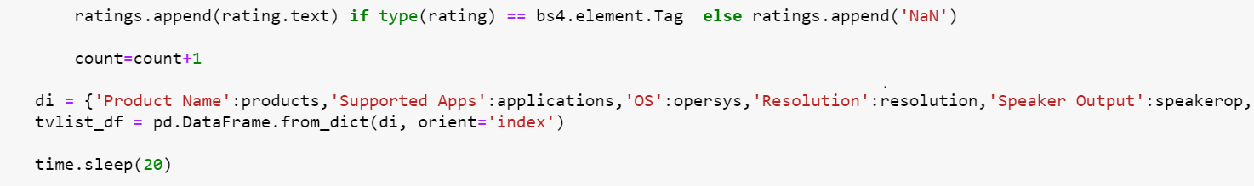
Web Scraping
Extracting “Television” data from “Flipkart” by iterating over 8 Pages of information.
Iterating each column and storing them as a Data Frame

Slide 5
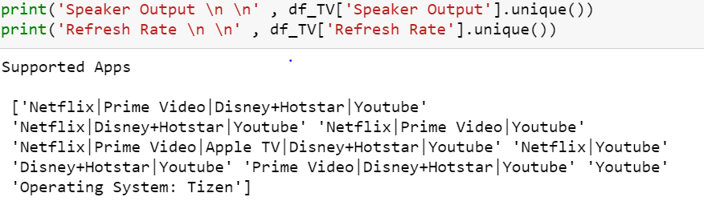
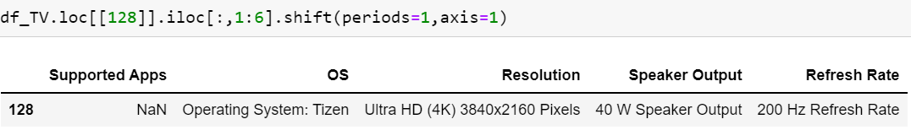
Data Cleaning
-Striping off, cleaning column values and extracting only the required data to store in DataFrame
-Checking for unique values to identify any mismatch is present
-Shifting row values to check for correctness of the data

Slide 6

-Calculating Discount Percentage from Original Price and Discounted Price available in the data for discount information while selecting the Television.
-Extracting Brand Name from the product description in the data.
-Converting the objects into float values for processing the data further.
-Checking Mino Matrix if any missing data.
-Rearranging Columns for ease of data presentation while performing Analysis.

Slide 7
EDA
-Grouping by required columns to analyse the data.
-Calculating count of variable by groupby from the data.
-Calculating the pivot table for Screen Size over Brand Name for better understanding from the matrix.
-Calculating the cross tabs for the values against Brand Name for better understanding of analysis.

Slide 8
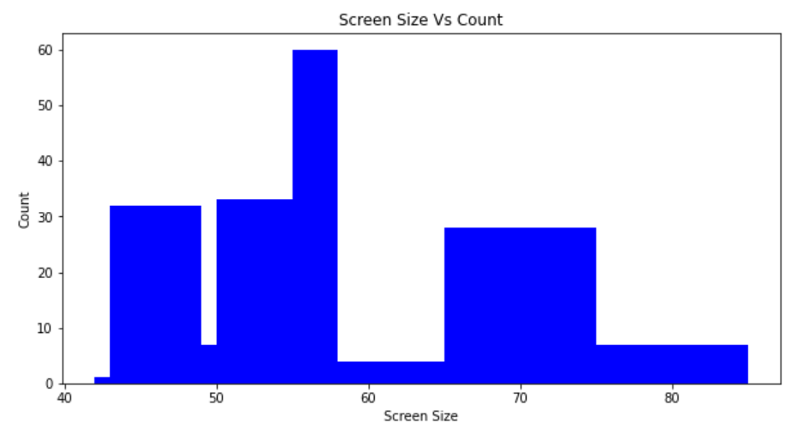
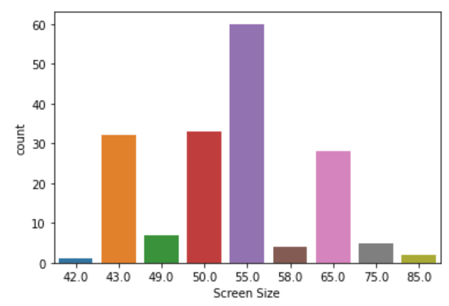
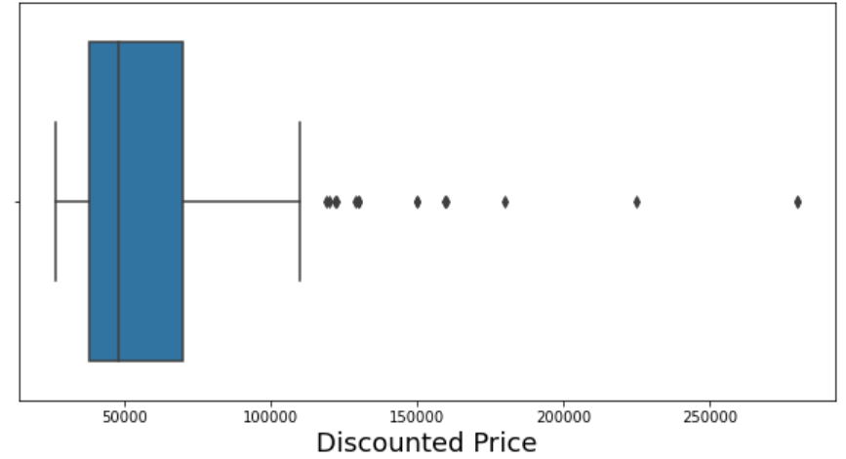
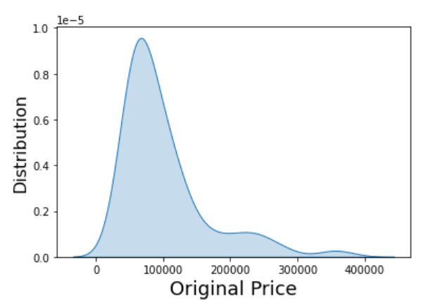
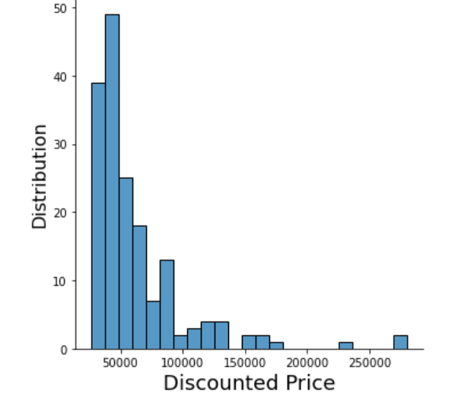
Data Visualization
Univariate Analysis Using Plot Histograms, Countplots, Kde, Displots and BoxPlots

Slide 9
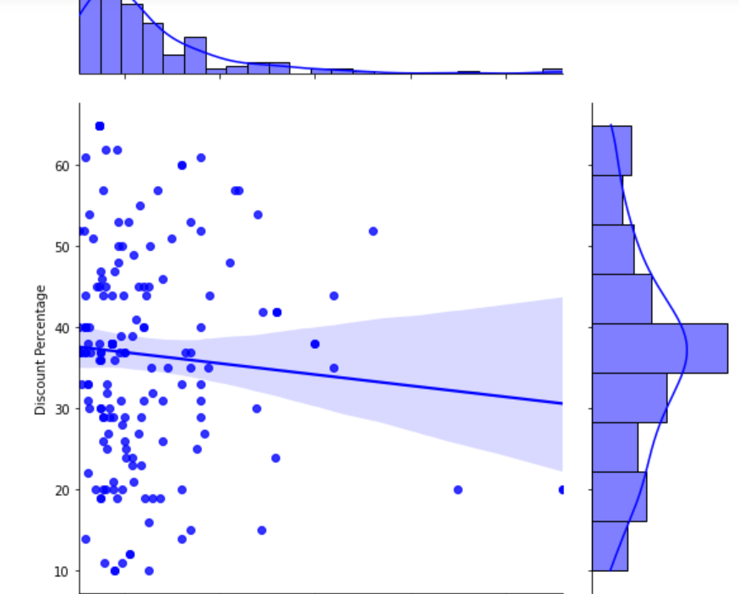
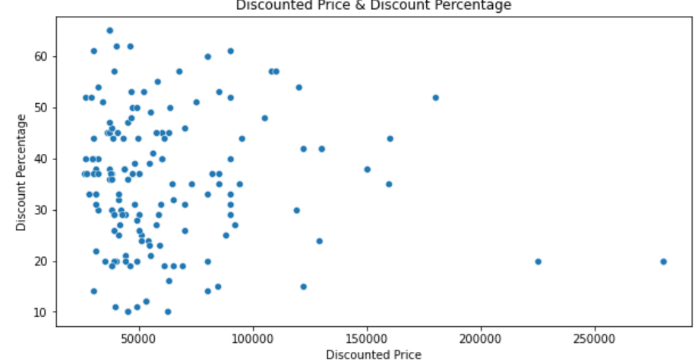
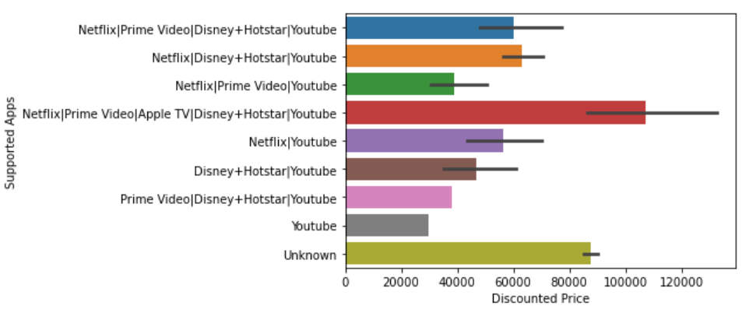
Bivariate Analysis Using Jointplot, Boxplot, Scatterplot & Barplot

Slide 10
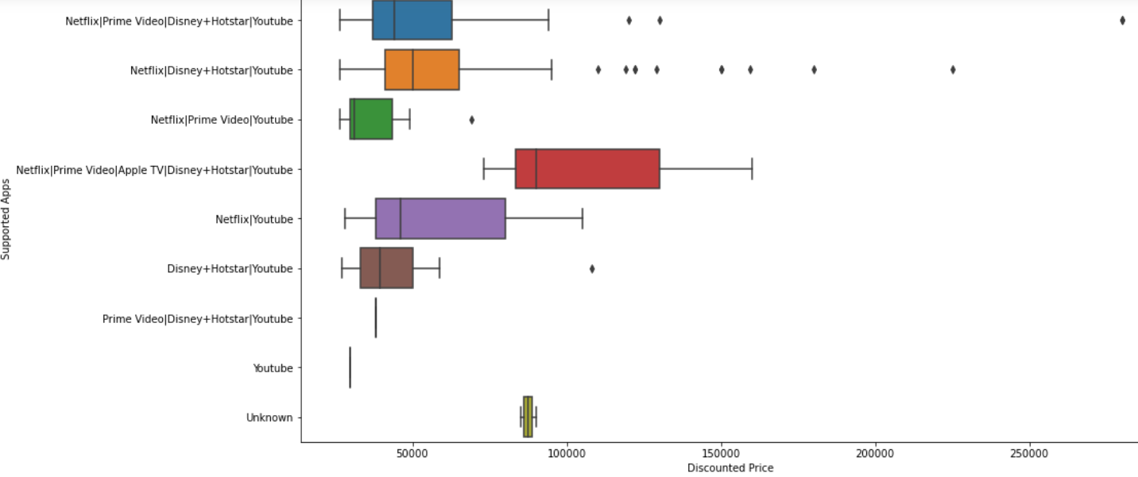
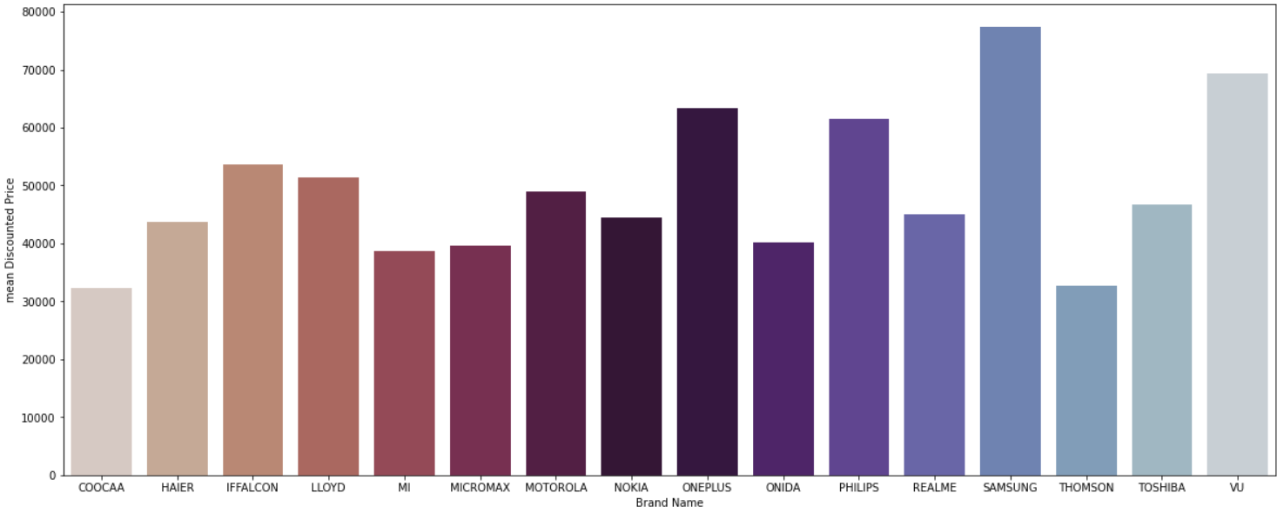

Slide 11
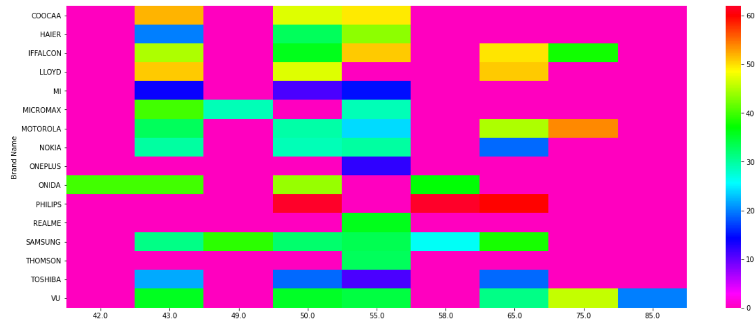
Bivariate Analysis Using Multivariate Dataset plotting Heatmap & Pairplot

Slide 12
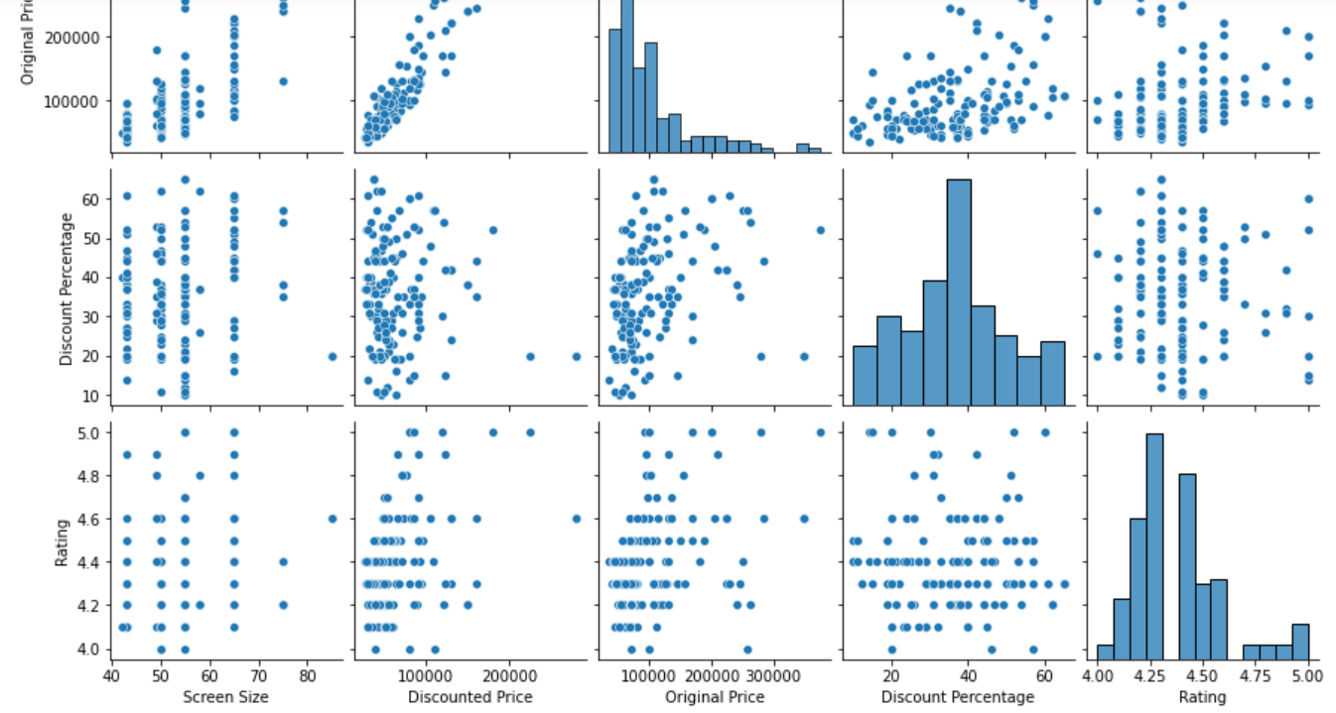

Slide 13
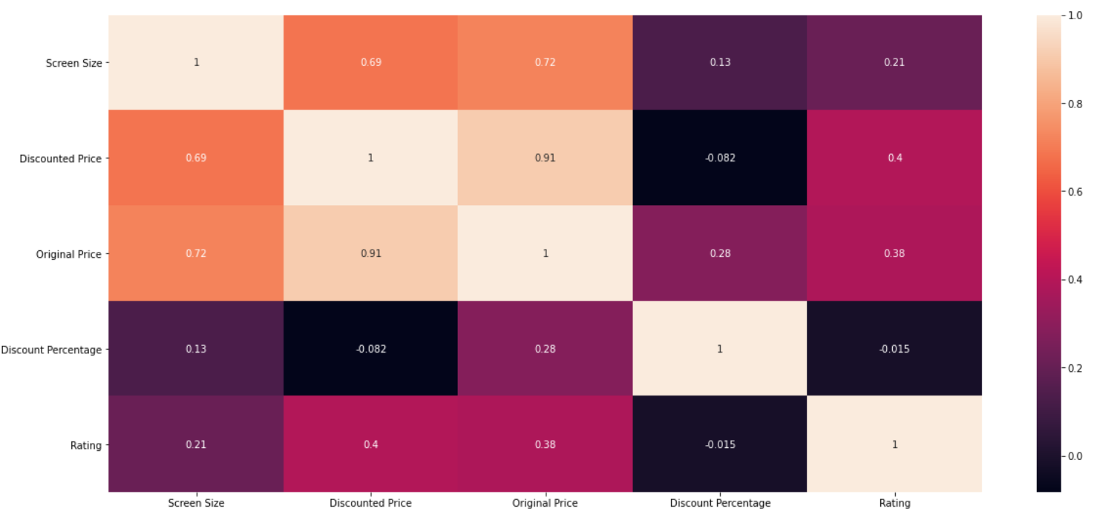

Slide 14
Thank you

