Slide 1
NISHINAE STORE
Your Daily Life Necessities
An e-commerce platform for OTP voucher purchase & redemption
Presented by: Danish • 2nd May 2026

Slide 2
Agenda
What we'll cover
1. Project Overview & Problem Statement
2. Key Features
3. Tech Stack
4. System Architecture
5. User Flow — Store & Checkout
6. Payment Integration (ToyyibPay)
7. User Flow — Redemption & OTP
8. Admin Dashboard
9. Database Schema
10. Deployment & Hosting
11. Challenges & Solutions
12. Future Improvements
13. Demo & Q&A

Slide 3
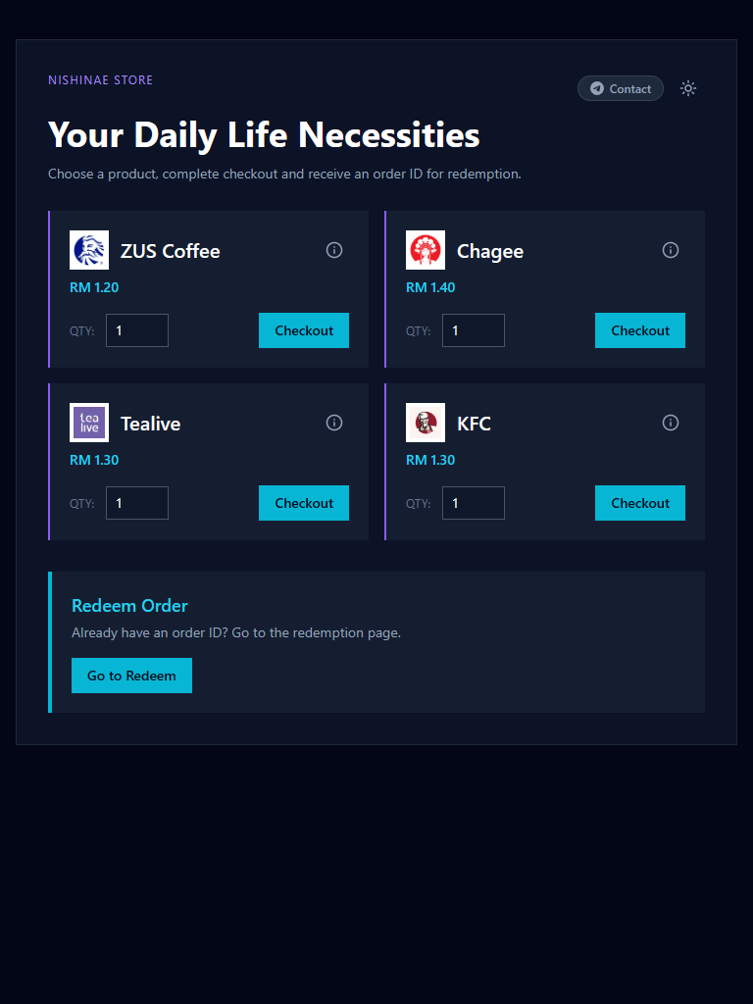
Project Overview
What is Nishinae Store?
The Problem Users need temporary phone numbers to receive OTPs for account registrations, verifications and promo redemptions — but accessing such services is inconvenient and requires technical knowledge. The Solution A simple, consumer-friendly store where customers can purchase vouchers, pay online via FPX/card and instantly claim a temporary number to receive OTPs — all in one place. Target Audience Malaysian consumers who want quick access to fresh disposable phone numbers for services with OTP-based promotions.
📸 Store Homepage
(insert screenshot here)

Slide 4
Key Features
What the platform offers
🛒
Product Catalog
💳
Secure Payment
📱
Instant OTP Claim
Browse available OTP voucher products with dynamic pricing
Integrated ToyyibPay (FPX + card) for Malaysian customers
Real-time phone number claim after successful payment
🔐
Order Redemption
⚙️
Admin Dashboard
🌓
Dark / Light Mode
Unique order ID system for voucher redemption
Inline editing of products, prices and orders
Responsive design with theme toggle

Slide 5
Tech Stack
Tools & technologies used
Frontend
Backend
Next.js 15 (App Router)
React 19
TypeScript
Tailwind CSS
Framer Motion
Sonner (toasts)
Next.js API Routes
Prisma ORM
SQLite (file-based)
JWT + HMAC auth
External APIs
Deployment
ToyyibPay (payments)
HeroSMS (OTP numbers)
Railway (hosting)
Persistent Volume (/data)
GitHub (version control)

Slide 6
System Architecture
How the components connect
💳 ToyyibPay
(Payment)
👤 Customer
(Browser)
🌐 Next.js App
(Railway)
📱 HeroSMS
(OTP API)
🔧 Admin
(Dashboard)
💾 SQLite DB
(/data volume)
Flow: Customer → App → (Payment + OTP APIs) → Database

Slide 7
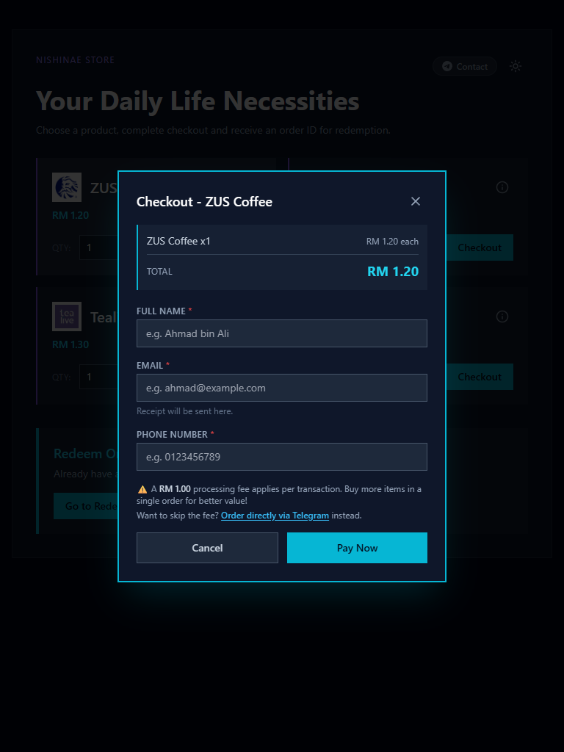
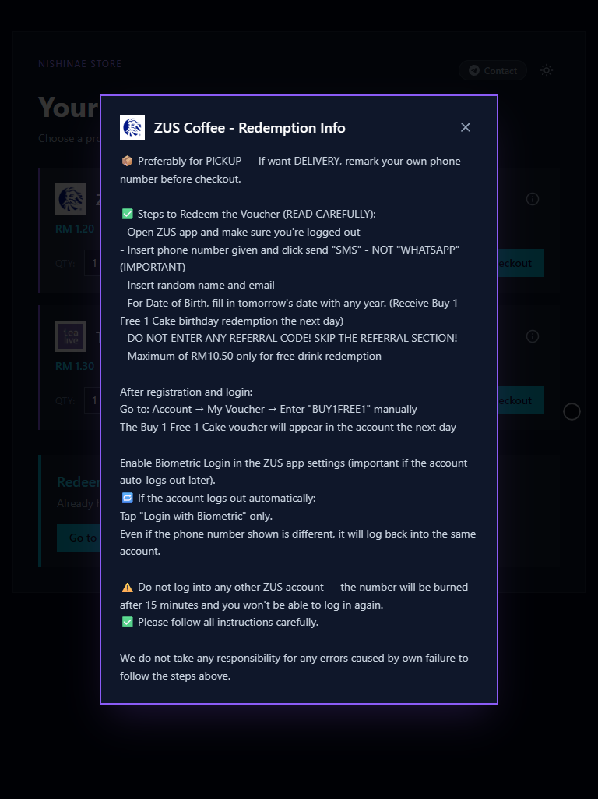
User Flow — Store & Checkout
From browsing to payment
1. Customer visits store homepage and browses product catalog
2. Selects a product and chooses quantity
3. Clicks “Checkout” — checkout modal opens
4. Fills in Full Name, Email, Phone Number
5. Confirms order with dynamic total price calculation
6. Clicks “Pay Now” → redirected to ToyyibPay payment page
7. Completes FPX / card payment via bank login
8. Redirected back to success page with unique Order ID

Slide 8
Payment Integration
ToyyibPay — FPX & Card payments
Why ToyyibPay? • Malaysian-native gateway (FPX + card) • Simple bill-based API • Low transaction fees (RM1 for all FPX transactions) Integration Flow 1. Create Bill via API (server-side) 2. Receive BillCode → redirect customer 3. Customer pays on ToyyibPay page 4. Callback URL receives payment status 5. Return URL redirects to success/fail page Environments • Sandbox (dev.toyyibpay.com) for local testing • Production (toyyibpay.com) for live payments
📸 ToyyibPay Page
(insert screenshot here)

Slide 9
User Flow — Redemption & OTP
Using your purchased voucher
1. Customer navigates to /redeem with their Order ID
2. System validates the Order ID against the database
3. User clicks “Claim Number” to request a phone number
4. HeroSMS API returns a temporary phone number (15-min window)
5. Customer uses the number on target service
6. App polls HeroSMS every 5 seconds for incoming OTP
7. OTP displayed instantly upon arrival
8. Customer can cancel claim (with 2-minute cooldown protection)
📸 Redeem Page
(insert screenshot here)
📸 OTP Received
(insert screenshot here)

Slide 10
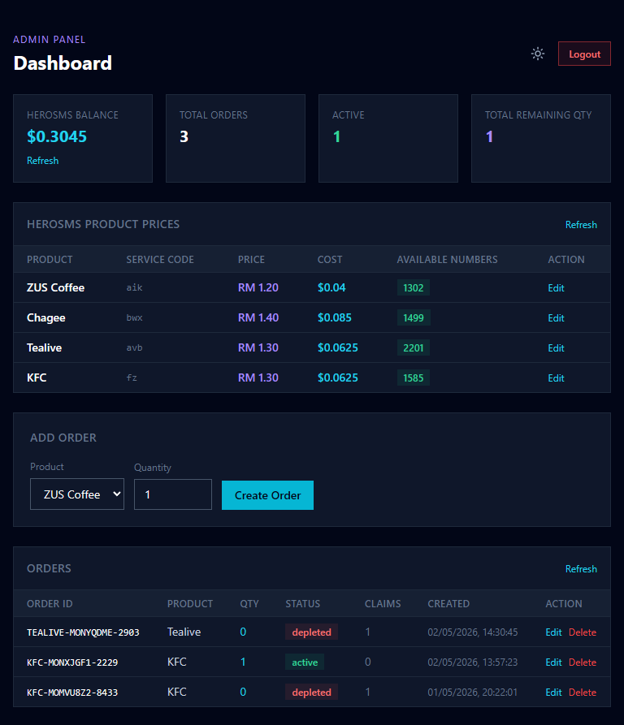
Admin Dashboard
Backend management tools
Authentication JWT-based login with HMAC-signed tokens, stored as HTTP-only cookies. Features • View HeroSMS balance in real-time • Inline edit product prices • View & manage all orders • Edit Order ID and quantity inline • Delete orders • Order statistics dashboard Security Routes protected via middleware that validates admin tokens on every request.
📸 Admin Dashboard
(insert screenshot here)

Slide 11
Database Schema
Prisma + SQLite models
Order
Payment
Claim
id (PK)
orderId (unique)
productKey
productName
serviceCode
quantity
totalPrice
status
createdAt
id (PK)
orderId (FK)
billCode
billExternalRef
amount
status
paidAt
createdAt
id (PK)
claimId (unique)
orderId (FK)
heroActivationId
phoneNumber
status
otp
expiresAt
ProductSetting
AdminUser
id (PK)
productKey (unique)
priceOverride
updatedAt
id (PK)
username (unique)
passwordHash
createdAt

Slide 12
Deployment & Hosting
Going live with Railway
Platform: Railway Node.js-based hosting with automatic builds from GitHub and persistent volume support. Configuration • Persistent volume mounted at /data • DATABASE_URL = file:/data/dev.db • Prisma db push runs on every startup • Environment variables for ToyyibPay + HeroSMS CI/CD • railway up -s nishinae-store for manual deploy • Build logs streamed live • Health check endpoint at /api/health Domain Custom domain with Google Search Console verification
📸 Railway Dashboard
(insert screenshot here)

Slide 13
Challenges & Solutions
Problems solved during development
Problem: Database persistence on Railway (data wiped on redeploy) Solution: Mounted persistent volume at /data with updated DATABASE_URL
Problem: ToyyibPay userSecretKey missing errors Solution: Added required userSecretKey parameter to all API calls
Problem: Next.js build errors with useSearchParams Solution: Wrapped components in Suspense boundary
Problem: HeroSMS early cancellation exposing raw error Solution: Sanitized error messages at API route layer
Problem: ESLint no-explicit-any / no-require-imports blocking build Solution: Refactored imports + added targeted eslint-disable comments
Problem: Cannot hide customer info on ToyyibPay page Solution: Accepted limitation; collect info upfront for transparency

Slide 14
Future Improvements
Roadmap & planned enhancements
Near-term
Mid-term
Long-term
Email receipts via SMTP
Order history for customers
Bulk discount tiers
Promo code system
Analytics dashboard
Multi-language (BM / EN)
Customer accounts
Wishlist feature
Referral program
Mobile app (PWA)
Multi-payment gateways
Migrate to PostgreSQL
Microservices architecture
AI-powered support chat
International expansion

Slide 15
Thank You
Questions & Discussion
🌐 nishinae.store 💬 t.me/nishinaestore

