Slide 1
FleetOps V2
Cloud Native Fleet Management Platform
AWS EKS
Terraform
GitHub Actions
ArgoCD
🏅 GitHub Actions Certified · GH200
UST Fresher Capstone • June 2026
fleetops.website

Slide 2
FLEETOPS V2
Project Overview
Production-grade microservices platform — vehicle tracking, maintenance scheduling, service requests, and AI-powered advisory.
🌐 fleetops.website
4
27
3
5+
Spring Boot 3.x
Microservices
Terraform
Modules
CI/CD
Pipelines
Bonus
Features
Amazon EKS 1.31 (us-east-1) for container orchestration
Terraform IaC with 27 modular configurations
GitOps delivery via ArgoCD + GitHub Actions
IRSA for zero static credential access
Amazon Nova Lite (amazon.nova-lite-v1:0) AI integration via Bedrock

Slide 3
THE PROBLEM
Why FleetOps?
The Problem
What FleetOps Delivers
📍 No fleet visibility
✅
Vehicle registry
Managers call drivers individually to know vehicle status
Status · mileage · driver — live dashboard KPIs
✅
Step Functions workflow
🔁 No service request lifecycle
Raised → Assigned → In Progress → Completed
Repairs tracked verbally — no records, no accountability
✅
Lambda daily scanner
📅 Deadlines missed
Scans every vehicle → SNS alert → email to managers
Insurance renewals & service dates lost in shared Excel files
✅
Per-user task queue
🔧 Tasks fall through
Technicians see their work; managers assign across the team
Work assigned verbally — invisible when a mechanic is absent
✅
Shared EFS + S3
Photos & PDFs tagged to vehicle, accessible fleet-wide
📁 Documents scattered
✅
AI fleet analysis
Inspection photos emailed around, never linked to a vehicle
Bedrock Nova Lite — health score + recommended actions

Slide 4
01
Infrastructure as Code
27 Terraform Modules | Modular | State-Managed

Slide 5
SECTION 1 — IaC
27 Modules Total
Terraform Architecture
Networking
VPC · 3 Subnet Tiers · NAT Gateways · Multi-AZ
Compute
eks/cluster · eks/nodegroup · eks/addons · eks/oidc
Data
RDS · Redis · S3
Messaging
SNS · SQS · EventBridge · Step Functions · Lambda
Security
IAM · KMS · Secrets Manager · SSM · WAF
Delivery
ECR · ACM · Route53 · ALB · CloudFront
Observability
CloudWatch · CloudTrail · Config
AI / Bedrock
Amazon Bedrock — Nova Lite (amazon.nova-lite-v1:0) · Cross-account IAM

Slide 6
SECTION 1 — IaC
Terraform Code Quality Standards
✓
Modular Structure
✓
Remote State
modules/networking, modules/eks, modules/database, modules/storage
S3: fleetops-terraform-state-johan + DynamoDB: fleetops-terraform-locks
✓
No Hardcoded Values
✓
All Resources Tagged
All config in terraform.tfvars per environment (dev / staging / prod)
Environment and Owner tags on every resource
✓
.gitignore Complete
✓
Outputs Exported
Excludes *.tfstate, .env, *.tfvars, credentials
Cluster endpoint, OIDC URL, ECR URIs — all exported
✓
Code Clean
terraform validate and terraform fmt — both pass

Slide 7
02
Kubernetes Deployment
5 Services · HPA · Health Probes · Network Policies

Slide 8
SECTION 2 — K8S
Kubernetes Deployment Architecture
Namespace: fleetops-prod (not default)
auth-service
vehicle-service
maintenance-service
request-service
frontend (nginx)
2+ Replicas
2+ Replicas
2+ Replicas
2+ Replicas
2+ Replicas
JWT auth, stateless
Bedrock AI + S3
SNS publishing
Step Functions
React 18 SPA
Every service includes:
Deployment
Service
HPA
ConfigMap
ExternalSecret
Liveness: httpGet /health Readiness: httpGet /health (all 5 services)
Java services — requests: cpu 100m / mem 256Mi limits: cpu 500m / mem 512Mi
Frontend (nginx) — requests: cpu 100m / mem 128Mi limits: cpu 250m / mem 256Mi

Slide 9
SECTION 2 — K8S
GitOps with ArgoCD
App-of-Apps Pattern
Sync Configuration
📦 root-app-prod.yaml
Sync Policy
Automated
├── auth-prod.yaml
├── vehicle-prod.yaml
Prune
Enabled
├── maintenance-prod.yaml
├── request-prod.yaml
Self Heal
Enabled
├── frontend-prod.yaml
├── secrets-prod.yaml ← ExternalSecrets
Sync Latency
~90 sec
├── ingress-prod.yaml ← ALB
├── networkpolicy-prod.yaml ← micro-segmentation
ArgoCD Dashboard: argocd.fleetops.website

Slide 10
03
CI/CD Pipelines
3 GitHub Actions Workflows · Security Gates

Slide 11
SECTION 3 — CI/CD
Three GitHub Actions Workflows
Build Pipeline
prepare
→
quality
→
build
→
trivy-scan
→
push
→
release
→
notify
java-ci-ecr.yml
⚡ push to main / develop
Deploy Pipeline
update-dev
→
update-prod
→
smoke-test
→
notify
cd-ecr.yml
⚡ successful build
Infrastructure Pipeline
validate + checkov
→
plan
→
manual approval
→
apply
terraform-apply.yml
⚡ push main: environments/**, modules/** + workflow_dispatch

Slide 12
SECTION 3 — CI/CD
Security Scanning in CI/CD
🔍
📊
🐳
Gate 1
Gate 2
Gate 3
Dependency Scanning
SAST / Code Quality
Container Scanning
Tool: Snyk
Tool: SonarQube
Tool: Trivy
Third-party libraries
& open-source packages
Static analysis, code
quality & security rules
Docker image CVEs
& misconfigurations
🔐 OIDC-based AWS credentials — Zero static keys in GitHub Secrets

Slide 13
04
Cloud Integration
IRSA · Bedrock AI · S3 · SNS · Step Functions

Slide 14
SECTION 4 — CLOUD
IRSA — Zero Static Credentials
Terraform — OIDC Provider
1
resource "aws_iam_openid_connect_provider" "eks" { ... }
modules/eks/oidc creates the OIDC provider linked to EKS cluster
IAM Role with OIDC Trust Policy
2
"Federated": "arn:aws:iam::538661800892:oidc-provider/{url}"
Trust policy scoped to fleetops-prod:fleetops-app service account
ServiceAccount Annotation
3
eks.amazonaws.com/role-arn: arn:aws:iam::...:role/fleetops-prod-app-irsa-role
Kubernetes ServiceAccount annotated — pods receive automatic token exchange

Slide 15
SECTION 4 — CLOUD
What Pods Can Access (IRSA Permissions)
Permission | Resource | Service Using It
S3 Get/Put/Delete | vehicle-docs bucket | vehicle-service
Bedrock InvokeModel | foundation-model/* | vehicle-service
SNS Publish | insurance-alerts, service-alerts | maintenance-service
Step Functions Start/Describe | Request workflow | request-service
Secrets Manager | fleetops/* | All services (via ESO)
CloudWatch Logs | /fleetops/* log groups | All services
KMS Decrypt | All KMS keys | All services
Zero static credentials for AWS services — IRSA handles all native AWS access

Slide 16
SECTION 4 — CLOUD + BONUS
Amazon Nova Lite AI Integration
🤖 Fleet Maintenance Advisor — FleetAiService.java · vehicle-service only
Model:
amazon.nova-lite-v1:0 (Amazon Nova Lite via Bedrock Converse API)
Use Case:
Analyses all vehicles → returns health score + maintenance recommendations
Auth:
Cross-account IAM credentials in Secrets Manager → K8s Secret fleetops-bedrock-secret
Caching:
Redis 15-min cache @Cacheable("fleetAnalysis") — avoids redundant Bedrock calls
Audit:
Every call saved to ai_analysis_audit table (model, requester, health score, exec time)
Endpoint:
GET /api/vehicles/ai/fleet-analysis
⚠️ Note: Terraform IAM policy lists claude-3-haiku / claude-v2 — stale; actual runtime model is nova-lite-v1:0

Slide 17
05
Security & Compliance
All Requirements Met — Zero Hardcoded Credentials

Slide 18
SECTION 5 — SECURITY
Security Checklist — All Met
✓
No hardcoded credentials
External Secrets Operator + IRSA
✓
Non-root containers
spring:spring user (Java), nginx user (frontend)
✓
Multistage Docker builds
All 5 services — Alpine base, JRE-only final image
✓
Container image scanning
Trivy in CI — blocks on HIGH/CRITICAL
✓
Secrets in K8s Secrets
ExternalSecrets pulls from AWS Secrets Manager
✓
RBAC configured
ServiceAccount minimal permissions via IRSA
✓
Encryption at rest
KMS for RDS, S3, SNS, SQS, Secrets Manager
✓
Audit trail
CloudTrail to encrypted S3
✓
WAF
AWS WAFv2 Common Rule Set on CloudFront
✓
.gitignore complete
Excludes *.tfstate, .env, *.tfvars, credentials

Slide 19
SECTION 6 — BONUS
Bonus Features Achieved
🤖
⚡
🔄
AI Integration
Event-Driven Architecture
GitOps Deployment
Amazon Nova Lite via Bedrock Converse API
EventBridge → Lambda, SNS, SQS + DLQ, Step Functions (6 states)
ArgoCD App-of-Apps, automated sync, selfHeal=true
🛡️
📊
Network Policy
Advanced Monitoring
allow-apps-to-rds.yaml, allow-service-discovery.yaml
CloudWatch dashboards + metric alarms (RDS, ALB, Lambda)

Slide 20
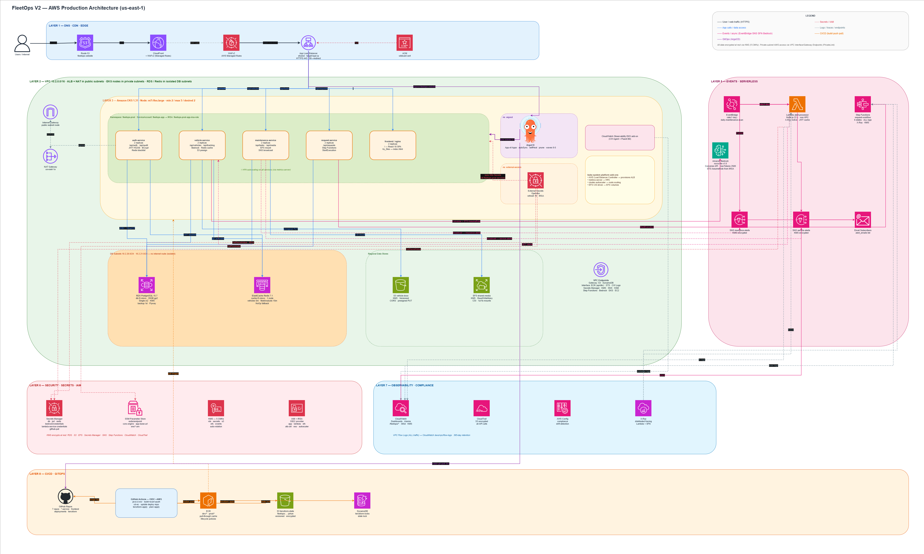
AWS PRODUCTION ARCHITECTURE — us-east-1
DNS / CDN / Edge · VPC / Subnets · EKS · Events / Serverless · Security · Observability · CI/CD & GitOps

Slide 21
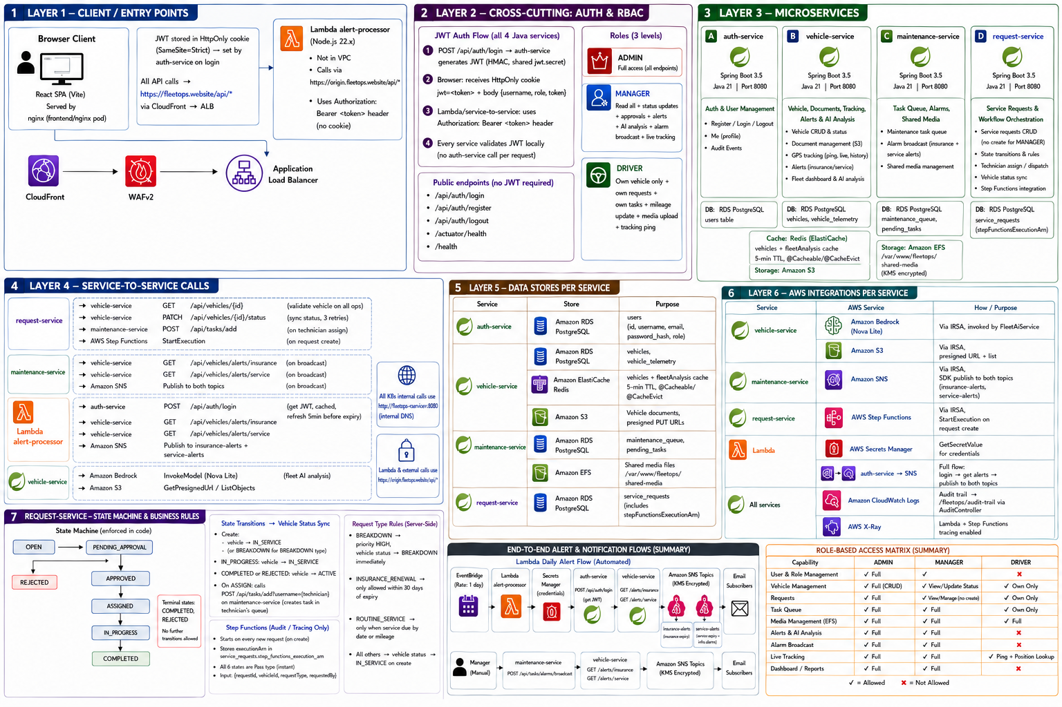
APPLICATION ARCHITECTURE
7 Layers · Microservices · Auth & RBAC · Service-to-Service · State Machine · Alert Flows

Slide 22
Thank You
FleetOps V2 — Production-grade fleet management platform
Built end-to-end as a DevOps Capstone
Repository: github.com/FleetOps-V2
Live Site: fleetops.website
ArgoCD: argocd.fleetops.website
Questions welcome.

