Slide 1
Data Platform Canada
2020-10-30

Slide 2
Scripting is good
PowerShell is awesome
No, really, I mean it

Slide 3
Agenda
Why scripting
The usual suspects
Demo

Slide 4


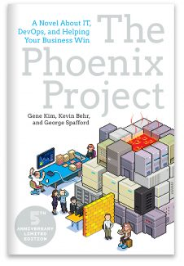
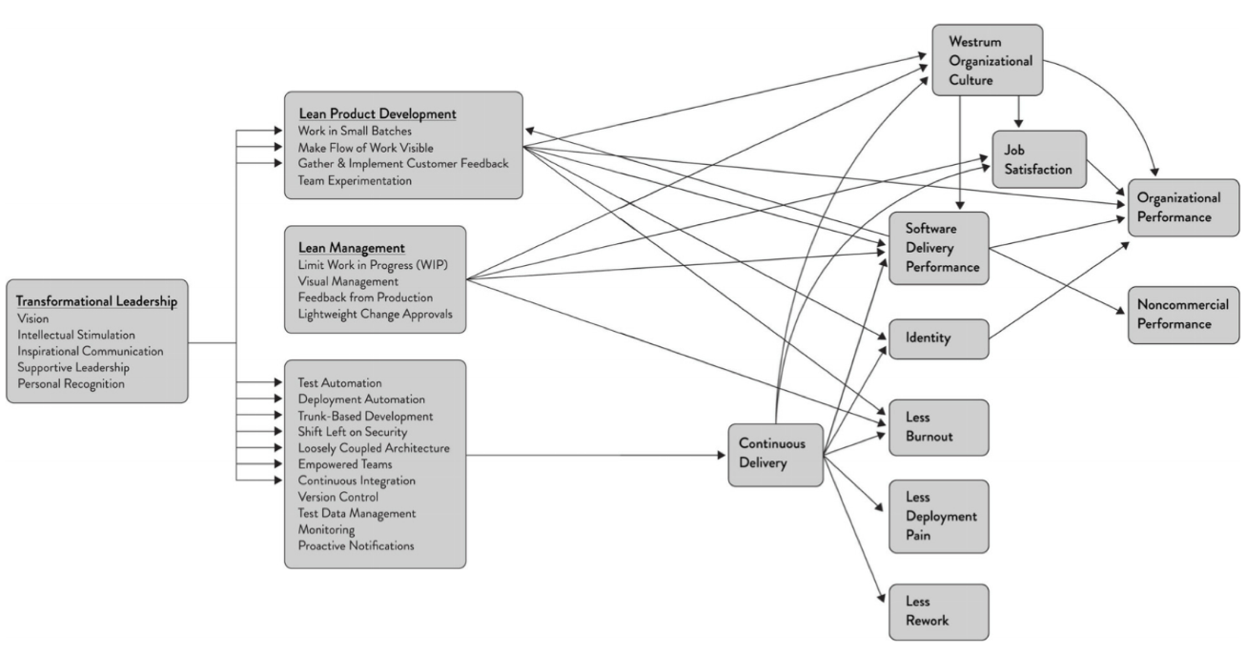
Why scripting : 2 reasons
1 – It’s a key component of DevOps
Test Automation
Deployment Automation
Trunk-based development
Shift Left on Security
Loosely Coupled Architecture
Empowered Teams
Continuous Integration
Version Control (Infra as Code)
Test Data Management
Monitoring
Proactive Notifications
2 - It’s a key contributor to scaling ourselves up via code/IP re-use
Notes:
Here let’s focus on test automation, version control and test automation

Slide 5
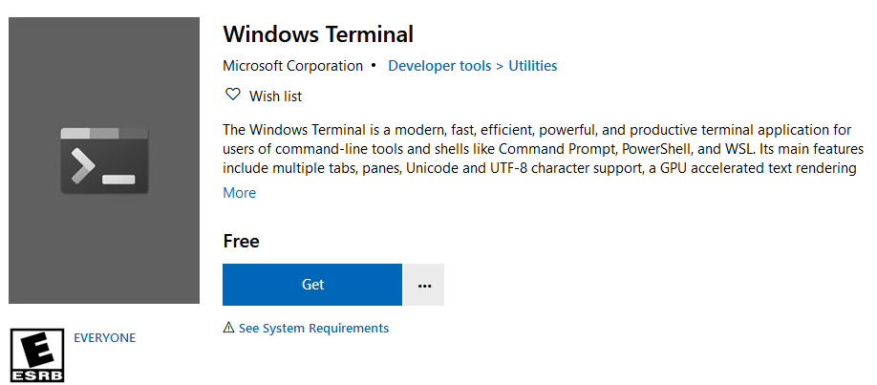
The Usual Suspects
Shell
Any program that users employ to type commands, usually comes with a scripting language
Accessed via a terminal / host
Bash : Unix Shell, via the WSL on Windows
Pipelines of messages (string)
PowerShell : Cross Platform (6+)
Pipelines of .NET objects
Extensible via modules (Az vs AzureRM)
Tool/product specific CLI (Command Line Interface)
AzCLI : create and manage Azure resources (cross platform)
GitHub CLI : GitHub via the terminal
Not to be confused with Git itself

Slide 6
Demo 1 : Version Control
Create a new repository on GitHub
Initialize the repository, commit and push to check wiring
Check on GitHub
$reposRootPath = "C:\users\fleide\repos"
cd $reposRootPath
$repoName = "asa.demo01“
gh repo create $repoName --public -y
cd $repoName
"# Azure Stream Analytics - unit testing" | Out-file README.md
git add .
git commit -m "first commit"
git push -u origin master
code .

Slide 7
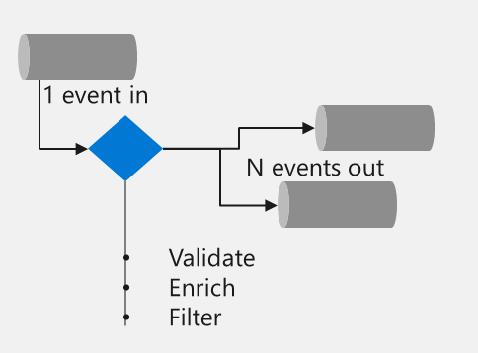
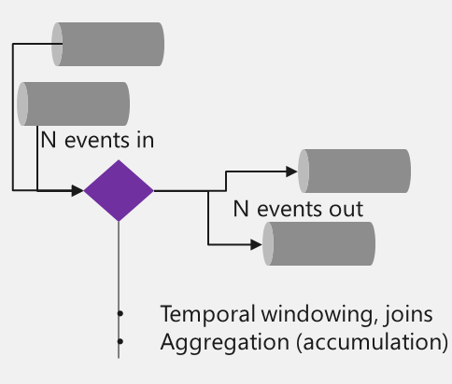
Demo Context
Azure Stream Analytics (ASA)
Serverless Complex Event Processing engine
Stateless
1 event at a time
Function, Logic App,
etc…
Stateful
N events at a time
Stream Analytics,
Spark Structured Streaming…

Slide 8
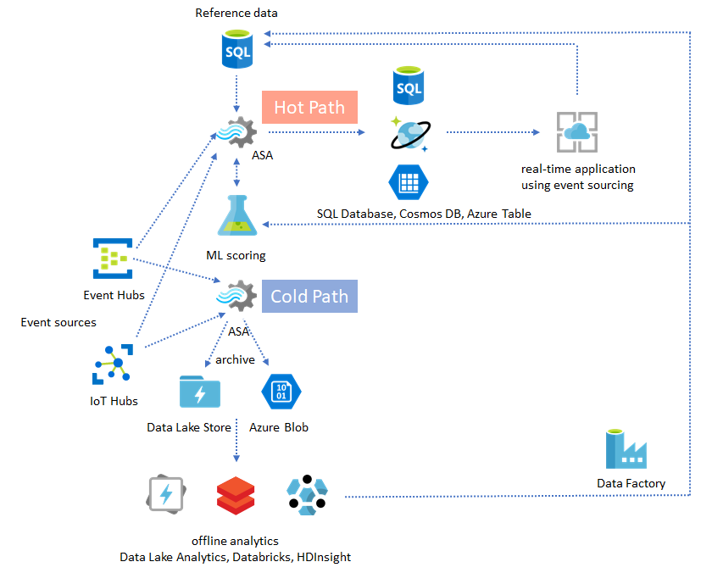
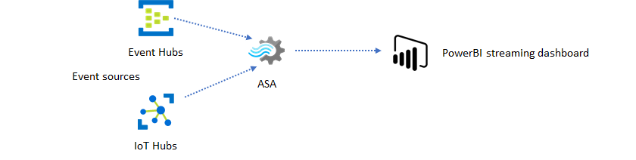
Demo Context
ASA Solution Patterns

Slide 9
Demo 2 : Creating an ASA project
Create the project in Visual Studio Code
CTRL-SHIFT-P (Command Pallet) : ASA New Project
Git Add/Commit/Push
Add a local input and a simple query
Run it (add a .gitignore file)
dotnet new, func new…
SELECT
SystemProperties.connectionDeviceId,
SystemProperties.connectionModuleId,
System.Timestamp as enqueuedTime,
COUNT(*) AS messageCount
INTO
[YourOutputAlias]
FROM
masks TIMESTAMP BY SystemProperties.enqueuedTime
GROUP BY
TumblingWindow(minute,1),
SystemProperties.connectionDeviceId,
SystemProperties.connectionModuleId

Slide 10
Demo Context
Unit Testing
Unit tests are typically automated tests written and run by software developers to ensure that a section of an application (known as the "unit") meets its design and behaves as intended
Azure Stream Analytics (ASA)
Unit tests in the context of ASA
Here the unit is an individual output of an ASA job / query
Unit tests should not rely on external services, so all are executed locally on sample data (here in VSCode)
Tooling
Up until last month : asa.unittest (PowerShellGallery)
Since last month : azure-streamanalytics-cicd (npm)

Slide 11
Demo 3 – Unit Testing ASA
Add a test folder to the solution : Project.Tests
Create a test manifest
Create a test output and complete the manifest
Run the test (edit the gitignore file), check that it fails
$projectPath = "C:\users\fleide\repos\$repoName\ASATest1\asaproj.json"
$testPath = "C:\users\fleide\repos\$repoName\ASATest1.Tests\testConfig.json"
azure-streamanalytics-cicd addtestcase `
-project $projectPath `
-testConfigPath $testPath
$testOutputPath = "C:\users\fleide\$repoName\ASATest1.Tests\testRuns\" + (Get-Date -Format "yyyyMMddHHmmss")
azure-streamanalytics-cicd test `
-project $projectPath `
-testConfigPath $testPath `
-outputPath $testOutputPath

Slide 12
All done!
Conclusions
Demo is done, the code is available on GitHub
Most operations are scripted, easy to reproduce at another time
I felt the pain of the customer doing it, leading to shared empathy
Takeaways
Try not to use the Azure portal ever for anything that could be re-used later
Learn PowerShell : Learn Windows PowerShell in a Month of Lunches, Third Edition
Read the Unicorn project (or Phoenix project)
Next steps
If you indulge me, follow-up session(s) on deploying in Azure, and building the CI pipeline in Azure DevOps

