Slide 1
Faster Inner Dev Loop For Stream Processing
Florian Eiden, product manager, Azure Stream Analytics
2022-04
linkedin.com/in/fleid
@fleid_bi
Notes:
Why : streaming is hard, real compete is batch, we should make our developers happy, so they come back, it starts with the inner dev loop

Slide 2
The inner development loop should be fast
Build
Test
Code
CI/CD
pipeline
git push
Notes:
Single developer workflow

Slide 3
3 factors that make things slow
Distributed infrastructure (cloud or not)
Integration : strong coupling to sources and sinks
Extensive metadata definition
Notes:
I’ll present how we address each with Azure Stream Analytics

Slide 4
Workarounds
Distributed infrastructure > local development
Pros : fastest experience, cheapest
Cons : runtime desynch between local and cloud, not appropriate at scale, networking concerns
Integration : strong coupling to sources and sinks
Extensive metadata definition
Notes:
Why : running a query means packaging, uploading and deploying it on a cluster, sometimes spinning up the cluster as well

Slide 5
Workarounds
Distributed infrastructure
Integration > mocking sources with files
Pros : fastest, cheapest, no setup
Cons : only an emulation, beware when switching back to live
Extensive metadata definition
Notes:
Why : same for all of data engineering, a query in itself means nothing, it needs data to make sense. That’s a lot of scaffolding we can remove by using local files instead
We can’t use arrival time only : TIMESTAMP BY

Slide 6
Workarounds
Distributed infrastructure
Integration
Extensive metadata definition
> no DDL (schema) requirement
> opinionated default settings
Pros : fastest time to query result, easy to explore the content of a stream
Cons : easy to rely on implicit conversions that will bite in production

Slide 7
Azure Stream Analytics – local experience
VS Code + Azure Stream Analytics Tools extension
> Local runs on mock input files
SELECT
*
FROM myInput
myInput
(Mock)
(myInputSample.json)
local output
(json file)
Notes:
With that setup, we have the shortest run time with ASA, as I’ll demo shortly
>> The only thing missing to get the inner loop is testing

Slide 8
Azure Stream Analytics – unit testing
azure-streamanalytics-cicd npm companion package
SELECT
*
FROM myInput
myInput
(Mock)
(myInputSample.json)
local output
(json file)
testConfig
(myInputTestDataset.json)
(myExpectedOutput.json)
azure-streamanalytics-cicd test
test results
(json file)
Notes:
>> Now we’re ready for the demo

Slide 9
Demo

Slide 10

Thank you
web | azure.com/sa
email | askasa@microsoft.com
Twitter | @AzureStreaming
GitHub | azure/azure-stream-analytics
Stack Overflow | azure-stream-analytics

Slide 11
Azure Stream Analytics – job artifacts
SQL query
SELECT INTO and CTEs (DML only)
Input configs
Connection details
Source info
Optimization knobs
Output configs
Connection details
Sink info
Optimization knobs
Job properties
Scale, region, time policies, compatibility mode …
Notes:
Source info : object name, serialization, not the schema
>> Thinking about the inner loop, let’s focus on what’s strictly necessary to issue a query

Slide 12
Azure Stream Analytics – hello world (live service)
SELECT
*
FROM myInput
myInput
Connection string
Serialization format
Notes:
Thanks to :
Default settings
no DDL required (dynamic schema handling / row-by-row typing)
Query level timestamp definition
>> We can even reduce those requirements by using the local dev environment

Slide 13
Azure Stream Analytics
The native stream processing service in Azure, since 2014 (azure.com/sa)
Our mission is to democratize streaming
Easy to use : PaaS, SQL, deeply integrated with other Azure services, strong record/array parsing capabilities, JavaScript UDFs, custom deserializers, built-in geospatial and anomaly detection functions…
Easy to operate : 40+ Azure regions, simple pricing, cloud and edge, logs/metrics and alerts with Azure Monitor, 99.9% availability…
SELECT
EquipementId,
AVG(Temperature) AS AvgTemperature
INTO NotificationBus
FROM FactoryFloorStream
GROUP BY EquipementId, Tumbling(minute,1)
HAVING AvgTemperature >= 75.0
I want to know when an equipment has
its average temperature per minute
rising above 75.0 degrees

Slide 14
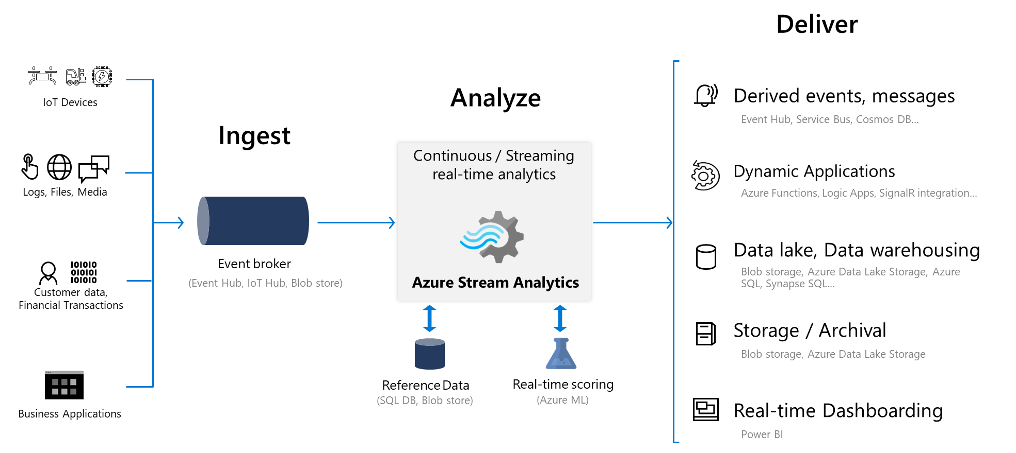
Azure Stream Analytics – components

