Slide 1
Timestamp | DeviceId | Value
9:00am | 10012A | 12
9:01am | 304B | 15
DeviceId | Latest | Sum | Count
10012A | 12 | 12 | 1
304B | 15 | 15 | 1
9:05am | 10012A | 2
9:06am | 304B | 20
DeviceId | Latest | Sum | Count
10012A | 2 | 14 | 2
304B | 20 | 35 | 2
10:37am | 10012A | 1
10:37am | 304B | 5
10:37am | 304B | 10
10:37am | 304B | 17
DeviceId | Latest | Sum | Count
10012A | 1 | 15 | 3
304B | 17 | 67 | 5

Slide 2
Input Stream in Event Hub
Timestamp | DeviceId | Value
9:00am | 10012A | 12
9:01am | 304B | 15
Final Table in Azure SQL
DeviceId | Latest | Sum | Count
10012A | 12 | 12 | 1
304B | 15 | 15 | 1
9:05am | 10012A | 2
9:06am | 304B | 20
DeviceId | Latest | Sum | Count
10012A | 2 | 14 | 2
304B | 20 | 35 | 2
10:37am | 10012A | 1
10:37am | 304B | 5
10:37am | 304B | 10
10:37am | 304B | 17
DeviceId | Latest | Sum | Count
10012A | 1 | 15 | 3
304B | 17 | 67 | 5

Slide 3
Input Stream in Event Hub
Timestamp | DeviceId | Value
9:00am | 10012A | 12
9:01am | 304B | 15
9:05am | 10012A | 2
9:06am | 304B | 20
Final Table in Azure SQL
DeviceId | Latest | Sum | Count
10012A | 2 | 14 | 2
304B | 20 | 35 | 2

Slide 4
Input Stream in Event Hub
Timestamp | DeviceId | Value
9:00am | 10012A | 12
9:01am | 304B | 15
9:05am | 10012A | 2
9:06am | 304B | 20
10:37am | 10012A | 1
10:37am | 304B | 5
10:37am | 304B | 10
10:37am | 304B | 17
Final Table in Azure SQL
DeviceId | Latest | Sum | Count
10012A | 1 | 15 | 3
304B | 32 | 67 | 5

Slide 5
Timestamp | DeviceId | Latest | Count
9:00am | 10012A | 12 | 1
9:00am | 304B | 15 | 1
9:05am | 10012A | 2 | 1
9:05am | 304B | 20 | 1
10:35am | 10012A | 1 | 1
10:35am | 304B | 32 | 3

Slide 6
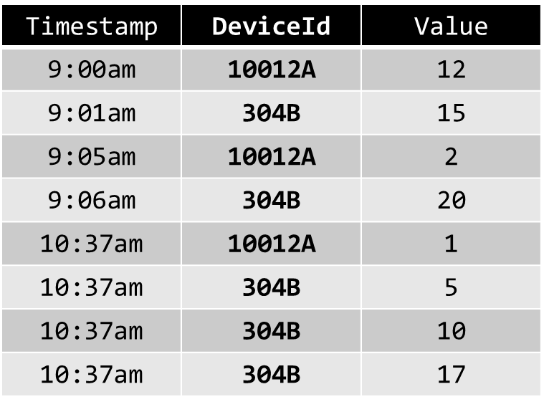
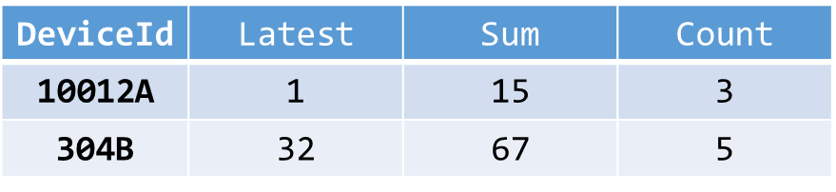
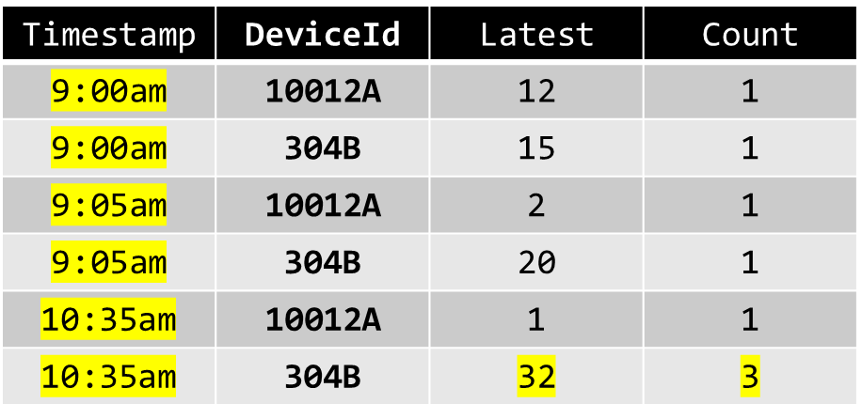
‘Materialized View’
Azure SQL
Input Stream
Event Hub
Event Processing
Stream Analytics
Full Output Table
Azure SQL

Slide 7
Event Post-Processing
Function
‘Materialized View’
Azure SQL
Event Processing
Stream Analytics
Input Stream
Event Hub
Full Output Table
Azure SQL

