Slide 2
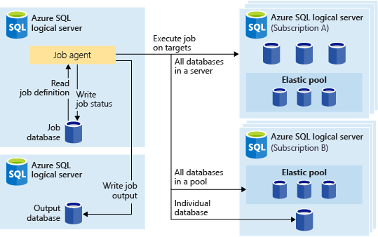



Job
database
On Trigger
Get last results
Archive results
Check for failure, notify if not already
Notifications
database
https://docs.microsoft.com/en-us/azure/azure-sql/database/job-automation-overview#elastic-database-jobs-preview
Job history : 45 days Job automation - Azure SQL Database | Microsoft Docs

