Slide 1



Slide 2











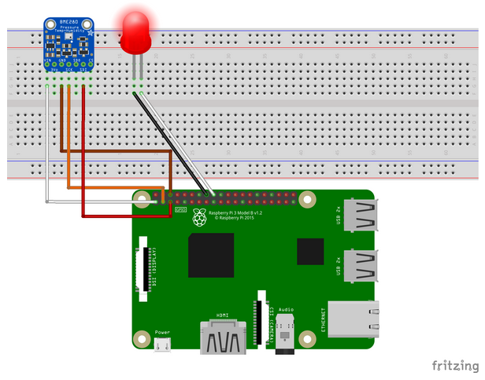
Sprint 1
Variable group
- keys / connection strings
Repo
> provisioning
> myASAproject
> Deploy
- my.JobTemplate.json
- my.JobTemplate.parameters.json
> Inputs/Outputs
- asaproj.json
- JobConfig.json
- myASAproject.asaql
Pipeline – Build
> ARM template deployment (validation)
> Publish Artifact
Every commit
on Master
Git push
Pipeline – Release
> ARM template deployment (incremental)
myASAsolution
> provisioning
- provision.azcli
- provision.ps1
- provision.JobTemplate.json
> myASAproject
> Deploy
- my.JobTemplate.json
- my.JobTemplate.parameters.json
> LocalRunOutputs (gitignored)
> Inputs/Outputs
- asaproj.json
- JobConfig.json
- myASAproject.asaql
Restart on
every release
ASA
Compile Script
ASA
Start Local Run
(Unit Tests)
Done once
rg-staging
Real output
rg-shared
Raspberry Pi
Azure IoT Simulator
(url)
Start/Stop necessary
Debug output
Cosmos DB – TTL 12h
IoT Hub - Device

Slide 3

Sprint 2 - plan
Compile in build instead
In release, prevent unnecessary restart by checking for actual changes
Variable group
- keys / connection strings
Repo
> provisioning
> myASAproject
> Inputs/Outputs
- asaproj.json
- JobConfig.json
- myASAproject.asaql
Pipeline – Build
> Compile script to ARM
> ARM template deployment (validation)
> Publish Artifact
Every commit
on Master
Git push
Pipeline – Release
> Check artifact vs target
- Continue only if different
> ARM template deployment (incremental)
myASAsolution
> provisioning
- provision.azcli
- provision.ps1
- provision.JobTemplate.json
> myASAproject
> LocalRunOutputs (gitignored)
> Inputs/Outputs
- asaproj.json
- JobConfig.json
- myASAproject.asaql
Restart on
every release
ASA
Start Local Run
(Automated Unit Tests)
Done once
rg-staging
No more local compiling (folder added to gitignore)
Unit Test results simplification (0/1 instead of set, scriptability outside of VSCode: asa.exe input output ok/ko)
Real output
rg-shared
Raspberry Pi
Azure IoT Simulator
(url)
Start/Stop necessary
Debug output
Cosmos DB – TTL 12h
IoT Hub - Device
K/V secrets storage – or better managed accounts?

Slide 4
Variable groups
Connection strings from KeyVault
Local variables
Repo
> deploy
- asa-yaml-ci.yml
- build.ps1
- release.ps1
> myASAproject
> Inputs
> Outputs
- asaproj.json
- JobConfig.json
- myASAproject.asaql
> provision
Pipeline – Release
> Execute release.ps1
> Get secrets from KeyVault
> ARM parameters fill-in
> ARM template execution
On commit
on Master
Pipeline – Build
(definition in asa-yaml-ci.yml)
> Execute build.ps1
> ARM template generation
> ARM parameters fill-in
> ARM template validation
> Publish ARM template + release script
Git
Commit/Push
Not automated
rg-staging
Real output
myASAsolution
> deploy
- asa-yaml-ci.yml
- build.ps1
- release.ps1
> myASAproject
> Deploy (gitignored)
> LocalRunOutputs (gitignored)
> Inputs
> Outputs
- asaproj.json
- JobConfig.json
- myASAproject.asaql
> provision
- provision.azcli
- provision.ps1
- provision.JobTemplate.json
rg-shared
ASA
Start Local Run
(Unit Tests)
Debug output
Cosmos DB – TTL 12h
IoT Hub - Device
rg-infra
KeyVault

Slide 5
Pipeline – Build
rg-infra
On commit
on Master
KeyVault
Central Repository
Pipeline – Release
Credentials
Successful
Build
ARM Template Deployment
Git
Commit/Push
rg-staging
Real output
Local Repository
rg-shared
Debug output
Cosmos DB – TTL 12h
IoT Hub - Device

Slide 6
Pipeline – Build
(definition in .yml file)
Step 1 : Generate ARM template files
Step 2 : Validate ARM template files
Step 3 : Publish files for release
Pipeline – Build
(definition in asa-build.yml file)
> Somehow run build.ps1
> ARM template generation
> ARM parameters fill-in
> ARM template validation
> Move ARM template + release script to staging folder
On commit
on Master
On commit
on Master
Central Repository
+ .yml file
Central Repository
> deploy
- asa-build.yml
- build.ps1
> myASAproject
> …
YAML definition
YAML definition
Git
Commit/Push
Git
Commit/Push
Local Repository
Local Repository

Slide 7
Pipeline – Build
(definition in asa-build.yml file)
> Execute build.ps1
> ARM template generation
> ARM parameters fill-in
> ARM template validation
> Move ARM template + release script to staging folder
> Publish build artifacts
On commit
on Master
Central Repository
> deploy
- asa-build.yml
- build.ps1
> myASAproject
> …
YAML definition
Git
Commit/Push
Local Repository

Slide 8
Variable Group “Target”
> vg-Location
> vg-OutputStartMode
> vg-ResourceGroup
> vg-ASAJobName
Pipeline – Build
rg-infra
Variable Group “KV”
> kv-Credential01
> kv- Credential02
Credentials
On Success
Build Artifacts
KeyVault
Pipeline – Release
ARM Template Deployment

Slide 9
myASAsolution
> myASAproject)
.> Inputs
- myEventHub.json
- Local_myEventHub.json
.> Outputs
- myBlobStore.json
- asaproj.json
- JobConfig.json
- myASAproject.asaql
- myASAproject.asaproj
> unittest
.> 1_arrange
-001~Input~myEventHub~Nominal.json
-001~Output~myBlobStore~Nominal.json
-002~Input~myEventHub~MissingFields.json
-002~Output~myBlobStore~MissingFields.json
.> 2_act
-unittest_install.ps1
-unittest_run.ps1
.> 3_assert
..> 20200115120000
...> 001
...> 002
..> 20200115130000
...> 001
...> 002

Slide 10
ASA Project
Inputs folder
Input A configuration file
Local input A configuration file
(Local input A data file)
project.asaproj (to be added for VSCode projects)
Test Results
project.asaql
SELECT * INTO B FROM A
Test Script
ForEach test case from test cases
Arrange the test : modify local input config files to use test input data files instead
Run the test and save output to test result subfolder
Check output result vs expected output
Report errors
Test Run Result
Test Case #001
Test Cases
Test Case #002
Test Case #001
Test Run Result
Test input data file
Test Case #001
Expected output data file
Test Case #002
Test Case #002
Test Run Result
Test input data file
Test Case #001
Expected output data file
Test Case #002

Slide 11
ASA Project
Inputs folder
Input A configuration file
Local input A configuration file
(Local input A data file)
\2_Act\unittest_run.ps1
TotalErrorCounter = 0
Read test cases from \1_Arrange\ metadata
ForEach test case from test cases
CaseErrorCounter = 0
ForEach test input data file
- Backup the existing local input configuration file
- Modify that config file to point to the test file
Run sa.exe and save output to test result subfolder
ForEach expected output file
- Run jsondiffpatch between the test output and the expected file
and Save the diff output in the test result subfolder
- Update CaseErrorCounter and TotalErrorCounter
ForEach test input data file
Restore the local input configuration file
Output CaseErrorCounter
Output TotalErrorCounter
\3_Assert
project.asaproj (to be added for VSCode projects)
\YYYYMMDDHHMMSS
project.asaql
SELECT * INTO B FROM A
\001\
ASA run output files
Diff file
\002\
ASA run output files
Diff file
\YYYYMMDDHHMMSS
\1_Arrange\
\001\
ASA run output files
Diff file
001-Input-A.{csv/json/…} : Content for local input A
001-Output-B.json : Content expected in output for B
\002\
ASA run output files
Diff file
002-Input-A.{csv/json/…} : Content for local input A
002-Output-B.json : Content expected in output for B

