Slide 2
@Adam Paternostro, are you saying you want multiple adf_publish branches per ADF, or for different ADFs? We anyway drop ARM templates for different ADFs in different folders.
Also you can configure adf_publish to be different for different factories. Here is the documentation for the same https://docs.microsoft.com/en-us/azure/data-factory/source-control#configure-publishing-settings
Using single factory or multiple, that actually depends on your teams. Usually one repo – one factory is best, but ADF is also designed to support one folder per factory where as multiple factories are can be in same repo.
Multiple teams working on the a code base is general practice (as long as code is related), which I am assuming in customer’s case is true.
I will again start with comparing regular software with ADF
Regular software development
Multiple teams land their changes after testing in master
Still there could be some bad changes landed in master, release process catches it by means of testing.
Once bug is detected, developer prepares hotfix for the current release and fix the changes, it can be removing changes or making more changes.
Sometime build is too bad or fix already checked in master, then new release process starts from master.
From hotfix branch a build is created, and release process starts again.
For ADF development
Multiple teams land their changes after testing in master. Means of testing [Debug pipeline, export arm template to deploy to individuals own instance]
if user needs to test something end 2 end which can’t be tested by Debug pipelines then developer can “export arm template”, deploy to his own ADF. Similar to a private build being tested on user’s machine or web app. In case of ADF application is ADF itself.
Still there could be some bad changes which are caught during release process by testing.
Once bug is detected, developer prepares hotfix for current release and fix the changes, by changing by ADF resource (add/remove).
Sometime build is too bad or fix already checked in master, then new release process starts from master.
From hotfix branch an ARM template (equivalent to build) is created by clicking “Export ARM template”, and then release process start again.
In every software development testing phase is before/after checkin in to master
In ADF you can test before using Debug pipeline or by exporting ARM template and deploying to different factories.
ADF is not a git tool, git tools are like Visual Studio, VS Code, Git Bash, users need to use these tools to do cherry picking and create hot fix branches etc.
To stop frequent hot fixing, testing needs to be done before pushing to master.
@Florian Eiden in case of triggers need to be tested, developer needs to export ARM template and deploy in his own factory. Yes this requires developers to setup their own factory (or some other shared factory), which is true for other kind of software development as well. Like in case of web app development developers deploy their web app to test their changes. Then they push to master, then integration testing.
Alternative
https://github.com/AdamPaternostro/Azure-Data-Factory-CI-CD-Source-Control
Individual instances
(triggers, identity)
Team instances
1 Factory per Developer
+
ARM Templates
1 Factory for the team
+
ARM Templates
Deploy all or nothing
1 Factory per Developer
+
JSON Deployments
1 Factory for the team
+
JSON Deployments
Selective deployments
Thanks Christian. This 3rd party devops extension gave the flexibility to move only the changed artifacts across environments and build releases accordingly.
https://github.com/liprec/vsts-publish-adf
I have been working with a customer using this to automate their process.
DEV data factory will be synced to GIT and collab_brach is set to DEV_MASTER. All the developers merge their changes to DEV_MASTER.
Based on the latest commit to this branch a release pipeline is triggered and only the recent changed files are fetched and used for moving them to other environment.
Pipeline steps usually would be update json values to reflect stage environment naming convention, stop triggers, deploy updated datasets or pipelines, enable triggers.
Once testing is successful they create a pull request to merge the changes to PROD_MASTER.
Same pipeline will be used to pull recent changes from PROD_MASTER and push the changes to prod ADF.
This approach was flexible for the customer and gave control as they can move only the changed json files and not the entire arm templates.
Always 1 single Git repository

Slide 3
https://oshamrai.wordpress.com/2020/01/31/create-the-delta-package-with-azure-devops-pipeline-and-git/
$a = git diff adf_release_shared master --name-status
foreach ($d in $a) {$dd = $d.Split("`t"); write-host "NL $($dd[1]) was $($dd[0])"}
https://stackoverflow.com/questions/52280056/only-download-changes-to-git-repo-in-vsts-release-pipeline
Command above, or shallow depth = branching discipline
Dans tous les cas
1 process pour create/update
1 process pour delete (compare a prod)

Slide 4
Repo : Project 1
Team : Alpha
Auth : Shared
Dev : Debug only (triggers on collab)
Dev
Feature A
Pull
Requests
Feature B
New
branches
Web UI
Publish
QA
Prod
collaboration
t
CI/CD
adf_publish
master
Merge on successful
deployment

Slide 5
Repo : Project 1
Team : Alpha
Auth : Shared
Dev : Triggered runs in dev
Dev
Release
Feature A
Pick the right sub folder in the release task
Pull
Requests
Feature B
New
branches
Web UI
Publish
Web UI
Publish
QA
Prod
collaboration
t
CI/CD
adf_publish\dev
adf_publish\release
master
Merge on successful
deployment
Dev
Release
Feature A
collab_release
Pick the right sub folder in the release task
Feature B
Pull
Requests
Web UI
Publish
With one or 2 collaboration branches
QA
Prod
New
branches
collab_dev
t
Web UI
Publish
adf_publish\dev
adf_publish\release
CI/CD
master
Merge on successful deployment

Slide 6
Repo : Project 2
Team : Gamma
Auth : Managed identity per dev
Dev : Triggered runs in dev
Dev A
Dev B
Dev C
Feature A1
Feature B1
Feature C1
Pull
Requests
Pull
Requests
Pull
Requests
Feature A2
Feature B2
Feature C2
Web UI
Publish
Web UI
Publish
Web UI
Publish
collab_A
collab_B
collab_C
t
t
t
adf_publish\devA
adf_publish\devB
adf_publish\devC
Release
Pull
Requests
Pick the right sub folder in the release task
collab_release
master
Web UI
Publish
Merge on successful deployment
QA
Prod
adf_publish\release
CI/CD

Slide 7



Dev
QA
Prod
Self-Hosted
IR
same name
same name
adf_publish
CI/CD
Release task updates ARM parameters:
Factory Name
Infra
Self-Hosted IR Dev/QA
Shared to match Dev/QA setup
Dev
QA
Prod
Linked IR
adf_publish
CI/CD
Release task updates ARM parameters:
Factory Name
Linked SHIR LinkedId (QA>Prod only here)

Slide 8

Dev
QA
Prod
same name
same name
Key Vault Dev
Key Vault QA
Key Vault Prod
adf_publish
CI/CD
Release task updates ARM parameters:
Factory Name
Key Vault baseUrl

Slide 9
Self-Hosted IR VM Dev
Self-Hosted IR VMs
Dev A
Linked IR
Infra
Self-Hosted IR Dev
Self-Hosted IR
One or multiple factory instances depending on environment policies
Code versioning in another repository
Dev B
Release
QA
Prod
adf_publish\release
CI/CD
Release task gets artifacts from adf_publish\release
Release task updates ARM parameters:
Factory Name
Linked SHIR LinkedId

Slide 10
Self-Hosted IR VM Dev
Self-Hosted IR VMs
Dev A
Features
Linked IR
Infra
Feature 1
Create/reset
as needed
Pull Requests
collab_A
Self-Hosted IR Dev
Self-Hosted IR
Web UI
Publish
One or multiple factory instances depending on environment policies
Code versioning in another repository
t
adf_publish\devA
Dev B
Release
QA
Prod
Features
Feature 2
Pull
Requests
Pull Requests
collab_release
Web UI
Publish
collab_B
adf_publish\release
CI/CD
Web UI
Publish
t
adf_publish\devB
master
Release task gets artifacts from adf_publish\release
Release task updates ARM parameters:
Factory Name
KeyVault Base URL
Linked SHIR LinkedId
Merge on successful deployments
same secret names
same secret names
Key Vault Dev
Key Vault QA
Key Vault Prod

Slide 11
Self-Hosted IR VM Dev
Self-Hosted IR VMs
Dev A
Features
Linked IR
Infra
Feature 1
Create/reset
as needed
Pull Requests
collab_A
Self-Hosted IR Dev
Self-Hosted IR
Web UI
Publish
One or multiple factory instances depending on environment policies
Code versioning in another repository
t
adf_publish\devA
Dev B
Release
QA
Prod
Features
Feature 2
Pull
Requests
Pull Requests
collab_release
Web UI
Publish
collab_B
adf_publish\release
CI/CD
Web UI
Publish
t
adf_publish\devB
master
Release task gets artifacts from adf_publish\release
Release task updates ARM parameters:
Factory Name
KeyVault Base URL
Linked SHIR LinkedId
Merge on successful deployments
same secret names
same secret names
Key Vault Dev
Key Vault QA
Key Vault Prod

Slide 12


Managed Identity Factory A
Key Vault A
URL : https://a.vault.azure.net
MySecret : Credentials A
Emulating Integrated Security + Windows Authentication
Each developer has its own set of credentials for the same data source
Factory A
myParameter = “https://a.vault.azure.net”
Single Azure DevOps Repository
Unique Database
Linked Service
Credentials A
Unique Key Vault
Linked Service
baseURL = myParameter
Credentials B
Self Hosted
Integration Runtime
myParameter = “https://b.vault.azure.net”
Factory B
Key Vault B
URL : https://b.vault.azure.net
MySecret : Credentials B
Managed Identity Factory B

Slide 13
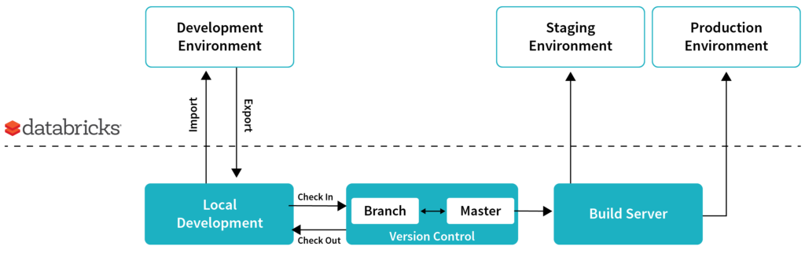
To review
https://databricks.com/blog/2017/10/30/continuous-integration-continuous-delivery-databricks.html
https://databricks.com/blog/2016/04/06/continuous-integration-and-delivery-of-apache-spark-applications-at-metacog.html
Open points:
Authentication story
Identities
Credential management (KeyVault)
Deploying notebooks vs JAR
Dev Workspace
QA Workspace
Prod Workspace
Notebook Git integration is supported but not very scalable
Azure DevOps
Deploy Tasks
Test results
Azure DevOps
Deploy Tasks
Workspace CLI
CI/CD
Features
PR
release
Feature 1
Feature 1
Local Git integration
Create/reset
master
Merge on successful deployments
Dev Workstations
Azure DevOps

