Slide 2
Build / Release pipeline
Code Repo
Project assets
Local Development Environment
Project files
Provisioning scripts
GIT integration
IDE + local run / testing
Shared assets

Slide 3
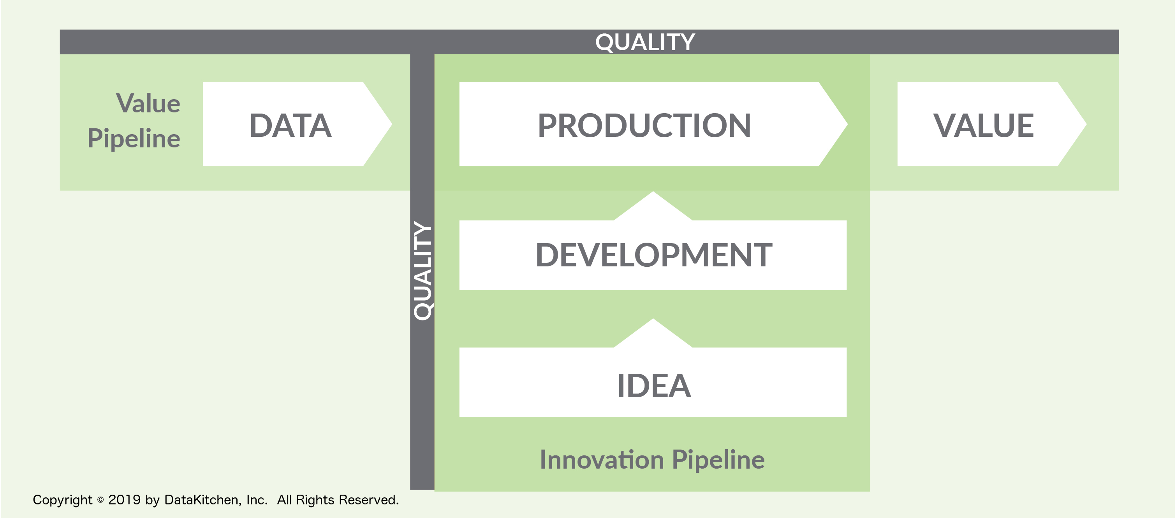
Data Pipeline
Shared assets
Project assets
Input
ASA Job
Output
Build / Release pipeline
Build triggered
Code Repo
Local Development Environment
Project files
Provisioning script
IDE + local run / testing
Git Push
Development
Pipeline

