Slide 2



streaming
relational
topic
table
atomic
artifact
fully-featured system
Kafka
database

Slide 3
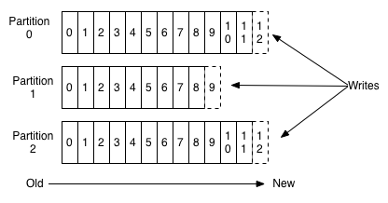
Consumers read at different
offsets on each partition
Ex: Consumer A and Consumer B

Slide 4
consumerLag(consumer,partition) = lastEnqueuedSequence(partition) – currentSequence(consumer,partition)
consumerLag(A,P0) = lastEnqueuedSequence(P0) – currentSequence(A,P0) = 11 – 9 = 3
consumerLag(A,P1) = lastEnqueuedSequence(P1) – currentSequence(A,P1) = 8 – 8 = 0
consumerLag(A,P2) = lastEnqueuedSequence(P2) – currentSequence(A,P2) = 11 – 10 = 1
From here it’s up to us to decide if/how to aggregate that metric

Slide 5

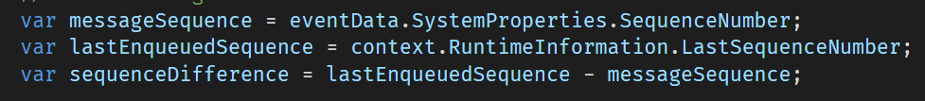
Event Hub
Partitioned Event Data
Event Processor Host
Consumer
Offset
Storage
Registration
Partition
Context
Event Data
Options
SimpleEventProcessor:IEventProcessor
> ProcessEventsAsync

