Slide 1


Devices
Company A
raw
Decoder
csv
parquet
sFTP
server
Big Data
Platform
Devices
Company B
Not the job
The job
Not the job

Slide 2
Azure File Store
(A)
Azure
File
Store
(B)
Azure
Blob
Store
Copy activities
parquet
VNet
3
Windows VM
sFTP activity
raw
sFTP
server
Decoder
csv
File
Deletion
1
Big Data
Platform
Operated
via File Store A
2
Logic
App
Windows
VM
4
HTTP
Endpoint
Self-Hosted
ADFv2 IR
Web
Activity
Operated
via File Store B
Registered
Data Factory
Auto IR
0
Data Factory
Trigger

Slide 3
Azure Storage Account > Files
Azure Storage Account > Blobs
Hierarchy of dynamic subfolders
Files need to be deleted once ingested
File storage and not blob : needs to be mounted on a VM in a VNet
Staging folder before ingestion into Big Data store
Blob storage and not files : easier to access
Move files with
conversion csv2parquet
<File Share>
Company
Year
Month
Device ID
xyz.csv
<Container>
Year_Month_Company_DeviceID_xyz.parquet
Root
Company
Year
Month
Device ID
xyz.csv
Root
Year_Month_Company_DeviceID_xyz.parquet
Move files with
conversion csv2parquet

Slide 4
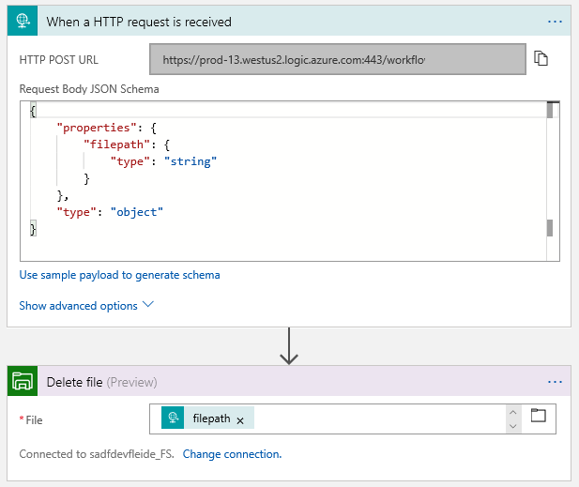

Slide 5
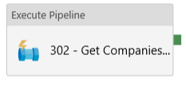
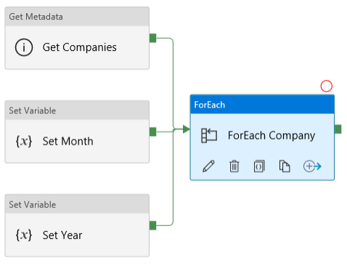
Linked Service – File Storage B
Datasets
FS_Companies: Point to a folder of Companies – Binary Copy
FS_IDs : Point to a folder of IDs – Binary Copy – Parameters : Company, Year, Month
Dir Path: @concat(dataset().Company,'/',dataset().Year,'/',dataset().Month)
FS_Files: Point to a folder of Files – Binary Copy – Parameters : Company, Year, Month, ID
Dir Path: @concat(dataset().Company,'/',dataset().Year,'/',dataset().Month,'/',dataset().ID)
FS_File: Point to a single file – Parameters : Company, Year, Month, ID, FileName
Dir Path: @concat(dataset().Company,'/',dataset().Year,'/',dataset().Month,'/',dataset().ID)
File Path: @dataset().FileName
Schema : column names from file, data types generated manually (explicit conversion is mapped from source, doc)
Key stored (user/password), no MSI yet but Key Vault available
IR needs to be Auto for the Parquet conversion
301 – Master Pipeline
Parameters
LogicAppEndPoint : Endpoint of the Logic app used for deletion on the File store
Activities
302 – Get Companies and IDs
Parameters
LogicAppEndPoint : Endpoint of the Logic app used for deletion on the File store
Variables
PipeYear – set to current Year via Set Year (@formatDateTime(adddays(utcnow(),-1),'MM'))
PipeMonth – set to via Set Year (@formatDateTime(utcnow(),'yyyy'))
Activities
Get Companies : From FS_Companies, select Child Items
Linked Service – Blob Storage
Datasets
Blob_File: Point to a single file – Parameters : Company, Year, Month, ID, FileName
File Path: @concat(dataset().Year,dataset().Month,'_',dataset().Company,'_',dataset().ID,'_',dataset().FileName)
Schema: cleaned column names (no space, just alphanum), data types – generated manually
MSI available (doc)
Substring available in file path expression to process data in the file name if necessary

Slide 6
Calculate year / month
For each company
Get the list of companies
Get the list of devices
For each device
Get the list of files
For each file
Move that file!

Slide 7
