Slide 2











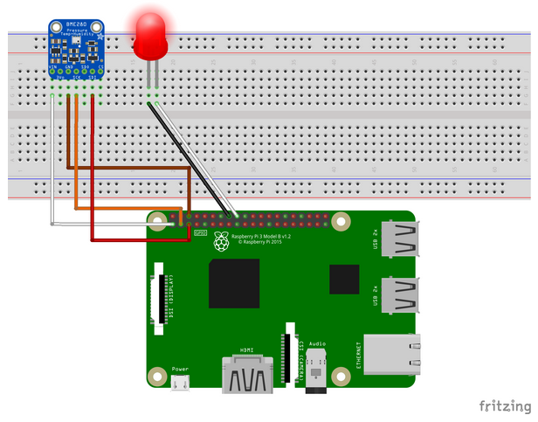
Variable group
- keys / connection strings
Repo
> provisioning
> myASAproject
> Deploy
- my.JobTemplate.json
- my.JobTemplate.parameters.json
> Inputs/Outputs
- asaproj.json
- JobConfig.json
- myASAproject.asaql
Pipeline – Build
> ARM template deployment (validation)
> Publish Artifact
Every commit
on Master
Git push
Pipeline – Release
> ARM template deployment (incremental)
myASAsolution
> provisioning
- provision.azcli
- provision.ps1
- provision.JobTemplate.json
> myASAproject
> Deploy
- my.JobTemplate.json
- my.JobTemplate.parameters.json
> LocalRunOutputs (gitignored)
> Inputs/Outputs
- asaproj.json
- JobConfig.json
- myASAproject.asaql
Restart on
every release
ASA
Compile Script
ASA
Start Local Run
(Unit Tests)
Done once
rg-staging
Real output
rg-shared
Raspberry Pi
Azure IoT Simulator
(url)
Start/Stop necessary
Debug output
Cosmos DB – TTL 12h
IoT Hub - Device

Slide 3

Sprint 2 - plan
Compile in build instead
In release, prevent unnecessary restart by checking for actual changes
Variable group
- keys / connection strings
Repo
> provisioning
> myASAproject
> Inputs/Outputs
- asaproj.json
- JobConfig.json
- myASAproject.asaql
Pipeline – Build
> Compile script to ARM
> ARM template deployment (validation)
> Publish Artifact
Every commit
on Master
Git push
Pipeline – Release
> Check artifact vs target
- Continue only if different
> ARM template deployment (incremental)
myASAsolution
> provisioning
- provision.azcli
- provision.ps1
- provision.JobTemplate.json
> myASAproject
> LocalRunOutputs (gitignored)
> Inputs/Outputs
- asaproj.json
- JobConfig.json
- myASAproject.asaql
Restart on
every release
ASA
Start Local Run
(Automated Unit Tests)
Done once
rg-staging
No more local compiling (folder added to gitignore)
Unit Test results simplification (0/1 instead of set, scriptability outside of VSCode: asa.exe input output ok/ko)
Real output
rg-shared
Raspberry Pi
Azure IoT Simulator
(url)
Start/Stop necessary
Debug output
Cosmos DB – TTL 12h
IoT Hub - Device
K/V secrets storage – or better managed accounts?

Slide 4
Build / Release pipeline
Code Repo
Project assets
Local Development Environment
Project files
Provisioning scripts
GIT integration
IDE + local run / testing
Shared assets

Slide 5
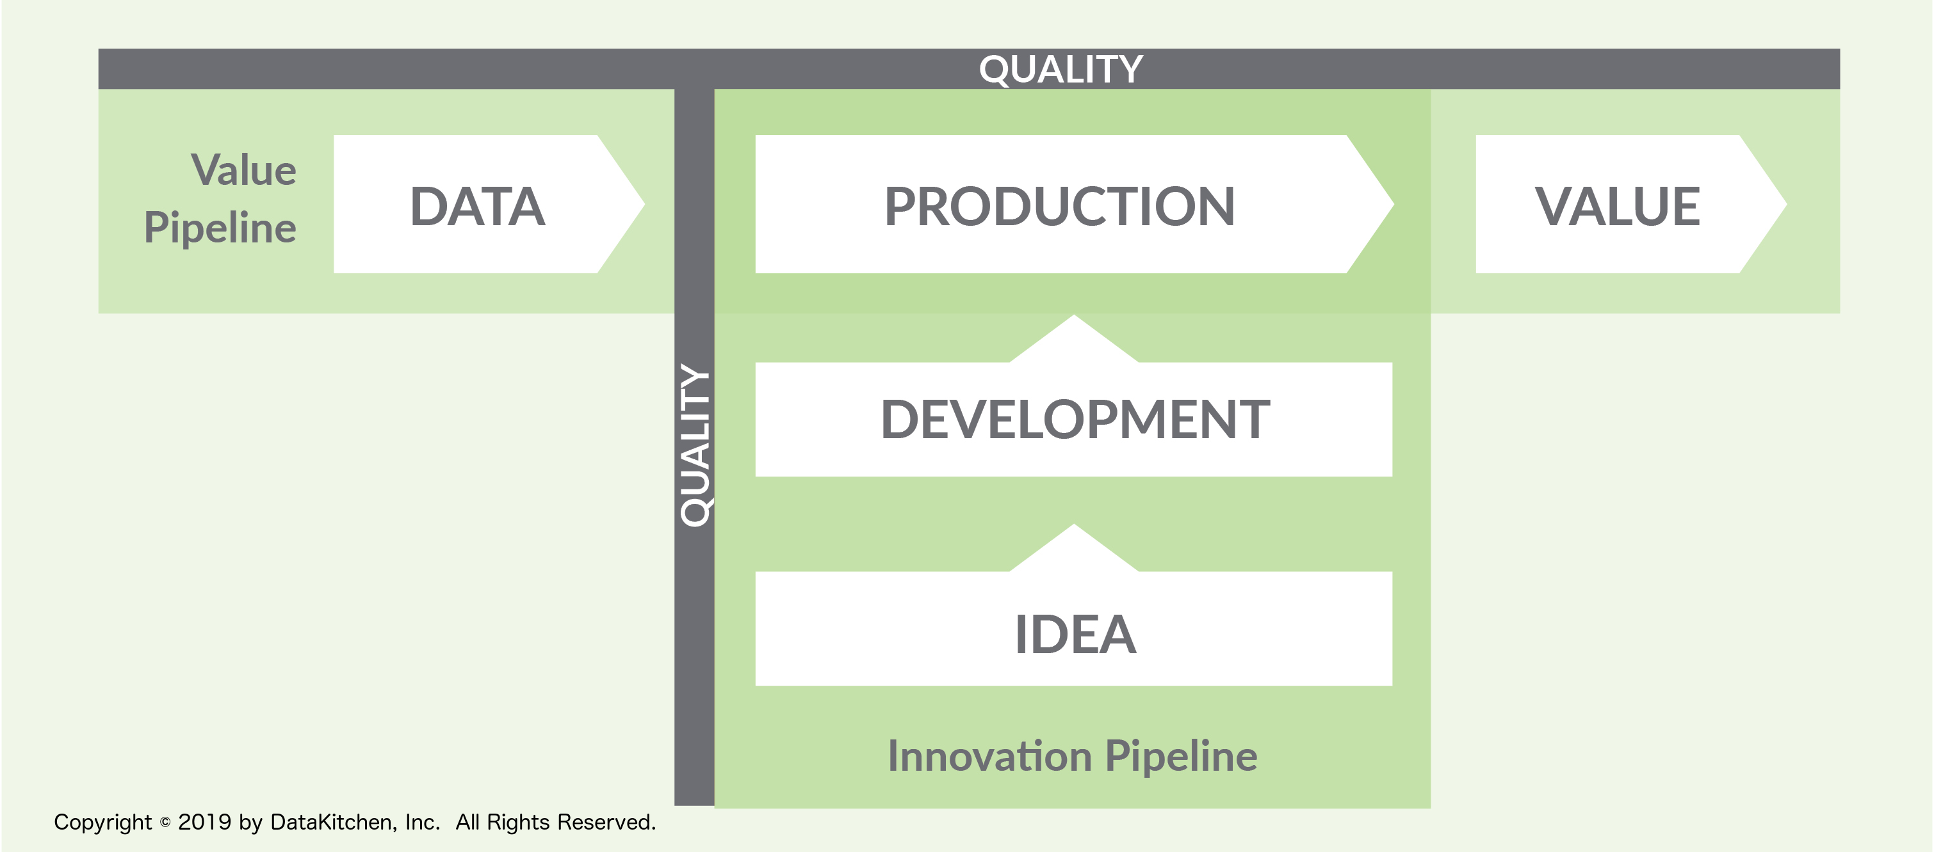
Data Pipeline
Shared assets
Project assets
Input
ASA Job
Output
Build / Release pipeline
Build triggered
Code Repo
Local Development Environment
Project files
Provisioning script
IDE + local run / testing
Git Push
Development
Pipeline

Slide 6
rg-staging
Storage Account
rg-shared
IoT Hub - Device
Raspberry Pi
Azure IoT Simulator
Start/Stop necessary

Slide 7
Azure DevOps
Variable group
- keys / connection strings
Pipeline – Release
> ARM template deployment (incremental)
Pipeline – Build
> ARM template deployment (validation)
> Publish Artifact
On commit on Master
Restart on
every release
Repo
> provisioning
> myASAproject
> Deploy
- my.JobTemplate.json
- my.JobTemplate.parameters.json
> Inputs/Outputs
- asaproj.json
- JobConfig.json
- myASAproject.asaql
rg-staging
Not automated
Real output
Git Commit/Push
myASAsolution
> provisioning
- provision.azcli
- provision.ps1
- provision.JobTemplate.json
> myASAproject
> Deploy
- my.JobTemplate.json
- my.JobTemplate.parameters.json
> LocalRunOutputs (gitignored)
> Inputs/Outputs
- asaproj.json
- JobConfig.json
- myASAproject.asaql
rg-shared
Debug output
Cosmos DB – TTL 12h
IoT Hub - Device
Raspberry Pi
Azure IoT Simulator
Start/Stop necessary
ASA
Compile Script
ASA
Start Local Run
(Unit Tests)

Slide 8
Azure DevOps
Azure DevOps
Repo
> myASAproject
> Deploy
- my.JobTemplate.json
- my.JobTemplate.parameters.json
> Inputs/Outputs
- asaproj.json
- JobConfig.json
- myASAproject.asaql
Repo
> myASAproject
> Deploy
- my.JobTemplate.json
- my.JobTemplate.parameters.json
> Inputs/Outputs
- asaproj.json
- JobConfig.json
- myASAproject.asaql
Git Commit/Push
Git Commit/Push
myASAsolution
> myASAproject
> Deploy
- my.JobTemplate.json
- my.JobTemplate.parameters.json
> Inputs/Outputs
- asaproj.json
- JobConfig.json
- myASAproject.asaql
myASAsolution
> myASAproject
> Deploy
- my.JobTemplate.json
- my.JobTemplate.parameters.json
> LocalRunOutputs (gitignored)
> Inputs/Outputs
- asaproj.json
- JobConfig.json
- myASAproject.asaql
ASA
Compile Script
ASA
Compile Script
ASA
Start Local Run

Slide 9
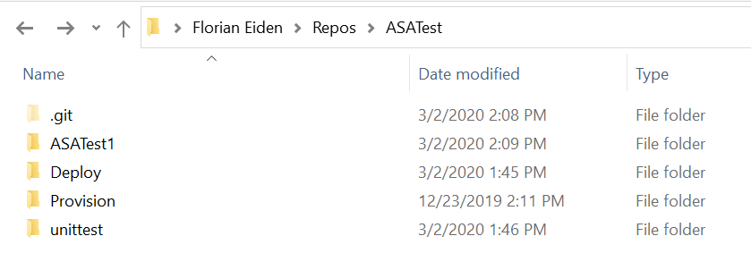
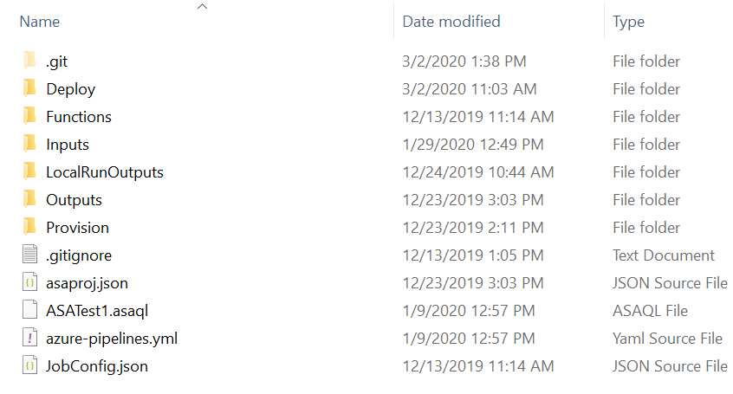
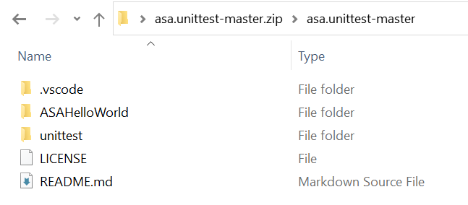

Slide 10
