Slide 1
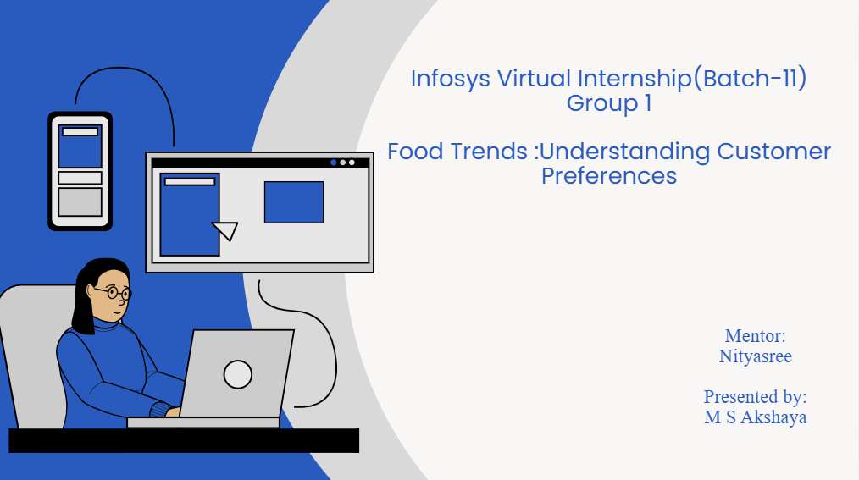
Infosys Virtual Internship(Batch-11)
Food Trends :Understanding Customer Preferences
Mentor:
Nityasree
Presented by:
M S Akshaya

Slide 2


OBJECTIVE
•To analyze food ordering data to identify key food trends and customer preferences.
•To understand customer behavior based on cuisine type, pricing, ratings, and location.
•To evaluate ordering and spending patterns across different customer segments.
•To support data-driven business decisions using interactive Power BI dashboards.
Project Description
•This project focuses on analyzing food ordering data to understand customer preferences and food consumption trends.
•The dataset is cleaned, transformed, and modeled using Power BI to ensure data accuracy and consistency.
•Interactive dashboards are developed to analyze business performance, customer demographics, restaurant performance, and food trends.
Dataset:
Source: Kaggle
Wardiere.inc

Slide 3
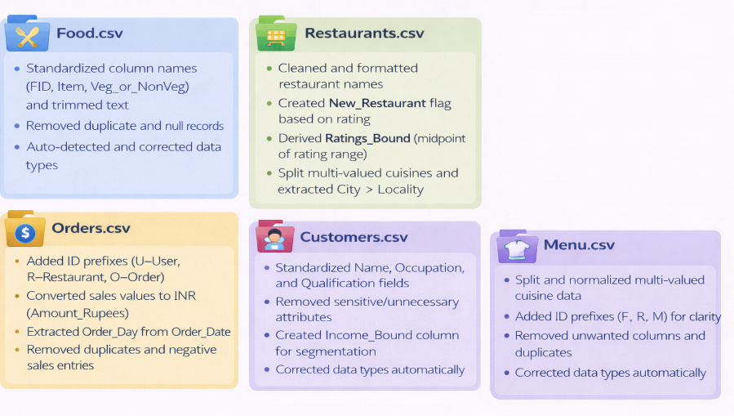
Milestone-1

Slide 4
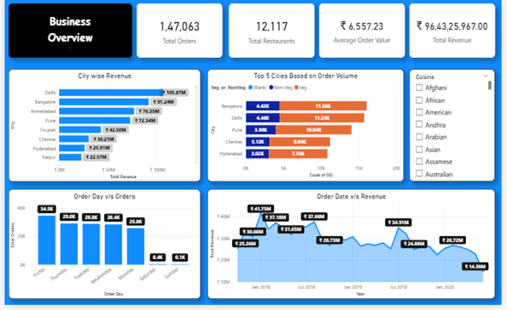
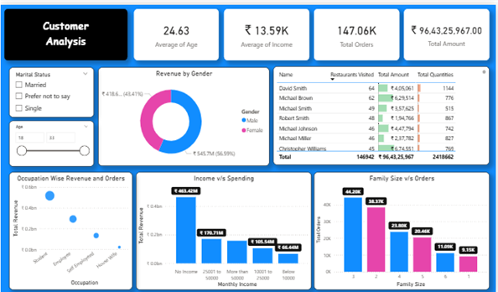
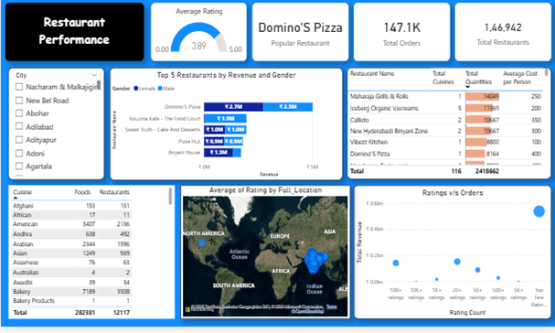
Milestone-2
BUSINESS OVERVIEW
•Revenue is highly concentrated in top cities, indicating that a few urban markets drive the majority of total sales..
•Orders are highest on weekdays, suggesting stable and recurring demand rather than weekend-only ordering behavior
CUSTOMER ANALYSIS
•Customers with no income levels contribute the highest revenue, indicating strong purchasing power and frequent ordering.
•Family size of 2–3 members places the most orders, making small families the most active customer segment.
•Revenue contribution is relatively balanced across genders, showing no strong gender bias in food ordering behavior.
RESTAURANT PERFORMANCES
•A small number of restaurants generate a disproportionately high share of revenue, highlighting key partner restaurants.
•Higher ratings do not always result in higher order volume, indicating that affordability and availability influence customer choices.
•Popular cuisines consistently receive more orders across cities, making cuisine type a major driver of restaurant performance.

Slide 5
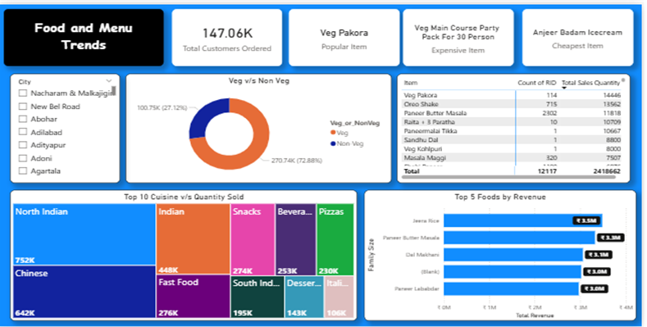
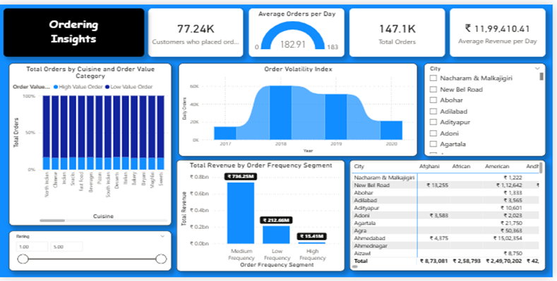
Milestone-3
Food and Menu Trends
•Veg food shows higher customer preference and revenue contribution than Non-Veg, indicating stronger demand for non-vegetarian menu options across cities.
•North Indian and Chinese cuisines dominate both quantity sold and revenue, making them core drivers of customer choice and repeat orders.
•A limited number of food items generate a large share of total revenue, suggesting that customers consistently prefer a few popular dishes over a wide variety.
Ordering Insights
•Medium-frequency customers contribute the highest share of revenue, indicating that regular but not excessive ordering customers are the most valuable segment.
Order volatility varies over time, highlighting seasonal demand patterns that can be used for targeted promotions and capacity planning.

Slide 6
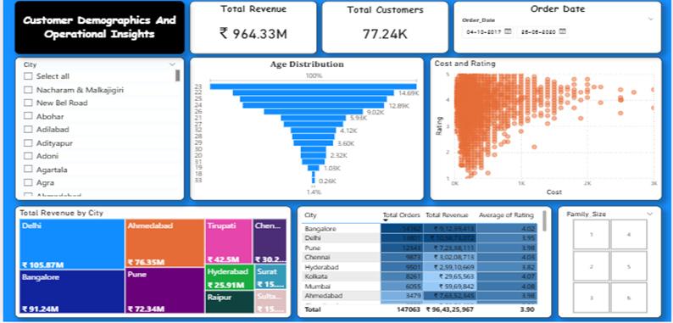
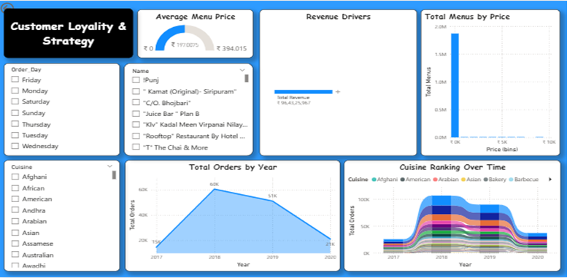
Milestone-4
Customer Demographics
•Revenue is driven mainly by metro cities, with Delhi and Bangalore leading.
•Majority of customers fall in the 20–30 age group, indicating a young customer base.
•Higher costs generally receive better ratings, showing value perception matters.
•Orders are mostly from small family sizes, highlighting individual and couple dining.
Customer Loyality & Strategy
•Most customers prefer moderately priced menus, as shown by the high concentration of orders in the mid-price range, indicating strong price sensitivity.
•Repeat orders peak during specific days and time periods, suggesting predictable customer habits that can be leveraged for loyalty offers and targeted promotions.

Slide 7

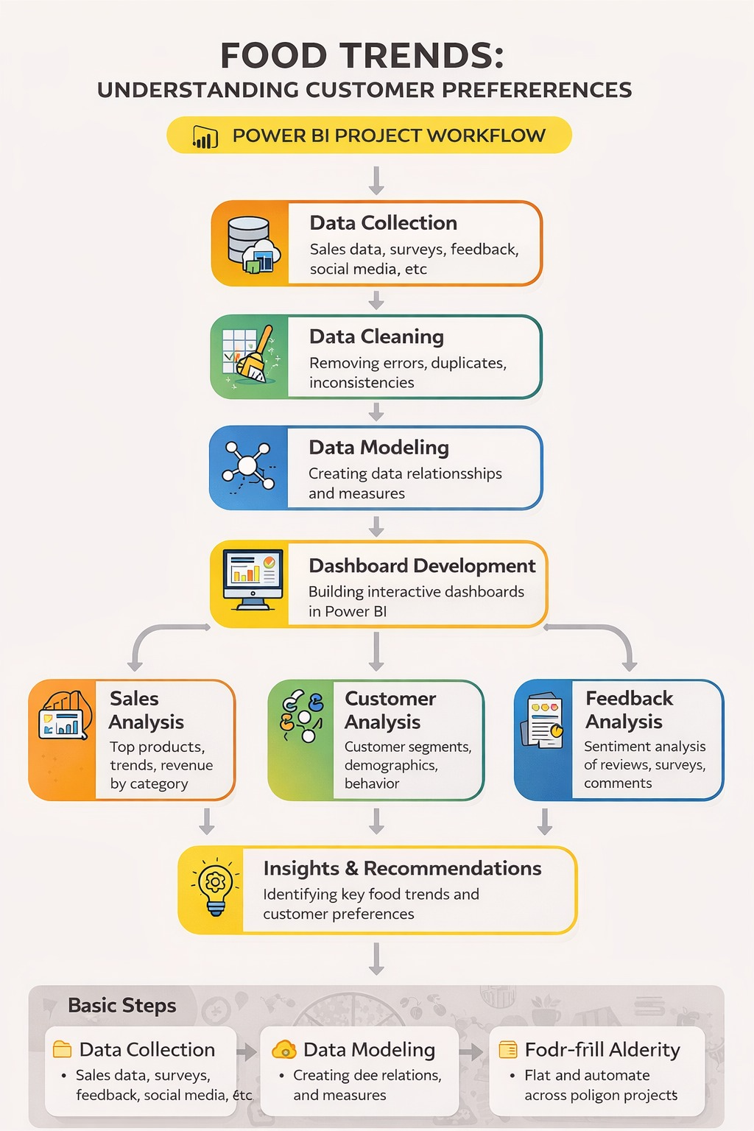
WORKFLOW
WORKFLOW

Slide 8

•Understanding customer preference from large and mixed data
Resolution: Data was organized by cuisine, food type, price range, and customer details to clearly analyze preference patterns.
•Identifying meaningful food trends instead of just showing charts
Resolution: Focused on Veg vs Non-Veg preference, popular cuisines, order frequency, and pricing behavior to align with the problem statement.
•Comparing customer behavior across cities and customer groups
Resolution: Used city-wise, demographic-wise, and cuisine-wise analysis to highlight differences in customer choices.
Challenges Faced & Resolutions

Slide 9

•Veg cuisine drives the majority of customer orders, showing clear preference and making Veg items a key focus area for menu expansion and pricing strategies.
•North Indian and Chinese cuisines lead in quantity sold and revenue, indicating these cuisines should be prioritized for promotions and new launches.
•Medium-priced menus and medium-frequency customers generate the highest revenue, proving that value-for-money offerings outperform premium pricing.
Key Insights & Feature enhancements
•Implemented interactive slicers (city, cuisine, date, rating) for dynamic and focused analysis.
•Added KPI cards to provide quick visibility into business performance metrics.
Designed trend and comparison visuals (time-based, category-based) to support strategic decision-making

Slide 10

•This project focuses on understanding food trends and customer preferences using food ordering data. The data was cleaned and analyzed to convert raw information into useful insights.
Power BI dashboards were created to visually represent customer behavior and ordering patterns.
Conclusion

Slide 11


Wardiere.inc
Acknowledgement and reference
Acknowledgement
We would like to express our heartfelt gratitude to: Infosys Springboard Team– for organizing this valuable internship opportunity. Our Mentor– for her continuous support and feedback. My Teammates – for collaboration, encouragement, and insights This internship has been a significant step in our professional growth and technical journey.
Reference
•Kaggle – Food Ordering / Food Trends Dataset
•Microsoft Power BI – Official Documentation
•Infosys Springboard Virtual Internship course materials

Slide 12

Thank
You!

