Slide 1
Food Trend Understanding
Customer Preferences
Infosys Springboard Data Visualization Domain Internship Batch – 11(Group 1)
Mentor: Ms. Nityasree
Team Members:
Vasanthi Kakkera
Flemin P Daniel
M S Akshaya

Slide 2
Objectives & Project Description
Objective: To design an interactive multi-page PowerBI dashboard that provides actionable insights into restaurant performance, customer behaviour, and ordering trends.
Description: This project analyses a vast dataset of food orders to help stakeholders identify high-performing cities, popular cuisines, and customer spending patterns. The dashboard is divided into specialised views: Business Overview, Customer Analysis, Restaurant Performance, and Menu Trends.

Slide 3
Dataset Overview
Source: Kaggle (Public Food Industry Dataset).
Volume: 1.47 Lakh Total Orders across 12,117 Restaurants.
Revenue Analysed: Approximately ₹96.43 Crores.
Key Parameters:
Order IDs,
Restaurant ratings
Cuisine types
User demographics (Age/Gender)
Geographic data

Slide 4
Project Execution Milestones
Milestone 1: Data Infrastructure: Data cleaning, ETL processes, and schema transformation (Data Transformation pages).
Milestone 2: Core Metrics: Development of the "Business Snapshot," "Customer Analysis," and "Restaurant Performance" views.
Milestone 3: Product Analysis: Deep dive into menu items, pricing, and category performance.
Milestone 4: Strategic Insights: Operational insights, demographics, and customer loyalty modelling.

Slide 5
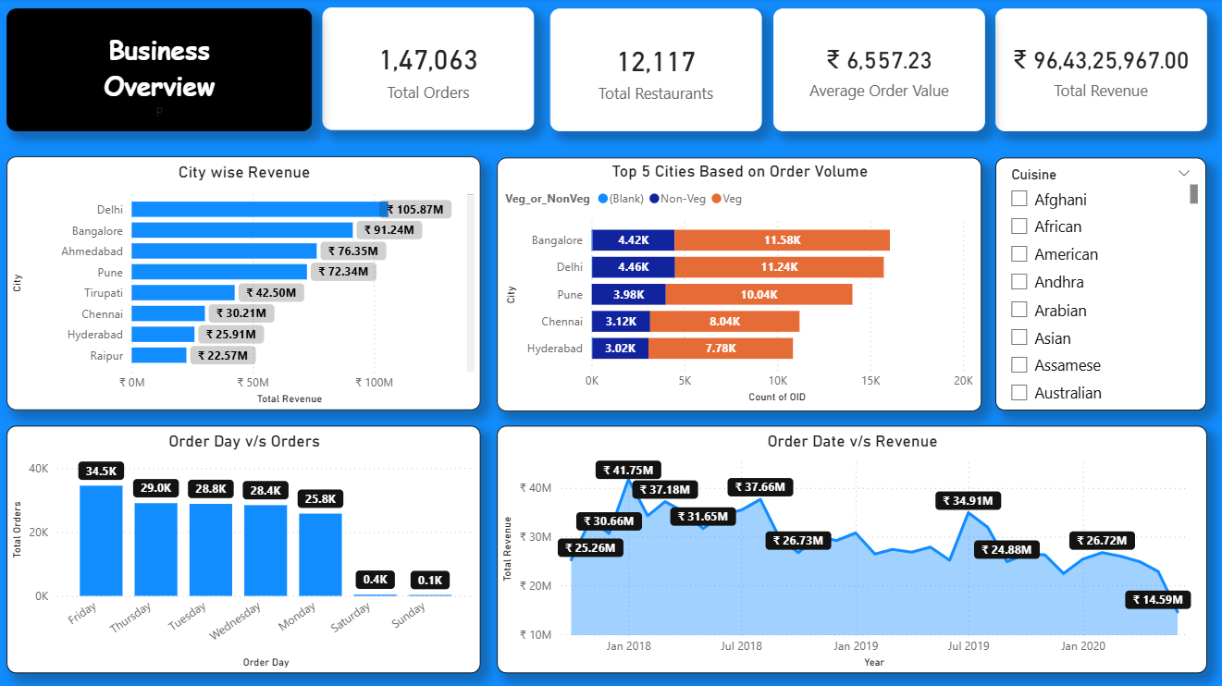
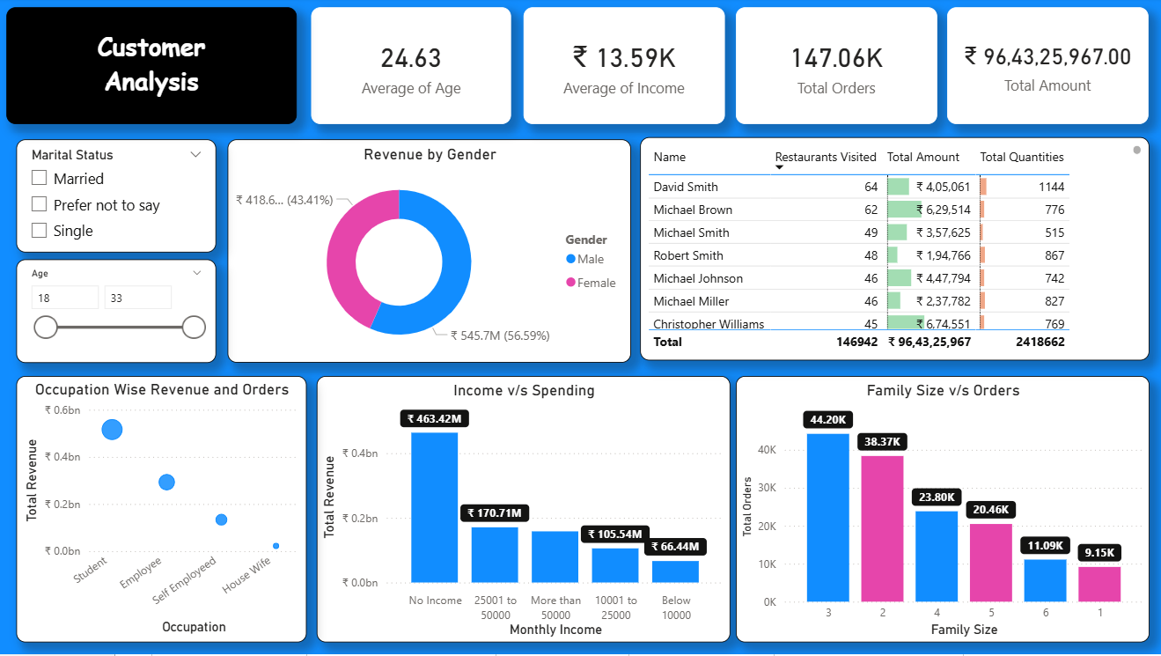
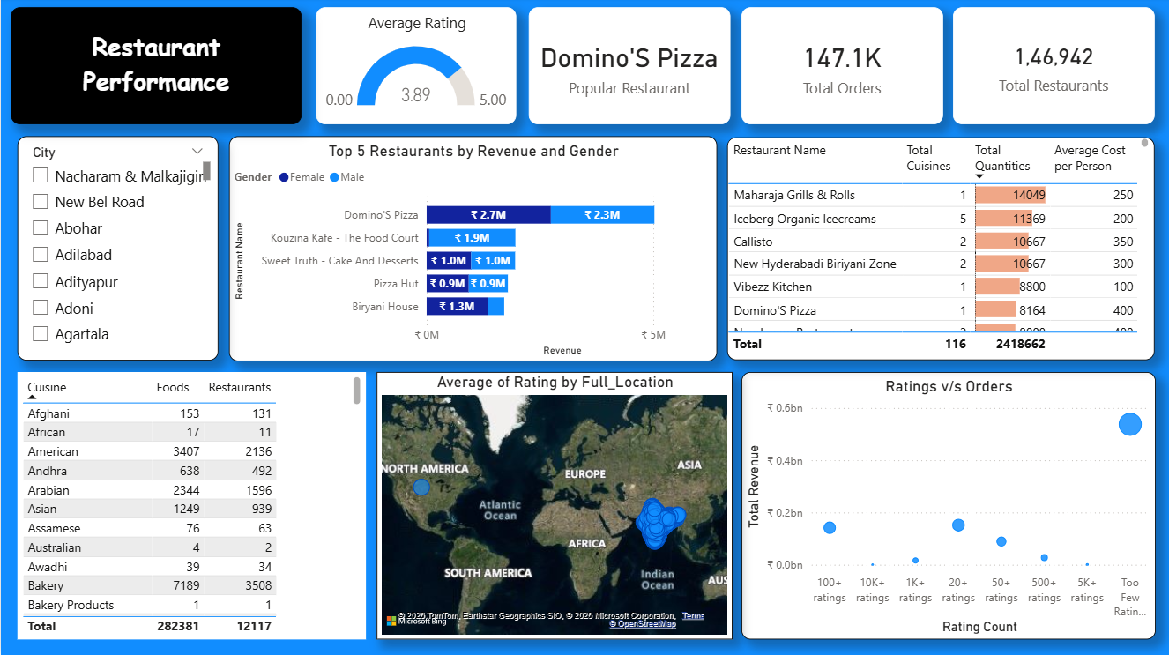
Dashboard Snapshots

Slide 6
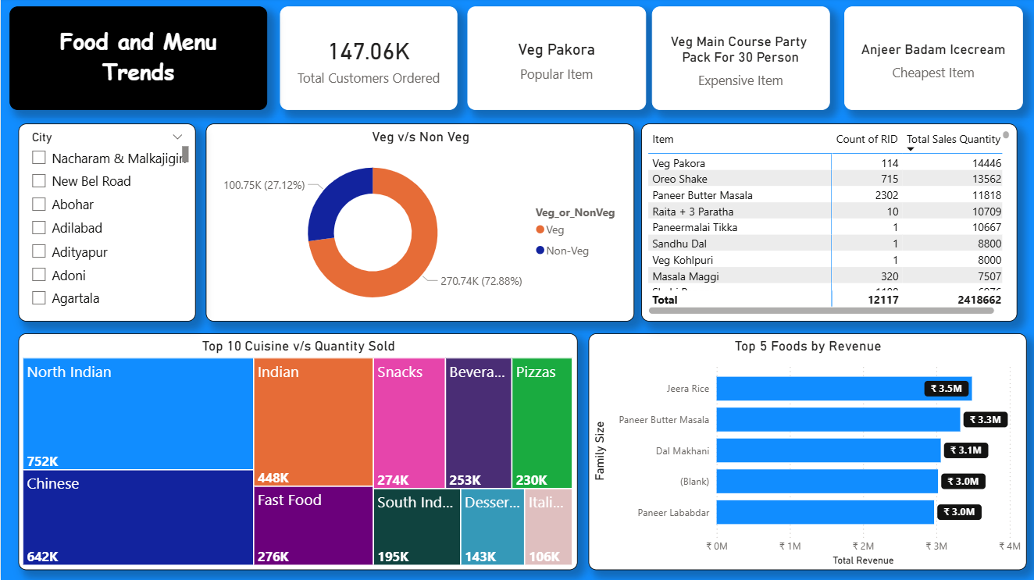
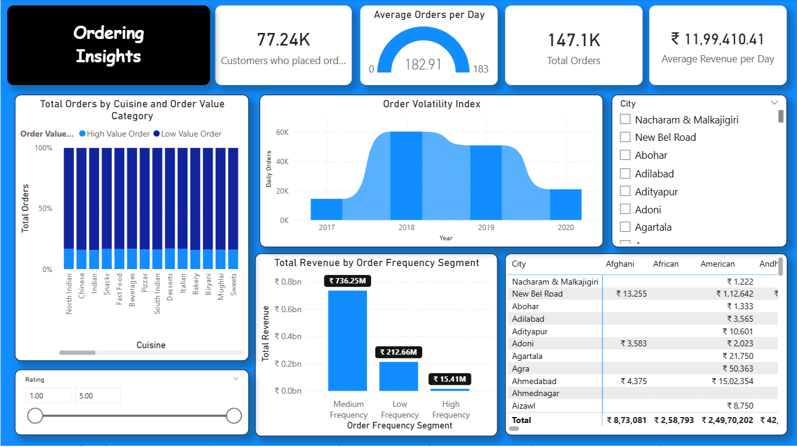
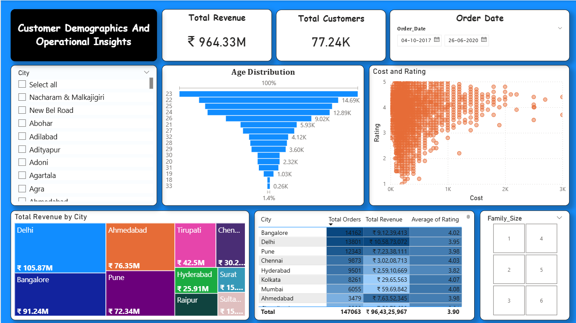
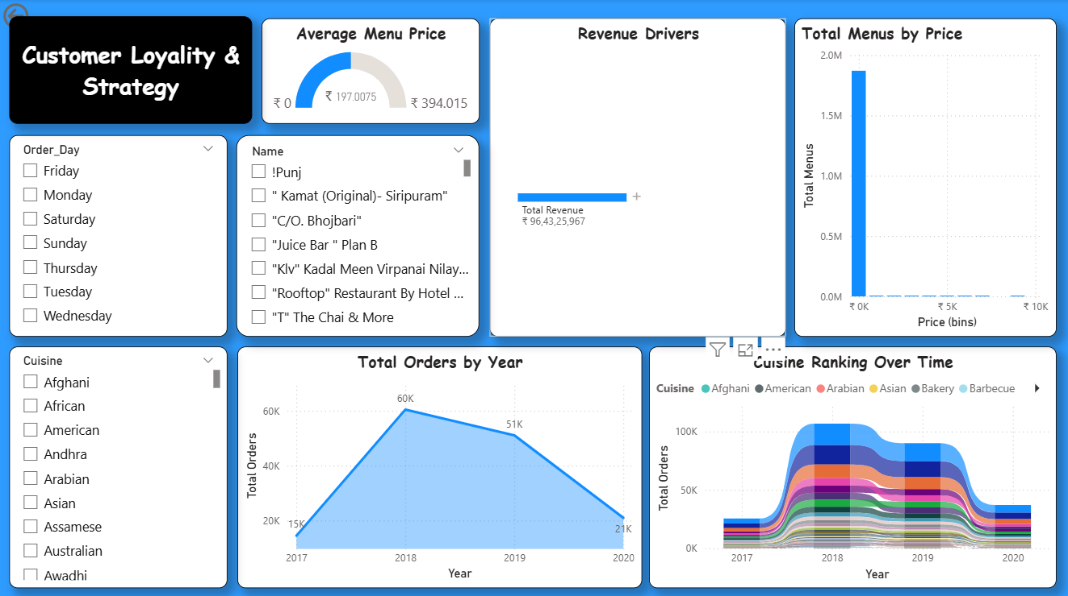

Slide 7
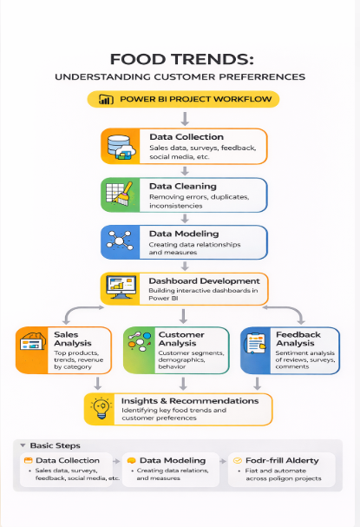
Project Workflow – Food Trends Analysis

Slide 8
Challenges Faced & Resolutions
Challenge 1: Data Inconsistency
Resolution: Used Power Query to handle null values in the "Veg/Non-Veg" fields and normalized currency formats.
Challenge 2: Visual Complexity.
Resolution: Implemented Slicers (City, Cuisine, Marital Status) and Drill-throughs to keep the UI clean while allowing deep-dive analysis.
Challenge 3: Volatile Order Data.
Resolution: Created an "Order Volatility Index" to visualize seasonal fluctuations and peak periods.

Slide 9
Key Insights:
Top Revenue Driver: Delhi and Bangalore lead the market, with Delhi contributing over ₹105M.
Customer Persona: The average customer is ~24 years old with a family size of 3, showing that Gen Z and young millennials are the primary market.
Peak Activity: Friday is the highest-grossing day (34.5K orders), while Sunday surprisingly shows lower volume in this specific dataset.
Menu "Hero" Items: While North Indian and Chinese are the leading cuisines, specific high-frequency items like Veg Pakora drive consistent volume, highlighting a preference for affordable, "snackable" comfort food.
Growth Trajectory: Data from 2018–2020 shows a transition from rapid expansion to market stabilization, suggesting that future revenue growth will likely come from increasing order frequency among existing loyal users.

Slide 10
Feature Enhancements
Product Trends: "Veg Pakora" emerged as the most popular item, while "North Indian" and "Chinese" are the dominant cuisines by volume.
Feature Enhancements: Advanced DAX: Used to calculate "Average Revenue per Day" and "Order Volatility.“
Interactive Mapping: Integrated a global map to track restaurant density and ratings.
Loyalty Prediction: Added a "Cuisine Ranking Over Time" chart to track shifting consumer tastes.

Slide 11
Conclusion
The dashboard successfully identifies that revenue is heavily concentrated in Tier 1 cities.
Businesses should focus marketing efforts on the 18-30 age demographic and optimize supply chains for high-volume weekends.
The transition from 2018 to 2020 shows a stabilizing trend in order frequency, suggesting a maturing market.
The analysis demonstrates that customer purchasing behavior is strongly influenced by pricing value and cuisine preferences, highlighting the importance of maintaining a balanced menu that meets both affordability and quality .

Slide 12
Acknowledgments & References
We would like to express our heartfelt gratitude to:
Infosys Springboard Team– for organizing this valuable internship opportunity.
Our Mentor– for her continuous support and feedback.
My Teammates – for collaboration, encouragement, and insights
This internship has been a significant step in our professional growth and technical journey.
References:
Kaggle Zomato Dataset
Microsoft Power BI Documentation
Infosys Springboard Virtual Internship course materials

Slide 13
Thank you

