Slide 1
I2C exercise: Arduino_slave and Arduino_master Helper slides

Slide 2
Arduino_slave: What is the task?
This Arduino code allows Arduino to receive messages over I²C (a communication protocol) and print the received messages to the Serial Monitor.
Specifically, the Arduino acts as a slave device with an address of 9. When data is sent to this address, the code reads the data, stores it in a buffer (a temporary storage space), and displays it on the Serial Monitor.
Write you code following the steps and ask volunteers for help!

Slide 3
Step 1: Include the Required Library
Library: You'll need the Wire library to enable I²C communication.
Write an #include statement at the very top of the code to include this library.
Why?
The Wire library allows your Arduino to send and receive data over the I²C bus.

Slide 4
Step 2: Define the Buffer Size
Buffer Size: Create a constant called BUFFER_SIZE and set it to 32.
This defines how much data (in characters) your Arduino can store when receiving messages.
Why?
This buffer will store incoming data, and 32 is a maximum reasonable size to work with, considering Arduino's memory limitations.

Slide 5
Step 3: Declare the Buffer and Index
Buffer: Create a character array called receivedText with a size of BUFFER_SIZE.
This will store the received message.
Index: Create an integer variable called textIndex and set it to 0.
This will track where the next character should be stored in the buffer.
Why?
The buffer stores the incoming data as characters. The index keeps track of where to place each character.

Slide 6


Step 4: Set Up the Arduino (Setup Function)
Write a setup function. This function runs once when the Arduino starts. (it should be there when you create a new file)
Start Serial Communication:
Inside the setup, initialize the Serial Monitor with a baud rate of 9600 using Serial.begin();.
This allows you to see messages printed to your computer.

Slide 7
Step 4: Set Up the Arduino (Setup Function)
Start I²C Communication:
Initialize the Arduino as an I²C slave device with the address 9 using Wire.begin().
Register the Receive Event:
Attach a function called receiveEvent using Wire.onReceive().
This function will automatically run whenever the Arduino receives data.
Why?
The setup function prepares the Arduino for serial communication and I²C communication.

Slide 8
Step 5: Write the Receive Event Function
Create a function called receiveEvent that:
Type: void (it doesn't return any value).
Input: An integer called bytes, which represents the number of bytes available to read.
Reset the Index:
At the beginning of the function, set textIndex to 0 to clear the buffer for new data.

Slide 9
Step 5: Write the Receive Event Function
Read Incoming Data:
Use a loop to read each byte from the I²C buffer:
As long as there are bytes available (Wire.available()), read one byte at a time and store it in a variable c of type char.
Store Data in the Buffer:
If textIndex is less than BUFFER_SIZE - 1:
Store c in the receivedText array at the position textIndex.
Increment textIndex by 1.
Loop to read each byte from the I²C buffer end here.

Slide 10
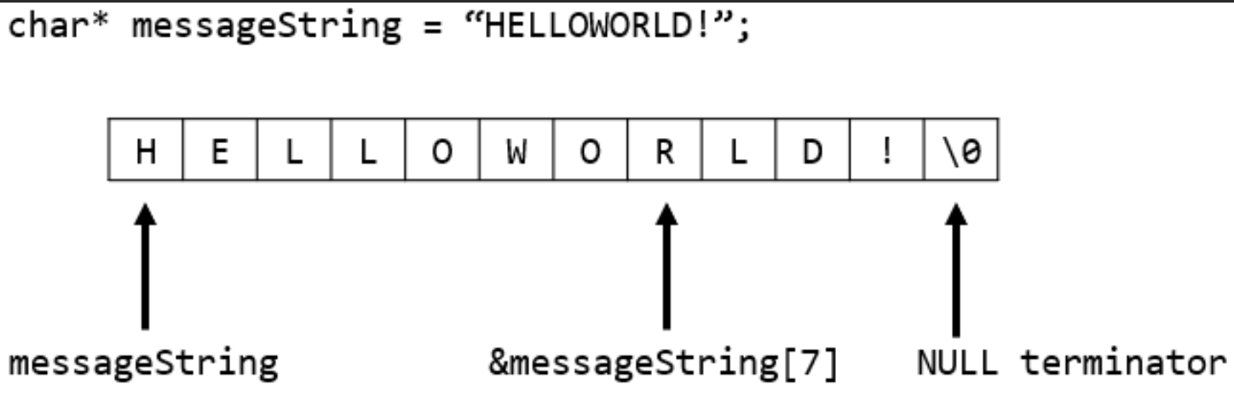
Step 5: Write the Receive Event Function
Add a Null-Terminator:
After reading all the bytes, add a \0 (null-terminator) to receivedText to mark the end of the string.
Why?
This function processes the data received over I²C and stores it as a proper string. The null-terminator is crucial to indicate the end of the text.

Slide 11
Step 6: Write the Loop Function
Create a loop function. This function runs repeatedly.(it should be there when you create a new file)
Check for New Data:
If textIndex is greater than 0 (meaning data has been received), print the message.
Print the Message:
Use Serial.println to display the message in receivedText on the Serial Monitor.

Slide 12
Step 6: Write the Loop Function
Reset the Index:
After printing, reset textIndex to 0 to prepare for the next message.
Why?
The loop function continuously checks if there's a new message to print. Resetting textIndex allows the buffer to be reused.

Slide 13
Variable Summary for Arduino_slave
Variable | Type | Purpose
BUFFER_SIZE | #define | Maximum size of the receivedText buffer (32).
receivedText | char[] | Buffer to store the incoming message.
textIndex | int | Tracks the current position in the buffer.
c | char | Stores each character read from the I²C buffer.
bytes | int | Number of bytes available to read in the receiveEvent function.

Slide 14
Arduino_master: What is the task?
This code allows an Arduino to act as an I²C master. The master device reads input from the Serial Monitor, stores it as a string, and then sends this string to an I²C slave device (like the Arduino Uno) with the address 9.
After sending the message, it prints a confirmation to the Serial Monitor.

Slide 15
Step 1: Include the Required Library
Library: You'll need the Wire library to enable I²C communication.
Write an #include statement at the very top of the code to include this library.
Why?
The Wire library allows your Arduino to send and receive data over the I²C bus.

Slide 16
Step 2: Define the Buffer Size and Input Buffer
Buffer Size: Define a constant BUFFER_SIZE with a value of 32.
Input Buffer: Declare a character array called inputText with a size of BUFFER_SIZE.
This array will store the text that the user inputs from the Serial Monitor.
Why?
The buffer allows you to temporarily store the input message before sending it over I²C.

Slide 17
Step 3: Set Up the Arduino (Setup Function)
Write a setup function. This function runs once when the Arduino starts. (it should be there when you create a new file)
Start Serial Communication:
Initialize the Serial Monitor with a baud rate of 9600 using Serial.begin();.
This allows you to send and receive text via your computer.

Slide 18
Step 3: Set Up the Arduino (Setup Function)
Initialize I²C Communication:
Call Wire.begin(); to set up the Arduino as an I²C master.
Print a Welcome Message:
Print a message prompting the user to type a message and press Enter.
Why?
The setup function prepares the Arduino for communication and informs the user how to interact with the device.

Slide 19
Step 4: Write the Loop Function
Create a loop function. This function runs repeatedly. (it should be there when you create a new file)
Check for User Input:
Use Serial.available() to check if there is any input available in the Serial Monitor. They are available if Serial.available() is greater than 0.

Slide 20
Step 4: Write the Loop Function
Read Input:
Use the Serial.readBytesUntil() function to achieve this. This function reads characters until it encounters a newline or reaches the maximum number of characters allowed.
Read characters from the Serial Monitor until a newline character (\n) is received, meaning the user pressed Enter or the buffer is full (up to BUFFER_SIZE - 1).
Store the characters in the inputText buffer.
Save the length of the input in a variable len.
len is declared as a size_t because Serial.readBytesUntil() returns the number of characters read, which is a size value.

Slide 21
Step 4: Write the Loop Function
Add a Null-Terminator:
Add a \0 (null-terminator) to the end of inputText to mark it as a valid string.
Send Data via I²C:
Use Wire.beginTransmission() to start communication with the slave device at address 9.
Send the string stored in inputText using Wire.write();.
End the I²C transmission with Wire.endTransmission();.

Slide 22
Step 4: Write the Loop Function
Print Confirmation:
Print a message to the Serial Monitor showing the text that was sent. Use Serial.println();
Prompt the user to type another message. Serial.println();
Why?
This function continuously checks for new input and sends it to the I²C slave. Adding a null-terminator ensures the string is properly formatted.
The if loop ends here.
The loop function ends here.

Slide 23
Variable Summary for Arduino_master
Variable | Type | Purpose
BUFFER_SIZE | #define | Maximum size of the inputText buffer (32).
inputText | char[] | Buffer to store the user’s input message.
len | size_t | Length of the input string read from the Serial Monitor.

