Slide 1
Open Day Robot Demo
29th June 2024
Junzhe Chen

Slide 2
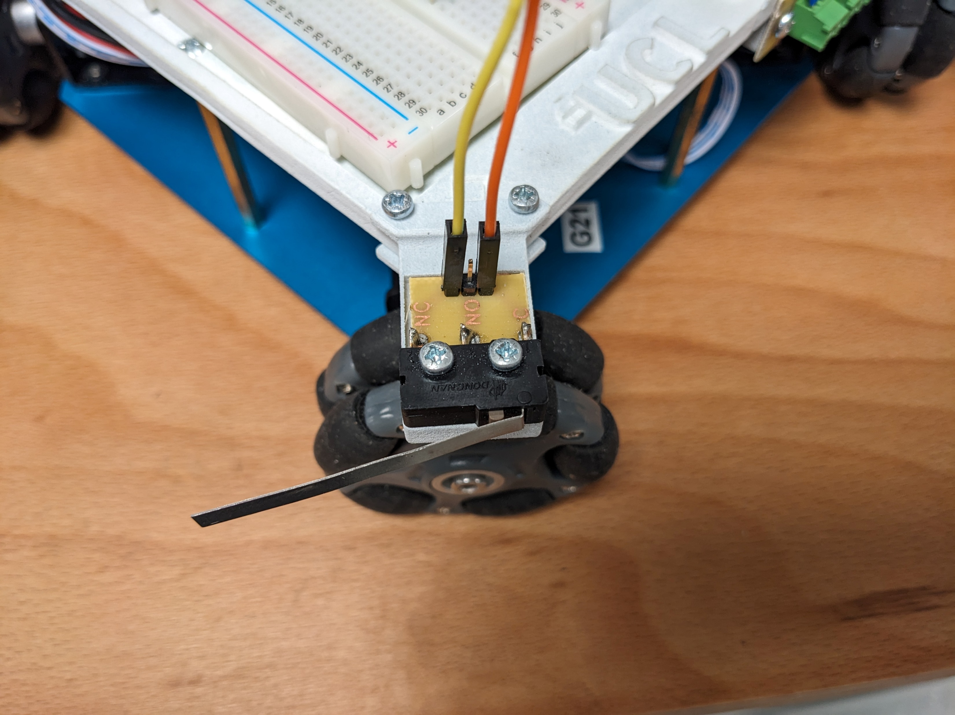
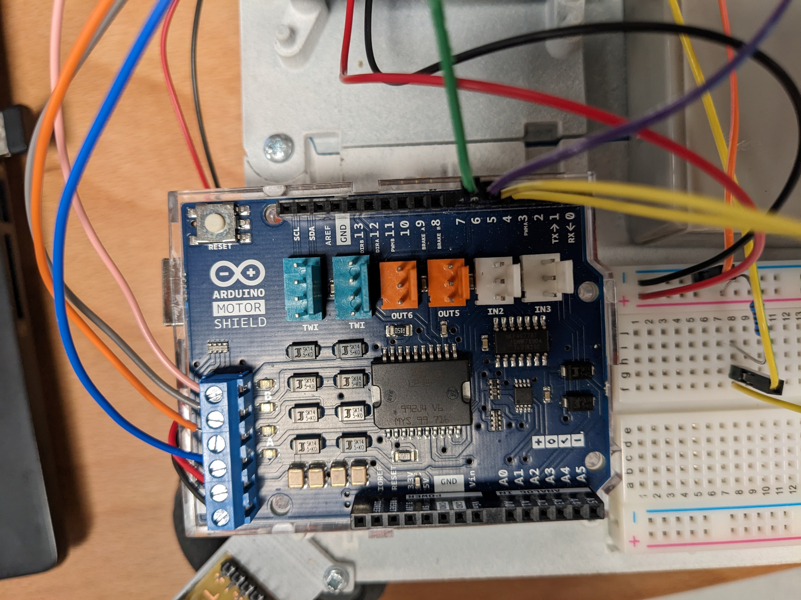
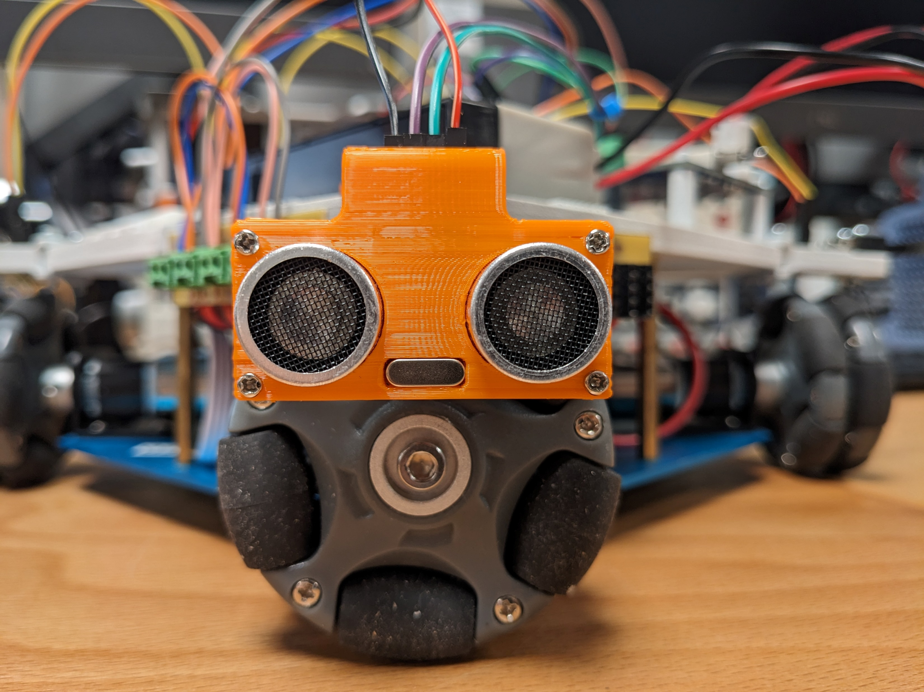
Building blocks of the robot
Wheels that controls the motion
  Forward and backward
  Left and right
  Speed adjustment by PWM
Buttons to indicate whether the robot hit the wall
Ultrasonic sensors to measure the distance

Slide 3
How to upload the code onto Arduino
Please have a read on the instruction on the table
Go to File/Examples/01.Basics/Blink as the test program
Go to Tools/Board, select Arduino Uno
Press the right arrow key (or <Ctrl-u>) to upload the code
Then, you will see the built-in LED blinking
  The LED is around PIN_13

Slide 4
Where to put your code
Search for void loop(){...} function (manually or by <Ctrl-f>)
Put your codes inside the curly bracket
  {
    Your codes goes here
  }
Press upload (or <Ctrl-u>) to upload the codes onto Arduino

Slide 5
How to operate the robot - movement
There are few functions that are made to control the robot’s movement
moving_forward();
moving_backward();
moving_left();
moving_right();
stop_moving_horizontal();
stop_moving_forward_backward();
Practice: Make the robot move in a square, e.g. right-down-left-up

Slide 6
Serial Comms: Talking between Arduino and Computer
Go to Tools/Serial Monitor or press <Ctrl-Shift-M>
To print out something, use Serial.print (“”); To print a line, use Serial.println (“”).

Slide 7
How to operate the robot - Buttons
Function button_state(); reads the state of the button
Open the serial monitor in Arduino, push the button to see what will happen
When left button is pressed, the DIRECTION_STATE will be 1
When right button is pressed, the DIRECTION_STATE will be 0
N.B. I distinguish left and right by putting the ultrasonic sensor facing in front of me, you might find inverting it easier to understand
Exercise: Try to press the button to see the output from the serial monitor

Slide 8
How to operate the robot – Ultrasonic sensor
Use distance_measurement(); function that can read values every 100 milliseconds
Open Serial monitor to see the distance measured by the ultrasonic sensor
Cannot measure the distance which is too far away (max distance measurement around 2m)
Use distance_cm to obtain the measured distance
* How the Arduino calculate the distance?
  Hint: What is the speed of Sound in the air
Exercise: Try to read distance from the Serial Monitor

Slide 9
Programming logic – if else statesment
Try to design the feedback system for the ultrasonic sensor reading data
4cm -> Too close
Between 4cm and 6cm -> OK
More than 6cm -> Too far
Serial.println (‘’); can be used to print out the text in the serial monitor
if (condition 1 is true) {
perform action 1;
perform action 2;
} else if (condition 2 is true) {
perform action 3;
} else {
perform action 4;
}

Slide 10
Time offset techniques: the millis();
Internal clock that will start running when the Arduino is powered
Set it to start when you want to start the offset timing (e.g. detecting a gap) by giving the millis value to currentMillis
Writing an if statement to check whether the time exceeds the time offset
Example:
startMillis = millis();
if (condition 1) {
if (currentMillis - startMillis >= OFFSET_TIME) {
moving_forward();
}

Slide 11
Further improvements?
Moving diagonally to make it solve the maze faster
Is it a gap? Or is it just the robot not in the middle of the lane?
How to make sure that the robot is actually in the middle of gap
How to ensure the speed of two wheels are the same (to making the robot moving straight)

