Slide 1

Notes:
Finish in 15-20 mins (Till LED Circuit)

Slide 2
What is and Why Arduino
What is Arduino?
Open-source electronic prototyping platform
A community that builds microcontroller projects
Arduino IDE: Integrated Development Environment to write / test codes
Arduino Dev Board: The Circuit Board that runs the code (UNO, Nano, Mega…)
Why Arduino?
Quickly build projects involving Microcontrollers
Simple code (very similar to C++)

Slide 3
Lesson Plan
Intro to Arduino
Layout for UNO R3
  Power
  Analog & Digital Pins
    PWM
IDE
TinkerCAD
Serial Communication
Time functions
Functions and Interrupt
Super Fun Project

Slide 4
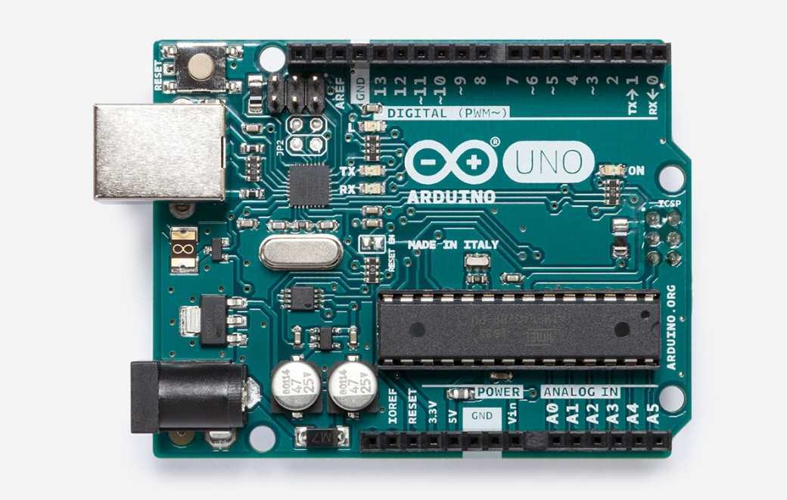
Arduino Layout
Digital I/O
USB
Interface
Power
Microcontroller
ATMega328p
Power
Input
Power
Output
Analog Input
https://docs.arduino.cc/retired/boards/arduino-uno-rev3-with-long-pins/

Slide 5
Power
Type B - USB
External (non-USB)
Battery
  Terminals connected to the GND and Vin pin
  Recommended range 7-12V
5V
3.3V
GND
Do not short circuit output power to GND

Slide 6
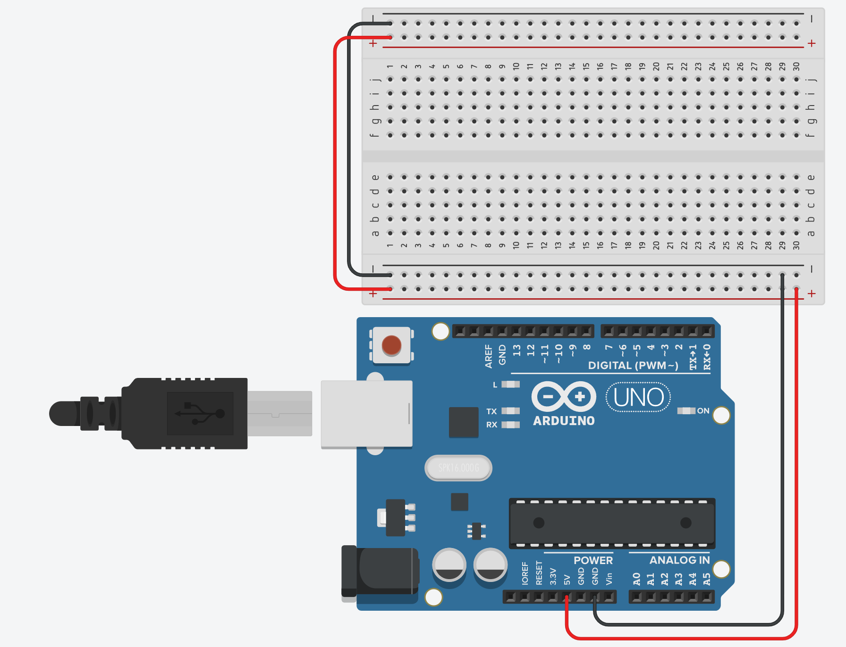
Power

Slide 7
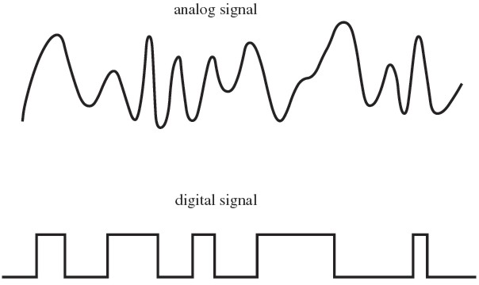
Digital I/O
Each pin operates at 5V
pinMode(pin, mode): INPUT or OUTPUT
digitalWrite(pin, value): HIGH or LOW
digitalRead(pin): returns type int (0 or 1)
PWM (Pulse Width Modulation)
Pins with ~
analogWrite(pin, value): 0 to 255
https://digestiblenotes.com/physics/electricity_and_waves/analogue_and_digital.php

Slide 8
Analog Input
10-bit resolution – measure from 0 to 5V
4.9mV per unit
analogRead(pin): returns 0 to 1023
https://digestiblenotes.com/physics/electricity_and_waves/analogue_and_digital.php

Slide 9
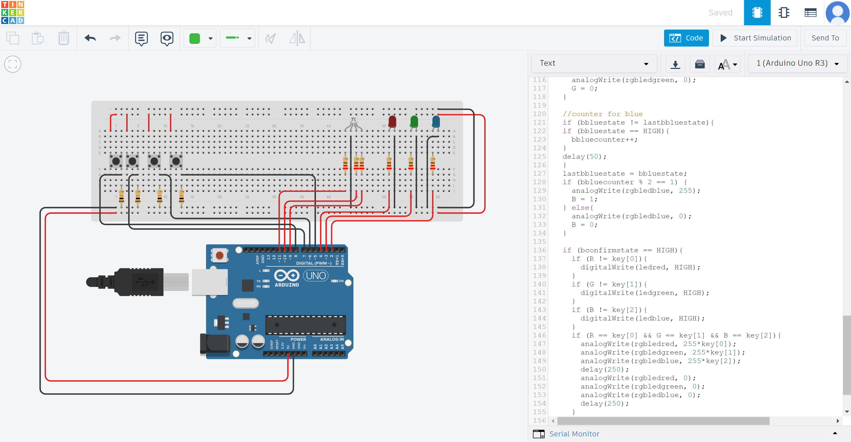
Tinkercad
https://www.tinkercad.com
Notes:
Quite convenient for simulating simple projects
There are a few sample projects to see and play around with

Slide 10
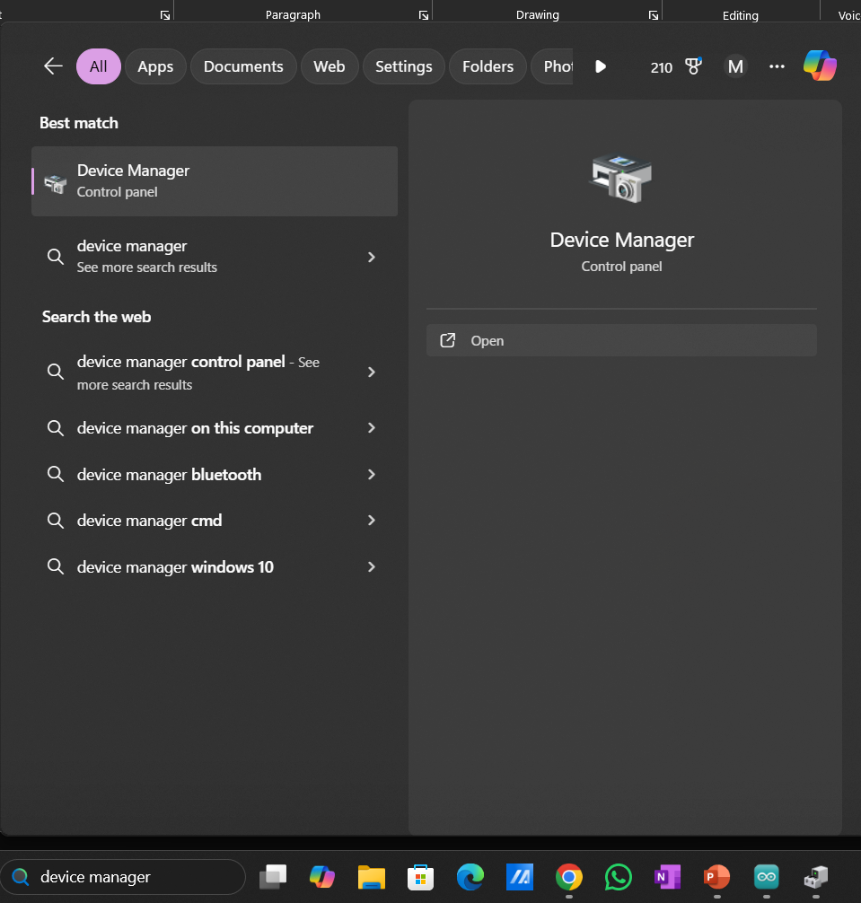
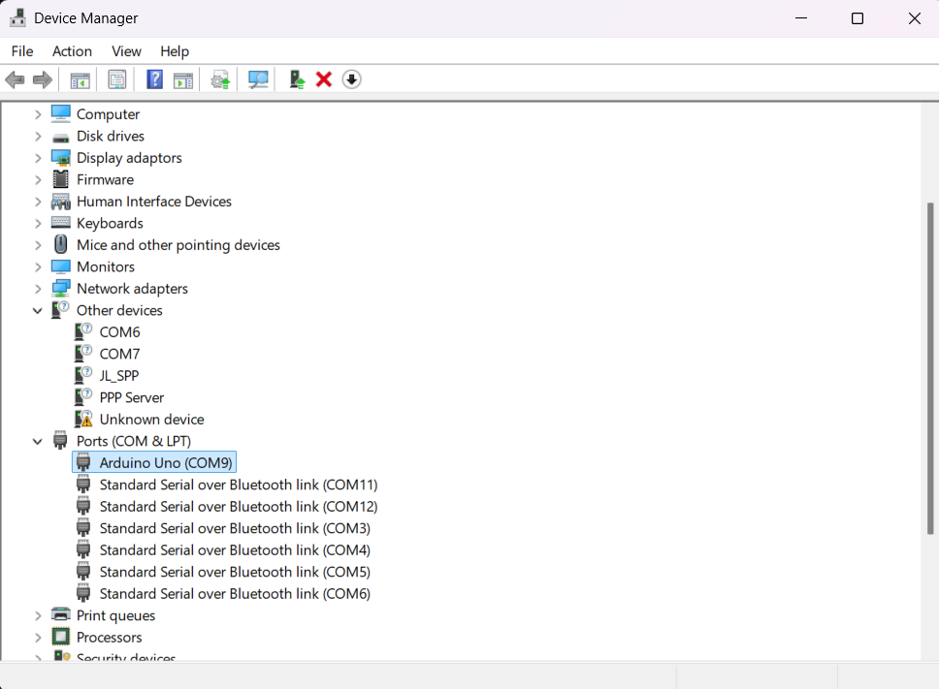
Finding the Arduino
Connect your Arduino to the computer via the USB Cable.
Open Device Manager using the start menu search bar.
Scroll to ‘Ports (COM & LPT)’ and open it to see your USB device.
Note the Port number with the Arduino on it. You’ll need it later.

Slide 11

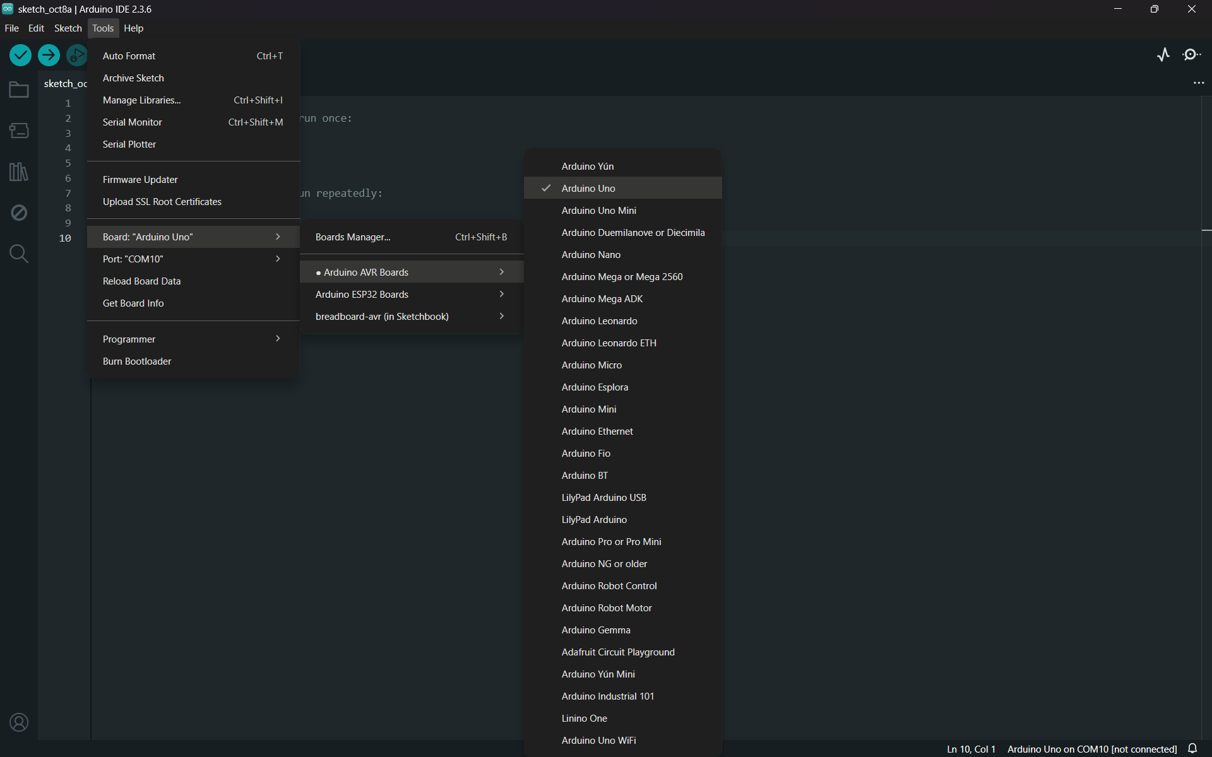
Arduino IDE
← This is the icon of the Arduino IDE. Find it
on your computer and launch it.
Setting up the Arduino:
Go to ‘Tools’.
In the ‘Boards’, select ‘Arduino AVR Boards’, then select ‘Arduino Uno’.
Again under ‘Tools’, find ‘Port’ - select the port number you found the device manager.

Slide 12
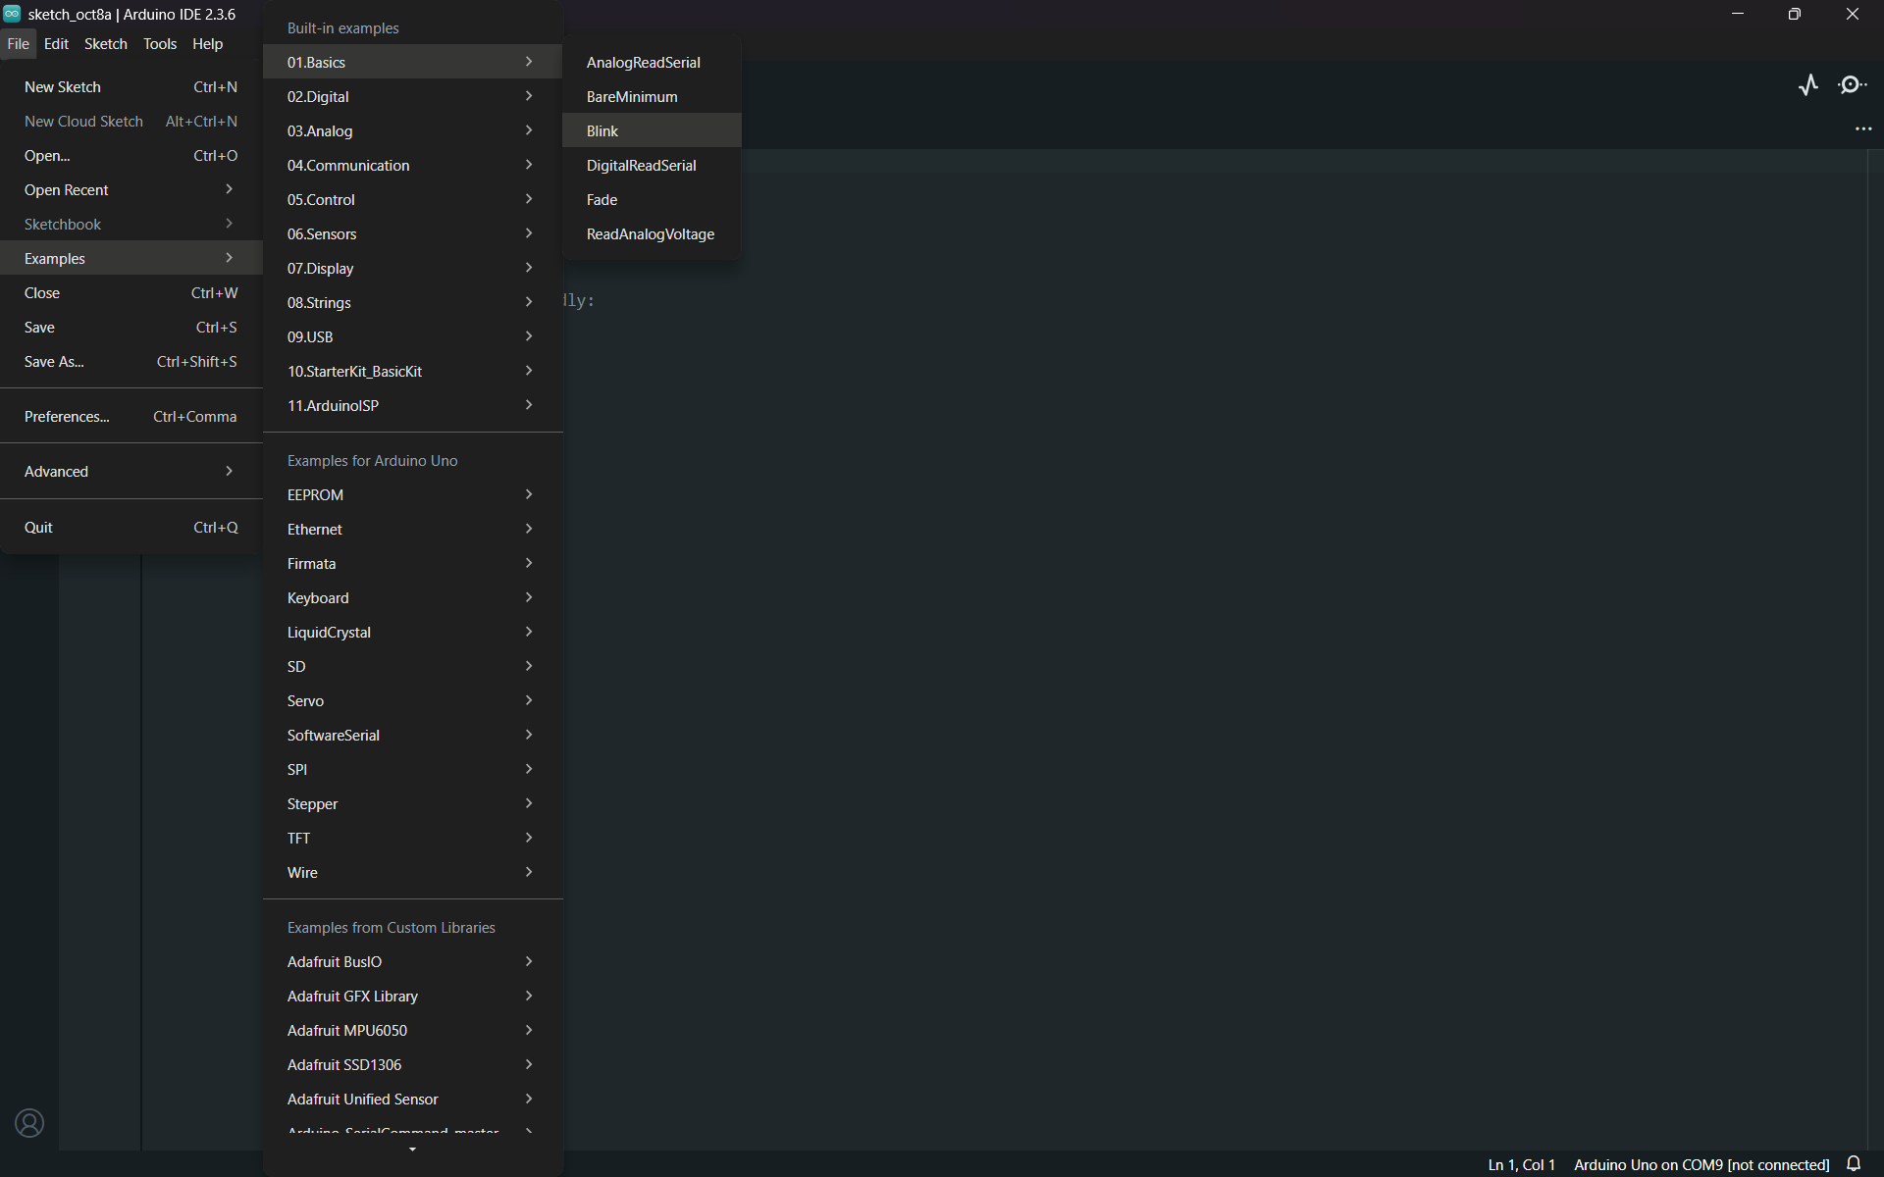
Let's look at some Examples
Go to ‘File’
Select ‘Examples’
Select ‘Basics’
Select ‘Blink’
Notes:
Quite convenient for simulating simple projects
There are a few sample projects to see and play around with

Slide 13
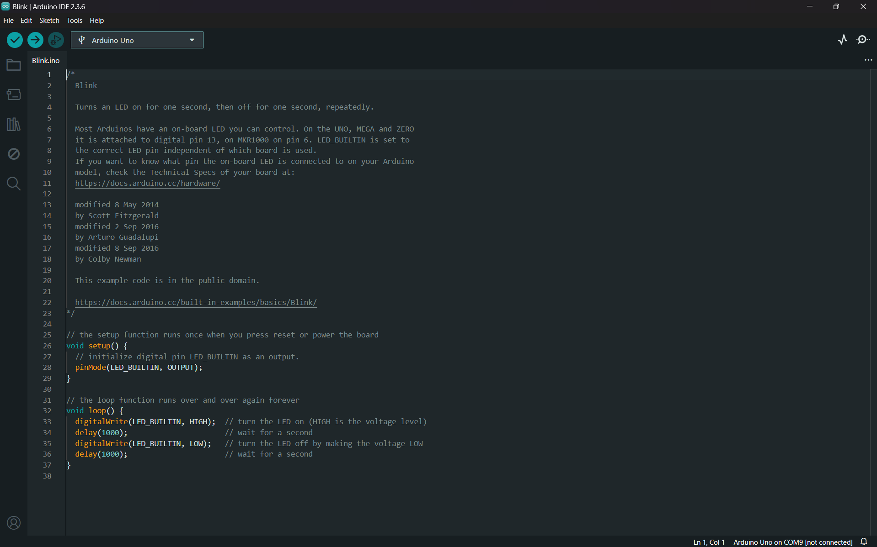
Arduino IDE
You can verify the code with the ‘✓’ Verify symbol (not usually required).
Upload code through USB cable to board using the ‘→’ Upload symbol.

Slide 14
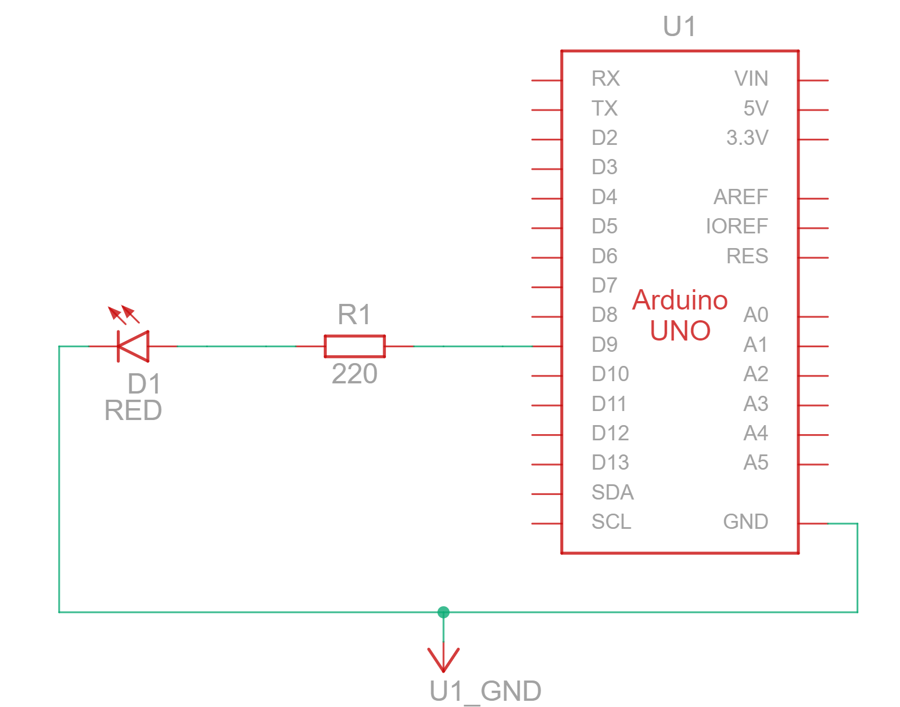
Mini Project time
You have an Arduino UNO and a LED; try to vary the LED’s brightness over time (fading).
You MUST connect a resistor between the digital output pin and the LED to limit the current (20mA) passing through.
You will need to use the delay() function.
delay(ms)
Pauses the program for the amount of time (in milliseconds) specified as parameter
Tip: you can assume a constant 0.7V drop across an LED.
https://www.arduino.cc/reference/en/language/functions/time/delay/
Notes:
For session 2, introduce potentiometer and use analogue read for serial write. Button for FSM?

Slide 15
Serial Communication
Communication between the Arduino board and a computer or other devices
Serial.begin(speed): sets the data rate for serial data transmission
  Use rates listed at the bottom right corner of the serial monitor
Serial.print(val): prints data to serial port
Serial.println(val): prints data followed by a ‘\r\n’
Serial.write(ASCII): prints value based on ASCII code.
  e.g. Serial.write(48) prints 0
Serial.read(): returns a character represented by its ASCII code

Slide 16
Sample Code
int incomingByte = 0; // for incoming serial data
void setup() {
Serial.begin(9600); // opens serial port, sets data rate to 9600 bps
}
void loop() {
// send data only when you receive data:
if (Serial.available() > 0) {
// read the incoming byte:
incomingByte = Serial.read();
// say what you got:
Serial.print("I received: ");
Serial.write(incomingByte);
Serial.println();
}
}
https://www.arduino.cc/reference/tr/language/functions/communication/serial/read/

Slide 17
Time Functions
delay(ms): pauses the program for time entered in milliseconds
millis(): Returns the time in milliseconds passed since the Arduino board began running the current program (unsigned long)
micros(): millis() but in intervals of 4 microseconds

Slide 18
Sample Code
unsigned long myTime; // store 32 bits (4 bytes)
void setup() {
Serial.begin(9600);
}
void loop() {
Serial.print("Time: ");
myTime = millis();
Serial.println(myTime); // prints time since program started
delay(1000); // wait 1 second
}
https://www.arduino.cc/reference/en/language/functions/time/millis/

Slide 19
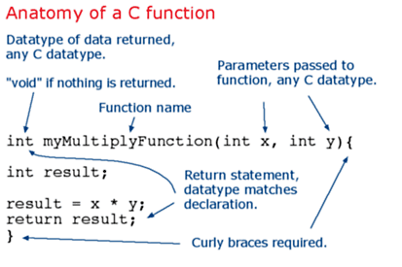
Sample Code
https://docs.arduino.cc/learn/programming/functions/

Slide 20
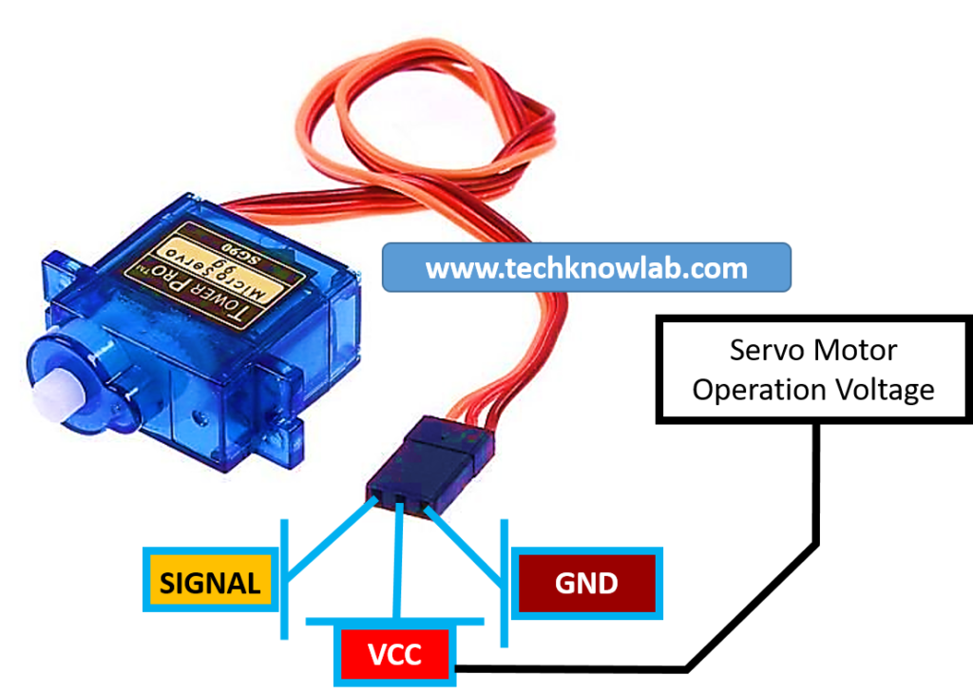
Let's make a Catapult!
A servo motor is a usually between 0° and 180°. It is a small motor with a built-in feedback system that allows it to rotate to a specific angle.
1. Signal – connected to an Arduino pin that sends control pulses
2. Power (VCC) – usually 5V
3. Ground (GND)
The Arduino controls the servo by sending PWM (Pulse Width Modulation) signals - short pulses that tell the servo what angle to move to.
You need the Arduino ‘Servo’ library makes them easy to control with just a few lines of code.
https://techknowlab.com/servo-motor-arduino-control-basics/

Slide 21
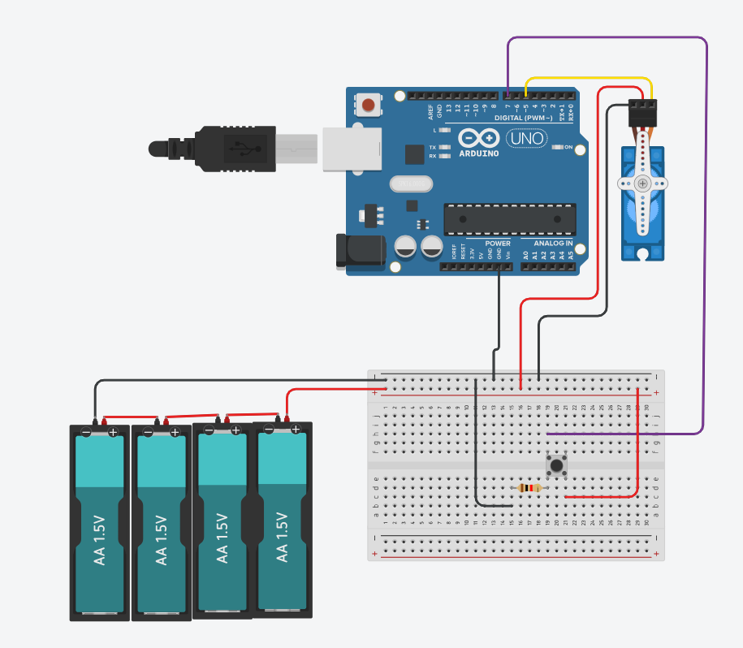
Connections

Slide 22
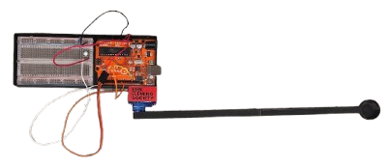
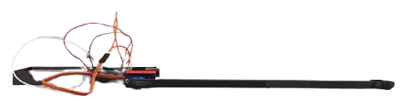
Attaching the catapult arm
Write the following code: ‘servo.write(0);’ in the:
void loop(){
//Put your main code here:
}
Attach the catapult arm as shown.
Ensure you put a screw through the servo horn securely!
Top view
Side View

Slide 23
The Goal
Objective: make the catapult launch a projectile as far as possible when the button is pressed. To do this, you must:
Start the catapult at a known initial position.
Wait and constantly check for a button press.
IF the button is pressed, flip the catapult up to some end position.
Then reset the catapult back to its initial position.

Slide 24
The Code
To achieve this, you may find the following code blocks useful to put inside the void loop():
You can find the sample code here:
https://beta.flemingsociety.com/arduino-workshop/

Slide 25
The Code
To achieve this, you may find the following code blocks useful to put inside the void loop():
Moving the servo
Rotate the servo to xº
servo.write(x);
Rotate the servo on a specific trajectory: the servo will be rotated from x1 to xn sequentially, where there is a delay of t milliseconds between every rotation.
int angle_trajectory = [x1, x2, x3, x4 ... xn];
int length = n;
for(int i = 0; i < length; i++){
servo.write(angle_trajectory[i]);
delay(t);
}
Detecting a button press
Method 1:
button_state = digitalRead(button_pin);
if(button_state == LOW){
// CODE IN HERE
// will be executed if the condition is TRUE
}
Method 2:
button_state = digitalRead(button_pin);
if(button_state == HIGH){
// CODE IN HERE
// will be executed if the condition is TRUE
}

Slide 26
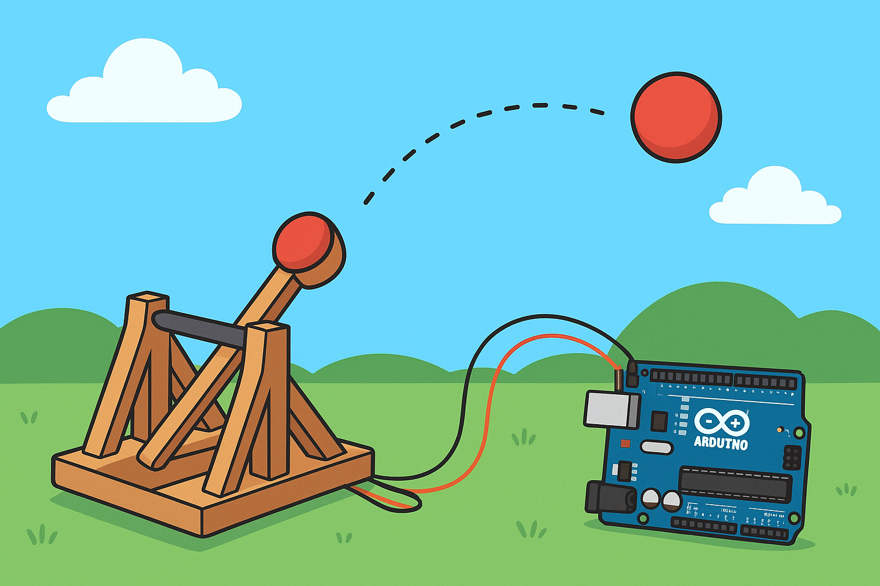
Try Tweaking the settings ☺
This image was generated by ChatGPT on 08/10/2025

