Slide 1

DATAVIZ Project 2
Visualizations of volcanic activity around the Earth

Slide 2
Team 2
Banu Nathan
Fleming Brathwaite
Dan Freda
Shawntell Manning

Slide 3

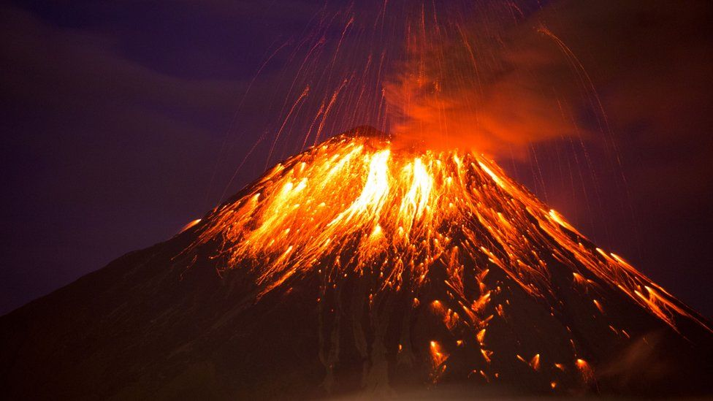
Theme
Interactive visualizations of global volcanic activity using a combination of web scraping and Leaflet or Plotly
Notes:
Your project should fall into one of the below four tracks:
- A custom “creative” D3.js project (i.e., a nonstandard graph or chart)
- A combination of web scraping and Leaflet or Plotly
- A dashboard page with multiple charts that update from the same data
- A “thick” server that performs multiple manipulations on data in a database prior to visualization

Slide 4
Coding approach
Notes:
Your visualization must include a Python Flask–powered API, HTML/CSS, JavaScript, and at least one database (SQL, MongoDB, SQLite, etc.).
project should include at least one JS library that we did not cover.

Slide 5
Data munging techniques
Smithsonian Institution: Global Volcanism Program
File Type: Excel
NOAA: Significant Volcanic Eruption Database
File Type: Json
Notes:
Data Sources:
Smithsonian Institution: Global Volcanism Program
Site: https://volcano.si.edu/search_volcano.cfm
File Type: Excel
"Volcanoes of the World" is a database describing the physical characteristics of Holocene volcanoes and their eruptions. This search returns a list which may be filtered based on a volcano name, volcano type, features, evidence of recent activity, location (set using a map), country, rock types, population within various distance ranges, or the availability of images. Name and country searches will also return subfeature names and synonyms; using other filters will result in only primary volcano names being returned. A standard set of fields is shown on the screen display, but full results with additional content may be downloaded into an Excel spreadsheet.
NOAA: Significant Volcanic Eruption Database
Site: https://public.opendatasoft.com/explore/dataset/significant-volcanic-eruption-database/information/
File Type: Json
The Significant Volcanic Eruption Database is a global listing of over 500 significant eruptions which includes information on the latitude, longitude, elevation, type of volcano, and last known eruption. A significant eruption is classified as one that meets at least one of the following criteria: caused fatalities, caused moderate damage (approximately $1 million or more), with a Volcanic Explosivity Index (VEI) of 6 or larger, caused a tsunami, or was associated with a major earthquake.
Description of data types
Outline process of how data was incorporated into project.

Slide 6
Final visualization
Notes:
Your final visualization should ideally include at least three views.
Project must include some level of user-driven interaction (e.g., menus, dropdowns, textboxes).

