Slide 1
St. John CMS Admin Manual
User Guide for Website Content Management

Slide 2
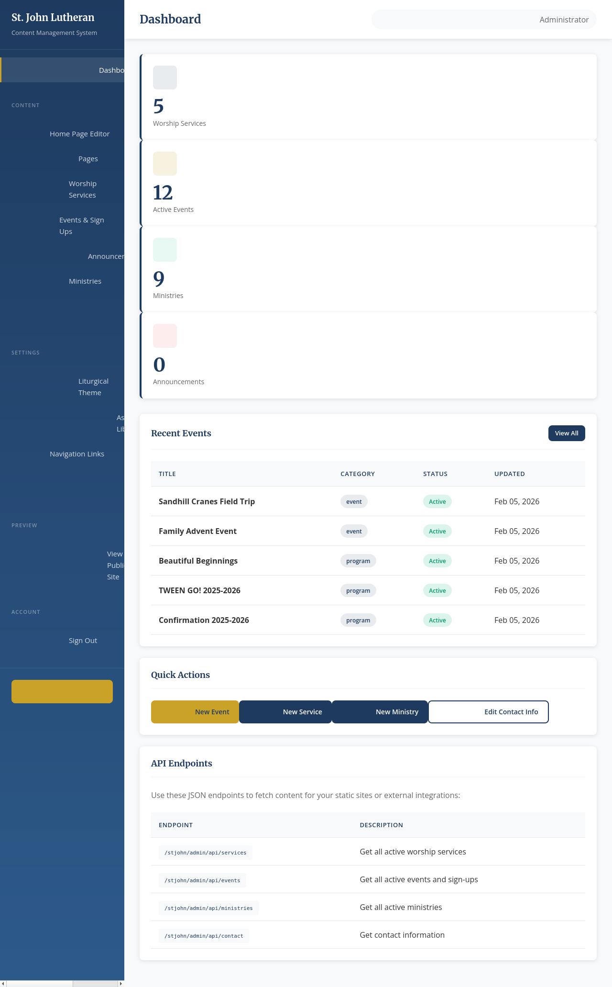
Accessing the Admin Panel
1. Navigate to: /stjohn/admin 2. Enter your credentials. Default Credentials: • Username: admin • Password: stjohn2024 Note: You will stay logged in for 8 hours.

Slide 3
Dashboard Overview
The Dashboard provides a quick snapshot of your site's content. Key Features: • Statistics Cards: View counts for Events, Ministries, etc. • Recent Activity: See the latest items added. • Quick Actions: One-click access to add common items. • Navigation: Use the sidebar (left) to access all sections.

Slide 4
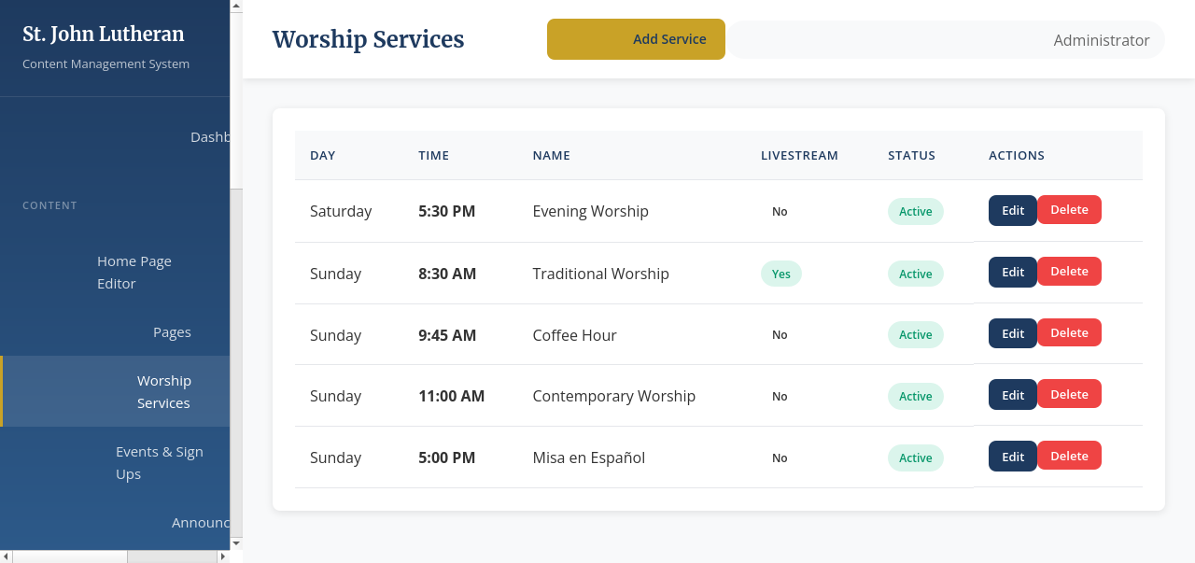
Managing Worship Services
Go to 'Worship Services' in the sidebar to see all services. This list shows: • Day & Time • Status (Active/Inactive) • Livestream Status Click 'Edit' to modify or 'Delete' to remove.

Slide 5
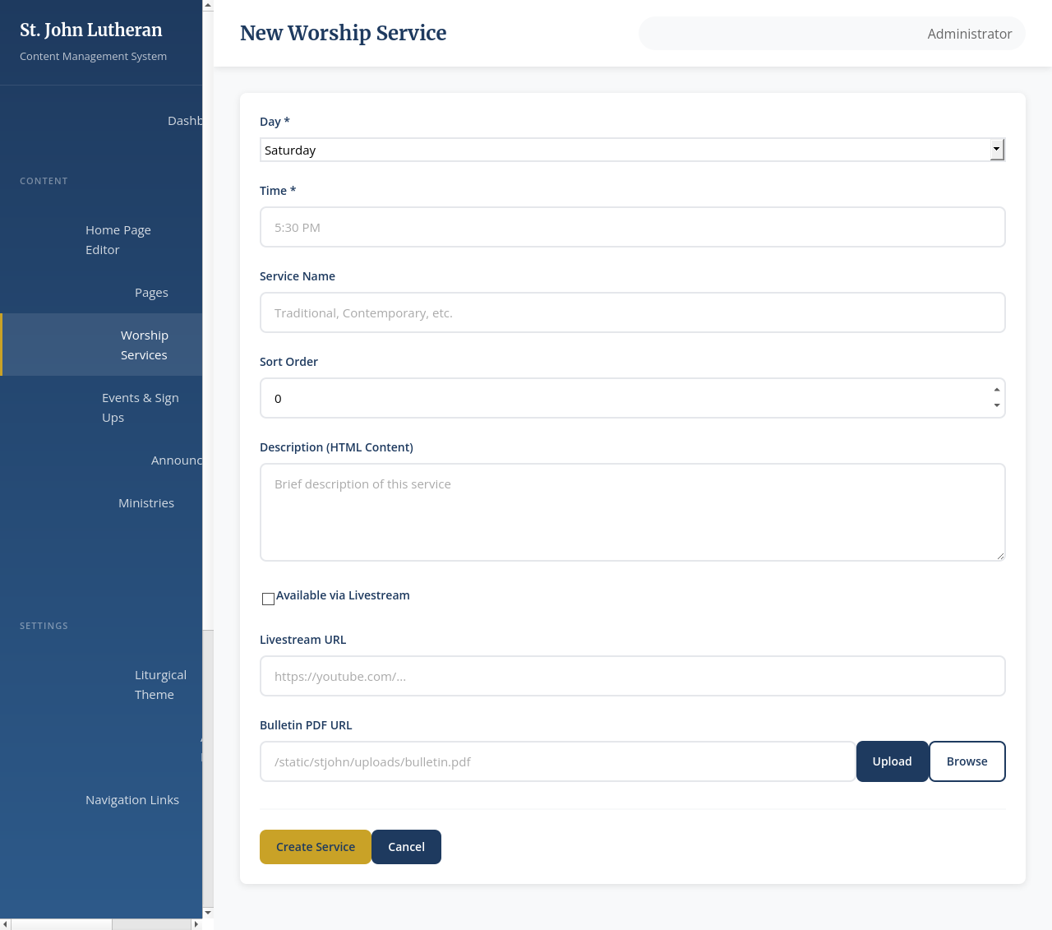
Service Details
When adding/editing a service: • Name: E.g., 'Contemporary Service' • Sort Order: Lower numbers appear first. • Bulletin URL: Upload the weekly PDF here. • Livestream: Enable to show the 'Watch Live' badge. • Description: Add notes or details.

Slide 6
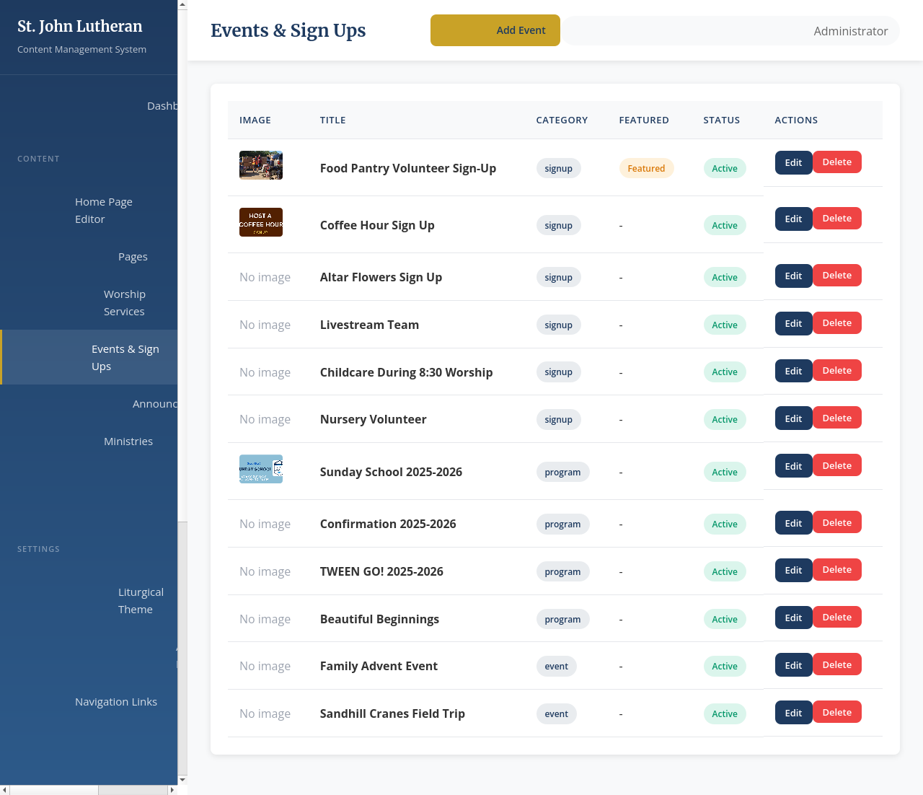
Events Overview
The Events section manages all upcoming activities. • Events are displayed in cards. • Use 'Sign Up' links for external forms (e.g. SignUpGenius).

Slide 7
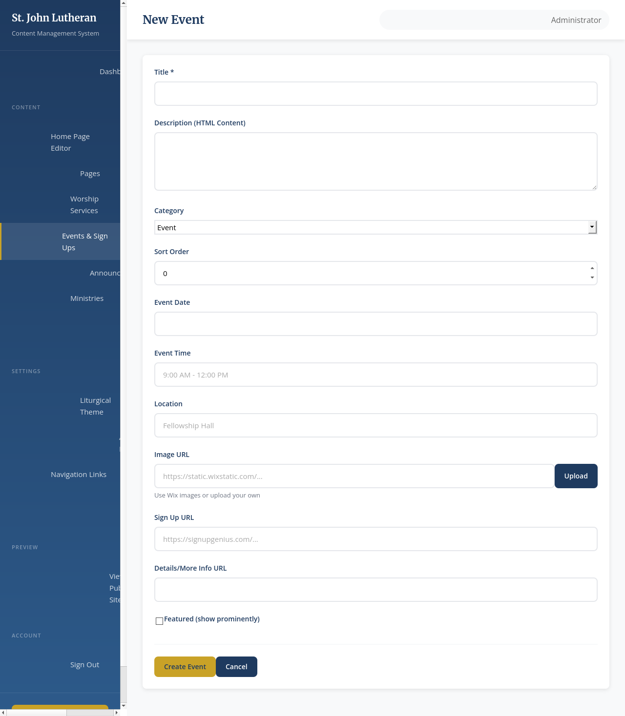
Creating Events
• Title: The headline of the event. • Image: Upload a promotional image (JPG/PNG). • Category: Appears as a badge (e.g. 'Youth', 'Worship'). • Sign-Up URL: The destination for the 'Sign Up' button. • Details URL: Alternative for 'Learn More' link.

Slide 8
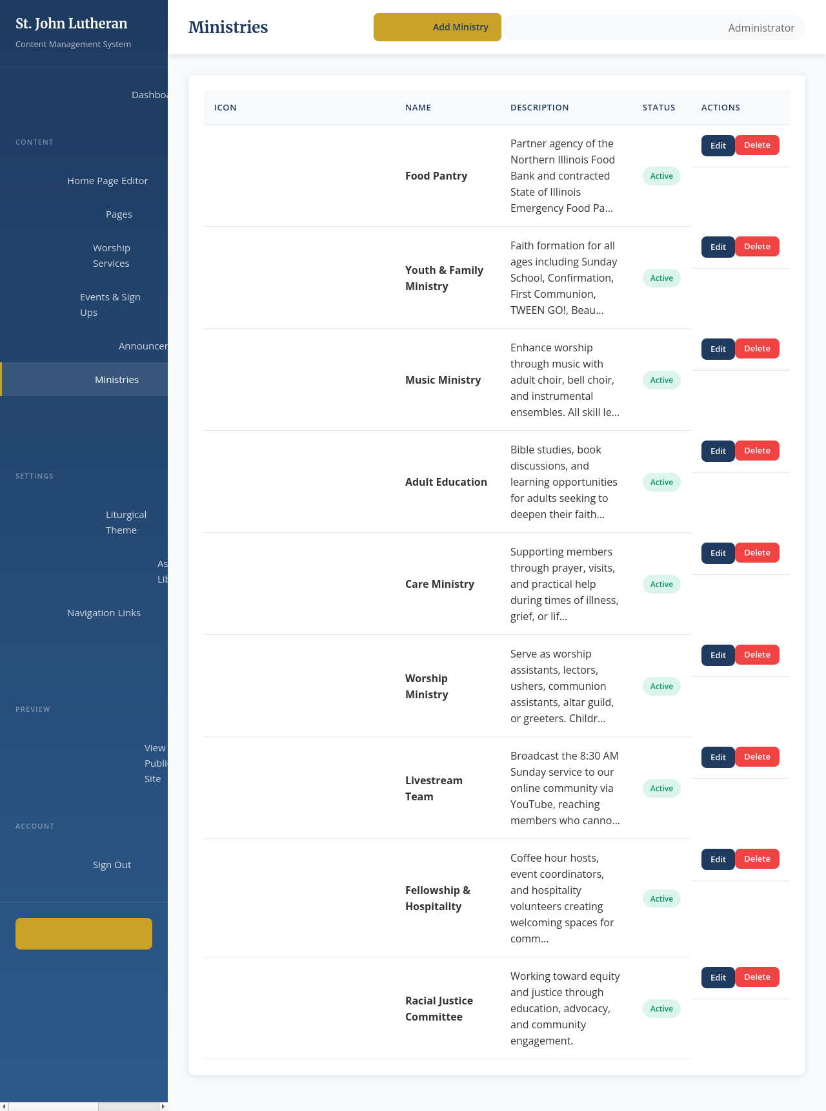
Ministries
Go to 'Ministries' to manage the diverse groups. • Icons: Uses Material Design icons (e.g., 'groups', 'music_note'). • Page URL: Link to a detailed internal page or external site.

Slide 9
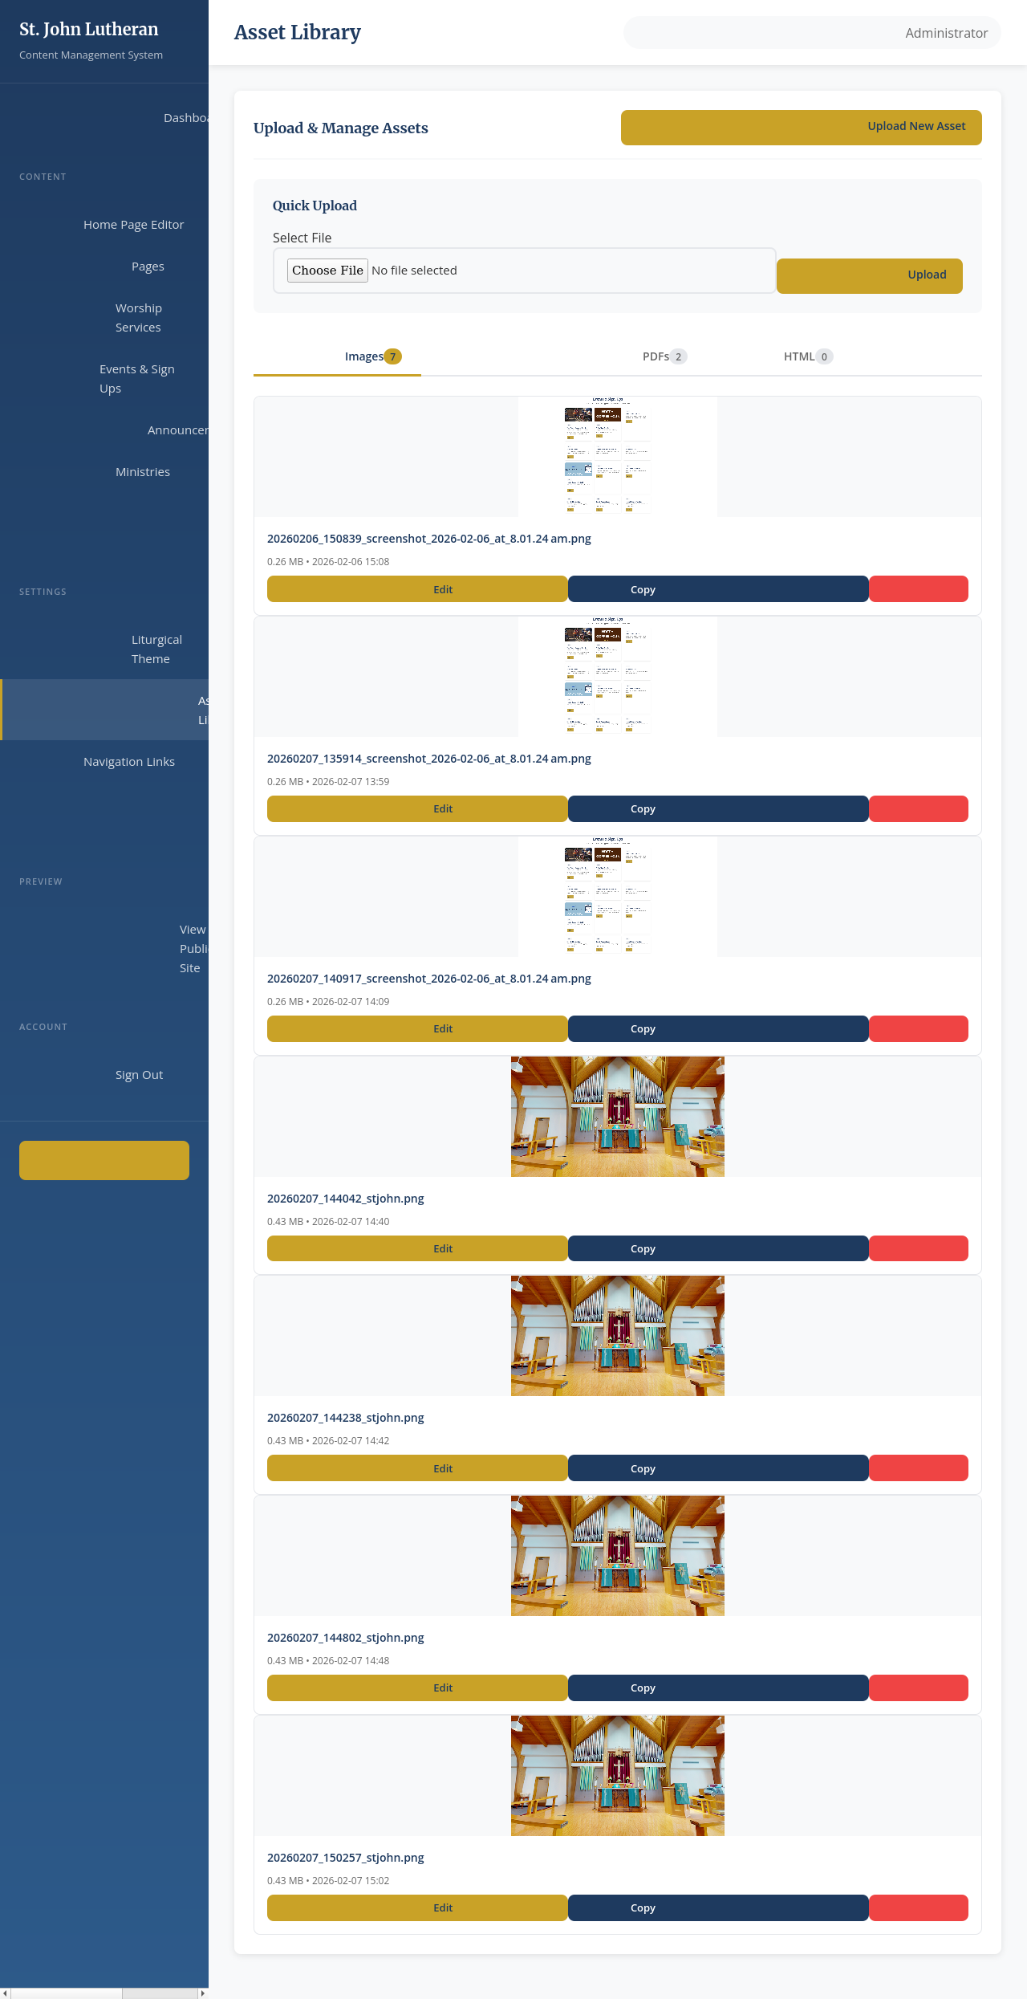
Asset Library
The Asset Library allows you to manage uploaded files. • Upload Once, Use Everywhere. • Click on an asset to copy its URL. • Supports images and PDFs.

Slide 10
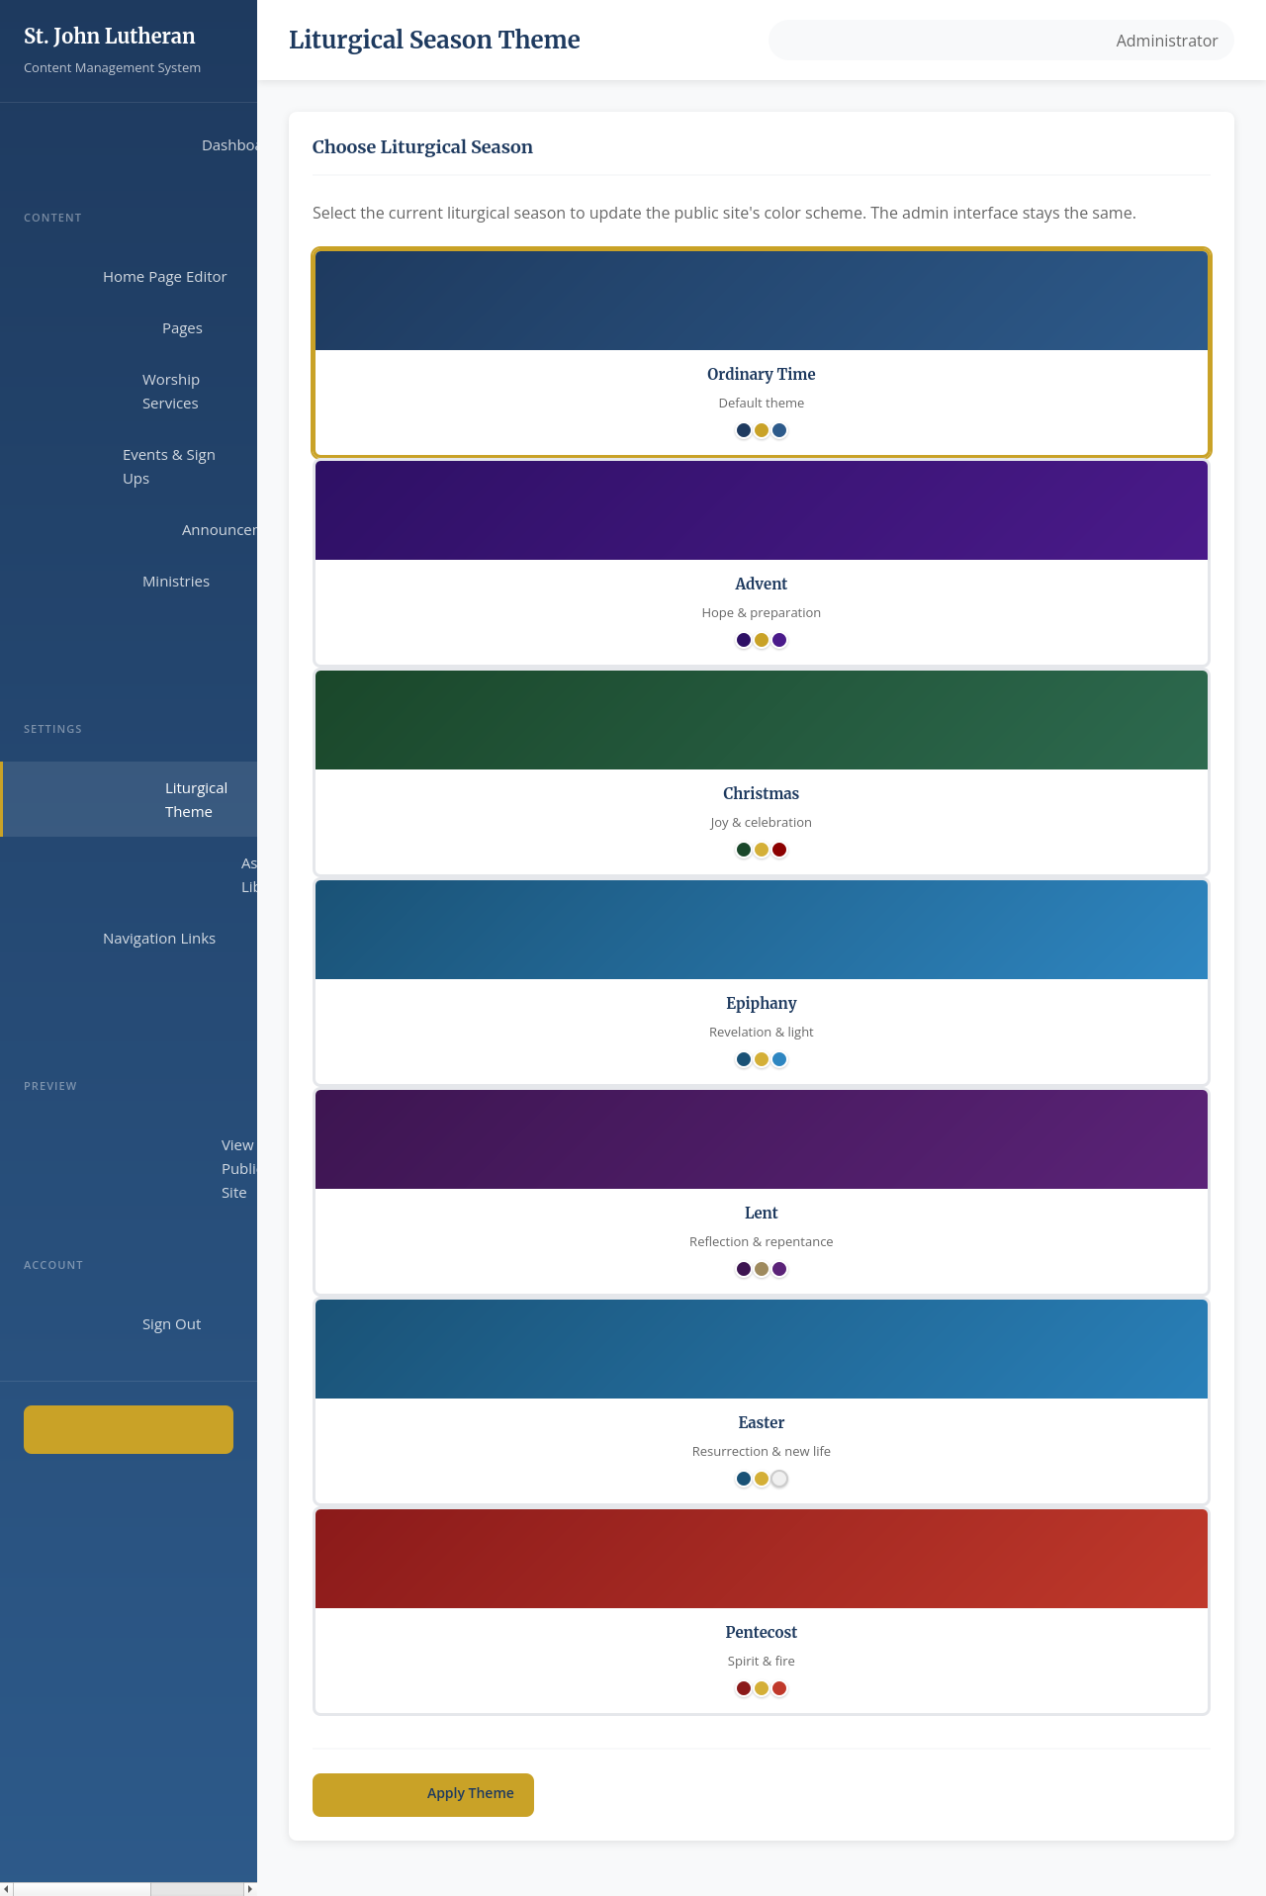
Liturgical Theme
Change the site's color scheme. • Select a season (Advent, Lent, etc.). • Click 'Update Theme'. • Changes are applied immediately to headers and buttons.

