Slide 1
Venture Foundry
STARTUP RESEARCH, WITH SOURCES
Research your market, competitors, cofounders and investors before you build.
Every answer carries the link it came from.
AI Factory hackathon · 2026

Slide 2
PROBLEM
Founders build before they know
Four questions decide whether a startup survives. Most founders answer them on instinct, because answering them properly takes weeks.
42%
65%
29%
fail because there was
no market need
of failures come from people
problems, not the product
run out of cash before
reaching the next round
→ Ideation · Market
→ People
→ Capital
Sources: CB Insights, The Top 20 Reasons Startups Fail · Noam Wasserman, The Founder's Dilemmas (Princeton, 2012)
Startup Genome puts it another way: 74% of ~3,200 high-growth startups failed by scaling before the market was proven.

Slide 3
SOLUTION
Answers you can defend
Venture Foundry researches the four questions for you — and shows its working. Every number, every name and every fund arrives with the page it came from.
What everyone else gives you
What we give you
“The market is worth $109 billion.”
The same number, plus the ten pages it came from.
No source. No method. No date. It might be right — you cannot tell.
Click any source. Check the work before you put it in a deck.
The model never supplies the evidence.
It only ever interprets what a live search actually found.

Slide 4
HOW WE SOLVE IT
Search first. Reason second. Never the other way round.
01
02
03
Gather
Extract
Reason
Search the live web for the
question being asked.
Pull the facts out of what
came back.
Answer using only those
facts — and cite them.
Four modules, one shared file — each starts where the last finished
Ideation
Problems people are actually complaining about
Market
Market size, competitors, and where you'd sit among them
People
Cofounders who cover the gap you name
Capital
Funds whose thesis fits, and how to open the email

Slide 5
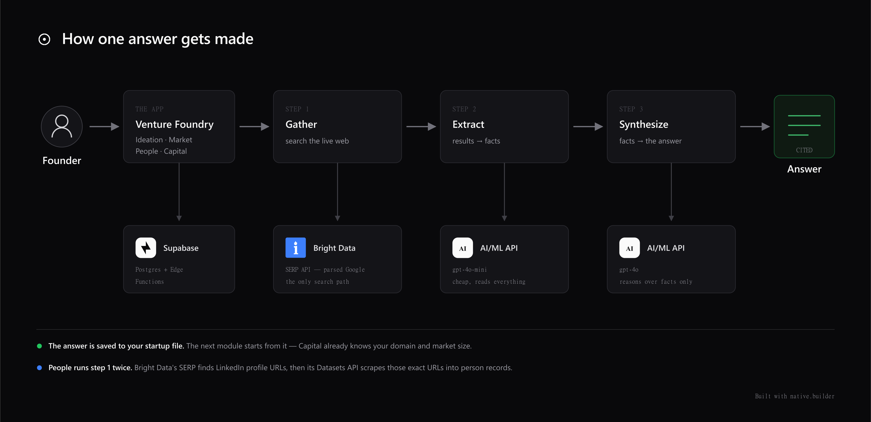
ARCHITECTURE
One flow, end to end
The founder asks. We search, extract, reason — and write the answer into their file, with its sources attached.

Slide 6
BUSINESS IMPACT
What it changes for a founder
2 weeks
→
15 minutes
of desk research
four modules, one sitting
£3–8k
→
free tier
for a market report
the same evidence, cited
“trust me”
→
click the link
in an investor meeting
every claim traceable
The market that matters: ~5 million new businesses are registered in the US alone each year, and the ones that raise are asked for exactly these four answers.

Slide 7
HOW WE USE BRIGHT DATA
It is where every answer starts
Nothing in this product is recalled from training data. Bright Data is the only way anything enters the system.
Search
Scrape
Real Google results for every question a module asks — market size, competitors, funds, people.
LinkedIn profiles turned into structured records, so cofounder search returns people rather than articles.
The two chained — this is what makes cofounder search work at all
Search finds eight real LinkedIn profiles for the gap you named. → Those exact profiles are scraped into full records. → Every one is scored against your gap and shown, including the poor fits.
A plain web search returns articles about cofounder matching. It cannot return people.

Slide 8
HOW WE USE AI/ML API
Two models, each doing what it's good at
Reading everything
Reasoning carefully
A fast, cheap model reads every search result and pulls out the facts. It runs on volume — nothing downstream ever sees raw pages.
A stronger model sees only those facts, and writes the answer: the market estimate, the ranked candidates, the opening line to an investor.
The hardest thing we ask it to do
Given ten competitors, work out the two questions that actually separate them — then place your idea among them.
Carbon software splits on who buys it and how automatic it is. Developer tools split on whether you can sign up alone. Nobody can write that list in advance — there are thousands of industries.
Two models, one key, chosen per task — the cheap one reads, the strong one decides.

Slide 9
TECH STACK
Built to ship, not to demo
BUILT WITH
native.builder
Vite + React, published to a live URL
BACKEND
Supabase Edge Functions
TypeScript, running close to the user
DATABASE
Supabase Postgres
One shared startup file per founder
EVIDENCE
Bright Data
Search and scraping — the only source of facts
REASONING
AI/ML API
Two models, chosen per task
Keys never reach the browser. The app is live, not a prototype.

Slide 10
Research your idea
before you build it
Every number, every name and every fund arrives with the link it came from.
Venture Foundry · AI Factory hackathon 2026

