Slide 1
DD & None DD Choices Workshop
Advising Center, JI
Host By Wenda Tang & Tianxin Shen
2018/10/24

Slide 2
Content
Data Overview & Comparison of DD/None DD
Personal Experience Sharing
Post-Graduation Development & IPO Programs
Future Plan For None DD Students
Summary & Tips

Slide 3
Data Overview & Comparison of DD/None DD
1

Slide 4
General Comparison of DD and none DD
2

Slide 5
Opinions from Staff
DD优势：
1.全球的平台。交往的是世界顶尖的教授、同学，要多参与UM的活动，多与教授有交集。如果不融入UM的环境，只是去刷刷GPA，还是为0.
2.两个不同的专业领域。交叉学科是未来的大趋势，选择真正有兴趣的两个专业学习，今后发展路径更宽
3.更多样化的专业选择。UM工学院的学科细分，并且人文、艺术等也很强，可以多选择不同的门类、选修课
4.更纯正的英语环境。从生活到学习，对语言和文化的一次全面提升

Slide 6
Opinions from Staff
非DD优势：
1.更从容的4年。比起四年两个学位，度过了大一大二的适应期后，大三大四是可以真正出成果的时候。
2.尝试更多的可能性。科研、实习、交换、竞赛……一切机会都在敞开大门。比较合理的安排时间，完全可以去两个不同国家交换、一份科研、一份实习、加上一些让自己outstanding的大赛和社会实践。
3.更高的性价比。80%同学都要出国，单从大四毕业前往美国top20的学校比例来看，DD与非DD比例都很高，但是两边的花费差到近百万。而且密院的非DDtop20比例每年都在稳步上升中。

Slide 7
None DD advantages?
Much easier to find an internship
Less trivial matters for living :D
Take your time to think about what you are interested in and want to do later
More opportunity to connect with domestic industry
Associate with new friends and extend human resources

Slide 8
Personal Experience Sharing
3

Slide 9
I. Personal Experience of Wenda Tang
2016 Fall: Decided not to apply for DD program
Reason: 1. Not enthusiastic towards settle down in US
2017 Winter: Went to Eryuan, Yunnan province to conduct a month-long volunteer teaching activity
2017 Spring & Summer: Working as a member of SSJIA, Travelling around, focus on study

Slide 10
2017 Fall: Began my first research in SJTU ACA Lab, mainly GPU acceleration and Machine learning
2018 Spring: Based on skills acquired from my lab, get the opportunity of a R&D intern in a startup company. Decided to seize the postgraduate recommendation chance.
2018 Summer: Focused on study, finished preparation for postgraduate recommendation
2018 Fall: Tried to apply for the Honorary PHD Program of SJTU, but failed :D

Slide 11
If I went back, I would…
Work harder in the Lab and try to publish a paper
Participate more meaningful activities and explore more possibilities
Hope to take more internships :D it’s really exciting for me
Maybe take the chance to exchange for a while is a good idea

Slide 12
II. Personal Experience of Tianxin Shen
2016 Fall: Decided not to apply for DD program
Reason: 1. No interested major
2. Reject typical JI students way
3. Leave time to think
2017 Spring: Enjoyed Spring Term, Travelled, Found what I have interest in
2017 Summer: Worked as Teaching Assistant, Joined Advising Center, Focused on Study

Slide 13
2017 Fall: Began doing research about the field I am interested in and want future development, Focused on study, Did several volunteer work
2018 Spring: Exchange to KTH for spring term, Took TOFEL Test
2018 Summer: Focused on study, Applied for internship, Strengthened technical skills
2018 Fall: Took GRE Test, Began intern in company, Prepare for master application

Slide 14
If I went back, I would…
Begin doing research as early as possible
Talk with professors, instructors, elder students more
Make more friends and share more views
Join Advising Center earlier and attend workshops
Try more fields, e.g Consulting, etc

Slide 15
III. DD Students Interview
1. 你dd之后具体做了哪些事情。
学习, 刷GPA, 做research：做了一个材料的research，一个流体力学的project，还有一些课上的project。
生活上会有以前没有的事情要操心，比如说租房子，买车，打工，因为都要自己处理，有的时候就会觉得很烦。。。不过也算是一种锻炼吧。
我喜欢做菜，然后就周末在家做着玩吧。
Social方面会跟外国人party，lab里也会一起出去玩，多说英语总归好。
Provided by樊元桢

Slide 16
2. 你觉得dd的优势在哪些方面。
（1） 老师好
几乎不会碰到JI有些上课不怎么样的老师，老师在office hour都很愿意帮助学生，平时人少找老师多聊聊会有收获
（2）Research机会多
每个老师都有自己的lab，反正本科生多一个不多少一个不少，所以他们都还愿意让本科生参与做research。项目也比较多，会有和JI一样的VM490/VE490鼓励学生做research拿学分。
（3）学校设施好
学校的硬件还是完爆JI的，图书馆是24小时开的，学习的环境还是比JI舒服很多的。
（4）GPA好看
GPA比较好提高，因为外国人不是很强，CS除外，你还是会跟JI很多人一起抢那些A，竞争还是很激烈的。
Provided by樊元桢

Slide 17
（5）美本的文凭+美国老师的推荐
美本的文凭和成绩单还是有用的。你有一个美本的文凭，人家就知道“哦，这个人跟我们美国人比起来大概是什么水平”
美国老师的推荐信比JI的老师还是有用很多的。还有他们之间也会有connection，所以如果你想读PhD，那UM的老师如果觉得你可以的话，会收你，或者推你去别的好学校同一个方向的老师那里，就比直接硬申PhD要好很多。
（6）压力
Peer pressure会变小, 但自己的压力会变大，因为选择很多。在JI只要刷高GPA准备2+2就行了，你不怎么需要考虑别的事情。到了美国，选择就变得很多，申研究生，找工作，包括回国，你就会选择障碍，而且这些选择会影响你未来的人生，压力就比较大了。
Provided by樊元桢

Slide 18
3. 现在美国ME中国学生的发展前景如何。
学历：
本科没有前景，招的ME的人本来就少，中国人机会更少
研究生拼命找还是能找的到工作的。
PhD么，找个工作是还可以的，毕竟PhD还是处于顶端的。
当教授：
不失为一种留在美国的好办法，不过当教授太难了，太累了，不是普通人能受得了的。
Provided by樊元桢

Slide 19
Post-Graduation Development & IPO Programs
4

Slide 20
Data supported by JI career
Spend several minutes and read this article
Miss Zhao: ECE, DD major: Industrial Engineering. Active in club activities like debate and hosting, participated in two internships.
Now going to Carnegie Mellon University, master’s degree in Computational Finance
Miss Zhou: ME, none DD. Half year internship in Siemens; Once held an art exhibition in Shanghai.
Now going to Dartmouth College, master’s degree in Engineering Management

Slide 21
IPO Programs
4 + 1 to UM
Ross business school in UM
3 + 2 to KTH
3 + 2 to UM (Big data)
Corporation with University of Southern California

Slide 22
Future Plan For None DD Students
5

Slide 23
Never ignore the possibilities!
Applying for master program abroad
Directly find a job after graduation
Switch to a none engineering major
Seeking PHD diploma abroad
Continue domestic study

Slide 24
Think about what you want to do, learn job content of different fields (Internship)
Tips
Try more things before too late, planning ahead is crucial

Slide 25
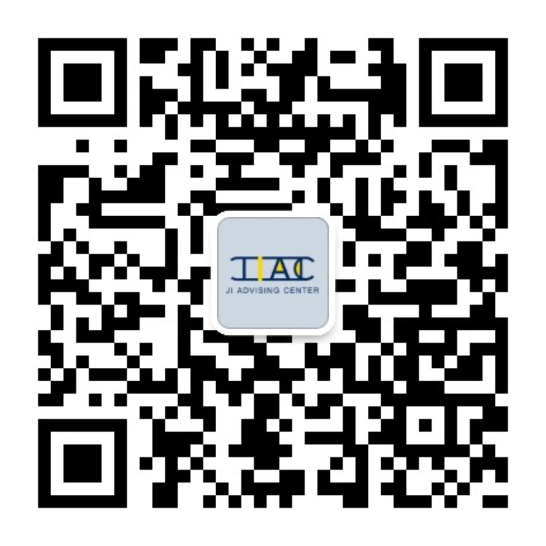

Slide 26
Q & A

Slide 27
THANK YOU FOR LISTENING! Please Leave Your Comments/Problems/Suggestions to the paper
Advising Center
UM-SJTU Joint Institute

