Slide 1
New Video ASIC
John P. Doty
Noqsi Aerospace Ltd
December 6, 2012

Slide 2
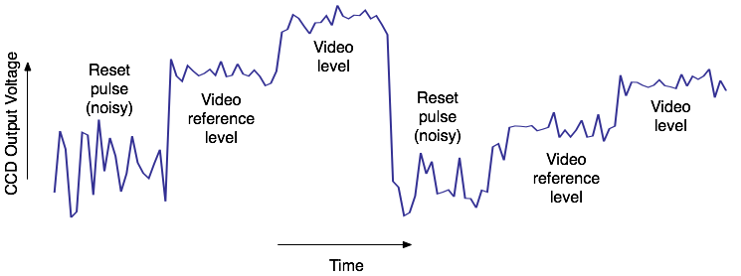
Two CCD Pixels
Reset pulse is very noisy (ignore data)
Reference level varies pixel to pixel (“kTC” noise)
Subtract filtered reference level from filtered video level (“correlated double sampling”) to get best estimate of charge.

Slide 3
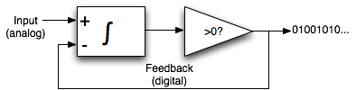
ΔΣ Principle
First-order ΔΣ “modulator”.
  Integrate the difference between input and output.
  Mean density of “1” bits in output will then approximate the input.
Difference between instantaneous output (“1” or “0”) and mean output is considered “modulator noise”.

Slide 4
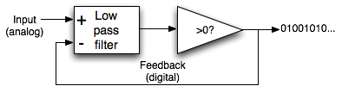
Noise Shaping
Substitute higher-order low pass filter for integrator.
  Stronger feedback at low frequencies forces modulator noise to higher frequencies.
    Fewer samples needed for high precision.
  Care needed to avoid instability.

Slide 5
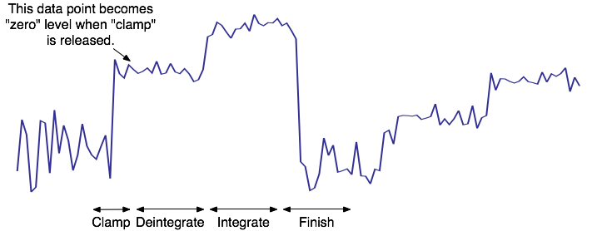
ΔΣ Signal Processing for CCD Video
Clamp phase – reset ΔΣ modulator, force reference level to approximately zero.
Deintegrate phase – process samples with negative weight to subtract residual reference level.
Integrate phase – process samples with positive weight to estimate video charge.
Finish phase – ignore input (zero weight), run modulator to obtain estimate of remaining modulator digitization error.
  MND02 needed long finish phase, extending into next pixel → even/odd modulator pairs.
    New ASIC does not need this.

Slide 6
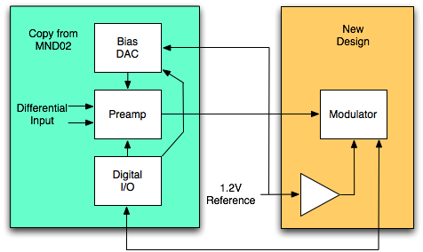
Changes in new ASIC
Fourth order modulator ( second order for MND02)
  Better precision from fewer samples
Both modulator and bias dac use 1.2V reference.
  MND02 needed 0.2V for modulator.
Single-ended circuits with higher voltage swing, 1.2V
  MND02 used differential circuits with 0.4V swing

Slide 7
Design Tools
"Delta-Sigma Modulators: Modeling, Design, and Applications" by Bourdopoulos, Pnevmatikakis, Anastassopoulos, and Deliyannis.
  Modulator architecture.
  Optimized Z-domain transfer functions.
Mathematica
  Solve for filter coefficients given transfer function parameters.
  Simulation of idealized modulator.
  Modeling with linear algebra.
gEDA/ngspice
  Schematic capture
  SPICE netlisting
    New netlister “spice-noqsi” allows control of net scope, reducing clutter.
  Simulation

Slide 8
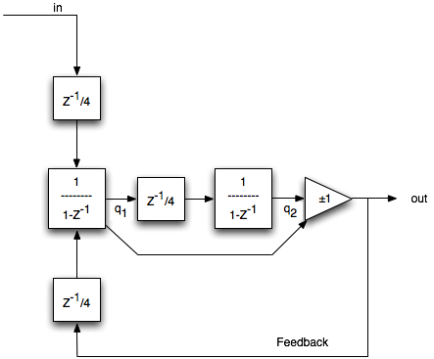
MND02 Modulator
Z transform representation
  Z⁻¹ indicates a one sample delay
  1/(1-Z⁻¹) indicates integration.

Slide 9
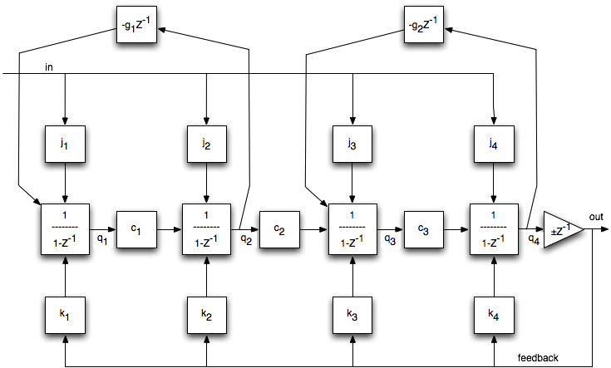
Modulator for new ASIC
j1= k1=0.389887 j2= k2=0.355616
j3= k3=0.484287 j4= k4=0.366992
c1= c2=c3=0.25 g1= 0.00730082 g2=0.0467911

Slide 10
Decimation
Turn output bit stream to a measured number
For first order ΔΣ modulator, just average the bits.
For higher order, a weighted average is needed.
  Depends on input noise spectrum and modulator noise shaping.
Implemented downstream in FPGA, not part of ASIC, but must have filter coefficients to analyze simulations.

Slide 11
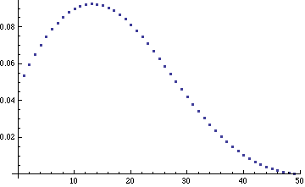
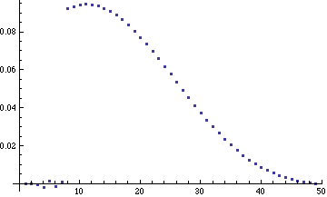
Decimation filter weights from linear algebra and simulation
Very similar appearance
  Simulation poorly constrains first few coefficients.

Slide 12
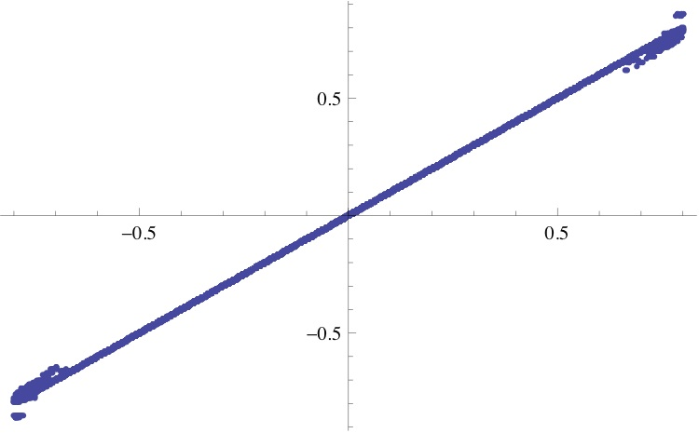
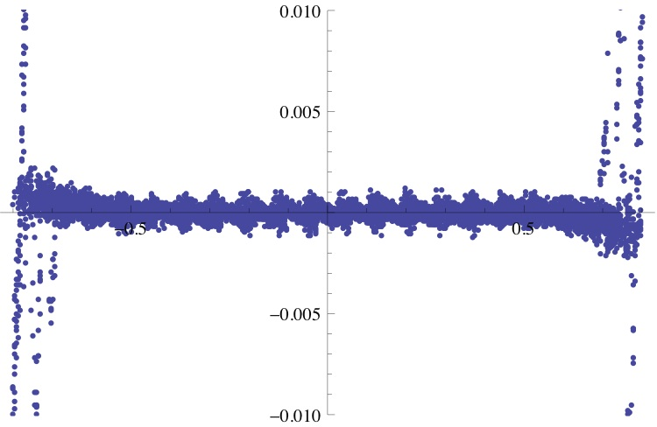
Modulator linearity and residuals
Simulation with kTC noise, but no other input noise. No even/odd (49 total clock cycles)
  Stable to ±0.6 of nominal full scale
  (peak-peak signal)/(RMS noise) > 4000

Slide 13
Circuit Blocks
OpenIP
  Mainly for digital and I/O
Custom
  InverterX
    CMOS inverter used as fast amplifier
  Q2V
    Charge integrator
  V2Q
    Delay-free charge input (chopped)
  ClockGen
    Non-overlapping clocks
  Comparator
  Polarity
    Voltage polarity switch

Slide 14
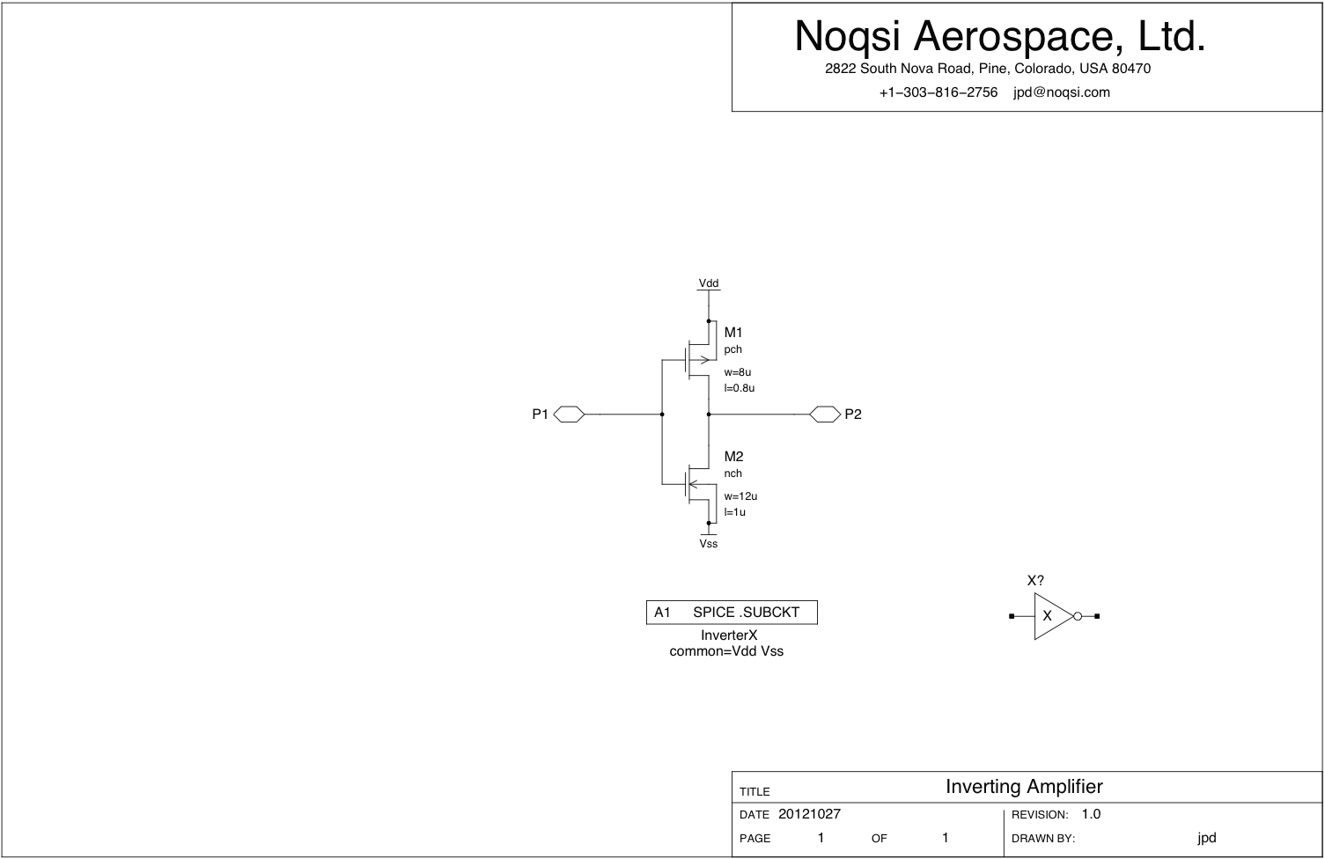

Slide 15
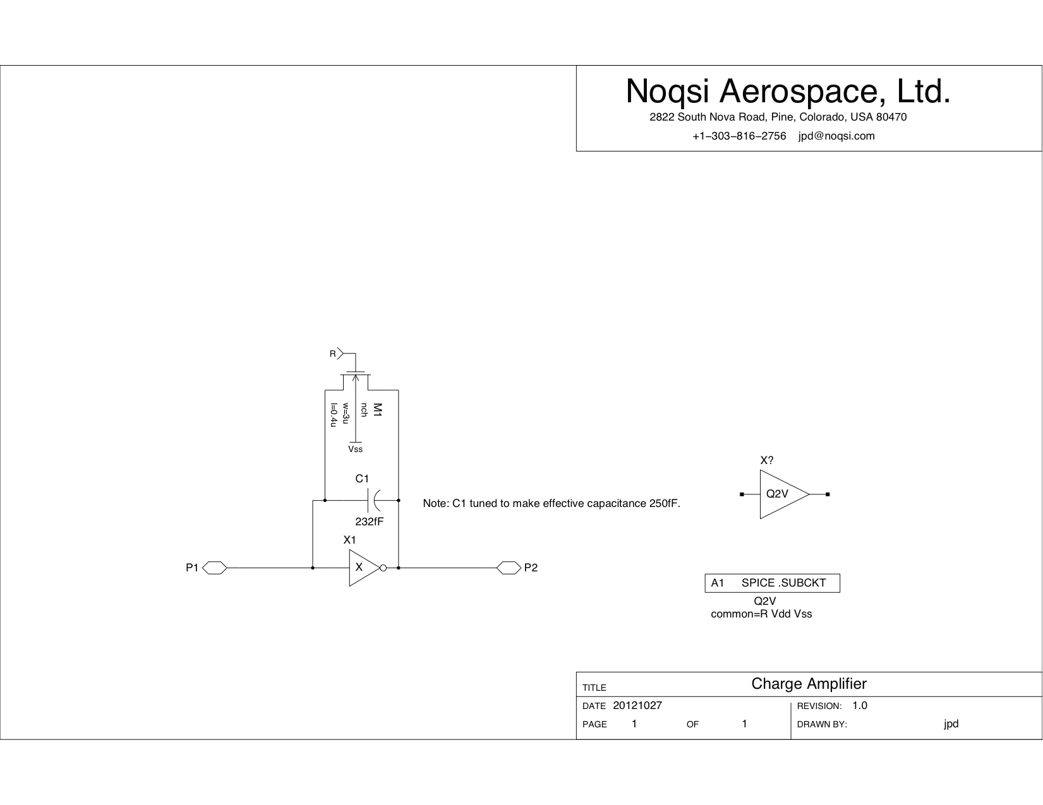

Slide 16
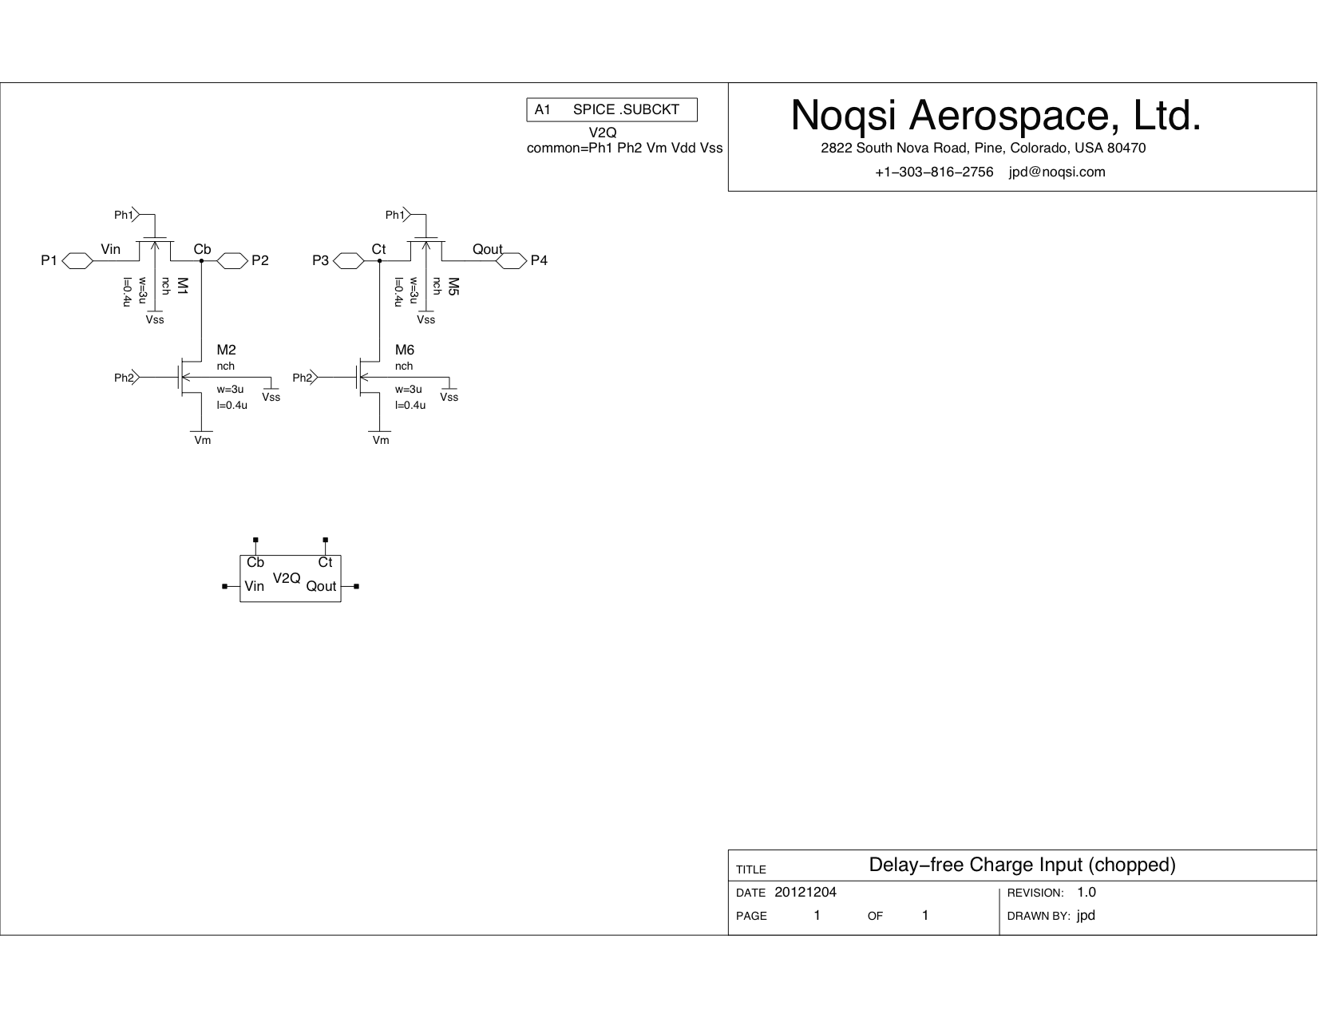

Slide 17
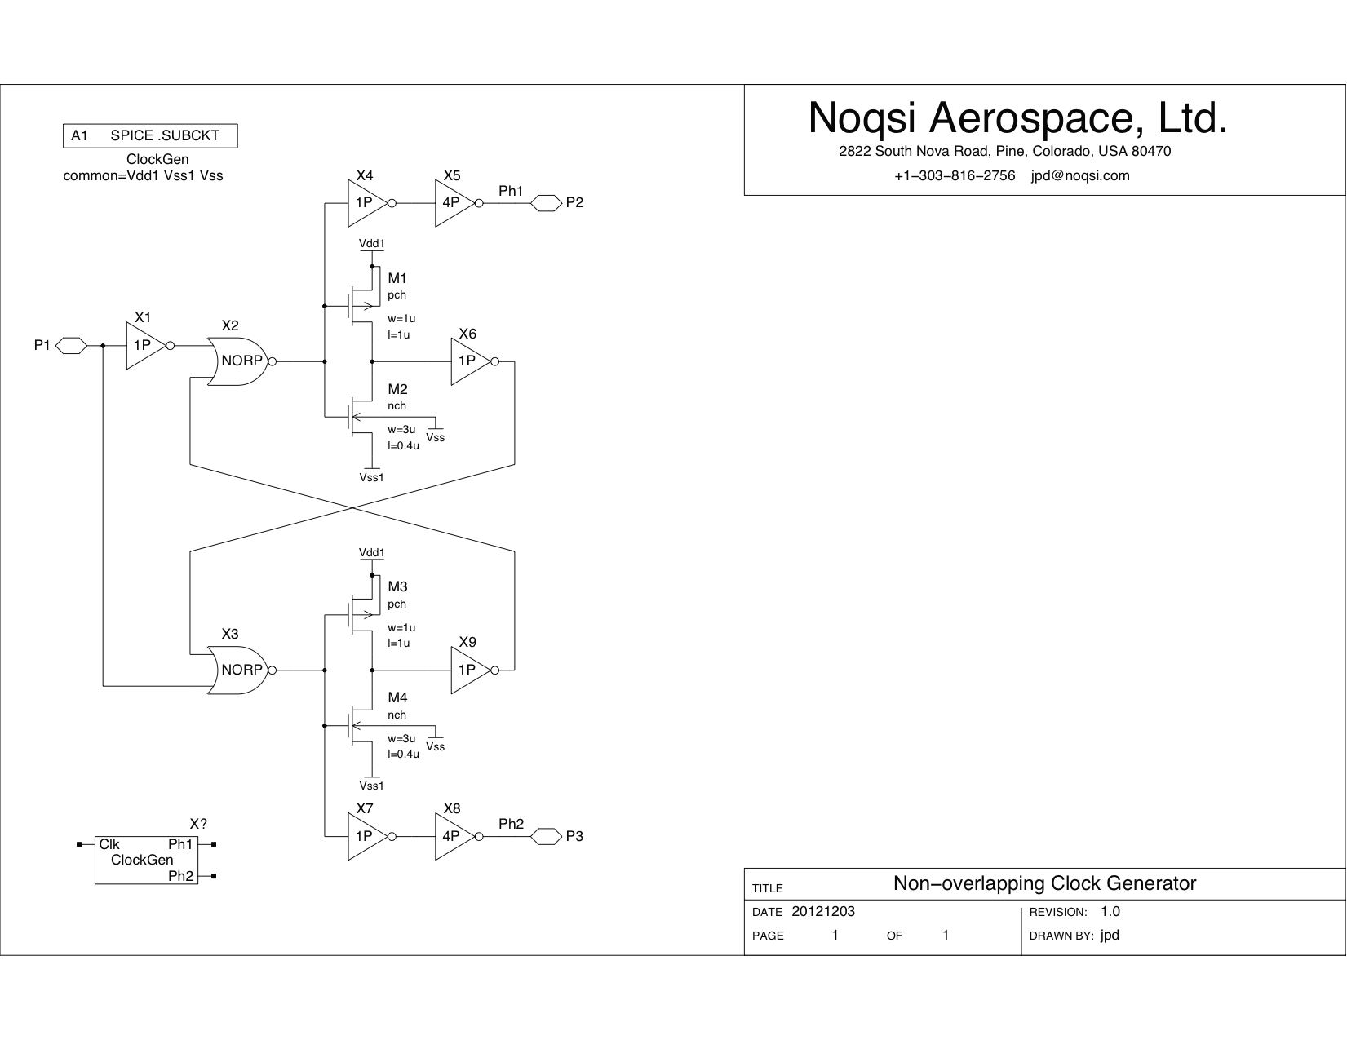

Slide 18
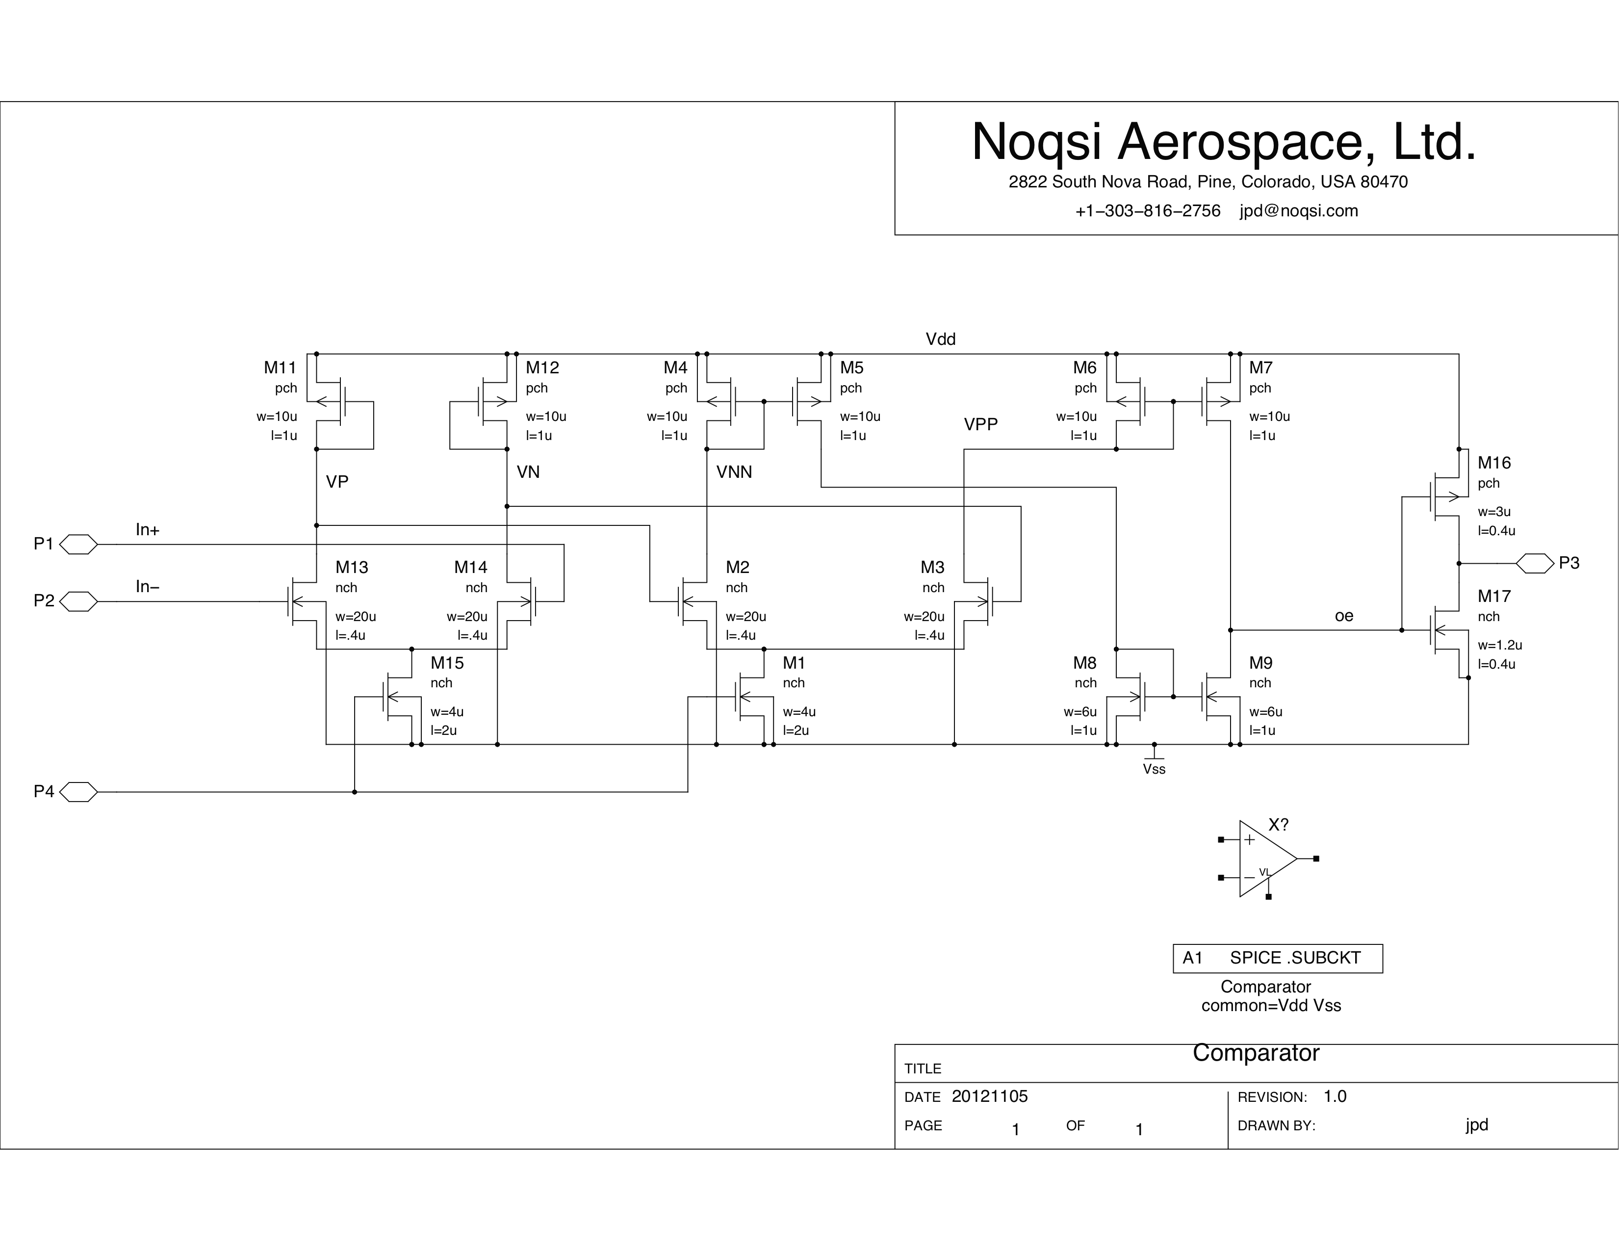

Slide 19
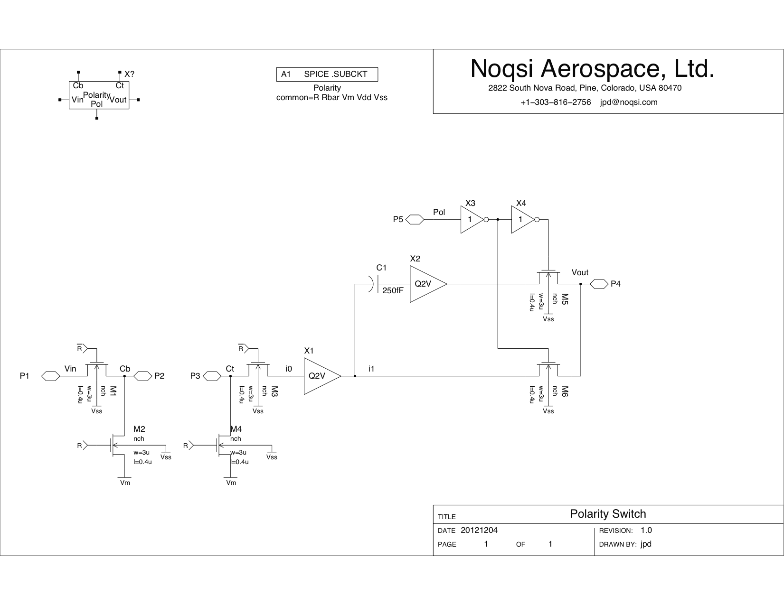

Slide 20
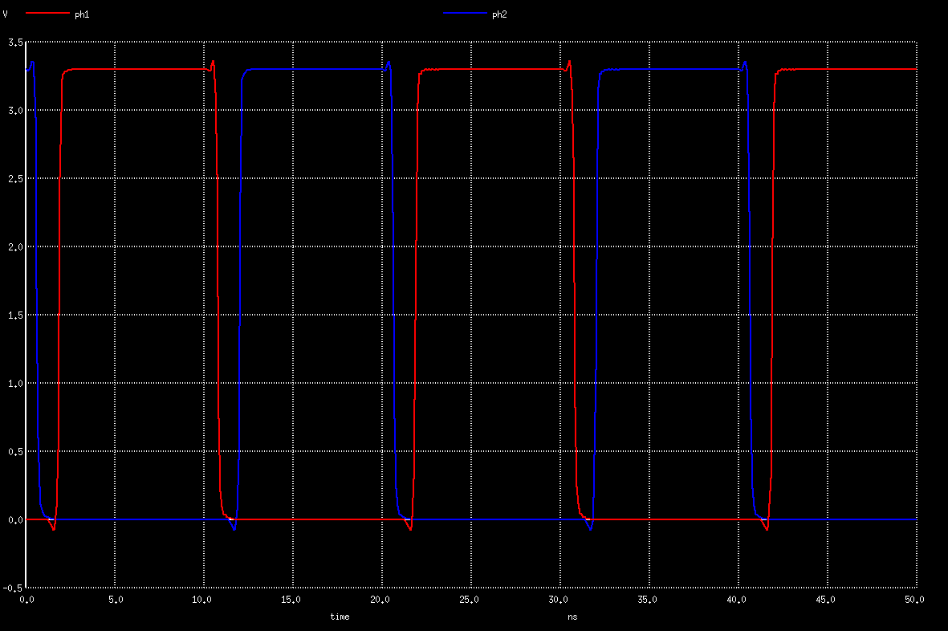
ClockGen Simulation

Slide 21
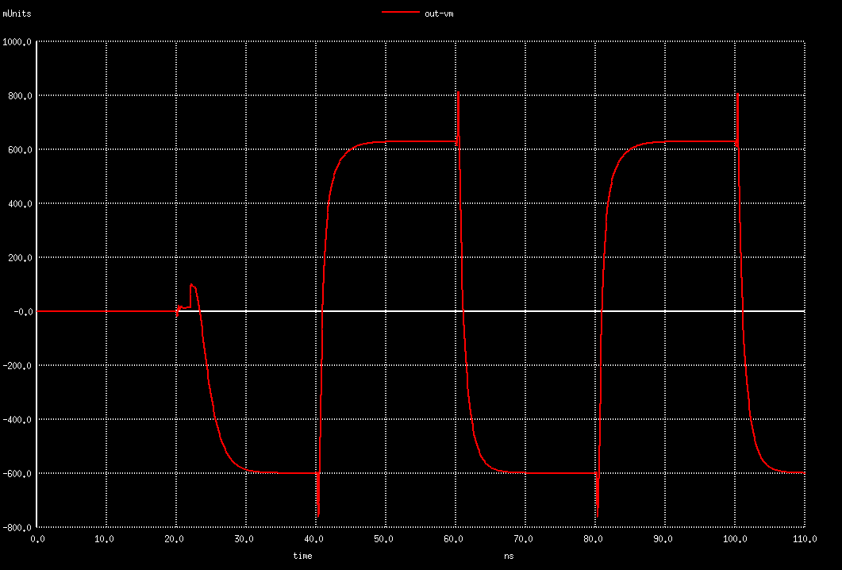
Polarity Switch Simulation

Slide 22
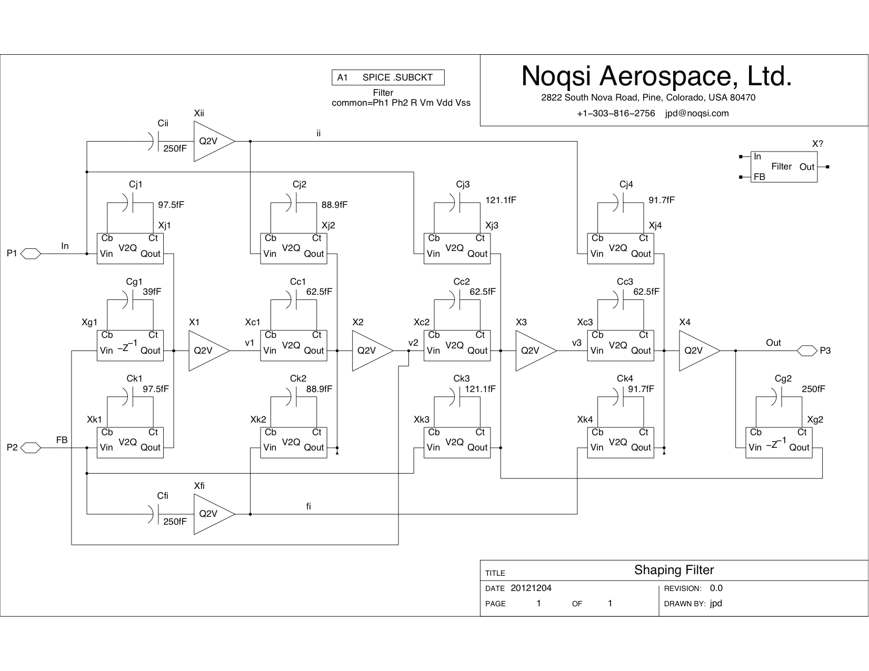

Slide 23
Question on Next Steps
Do we need filter resonance (g coefficients)?
  Tuned to a particular number of samples/pixel.
  Signal/(modulator noise) ~2000 at 50 samples/pixel without resonance, ~4000 with resonance.
  Difficult to design very weak feedback here, probably need significant power.

