Slide 1
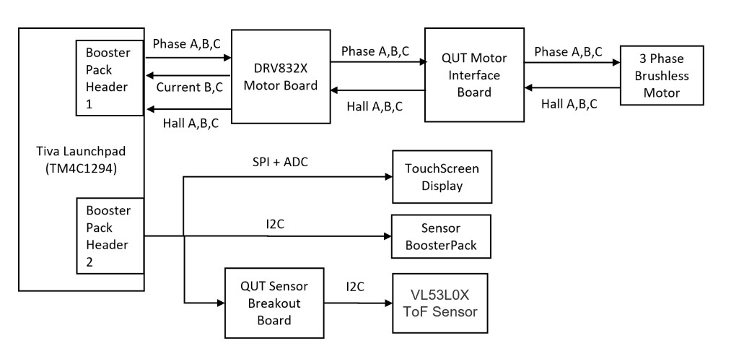
Motor Subsystem Hardware Flow (from provided architecture diagram)
TM4C1294 controls DRV832X commutation and reads Hall/current feedback for safe BLDC operation
What this motor system does
1) MCU outputs 3-phase PWM to DRV832X via BoosterPack header.
2) DRV832X drives the motor phases through the QUT motor interface board.
3) Hall A/B/C returns rotor position/speed to MCU for feedback.
4) Current feedback returns from DRV board for power monitoring/E-stop.
5) Touchscreen gives start/stop/speed commands and shows state live.
6) Sensor path provides accel/lux/power evidence and E-stop triggers.
Result: safe closed-loop-ready BLDC control with fault latching.
Notes:
Slide 1 script (~90s): This diagram shows our full motor signal path. The TM4C1294 sends commutation PWM to the DRV832X through BoosterPack header 1. Power stage output goes through the QUT motor interface board to the 3-phase BLDC. Hall A/B/C comes back to the MCU as rotor feedback used for speed estimation and state transitions. Current feedback from the DRV stage is used for power monitoring and safety trip logic. The touchscreen provides operator control and runtime state visibility. So the system integrates actuation, sensing, and safety in one controlled loop.

Slide 2
Motor State Machine and Evidence (Task 2.1)
States, ramps, E-stop behaviour, and serial plot channels used for marking evidence
State machine implemented
• Idle → Starting → Running → Stopping
• Fault/event → E-Stop Braking → Fault Latched
• User ACK required before returning to Idle
Control/ramp constraints
• Acceleration ≤ 500 RPM/s
• Normal deceleration ≤ 500 RPM/s
• E-stop deceleration = 1000 RPM/s
Serial plot evidence (UART 115200)
• desired_rpm, reference_rpm, actual_rpm, duty_percent
• estop_active (step marker), hall_display_rpm
3-minute demo flow
1) START at low RPM: show Idle → Starting → Running
2) Increase speed: reference ramps at 500 RPM/s
3) Trigger E-stop (power/accel): estop_active rises
4) Observe fast reference drop at 1000 RPM/s
5) Fault latched until ACK, then back to Idle
Notes:
Slide 2 script (~90s): We implement the required state machine with explicit transitions and safety latching. In normal operation, desired speed updates a ramped reference with 500 RPM/s limits. On any E-stop condition, user commands are ignored, estop_active asserts, and reference decelerates at 1000 RPM/s. Once speed reaches stop, the controller remains fault latched until operator acknowledgment. These channels on the serial plot provide direct evidence for marking against task 2.1.3, 2.1.5, and 2.1.9.

Slide 3
RTOS Integration (2.1.6)
EGH456 — FreeRTOS: ISRs, motor task, E-stop, prioritisation
ISRs — hall speed + sensor sampling
HallPortM / H / N: GPIO IRQ → g_edges + commutation (no blocking RTOS calls)
ADC1Seq0 → xPowerRawQueue (FromISR) · Timer2A → accel semaphore (FromISR)
RPM calculated in Speed task (100 Hz), not inside hall ISR
Motor task — 10 ms, priority idle+4
State machine · Ramp (500 / 1000 RPM/s) · Duty from reference
Fault / E-stop — event group xSystemEvents
Sensor: EVT_ESTOP_POWER, EVT_ESTOP_ACCEL → Motor: ESTOP_BRAKING → FAULT
GUI: START/STOP/ACK bits + xCommandQueue (mutex)
Fault task (idle+1): UART logging only
Priorities: Speed/GUI/Plot (+5) > Motor/AccSamp (+4) > Sensor (+3)

Slide 4
RTOS Communication
Hall ISR → Speed task → Motor task (control loop) ADC ISR → queue → Sensor task → event bits → Motor Timer ISR → semaphore → AccSamp task → Sensor GUI → queue + events → Motor → queue → GUI

