Slide 1
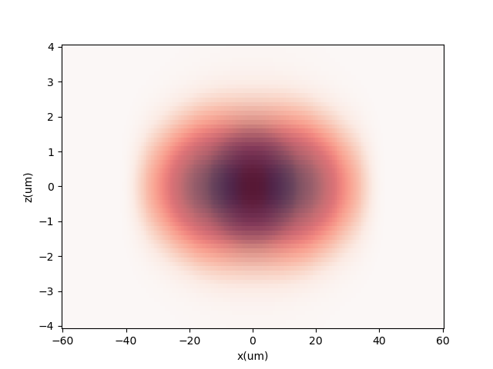
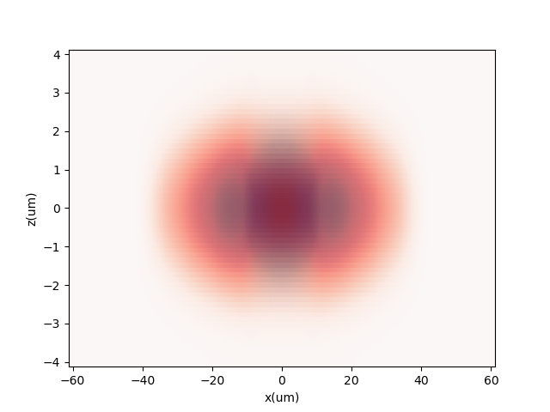
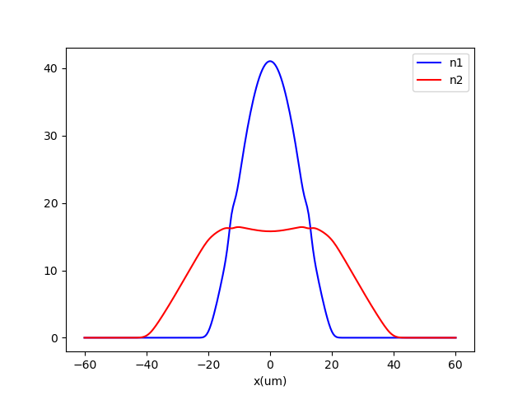
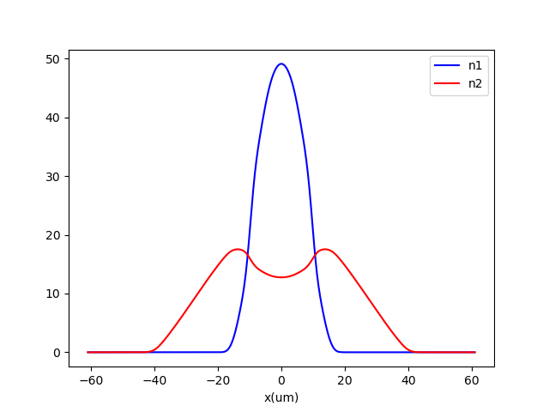
a11 = 65a0
b11 = 64a0
a22 = 65a0
fx = 10 Hz
fy=fz=150 Hz
N1=N2=30000
a12 = 20a0
a12 = 25a0

Slide 2
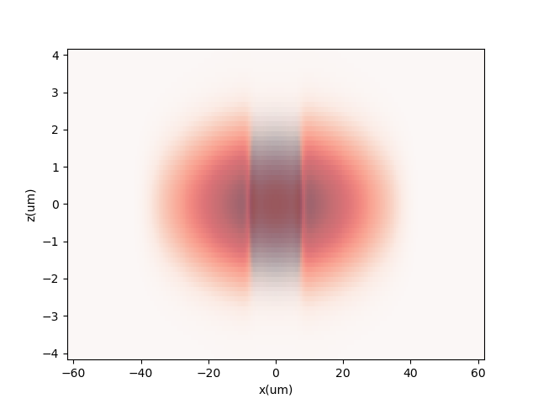
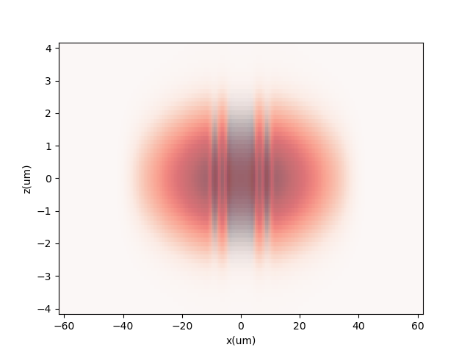
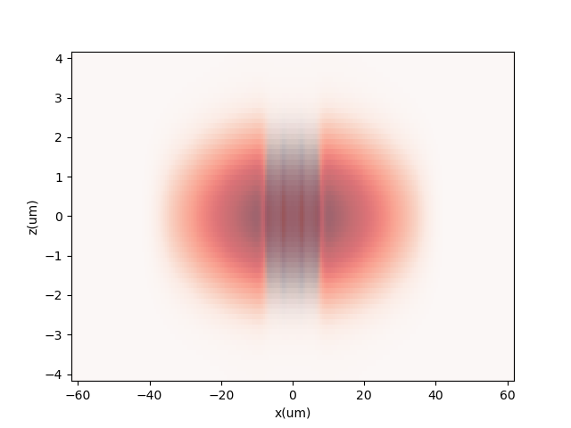
a11 = 65a0
b11 = 64a0
a22 = 65a0
fx = 10 Hz
fy=fz=150 Hz
N1=N2=30000
a12 = 31a0
155.88
156.05
156.24

Slide 3
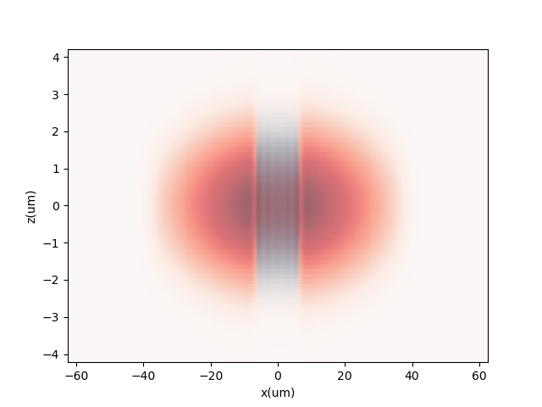

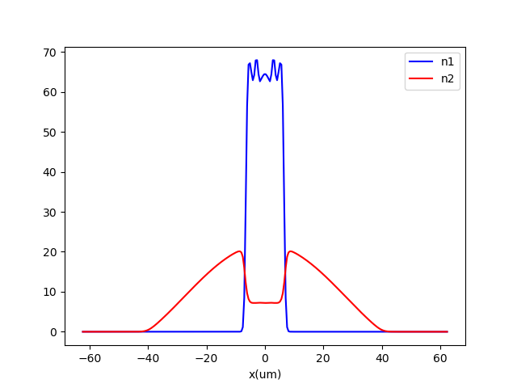
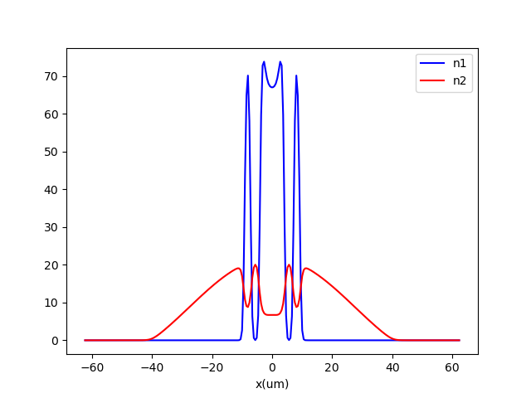
a11 = 65a0
b11 = 64a0
a22 = 65a0
fx = 10 Hz
fy=fz=150 Hz
N1=N2=30000
a12 = 36a0
157.05
156.95

Slide 4
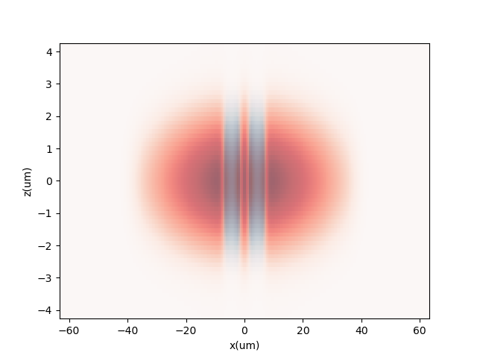

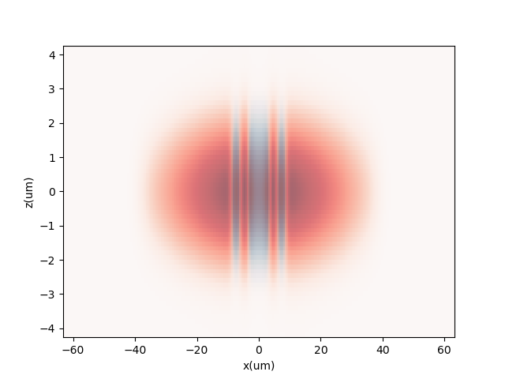
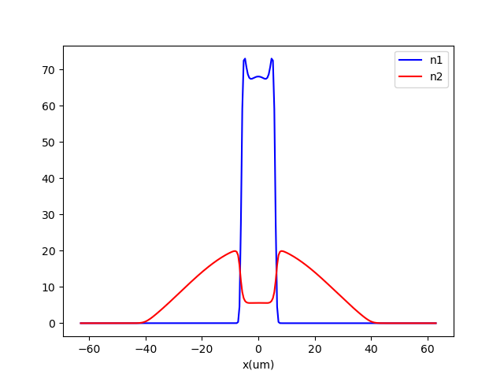
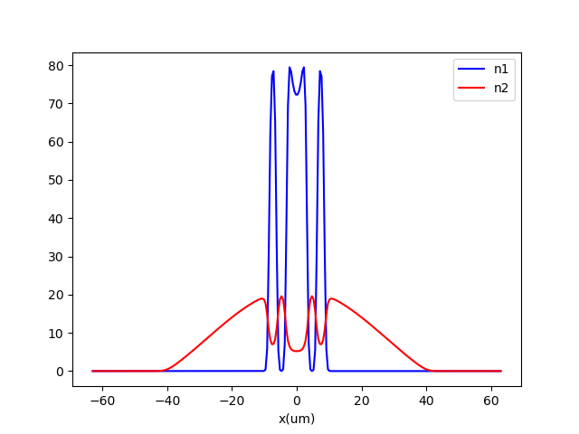
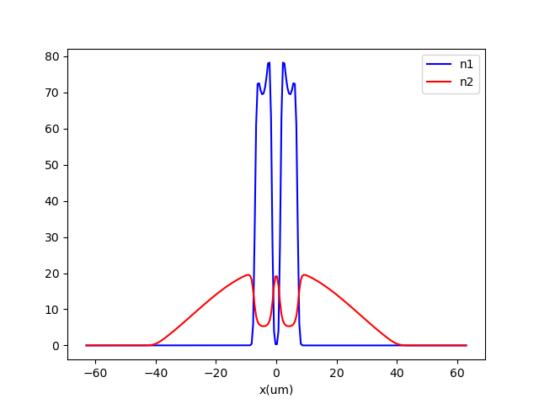
a11 = 65a0
b11 = 64a0
a22 = 65a0
fx = 10 Hz
fy=fz=150 Hz
N1=N2=30000
a12 = 42a0
157.13
157.38
157.60

Slide 5
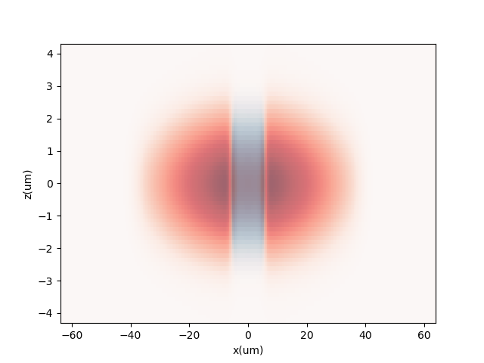
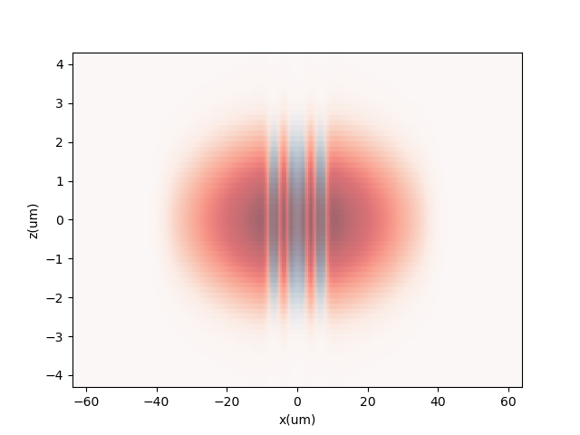
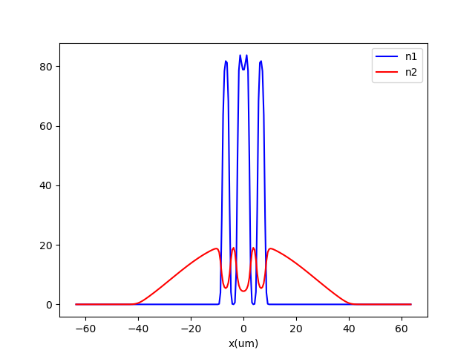
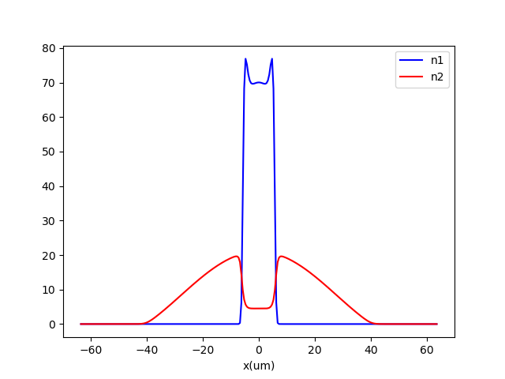
a11 = 65a0
b11 = 64a0
a22 = 65a0
fx = 10 Hz
fy=fz=150 Hz
N1=N2=30000
a12 = 47a0
157.47
158.10

Slide 6
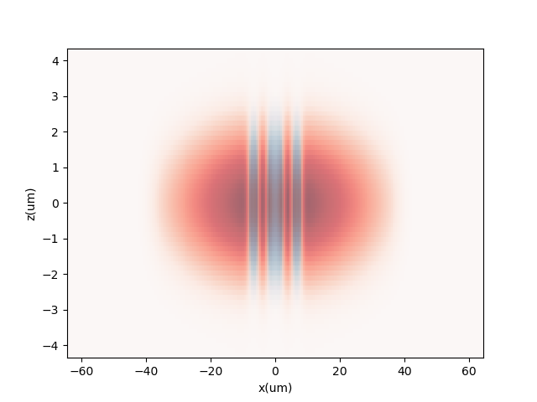
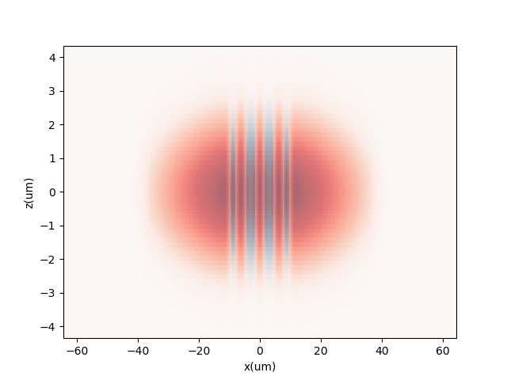

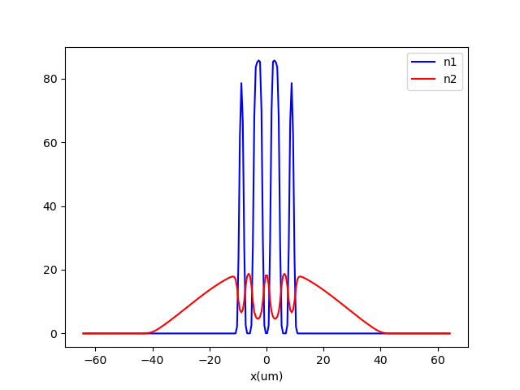
a11 = 65a0
b11 = 64a0
a22 = 65a0
fx = 10 Hz
fy=fz=150 Hz
N1=N2=30000
a12 = 53a0
158.49
158.94

Slide 7
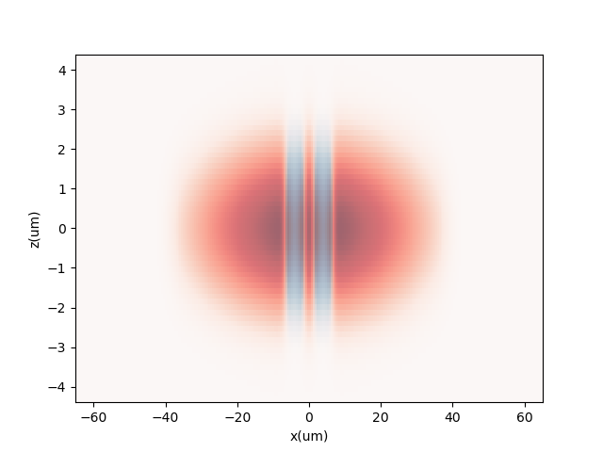
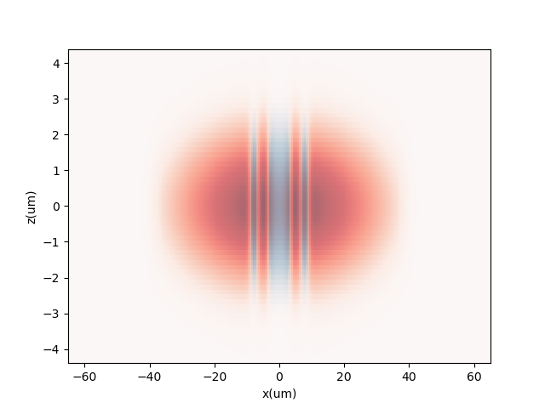


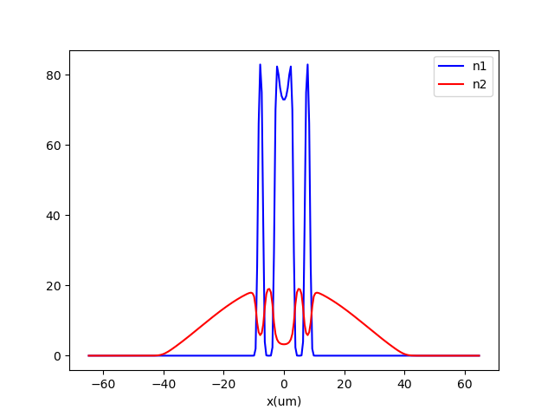
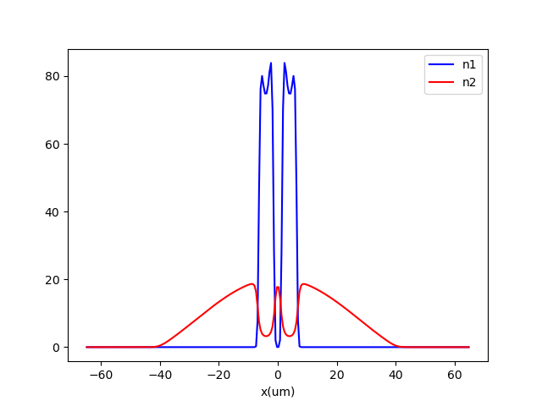
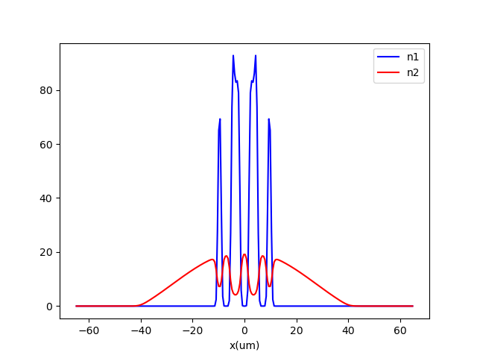
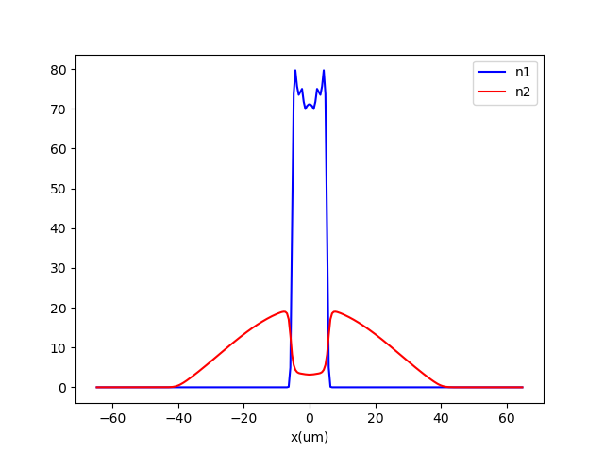
a11 = 65a0
b11 = 64a0
a22 = 65a0
fx = 10 Hz
fy=fz=150 Hz
N1=N2=30000
a12 = 58a0
158.48
158.53
158.83
160.00

Slide 8



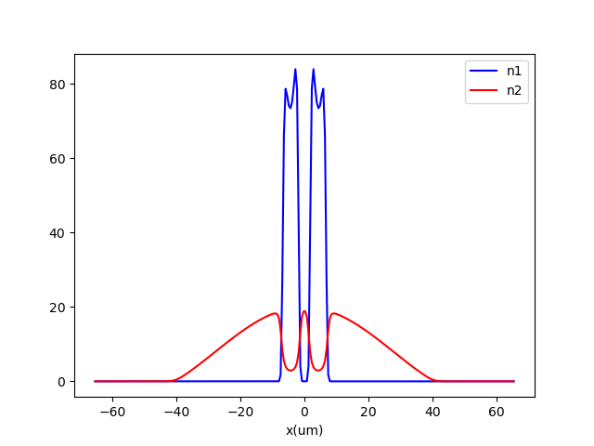
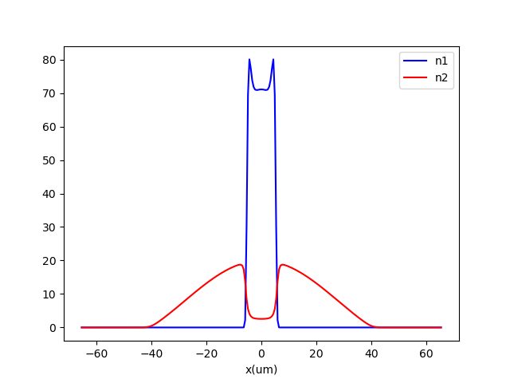

a11 = 65a0
b11 = 64a0
a22 = 65a0
fx = 10 Hz
fy=fz=150 Hz
N1=N2=30000
a12 = 64a0
158.19
158.68
159.11

Slide 9
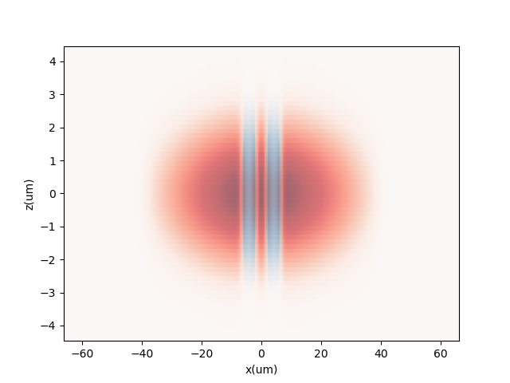
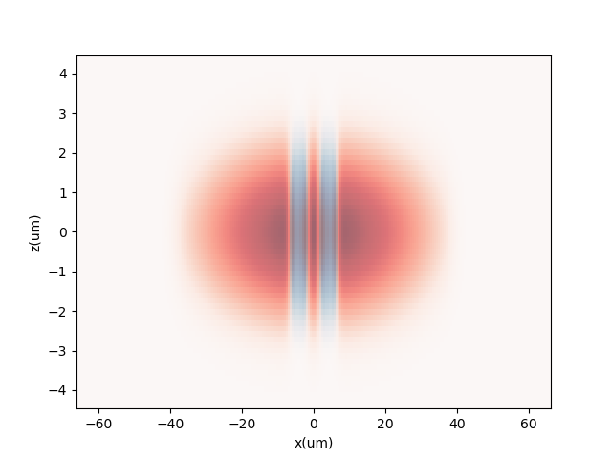


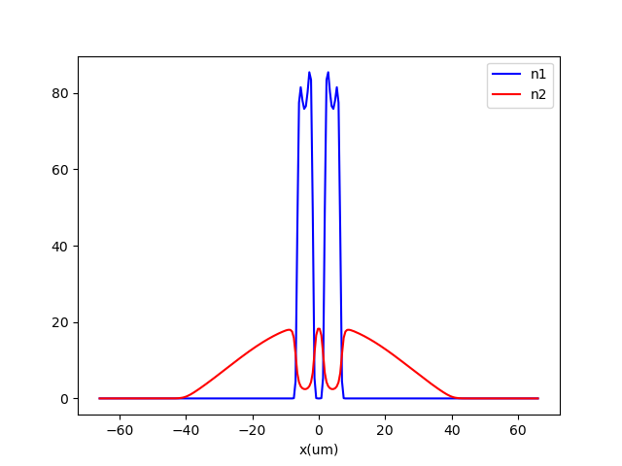

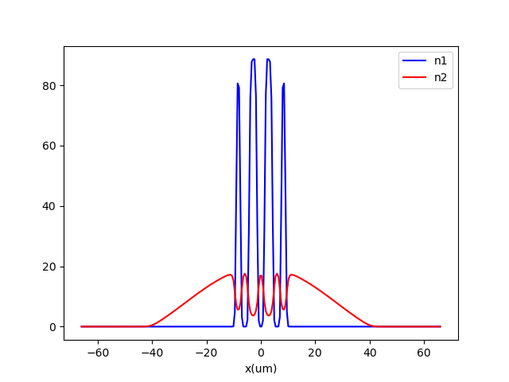
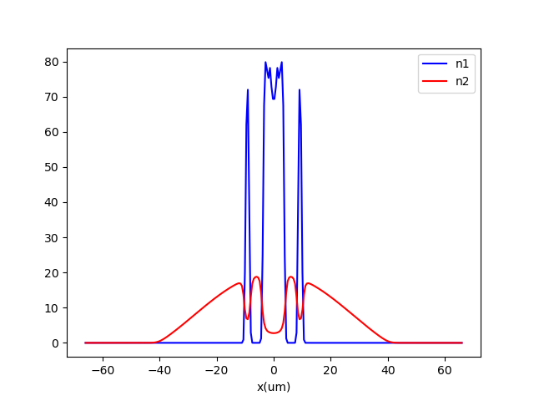
a11 = 65a0
b11 = 64a0
a22 = 65a0
fx = 10 Hz
fy=fz=150 Hz
N1=N2=30000
a12 = 70a0
158.90
159.53
159.95
160.0

