Slide 1
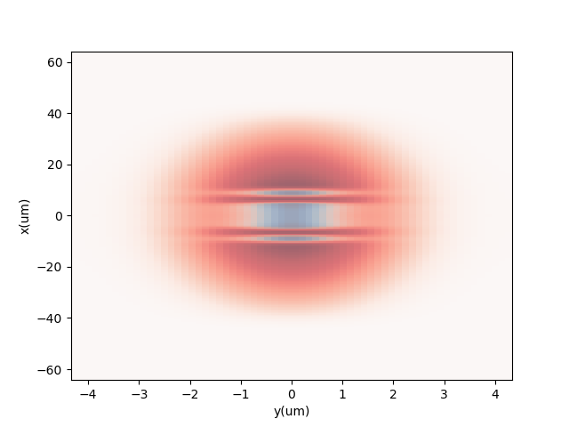
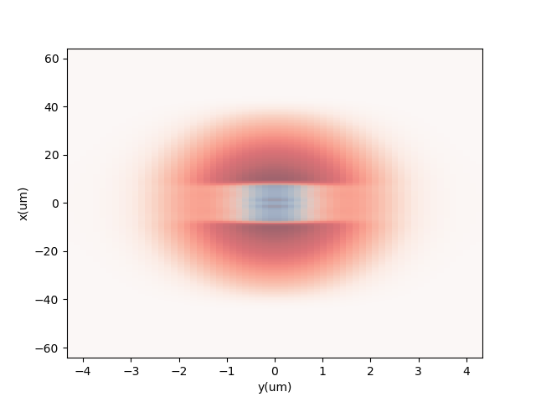
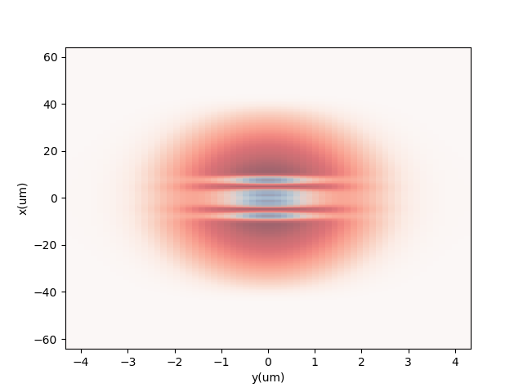
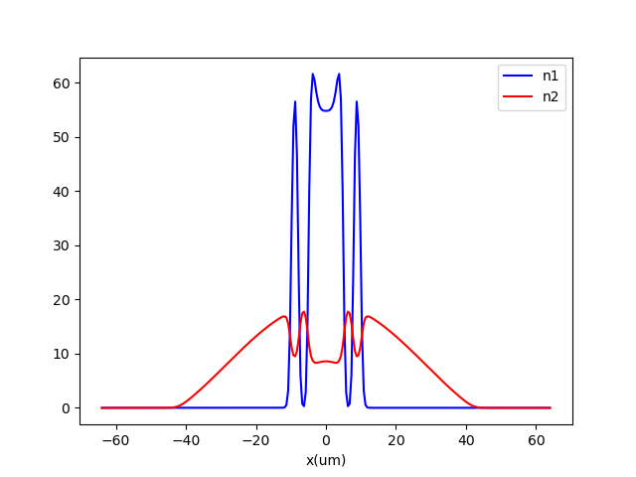
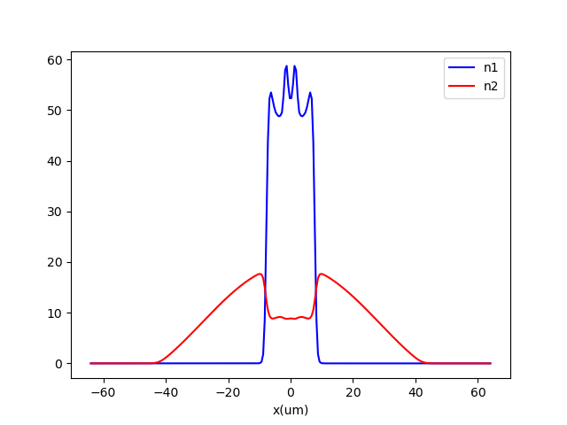
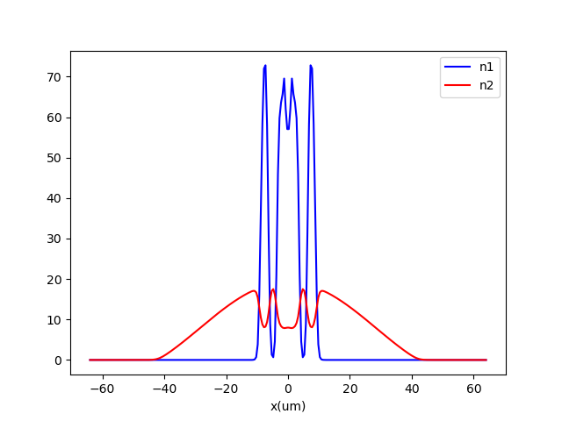
a11 = 65a0
b11 = 64a0
a22 = 80a0
fx = 10 Hz
fy=fz=150 Hz
N1=N2=30000
a12=36a0
164.11
164.29
164.96

Slide 2
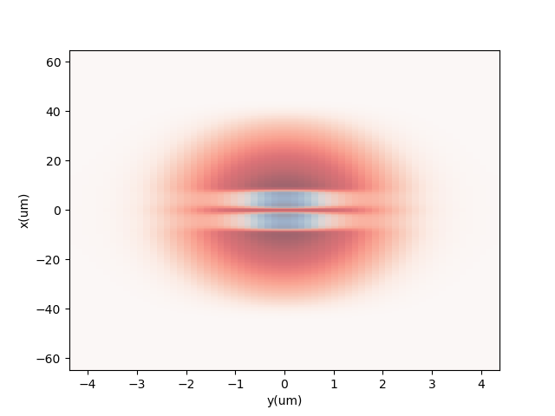
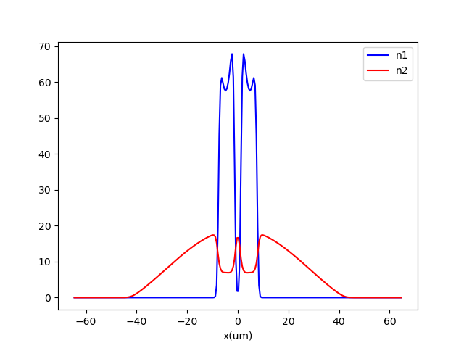
a11 = 65a0
b11 = 64a0
a22 = 80a0
fx = 10 Hz
fy=fz=150 Hz
N1=N2=30000
a12=42a0
164.74

Slide 3
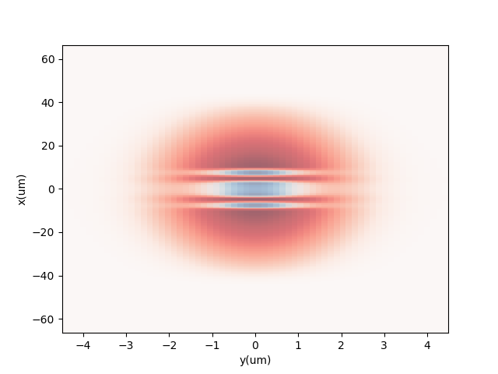
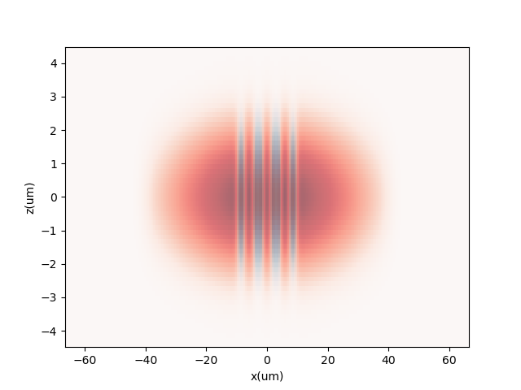
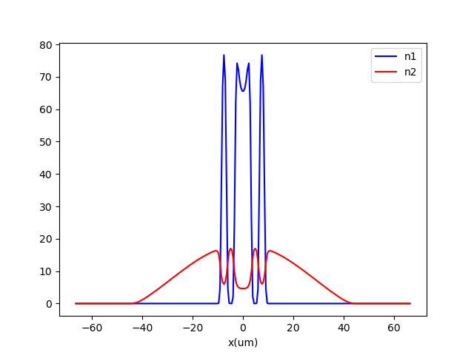
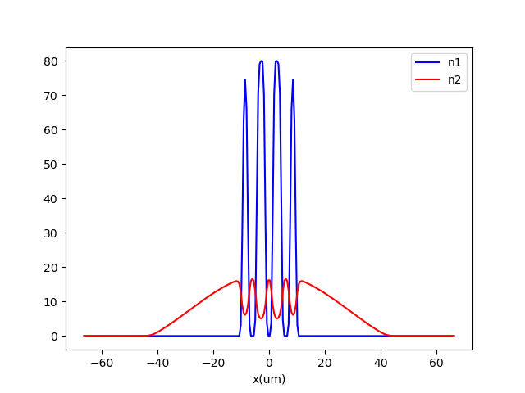
a11 = 65a0
b11 = 64a0
a22 = 80a0
fx = 10 Hz
fy=fz=150 Hz
N1=N2=30000
a12=58a0
166.17
166.54
Notes:
70 maybe also interesting

