Slide 1
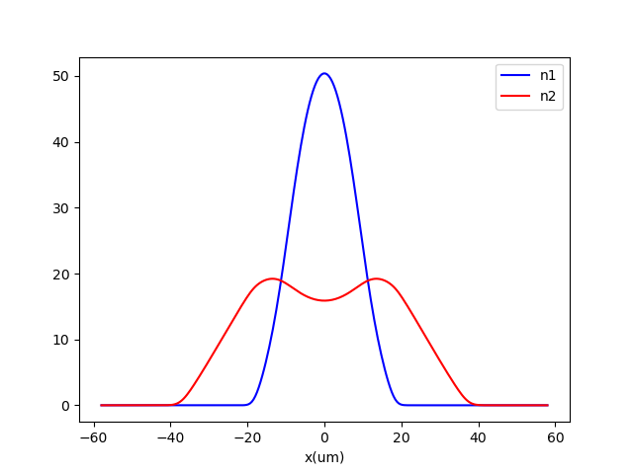
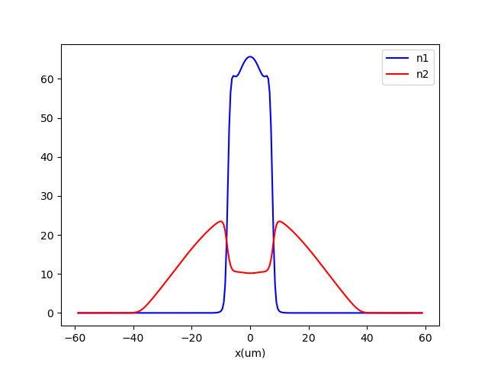
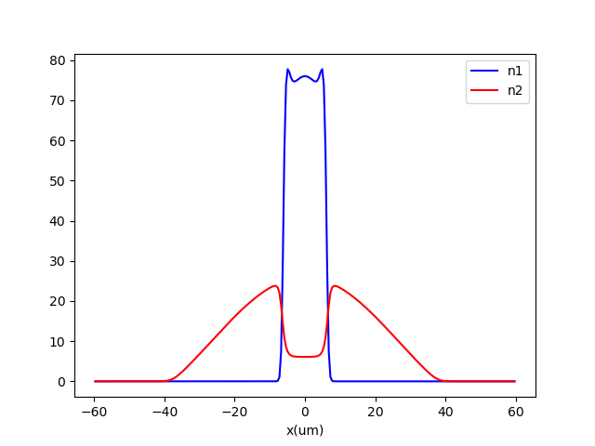
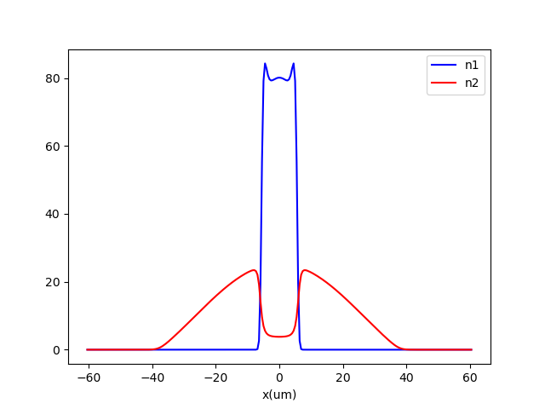
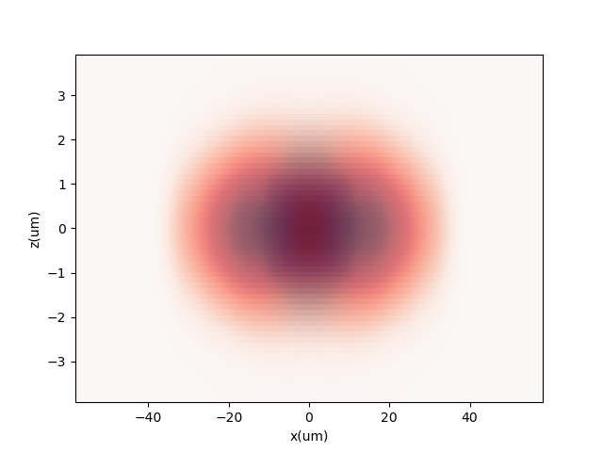
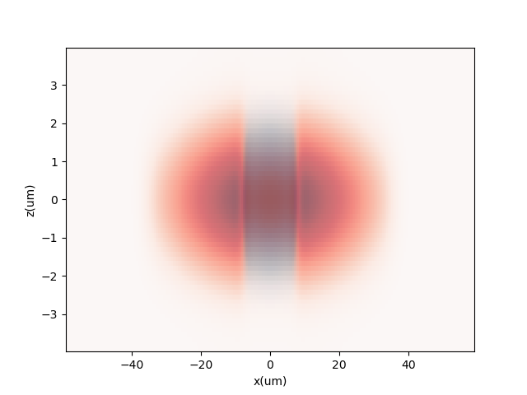
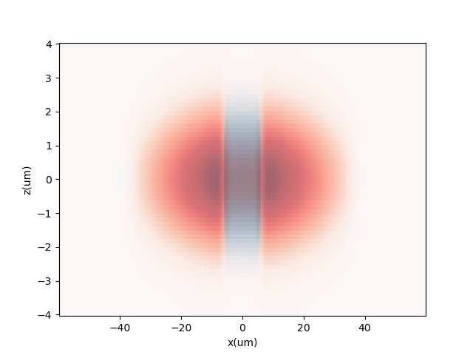
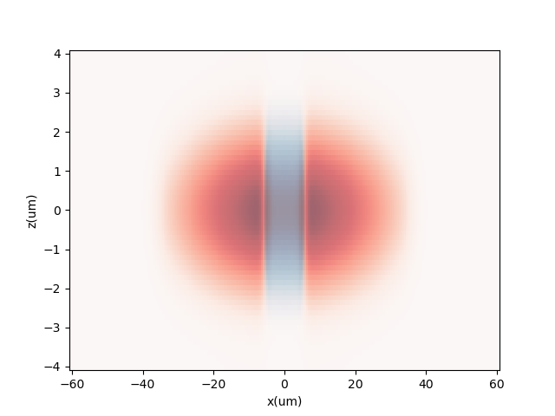
a11 = 65a0
b11 = 64a0
a22 = 50a0
fx = 10 Hz
fy=fz=150 Hz
N1=N2=30000
a12 = 20a0
a12 = 25a0
a12 = 31a0
a12 = 36a0

Slide 2
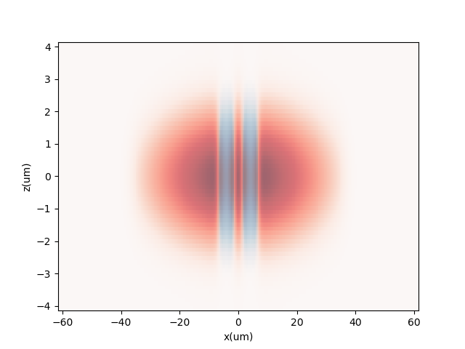
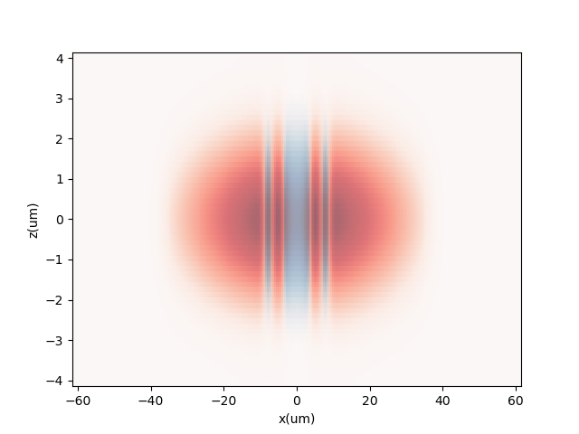

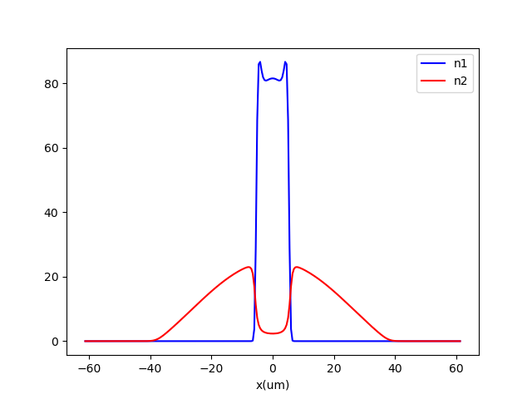
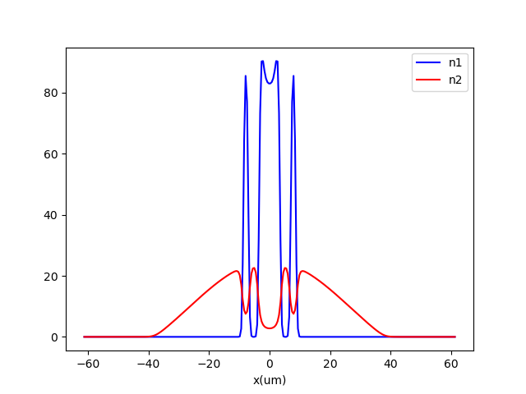
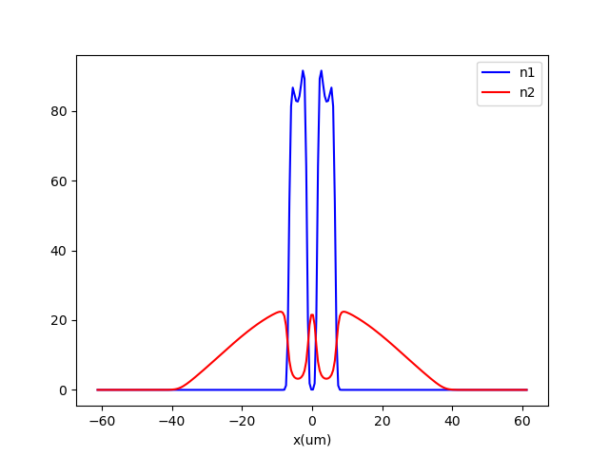
a11 = 65a0
b11 = 64a0
a22 = 50a0
fx = 10 Hz
fy=fz=150 Hz
N1=N2=30000
a12 = 42a0
148.89
149.29
148.43

Slide 3

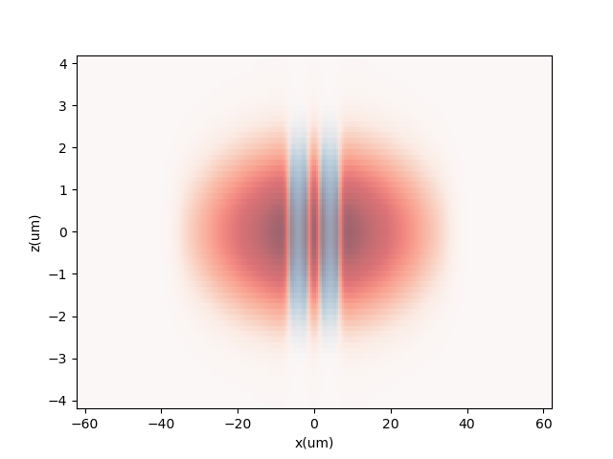
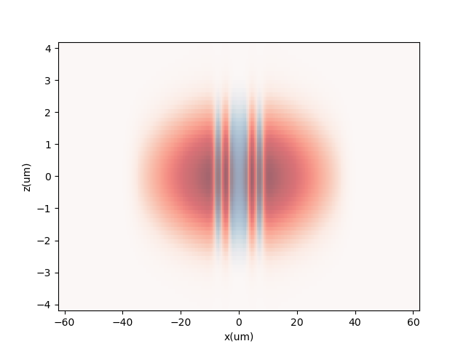

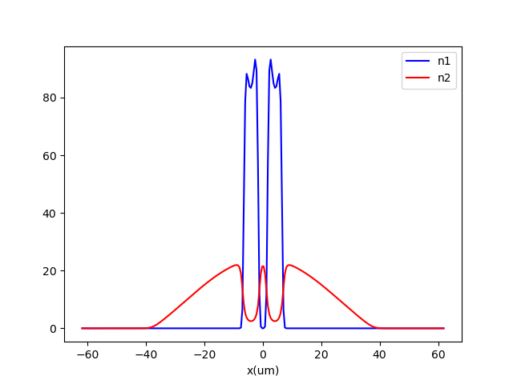
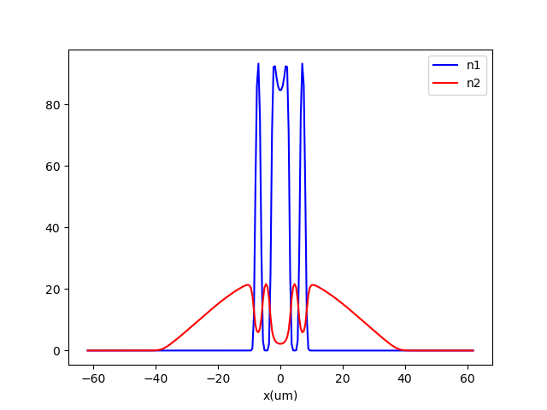
a11 = 65a0
b11 = 64a0
a22 = 50a0
fx = 10 Hz
fy=fz=150 Hz
N1=N2=30000
a12 = 47a0
148.72
149.26
149.73

Slide 4


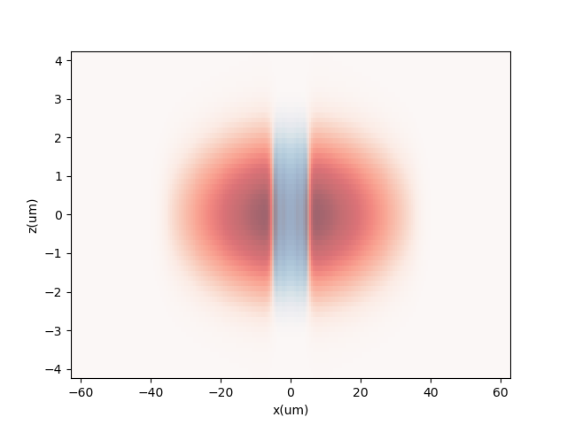
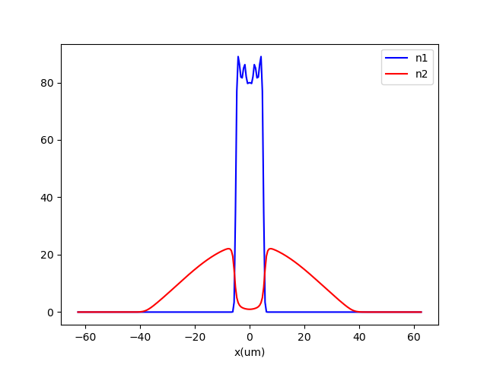
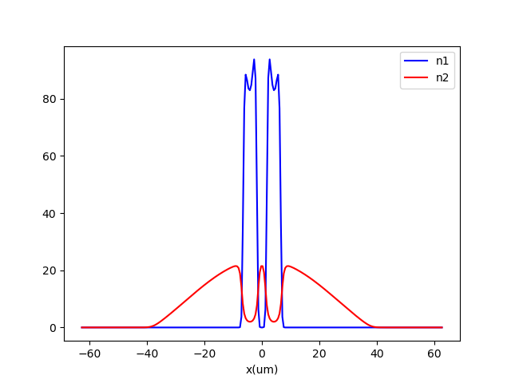
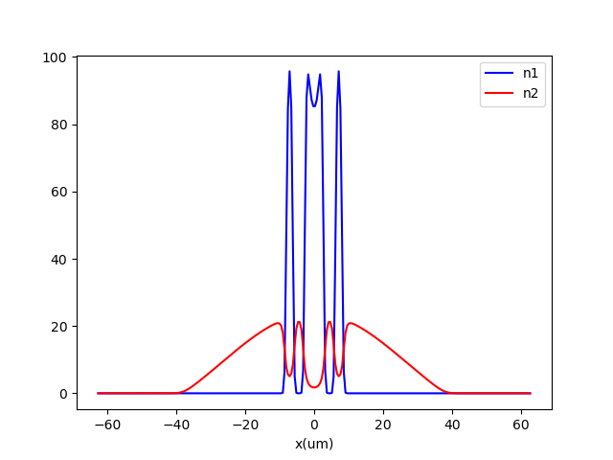
a11 = 65a0
b11 = 64a0
a22 = 50a0
fx = 10 Hz
fy=fz=150 Hz
N1=N2=30000
a12 = 53a0
149.56
150.10
149.47

Slide 5


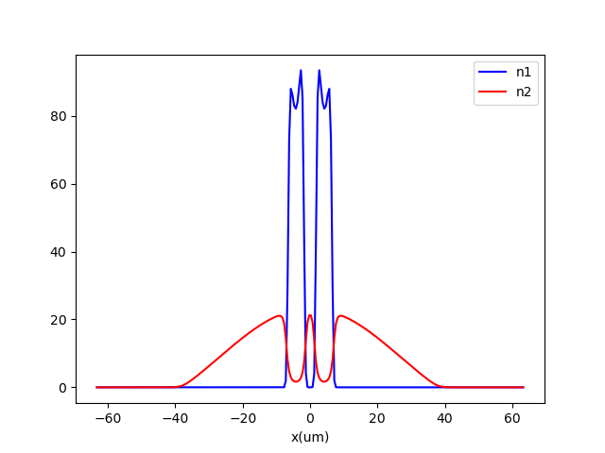

a11 = 65a0
b11 = 64a0
a22 = 50a0
fx = 10 Hz
fy=fz=150 Hz
N1=N2=30000
a12 = 58a0
149.82
150.43

Slide 6
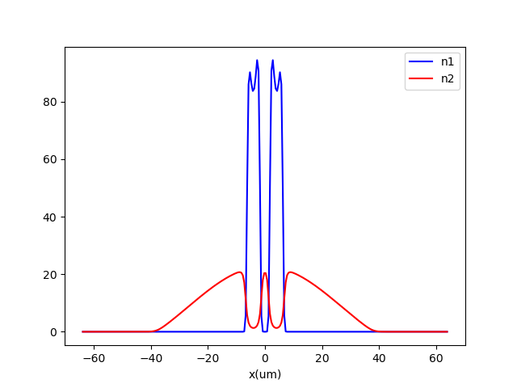
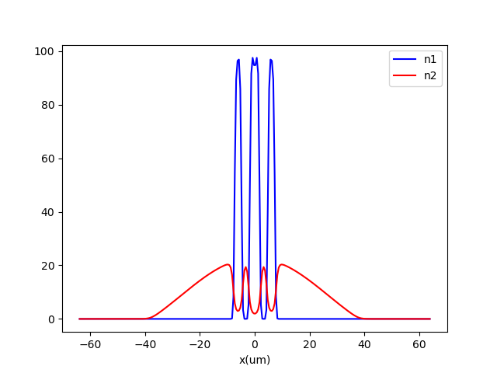


a11 = 65a0
b11 = 64a0
a22 = 50a0
fx = 10 Hz
fy=fz=150 Hz
N1=N2=30000
a12 = 64a0
150.05
150.74

Slide 7
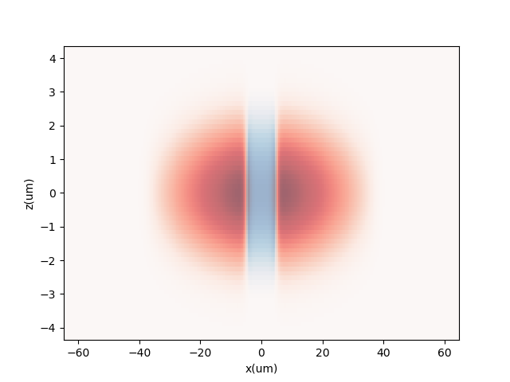
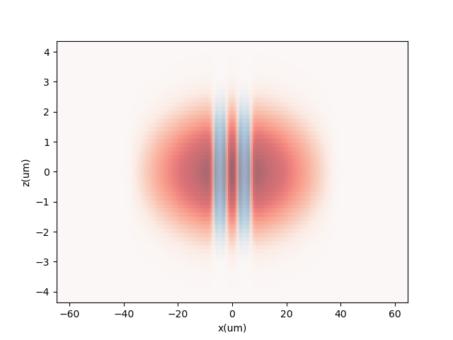
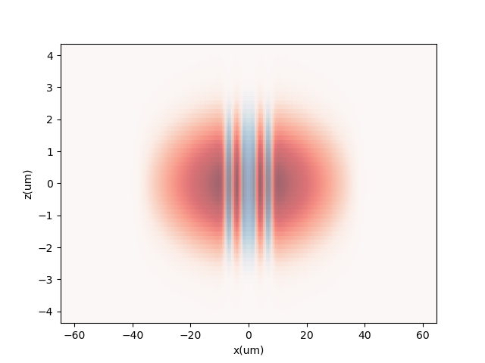
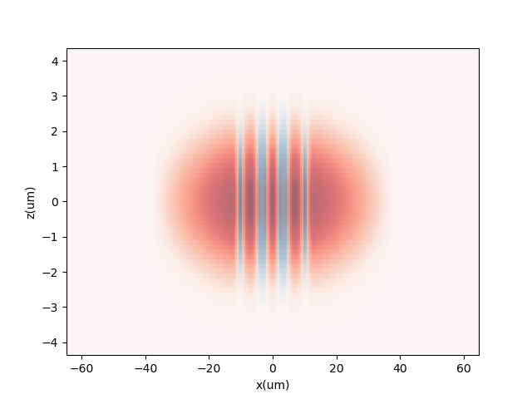
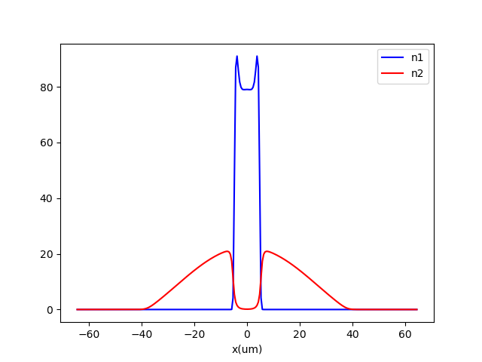
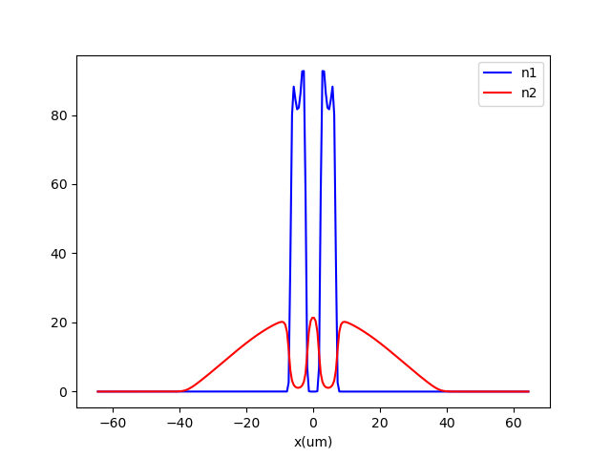
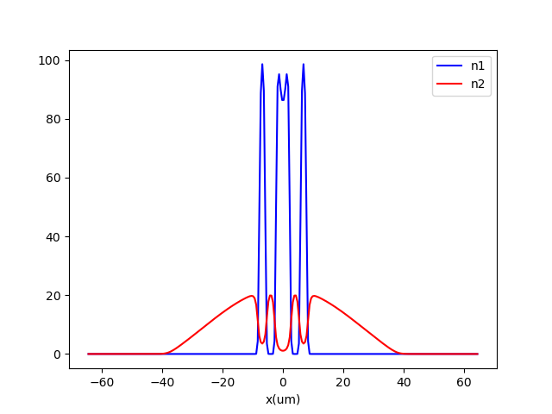
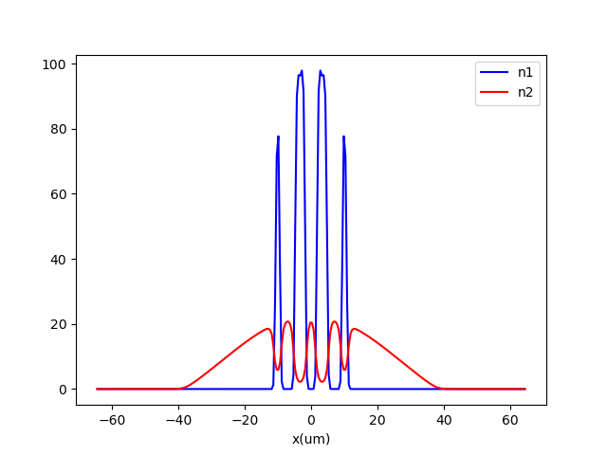
a11 = 65a0
b11 = 64a0
a22 = 50a0
fx = 10 Hz
fy=fz=150 Hz
N1=N2=30000
a12 = 70a0
149.45
150.26
150.93
151.76
Energy:

