Slide 1
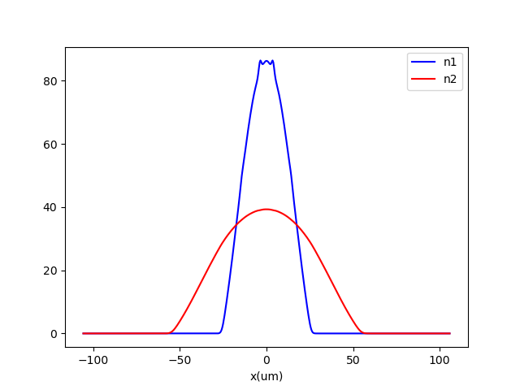
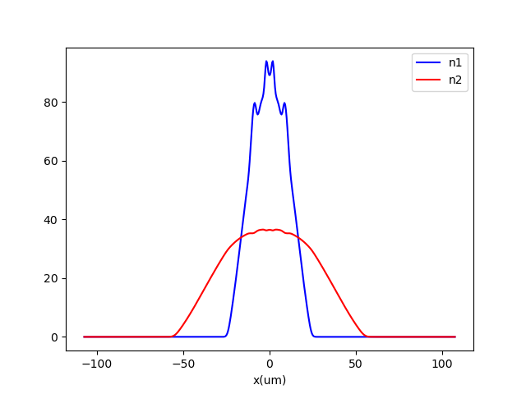
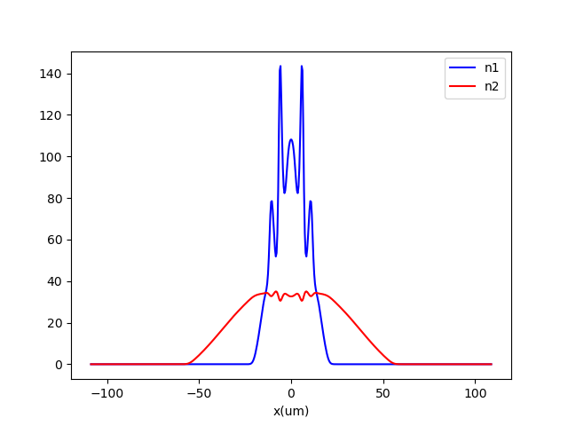
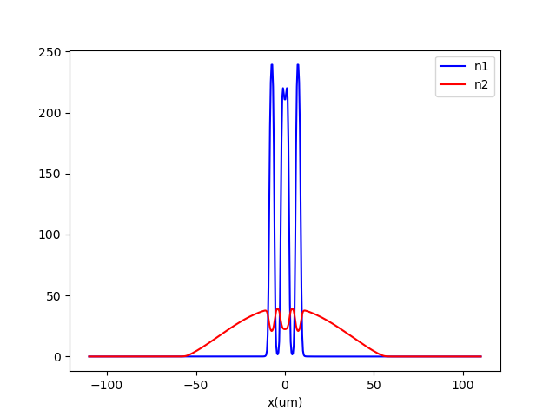
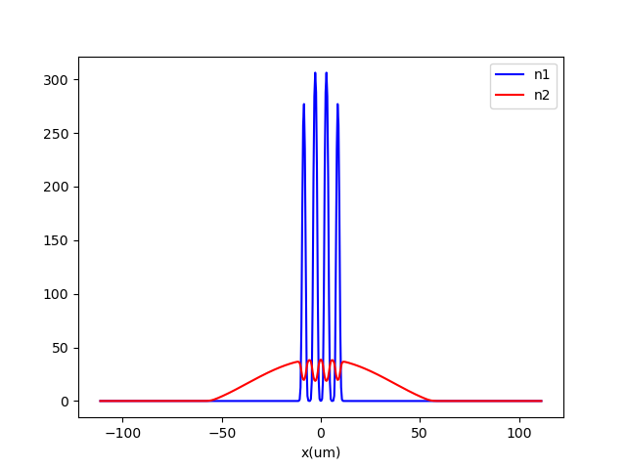
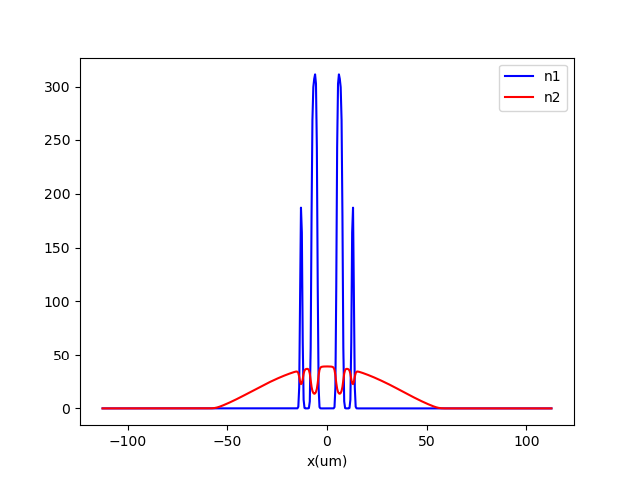
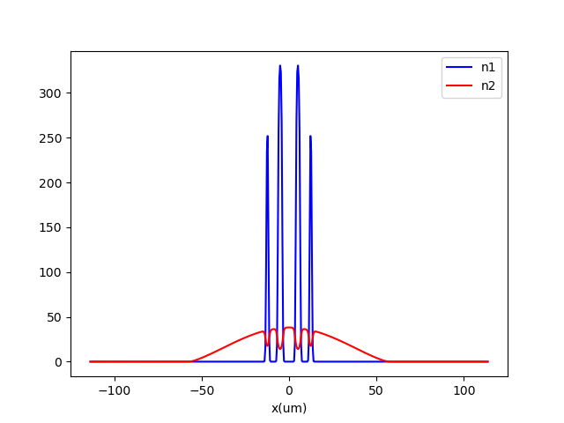
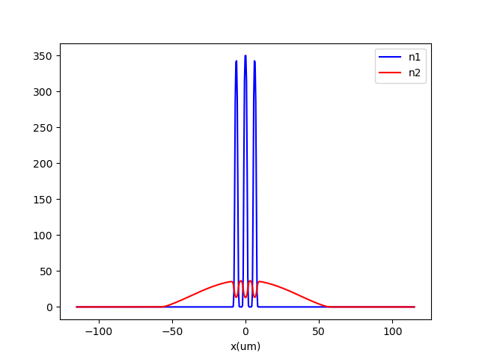
R0: tol,iter,dt,a12i,a12f,Na,a22,Nx,L,runs,guess
1e-07,20000,0.1,10,80,8,100,512,4,1,random_sym
243.78702582802327
249.21010977940193
253.830999425216
256.1613255080047
256.8223681378594
258.8262675200980
259.4537608143048
258.1731210415886

Slide 2

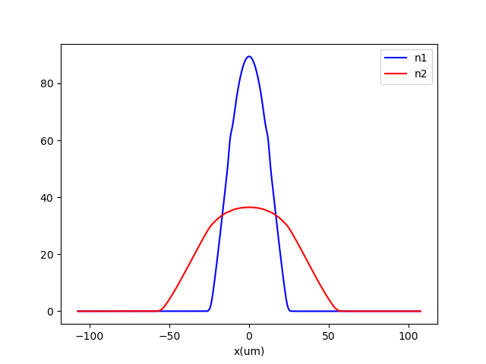
R1: tol,iter,dt,a12i,a12f,Na,a22,Nx,L,runs,guess
1e-8
1024
243.67508624793086
249.29691379464631

Slide 3

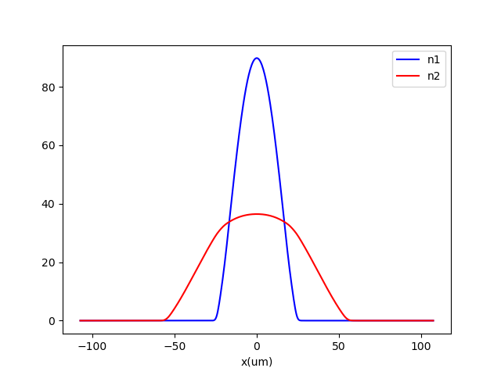
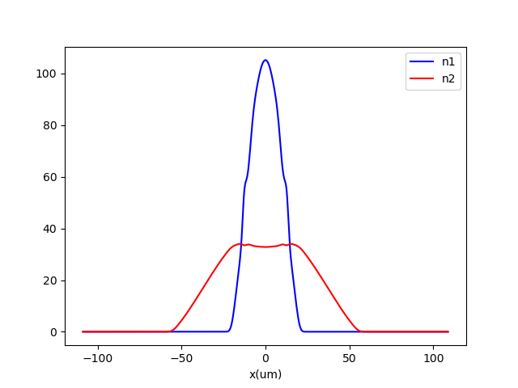
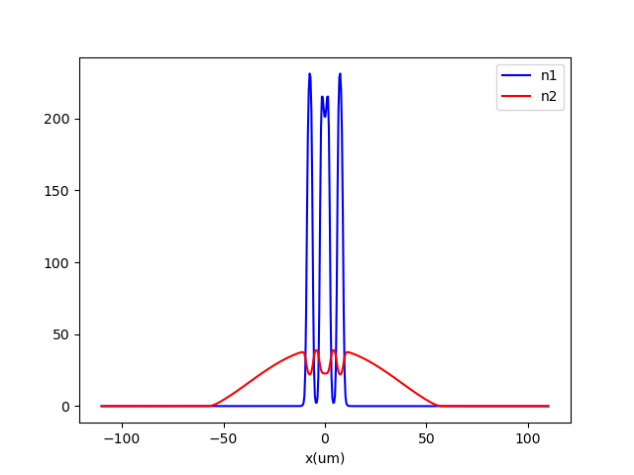
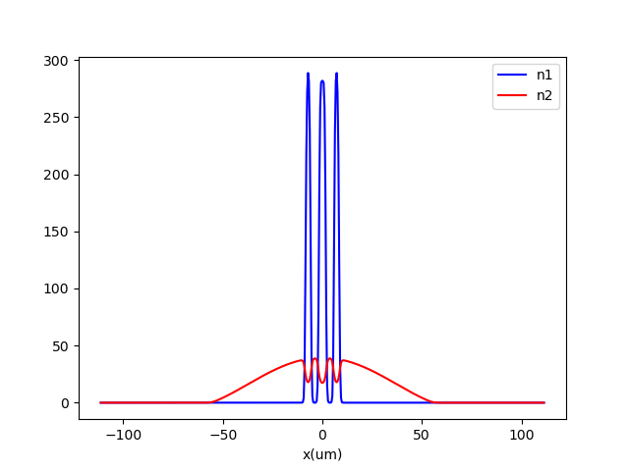

R2: 512, 1e-8,
243.953705054053
249.31326296281134
253.4711834263573
255.9777137552869
256.7241239530117
257.37591333531935

Slide 4
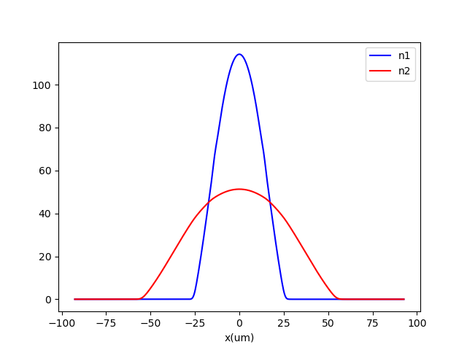
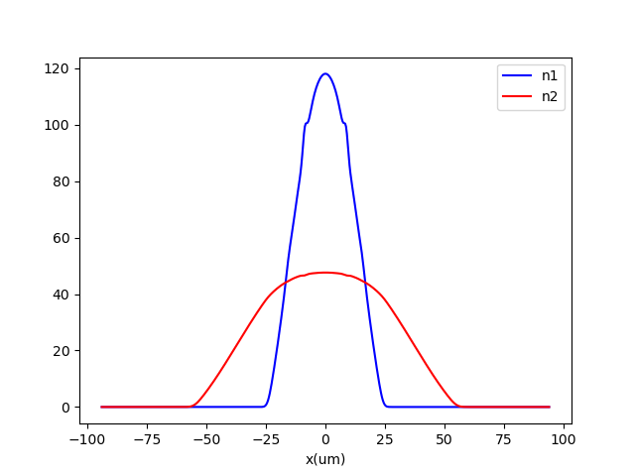
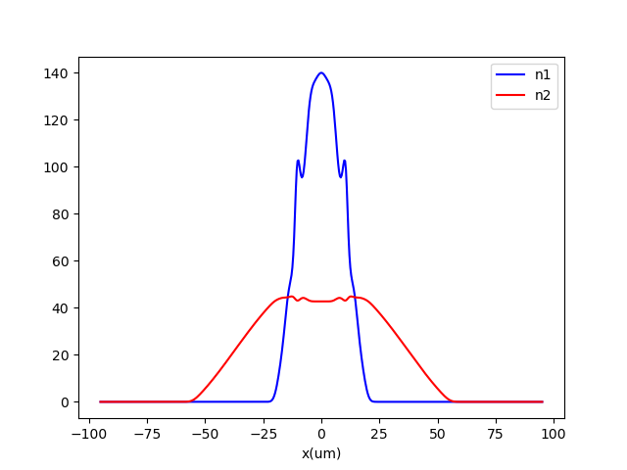
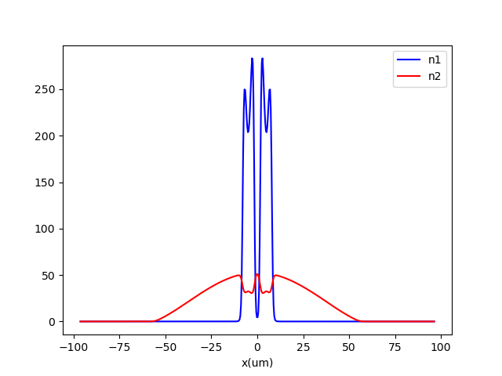
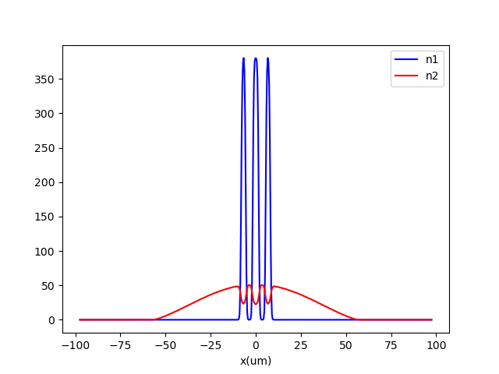
R3: 512, 1e-8, 3.5
243.88625678742812
248.9319330053029
253.7405635396541
255.95669853710896
256.5547756546992

