Slide 1
Droplets and supersolids in Er and Er-Li condensates
Rubaiya Emran
March 2026

Slide 2
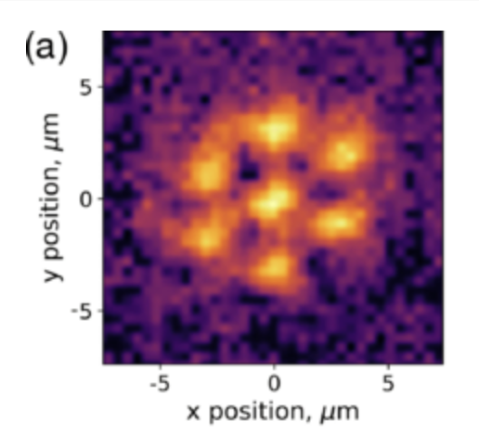
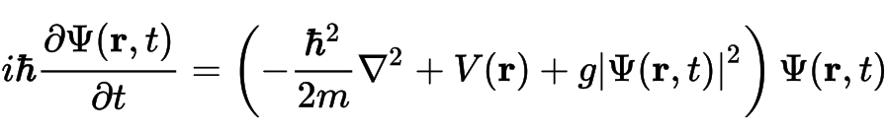
Overview
Supersolid: state with discrete translational symmetry and superfluid flow
Gross-Pitaevskii equation (GPE):
Two methods to study supersolid states:
  Numerical solver to find ground states of GPE
  Analytical solution for dispersion relation of homogenous 2D gases
2D hexagonal supersolid state imaged in situ [1]

Slide 3
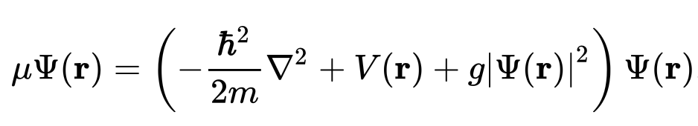
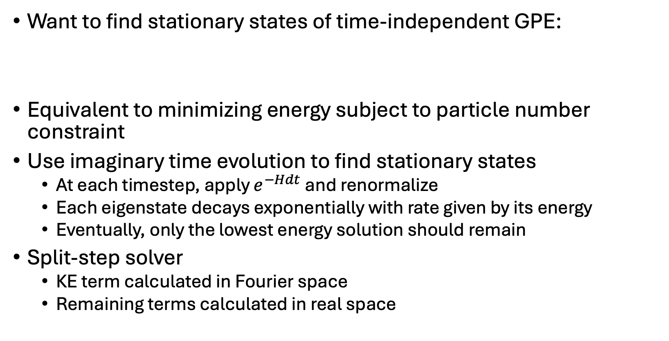
GPE solver
Want to find stationary states of time-independent GPE:
Equivalent to minimizing energy subject to particle number constraint
Use imaginary time evolution to find stationary states
  At each timestep, apply $e^{−Hdt}$ and renormalize
  Each eigenstate decays exponentially with rate given by its energy
  Eventually, only the lowest energy solution should remain
Split-step solver
  KE term calculated in Fourier space
  Remaining terms calculated in real space

Slide 4
Using the GPE solver
Simulation region size set by Thomas-Fermi radius
Adaptive time step set by largest contribution to energy (KE, contact, harmonic, dipolar, etc.)
  Necessary because contributions have different signs
Several runs with different initial guesses needed to converge to actual ground state
  Can get stuck in local minima in the energy landscape
GPU accelerated code (cupy) run on MIT engaging cluster
  For single species or nondipolar, can be fine to run locally without GPU acceleration

Slide 5
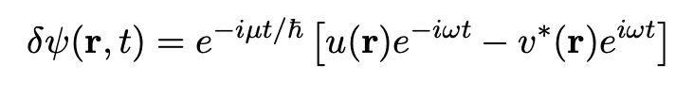
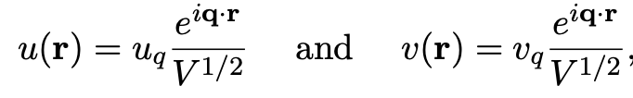
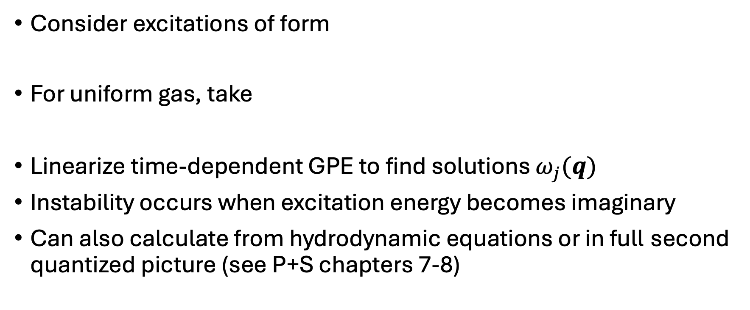
Excitations in BEC
Consider excitations of form
For uniform gas, take
Linearize time-dependent GPE to find solutions $ω_{j}(q)$
Instability occurs when excitation energy becomes imaginary
Can also calculate from hydrodynamic equations or in full second quantized picture (see P+S chapters 7-8)

Slide 6
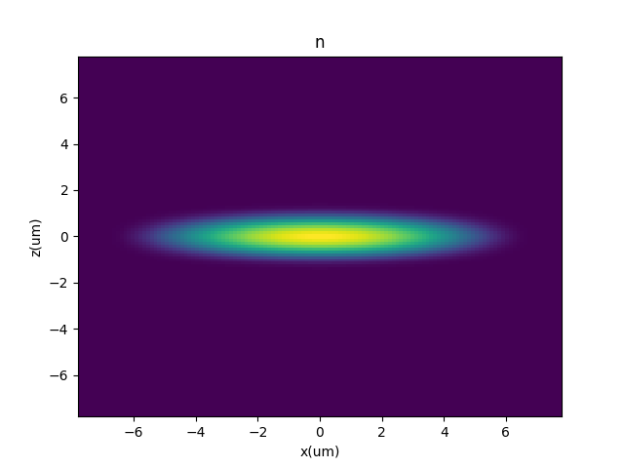
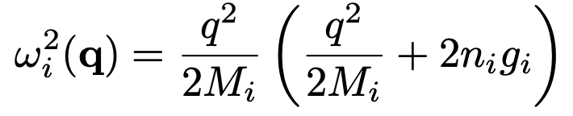
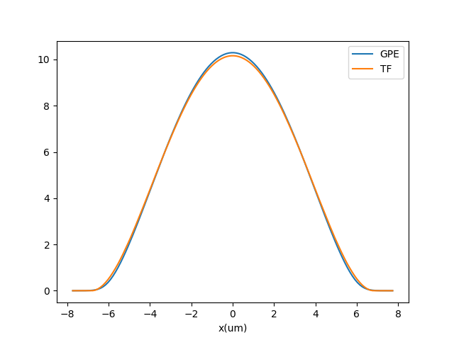
Start with nondipolar BEC in harmonic trap
Density profile approximated by Thomas-Fermi distribution
Dispersion for homogenous gas:
Transition from sound-like to free-particle-like dispersion

Slide 7
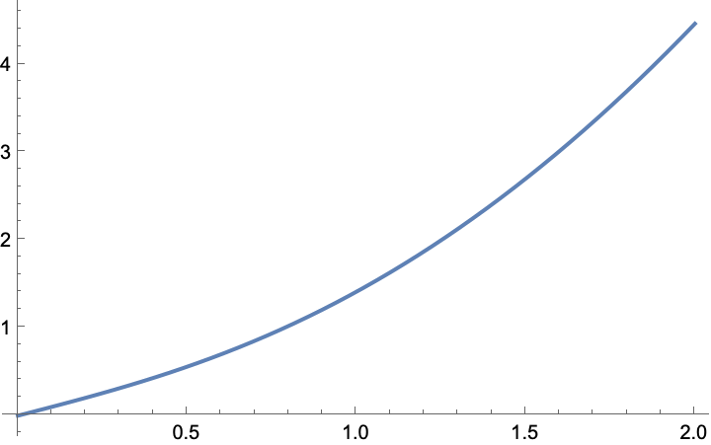
Start with nondipolar BEC in harmonic trap
Density profile approximated by Thomas-Fermi distribution
Dispersion for homogenous gas:
Transition from sound-like to free-particle-like dispersion

Slide 8
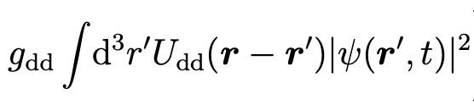
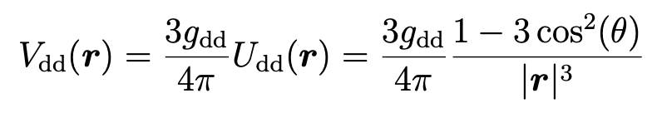
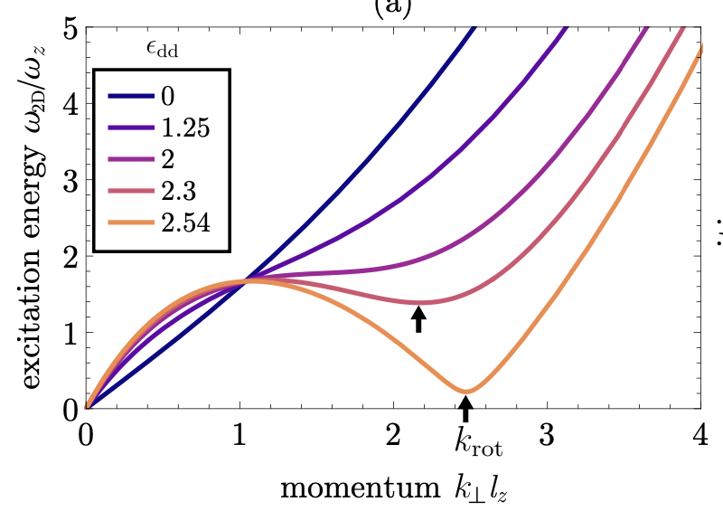
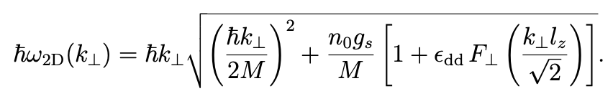
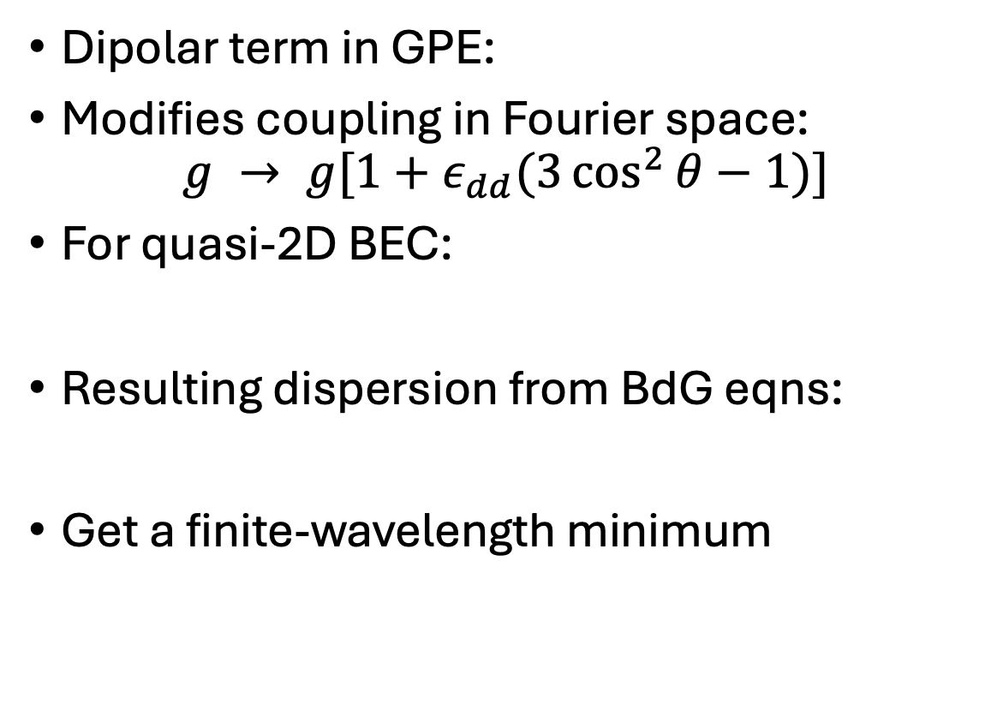
Add a dipolar term to get a finite-wavelength instability
Dipolar term in GPE:
Modifies coupling in Fourier space:
$$g → g[1+ε_{dd}(3\cos^{2}{θ−1)}]$$
For quasi-2D BEC:
Resulting dispersion from BdG eqns:
Get a finite-wavelength minimum
Fig from [2]

Slide 9
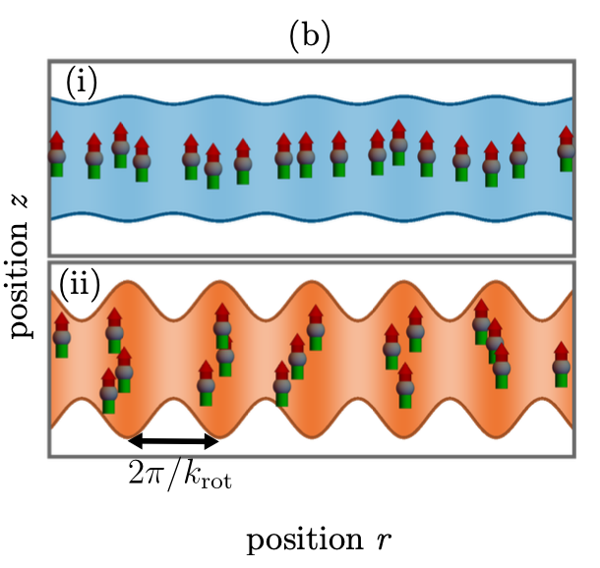
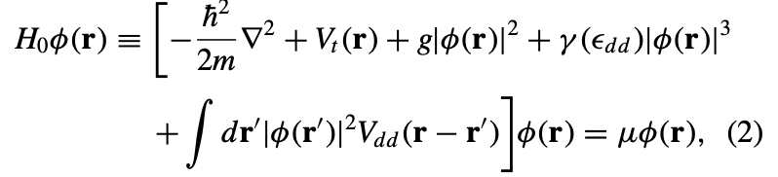
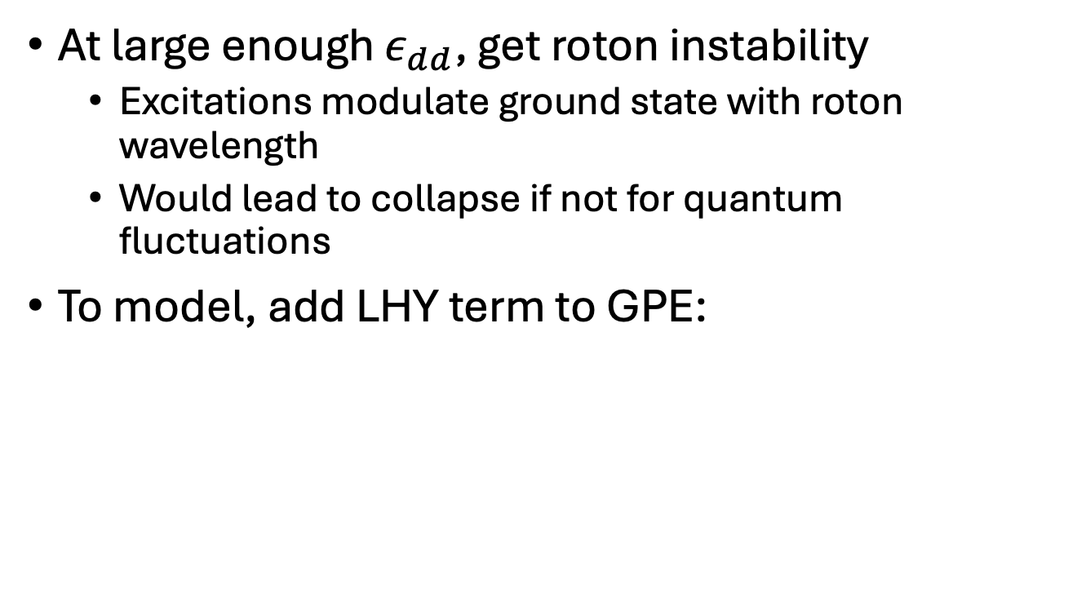
Roton instability and LHY stabilization
At large enough $ε_{dd}$, get roton instability
  Excitations modulate ground state with roton wavelength
  Would lead to collapse if not for quantum fluctuations
To model, add LHY term to GPE:
Fig from [2]

Slide 10
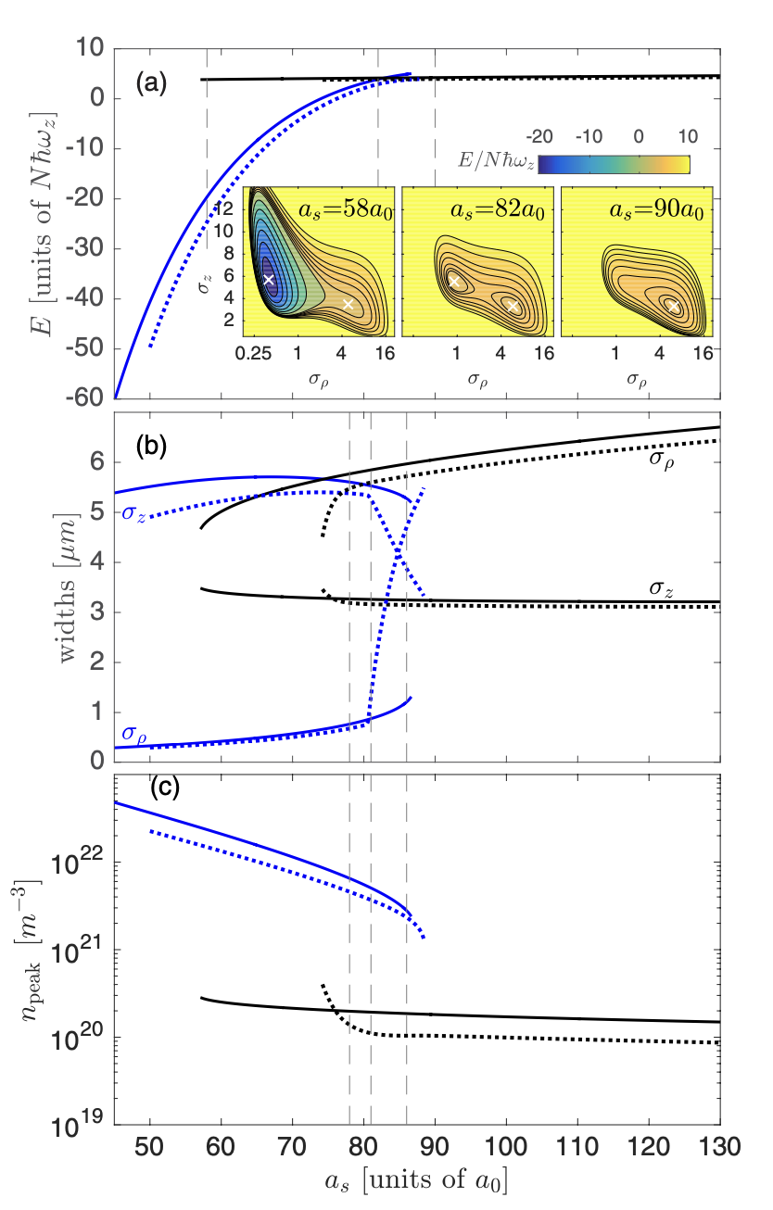
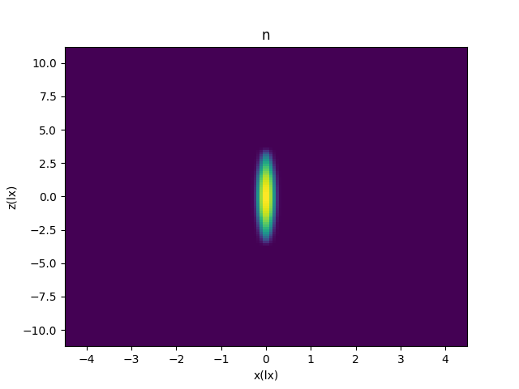
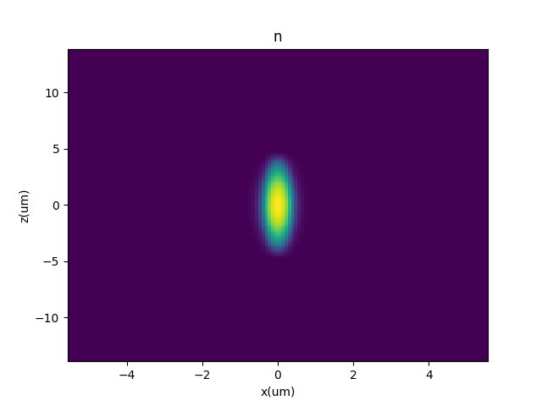
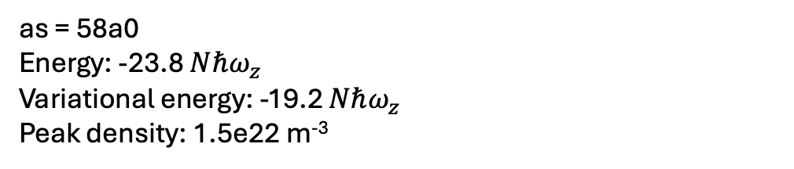
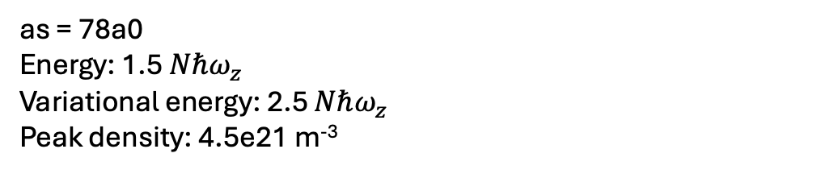
GPE: Dy single droplet states
as = 58a0
Energy: -23.8 $Nℏω_{z}$
Variational energy: -19.2 $Nℏω_{z}$
Peak density: 1.5e22 m⁻³
as = 78a0
Energy: 1.5 $Nℏω_{z}$
Variational energy: 2.5 $Nℏω_{z}$
Peak density: 4.5e21 m⁻³

Slide 11
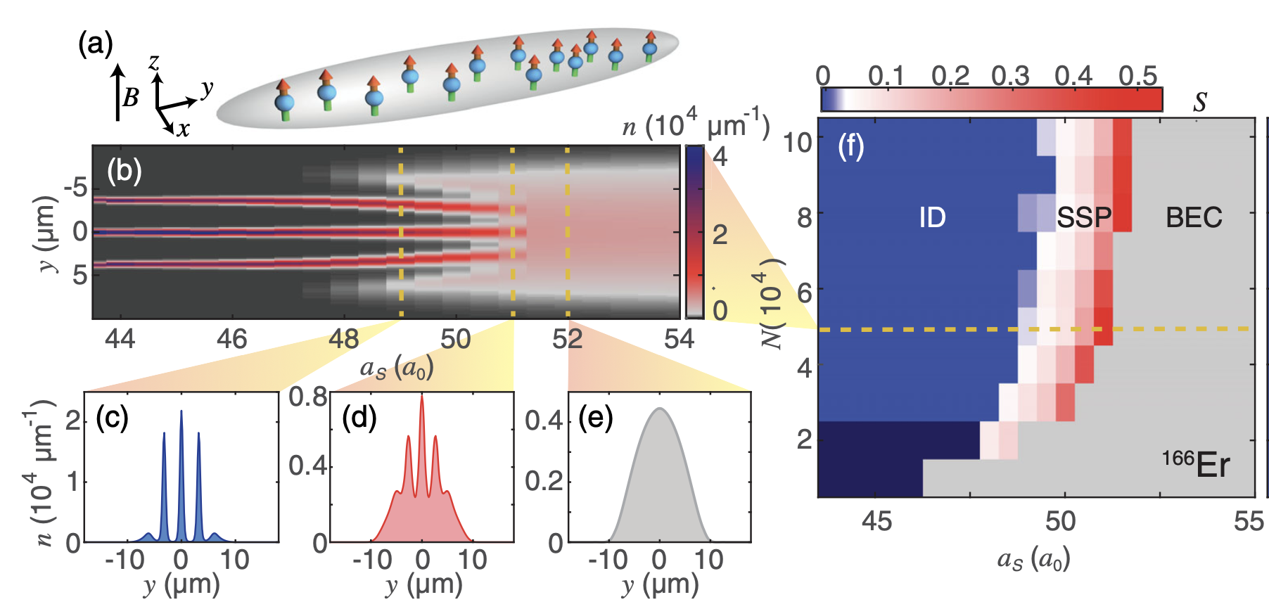

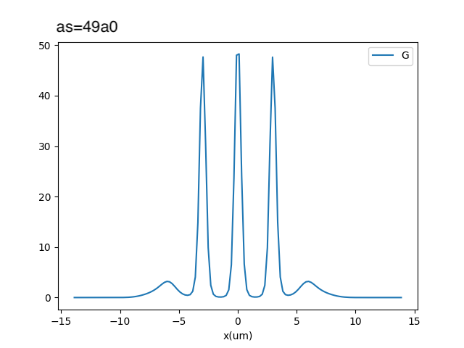
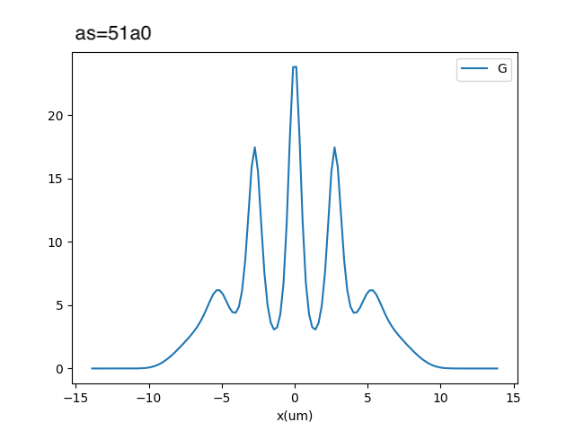
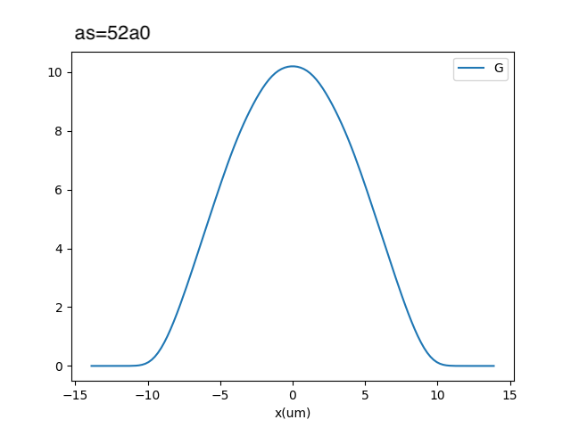
GPE: Er-166 droplet-supersolid-BEC transition
From [3]
N = 5 x 10⁴
From GPE solver:

Slide 12

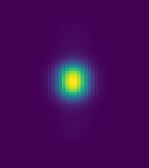
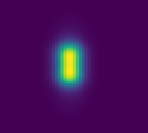


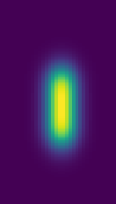
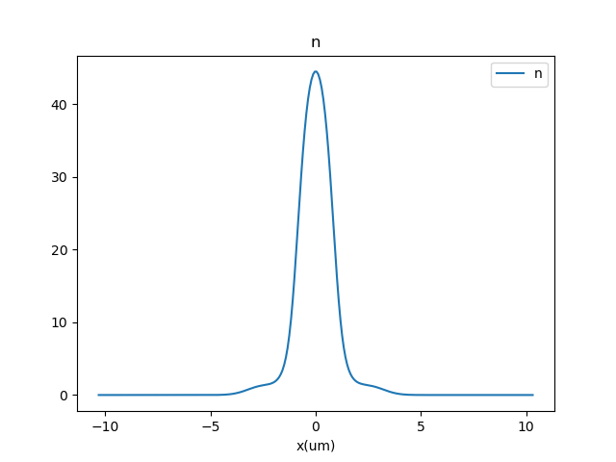
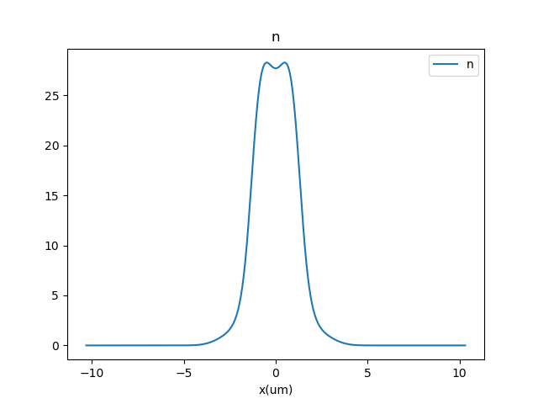
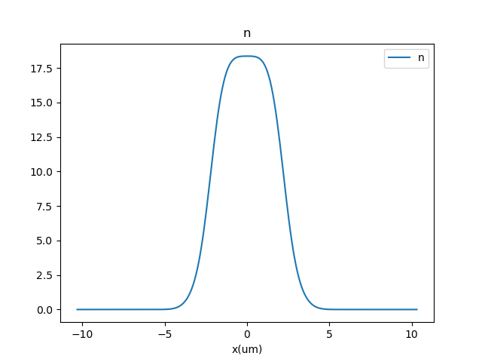
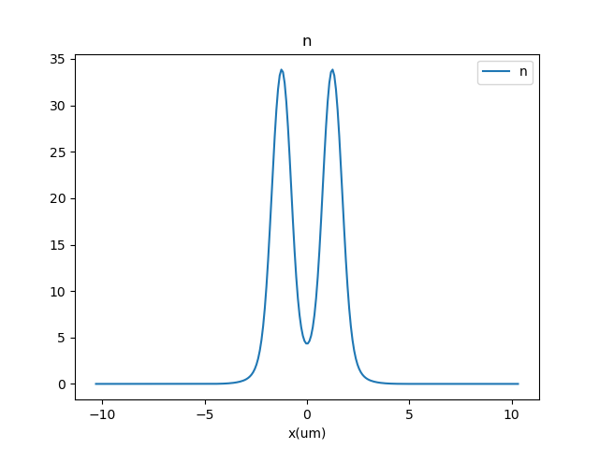
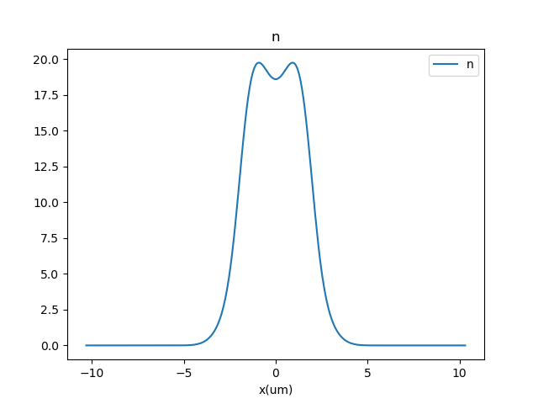
Er-166 droplets in our old trap
x, z, y
N = 4e4
as = 51.67a0
as = 52.11a0
as = 52.22a0
as = 53.33a0
as = 54a0

Slide 13
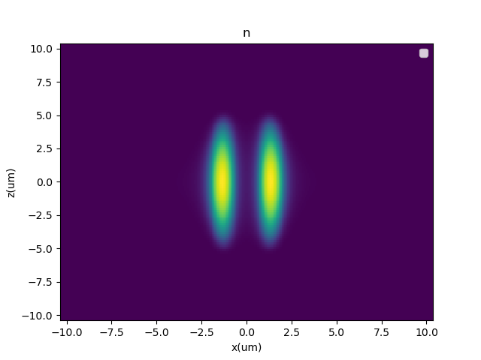
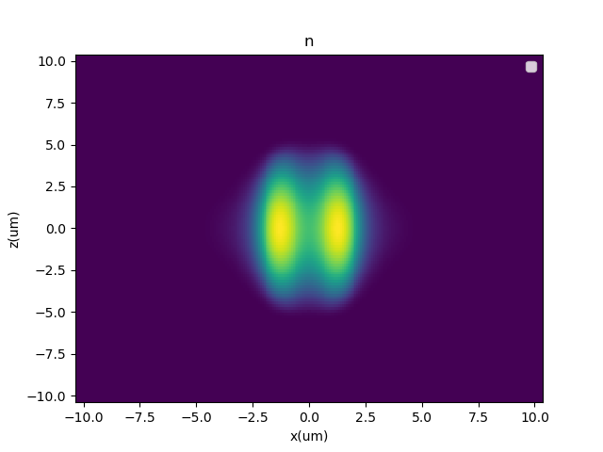
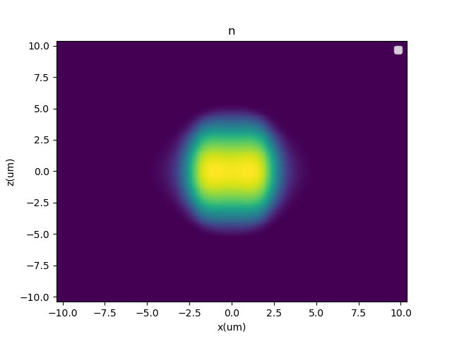

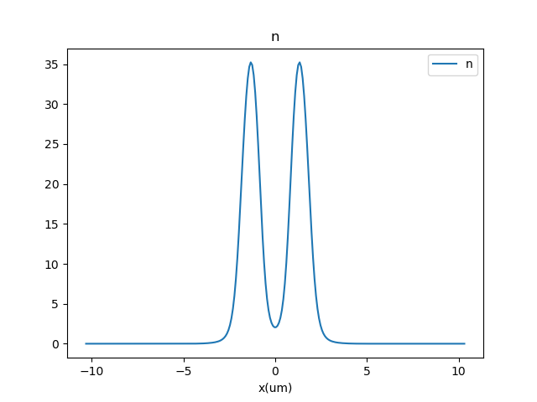
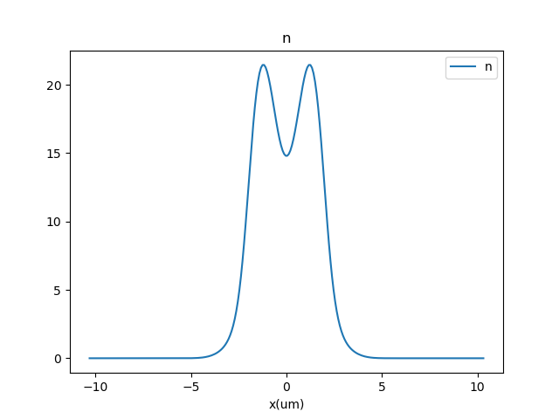
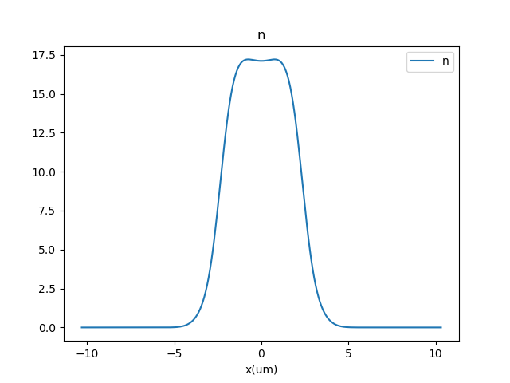
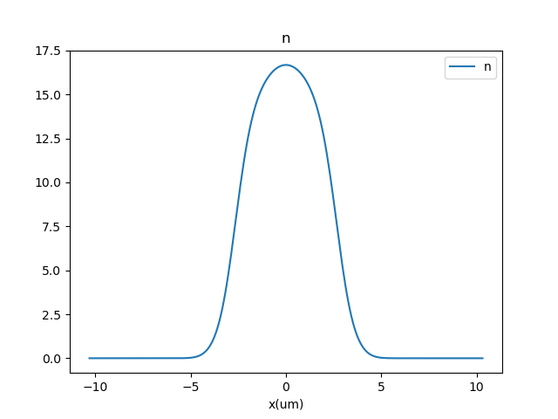
Er-166 droplets in our old trap
x, z, y
N = 5e4
as = 51a0
as = 52a0
as = 53a0
as = 54a0
High peak density (>10²¹ m⁻³)
Supersolid region is very narrow

Slide 14
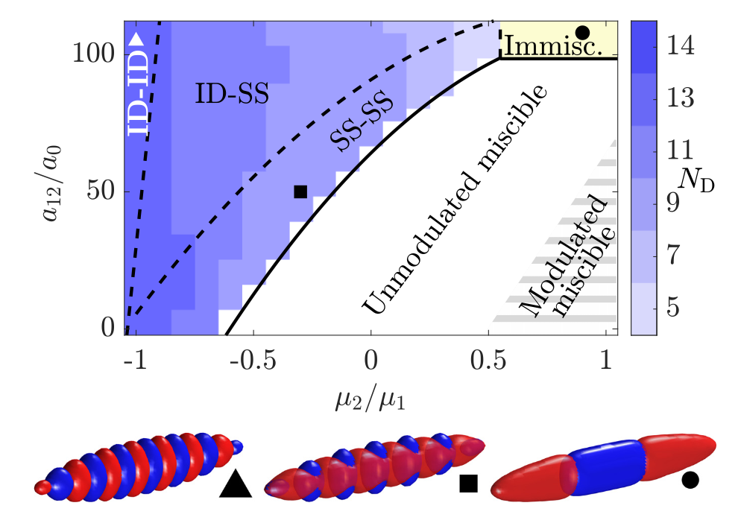
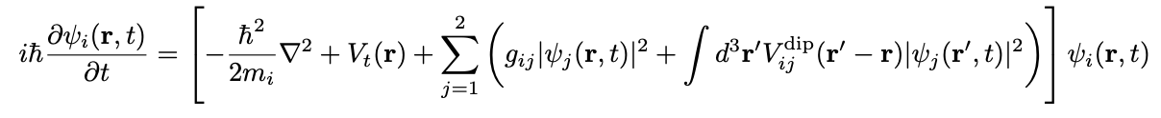
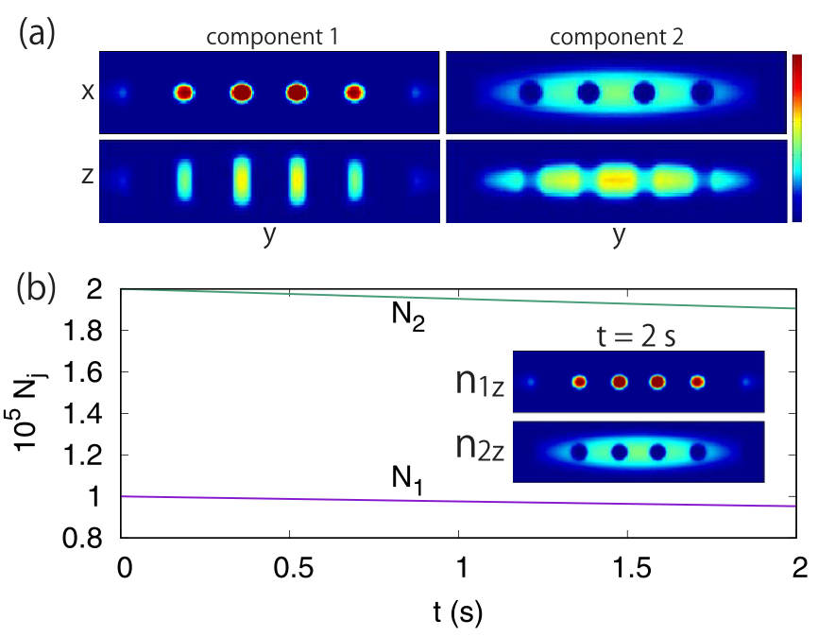
Add another species
Now have coupled GPEs:
In-phase “density mode” and out-of-phase “spin mode”
Instability in the spin mode resolved by immiscibility, rather than total density collapse
Supersolid peak densities reduced by order of magnitude [4,5]
[4]
[5]

Slide 15
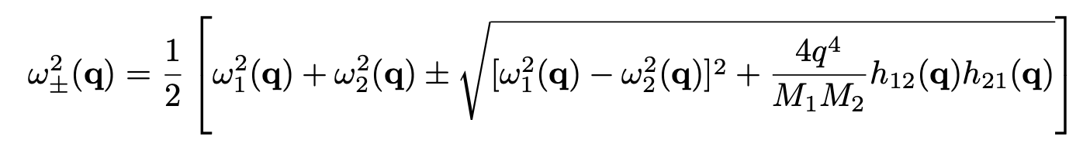
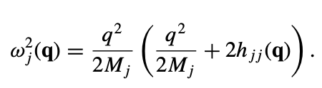
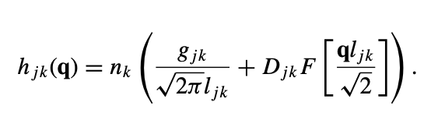
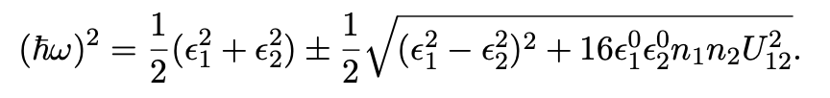
Roton immiscibility for uniform 2D mixture
Following same procedure as single GPE, derive following dispersion:
Effective coupling
Uncoupled modes:
Interactions:
P+S chapter 12
See reference [6]

Slide 16


Miscible-immiscible transition: no dipole
Effective coupling
a12 = 0: Miscible
a12 = 37a0: Immiscible

Slide 17




Miscible-immiscible transition: no dipole
No roton instability because coupling $∝q$, while $ω_{i}$are super-linear
Formally, condition for instability is
For no dipole, simplifies to
LHS clearly minimized at q = 0, so no way to have instability at finite wavelength

Slide 18



Miscible-immiscible transition: with dipole
Effective coupling
a12 = 0: Miscible
a12 = 24a0: Roton immiscible
a12 = 57a0: Immiscible

Slide 19


Miscible -> roton immiscible -> immiscible transition
Critical a₁₂ for transition to immiscibility occurs when, in the limit of q to 0,
Simplifies to typical immiscibility condition modified for dipole interaction and 2D
$$\frac{{(g}_{11}+2g_{dd})g_{22}}{l_{11}l_{22}}≤\frac{g_{12}^{2}}{l_{12}^{2}}$$
Miscible -> roton immiscible transition is more complicated

Slide 20


Small a₁₁, large a₂₂ favorable
l_{z1}=l_{z2}
M₂ = M₁/24
n₁ = n₂ = n_{2D}
b₁₁ = 64a₀
a₂₂ = 80a₀
a₁₁ = 68a₀
Immiscible
Immiscible
Roton immiscible
Roton immiscible
Miscible
Miscible
a₁₁ has greater effect on M-RIM transition
a₂₂ has greater effect on RIM-IM transition

Slide 21

Mass imbalance narrows roton immiscible region
l_{z1}=l_{z2}
n₁ = n₂ = n_{2D}
b₁₁ = 64a₀
a₁₁ = 68a₀
a₂₂ = 80a₀
Immiscible
Roton immiscible
Miscible
Smaller M₂ pushes $ω_{2}$ further away from $ω_{1}$

Slide 22

Size of roton immiscible region saturates with increasing n₂
l_{z1}=l_{z2}
M₂ = M₁/24
b₁₁ = 64a₀
a₁₁ = 68a₀
a₂₂ = 80a₀
Immiscible
Roton immiscible
Miscible

Slide 23

Size of roton immiscible region saturates with Li density
Recall condition for instability:
For roton immiscibility, optimal q (q*) is mostly determined by dipolar interaction (weak dependence on n₂)
If n₂ is sufficiently large, near q*,
Thus, n₂ dependence drops out roughly when species 2 still has sound-like dispersion at characteristic length-scale set by dipolar interaction

Slide 24


Mixture in harmonic trap: GPE solver
Propagate two wavefunctions in imaginary time
Ignore cross-term when calculating LHY correction
Basic benchmarks:
  Reproduces miscible-immiscible transition in box:
    $$\frac{g_{12}^{2}}{g_{11}g_{22}}=1$$
  Reduces to single-species solver if N₁ >> N₂

Slide 25







ADSS paper: Dy-Dy mixture

Slide 26






ADSS paper: Dy-Dy mixture

Slide 27






ADSS paper: Dy-Dy mixture

Slide 28






ADSS paper: Dy-Dy mixture

Slide 29



ADSS paper: Er-Er spin mixture
(a₁₁, a₁₂, a₂₂) = (65, 60 , 60) a₀
N₁ = N₂ = 20000
f_{y}=f_{z}=150 Hz

Slide 30




Er-Er GPE results

Slide 31

Looking for modulated states in Er-Li mixture
Much harder to find modulated ground states than for Er-Er
Li number seems to be very important
  Li density is reduced because Li spreads out in trap compared to Er
  TF radius ~ $l_{ho}^{4/5}a_{s}^{1/5}$
  $l_{ho}=\sqrt{\frac{ℏ}{mω}}∝{\left(αm\right)}^{−\frac{1}{4}}$
  For same scattering length, TF radius for Li increased by factor of 1.7
  Density decreased by factor of ~5
Have not seen a benefit from increasing a₂₂, likely due to effect on density

Slide 32


Er-Li modulated states (preliminary)
N_{Er} = 40000
N_{Li} = 60000
f_{x} = 8 Hz
f_{y} = f_{z} = 150 Hz
a₁₁ = a₂₂ = 65a₀
a₁₂=20a₀
Miscible

Slide 33


Er-Li modulated states (preliminary)
N_{Er} = 40000
N_{Li} = 60000
f_{x} = 8 Hz
f_{y} = f_{z} = 150 Hz
a₁₁ = a₂₂ = 65a₀
a₁₂=25a₀
Miscible

Slide 34






Er-Li modulated states (preliminary)
N_{Er} = 40000
N_{Li} = 60000
f_{x} = 8 Hz
f_{y} = f_{z} = 150 Hz
a₁₁ = a₂₂ = 65a₀
a₁₂=31a₀
$$E= 300.16ℏω_{x}$$
$$E= 300.03ℏω_{x}$$
$$E= 300.03ℏω_{x}$$

Slide 35




Er-Li modulated states (preliminary)
N_{Er} = 40000
N_{Li} = 60000
f_{x} = 8 Hz
f_{y} = f_{z} = 150 Hz
a₁₁ = a₂₂ = 65a₀
a₁₂=36a₀
$$E= 301.39ℏω_{x}$$
$$E= 301.34ℏω_{x}$$

Slide 36




Er-Li modulated states (preliminary)
N_{Er} = 40000
N_{Li} = 60000
f_{x} = 8 Hz
f_{y} = f_{z} = 150 Hz
a₁₁ = a₂₂ = 65a₀
a₁₂=42a₀
$$E= 302.10ℏω_{x}$$
$$E= 302.79ℏω_{x}$$

Slide 37








Er-Li modulated states (very preliminary)
N_{Er} = 20000
N_{Li} = 40000
f_{x} = 6 Hz
f_{y} = f_{z} = 150 Hz
a₁₁ = a₂₂ = 65a₀
a₁₂=25a₀
a₁₂=31a₀
a₁₂=36a₀
a₁₂=42a₀

Slide 38
Er-Li modulated states (very preliminary)
N_{Er} = 20000
N_{Li} = 40000
f_{x} = 6 Hz
f_{y} = f_{z} = 150 Hz
a₁₁ = a₂₂ = 65a₀
a₁₂=31a₀
C₁ = 0.9, fs₁ = 0.26, fs₂ = 0.92
Peak density: 5 x 10²⁰ m⁻³

Slide 39
Next steps
Continued simulations of Er-Li in harmonic trap
  Convergence testing
  Narrower scans to look for SS-SS phases
  Increased a₁₁
  Wider range of trap parameters
Real time simulations with three-body loss
Simulations in box trap
Suggestions?

Slide 40
References
[1] Bland, Thomas, et al. "Two-dimensional supersolid formation in dipolar condensates." Physical Review Letters 128.19 (2022): 195302.
[2] Hertkorn, Jens. Self-organized structures and excitations in dipolar quantum fluids. Dissertation, Universität Stuttgart, 2024.
[3] Chomaz, Lauriane, et al. "Long-lived and transient supersolid behaviors in dipolar quantum gases." Physical Review X 9.2 (2019): 021012.
[4] Bland, Thomas, et al. "Alternating-domain supersolids in binary dipolar condensates." Physical Review A 106.5 (2022): 053322.
[5] Li, Shaoxiong, Uyen Ngoc Le, and Hiroki Saito. "Long-lifetime supersolid in a two-component dipolar Bose-Einstein condensate." Physical Review A 105.6 (2022): L061302.
[6] Wilson, Ryan M., et al. "Roton immiscibility in a two-component dipolar Bose gas." Physical Review A 86.3 (2012): 033606.

