Slide 1
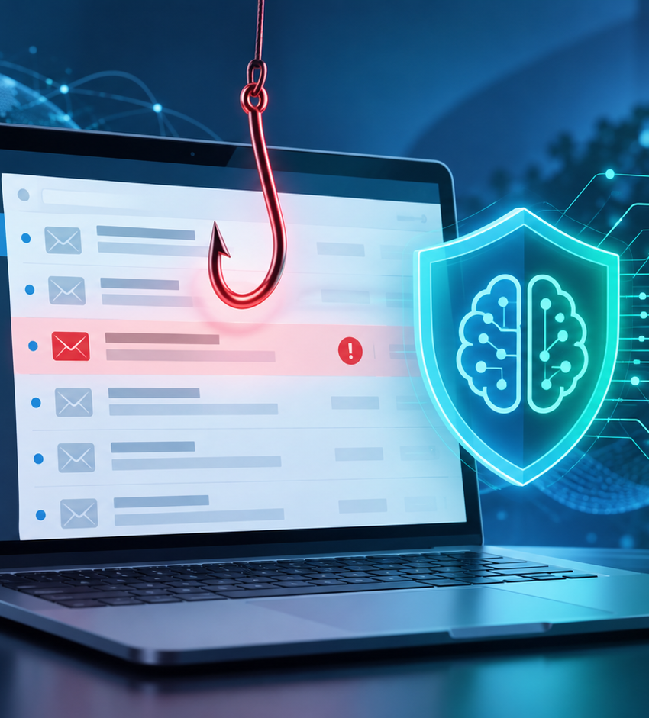
Phishing Detection
by AI
Track 2 - Fraud, Scam & Identity Defense
Goal: turn a raw email into an explainable and controlled security decision.
Signal -> Analysis -> Evidence -> Decision -> Controlled Action
Video support - 7 min max

Slide 2
AI Defense Lab 2026
The problem: an email can lie
Phishing exploits trust: urgency, impersonation, hidden links, attachments, or sensitive requests.
EMAIL
Manipulation channel
ATTACKER
Impersonates an organization
USER
Account, data, money
• Credential theft
• Fraudulent payment
• Malicious attachment
• Loss of trust
Need: an explained security decision, not just an opaque score.
02

Slide 3
AI Defense Lab 2026
Security definition
Threat
Protected asset
User
Outcome
Phishing email, social engineering, identity impersonation
Accounts, passwords, internal data, money
Employee, student, customer, or SOC analyst
Risk class + evidence + controlled action
The system must distinguish legitimate from suspicious, expose the signals, and recommend a proportional intervention.
• no blind deletion
• auditable decision
• uncertainty handling
• data protection
• authorized or synthetic datasets
• safe failure behavior
03

Slide 4
AI Defense Lab 2026
End-to-end workflow
Signal
Extraction
AI analysis
Evidence
Decision
Action
raw email
JSON + metadata
rules + model
visible signals
risk + confidence
warn / quarantine / escalate
Core security flow
Safety layer
Audit layer
• signal capture
• material analysis
• readable evidence
• confidence threshold
• human approval
• no secrets in repo
• score recorded
• evidence recorded
• action traceable
04

Slide 5
AI Defense Lab 2026
How AI explains the decision
Inputs
Analysis
Outputs
• sender
• subject + body
• URLs
• attachments
• headers
• manipulative urgency
• sensitive request
• domain mismatch
• masked link
• combined score
• low / medium / high risk
• confidence
• evidence
• proposed action
Example evidence
Defensible decision
"Urgent request" + "external link" + "inconsistent sender" -> high risk
The prediction is backed by signals, not only by a model answer.
05

Slide 6
AI Defense Lab 2026
Demo: three moments to show
1
Legitimate email
2
Phishing email
3
Ambiguous / failure case
Low risk
No strong indicator
High risk
Evidence + action
Reduced confidence
Controlled escalation
Simple video narration
Avoid this
• load an email
• show score + evidence
• show proposed action
• demo without explanation
• score without evidence
• broken links
06

Slide 7
AI Defense Lab 2026
Evaluation and safety controls
Normal
legitimate behavior
Required controls
Positive
phishing detected
• no credentials in GitHub
• public or synthetic data
• mask sensitive fields
• simulated or approved action
• audit log for decisions
Negative
false positive avoided
Failure
missing or malformed data
Adversarial
evasion attempt
Goal: a reliable and defensible prototype, not just an AI prediction.
07

Slide 8
Conclusion
Our contribution: make phishing detection explainable, auditable, and controlled.
To submit
• public GitHub
• final ZIP
• YouTube video <= 7 min
• README + architecture
• datasets/APIs disclosed
Limits
More data, score calibration, stronger attachment analysis, and email/SOC integration.
Thank you.

