Slide 1

Terraform blocks you don’t know
Lauri Suomalainen 2025

Slide 2





Who is this Lauri Suomalainen person?
Native of Finland
Master of Computers and Science
Wrangler of Clouds
Friend of developers
Enjoyer of music
Climber of rocks
Player of games
Servant of rabbits

Slide 3
Motivation
If I don’t know, there’s a good chance I’m not alone.
Learning experience
I generally enjoy obscure things.
Maybe I find something actually useful?

Slide 4

So many blocks!
resource
output
terraform
provider
data
module
variable
locals
provisioner
ephemeral
moved
check
import
Testing zone: test
run
mock_provider
dynamic
We are going for a dive
removed
Stacks deep sea!
store
deployment
orchestrate
component

Slide 5
Provisioner
Used for things not exactly in the scope of Terraform’s declarative model
In principle: TRY TO AVOID.
Use immutable resource definitions, metadata etc.
Pass data to VMs, use cloudinit etc.
Tied to resources.
To use without a resource, use terraform_data. Replaces null_resource.
file, local_exec, remote_exec
Connections either through ssh or winrm

Slide 6
resource "google_compute_instance" "default" {
/*...*/
metadata = {
ssh-keys = "terraform:${file("~/.ssh/id_rsa.pub")}"
}
provisioner "file" {
source = "example.txt"
destination = "/tmp/example.txt"
connection {
type = "ssh"
user = "terraform"
private_key = file("~/.ssh/id_rsa")
host = self.network_interface[0].access_config[0].nat_ip
}
}
}

Slide 7
resource "aws_instance" "cluster" {
count = 3
# ...
}
resource "terraform_data" "cluster" {
# Replacement of any instance of the cluster requires re-provisioning
triggers_replace = aws_instance.cluster[*].id
# Bootstrap script can run on any instance of the cluster
# So we just choose the first in this case
connection {
host = aws_instance.cluster[0].public_ip
}
provisioner "remote-exec" {
# Bootstrap script called with private_ip of each node in the cluster
inline = [
"bootstrap-cluster.sh ${join(" ", aws_instance.cluster[*].private_ip)}",
]
}
}

Slide 8
Ephemeral
Used to create temporary resources
Not stored in the state, don’t show up in plan files.
Obviously, creating randomised resources is not very idempotent.
Best use case is to retrieve sensitive values from a KMS and prevent them from leaking into plaintext output.

Slide 9
data "google_secret_manager_secret_version" "db_master" {
secret = "db-password" # Replace with your secret name
}
locals {
credentials = jsondecode(data.google_secret_manager_secret_version.db_master.secret_data)
}
provider "postgresql" {
host = google_sql_database_instance.example.public_ip_address
port = 5432
username = local.credentials["username"]
password = local.credentials["password"]
}

Slide 10
ephemeral "random_password" "db_password" {
length = 16
override_special = "!#$%&*()-_=+[]{}<>:?"
}
resource "google_sql_database_instance" "example" {
/* ... */
}
resource "google_sql_user" "example" {
name = "example"
instance = google_sql_database_instance.example.name
password = random_password.db_password.result
}

Slide 11
Check
Check on conditions outside of usual resource lifecycle
Failing does not block plans or applies.
Could be used, if your resources rely on external services
Check if endpoint configurations are valid
Check if datasources return correct data.
You can use postconditions, if you require operations to be blocked on failure

Slide 12
resource "google_compute_instance" "datadog_vm" {
/* ... */
metadata_startup_script = <<-EOT
#!/bin/bash
DD_API_KEY=${var.datadog_api_key}
DD_AGENT_MAJOR_VERSION=7
DD_SITE="datadoghq.com"
apt-get update
apt-get install -y curl gnupg
curl -s https://install.datadoghq.com/scripts/install_script_agent7.sh | bash -s -- --api-key $DD_API_KEY --site $DD_SITE
EOT
}

Slide 13
check "datadog_endpoint" {
data "http" "datadog_validate" {
url = "https://api.datadoghq.com/api/v1/validate?api_key=${var.datadog_api_key}"
}
assert {
condition = trimspace(jsondecode(data.http.datadog_validate.response_body)["valid"]) == true
error_message = "Datadog API key is invalid or endpoint is unreachable."
}
}

Slide 14
dynamic
Create multiple nested blocks in a resource
Could even be used to create blocks conditionally.
Works like a for block, but a bit neater
Can even be nested within themselves
A general rule with dynamic terraform applies here too: Use sparsely.
Overuse debilitates readability, makes troubleshooting a pain and is often a symptom of flawed design.

Slide 15
resource "google_compute_firewall" "example" {
/* ... */
dynamic "allow" {
for_each = var.allow_rules
content {
protocol = allow.value.protocol
ports = allow.value.ports
}
}
}
variable "allow_rules" {
type = list(object({
protocol = string
ports = list(string)
}))
default = [
{ protocol = "tcp", ports = ["22", "80", "443"] },
{ protocol = "icmp", ports = [] }
]
}

Slide 16
State management blocks - Import
Don’t do terraform import google_compute_instance.default projects/{{project}}/zones/{{zone}}/instances/{{name}}
Use the import block!
Because doing this manually is a pain.
Explicit on your configuration.
Generates terraform based on existing resources.
terraform plan -generate-config-out=generated.tf
provider "google" {
}
import {
id = "ringed-valor-196605/europe-north1-c/valheim-server"
to = google_compute_instance.valheim_server
}

Slide 17
State management blocks - moved
- Rename a resource.
- IMO, of dubious value.
- Could be useful if refactoring a single resource to multiple. See example.
- Adding multiple of these can cause long chains and hinder readability.
- Guess you could use them if you can’t recreate resources.
locals {
instances = tomap({
big = {
instance_type = "n1-standard-2"
}
small = {
instance_type = "e2-medium"
}
})
}
resource "google_compute_instance" "vm" {
for_each = local.instances
instance_type = each.value.instance_type
/* .. */
}
moved {
from = google_compute_instance.vm
to = google_compute_instance.vm["small"]
}

Slide 18
State management blocks - removed
Don’t do terraform state rm google_compute_instance.default projects/{{project}}/zones/{{zone}}/instances/{{name}}
You could use removed block?
You created a resource in terraform but now don’t want to manage it programmatically?
You run a mixture of tf managed and manual resources in the same env. Why?
Leave an audit trail?
NOTE: Replace the resource block with removed
removed {
from = google_compute_instance.vm
lifecycle {
destroy =false
}
}

Slide 19
Testing blocks
Terraform unit testing!
test: Just used to control test parallelism
run: Test actually run in these blocks
mock_provider: Can be used to speed up testing: Don’t require credentials.
- Surprisingly nice to sanity check!
- Also surprisingly robust!
- The question is, what should be tested, on what level etc.

Slide 20
mock_provider "google" {}
test {
parallel = true
}
run "set_correct_vm_name" {
variables {
vm-name = "test-vm"
}
assert {
condition = google_compute_instance.test-vm.name == "not-test-vm"
error_message = "Incorrect vm name"
}
}
run "vm_should_be_in_us" {
variables {
vm-name = "test-vm"
}
assert {
condition = can(regex("us-*", google_compute_instance.test-vm.zone))
error_message = "VM is not in the US"
}
}

Slide 21
My foray into Terraform Stacks
Impressions, complaints and a demo

Slide 22
First impression:
Unimpressed and confused

Slide 23
Impression tally
The good:
Architecture is clear
Single convention to reuse modules for multiple environments
Explicit provider linking & possible to use different providers per resource
The bad:
Inflexible
Deviation from standard terraform operation
HCP only
Documentation is sparse and lacks essential features

Slide 24
Time for the demo!
Featured blocks you don’t know: component
deployment
orchestrate
store

Slide 25
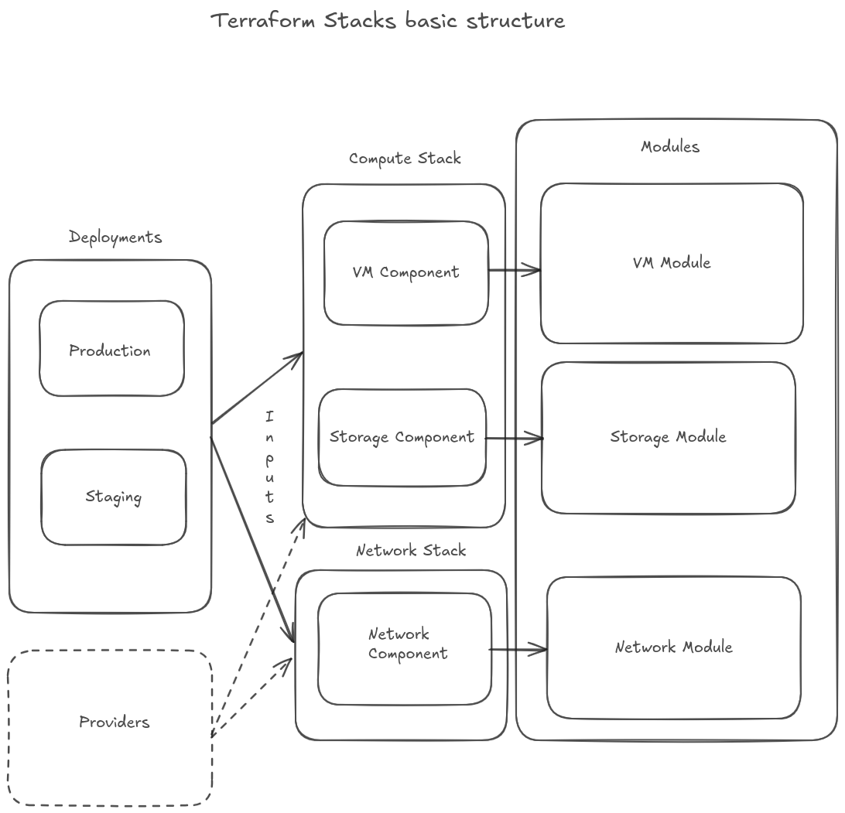

Slide 26
Thank you!
Terraform blocks you don’t know
Lauri Suomalainen 2025
Demo repo available in GitHub.
Source:
Terraform official documentation (v1.12.x)
Yeah, really. I RTFM.

