Slide 1

AMONG THEM
Segment Fault
Angus, Aloysius, Emery, Xujie, Zhan Peng

Slide 2
Table of Content
Product Vision
General Idea
Key Features (USP)
Feasibility
Comprehensive delivery plan
Engine Proof
Risk and Mitigation

Slide 3
Product Vision
General Idea
You play as a spacecraft defending Earth against imposters that were voted out
Take down incoming hordes of imposters using weapons that you unlock as you progress in the game
Goal of the game: Survive as long as possible and achieve highest score possible

Slide 4
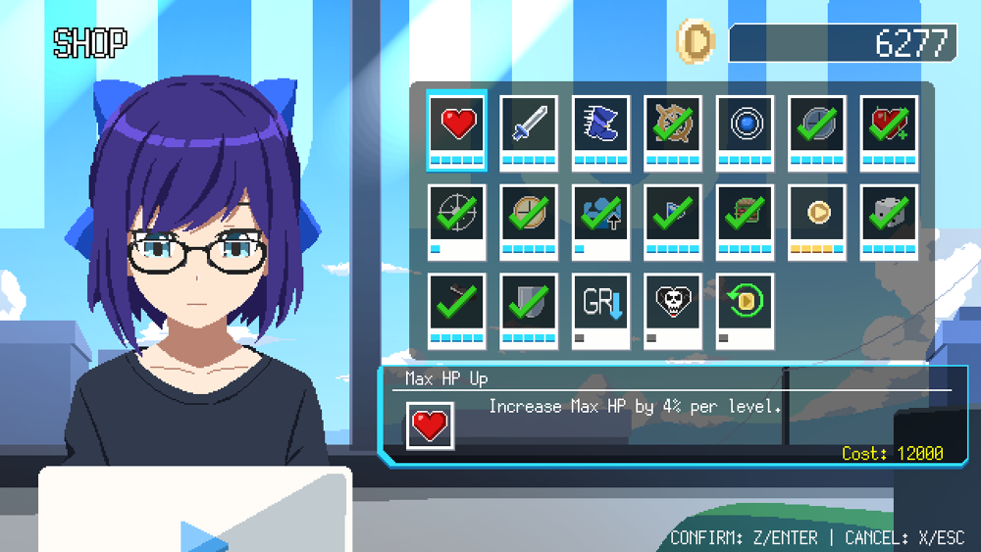
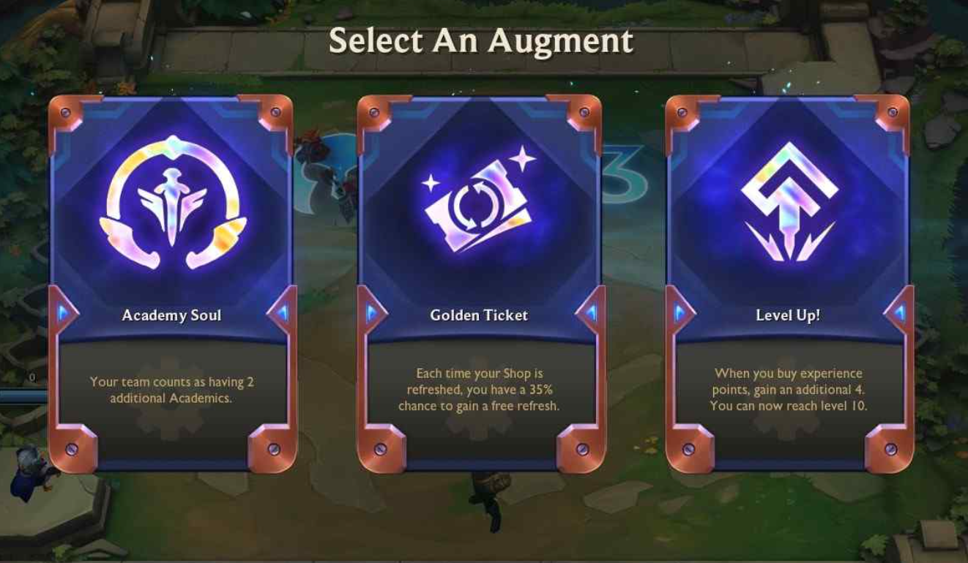
Key Features (USP)
Power ups to increase players abilities
Everytime you finish a game you get to purchase permanent power ups to your abilities using the gold earned during gameplay
Leveling System
Gain a Level point every time you level up and spend it on augments to your weapon whenever you want during the gameplay (game will pause when you open augment UI). Each augment will have different costs and effect

Slide 5
Feasibility

Slide 6
Comprehensive Delivery Plan
Week 6 | Render shapes (Creation of shapes, e.g. player = circle, cows = rectangles) Movement of the ship and enemies (W,A,S,D key) (Enemies charging at player) Interactions between player & enemies pt 1 (Collision)
Week 7 | Interactions between player & enemies pt 2 (Collision) Wave Creation (Endless waves) Implementation of Point system + Shop + Save/Load (How to earn points for skill tree) (In-game currency to purchase upgrades when in main menu)
Week 8 | Rendering animations (Temporary shapes/background to be replaced with images) Sound effects (Background music, animation sounds)
Week 9 | Alpha Playtesting (Debug / Add extra features)

Slide 7
Comprehensive Delivery Plan
Week 10 | Consolidate feedback and make necessary changes (Fix any major bugs that could occur, add more quality of life changes) Create the remaining game mode (A level system)
Week 11 | Cont. from week 10
Week 12/13 | Beta Playtesting (Final bug fixes, polishing the game, removing any unnecessary code.)
Week 14 | Final Presentation

Slide 8
DEMO

Slide 9
Risks and Mitigation

Slide 10
Risks | Mitigation
Ideal mob spawn vs frame drops Rendering too many mobs might cause performance issues such as crashes or lag | Instead of rendering increased number of mobs, we could empower the mobs, such as increasing the health/damage of the existing mobs.
2. Complications in implementing different game modes With our inexperience to game creation, we might find it tough to implement multiple game modes with the amount of time given to us. | Creating just one particular mode such as endless and adding appropriate scaling to the mobs to keep game engaging and encourages replay value.

