Slide 1
1

Slide 2

FlexChroma Tour Guide
- Let's Explore FlexChroma's Models -
Ver.1.11 2026.8.8
1. Introduction
FlexChroma™ is a set of models designed to create filament itself by combining commercially available filaments. It consists of multiple Series, each designed for a different purpose. Within each Series, multiple Models are provided, along with different Profiles and Plates depending on size and usage.
2. How to Choose a Model
First, follow this quick selection flow to download and print the correct data.
When choosing a model, start by deciding what kind of filament you want to create.
1. Select a Series: Blend Filament for mixed colors, Gradient Filament for color changes.
2. Select a Model size: Use an S4 Model for small objects, or an M1 Model for larger prints
requiring around 70g of filament.
3. Select a Profile and Plate: Choose the Plate that matches your desired mixing ratio or
pattern.
4. Assign filaments and slice: Use filaments with the same or similar material, assign
them, slice the model, and read the print notes before printing.
*Note: In FlexChroma, “Profile” means a purpose-based classification, not different print settings.
1

Slide 3
3. FlexChroma HUB
The FlexChroma HUB is the main entry point on MakerWorld, providing access to all Series and external portals. If you are unsure where to start, open this model first.
4. Blend Filament
The Blend Filament Series is the most basic FlexChroma lineup. It allows you to mix two filaments at various ratios to create your own custom color.
Each model supports blend ratios from 50% to 99.5%. For ratios below 50%, simply swap Filament A and Filament B.
Example: To create a filament with 25% cyan mixed into yellow, read the Plate value as the ratio of Filament A, interpret it as 75% yellow, and slice the model accordingly.
The following is the model configuration for Blend Filament.
2

Slide 4
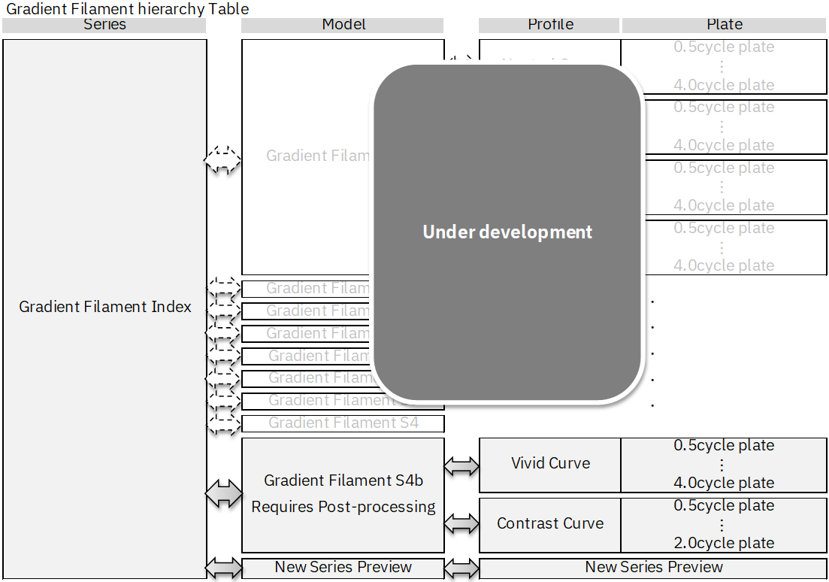
5. Gradient Filament
The Gradient Filament Series provides multiple color-changing Profiles and Plates with different cycle counts. Details vary by model, so please refer to each model’s description.
Color Curve: Settings based on color combinations. This option allows you to select the optimal gradient for each color—for example, “Vivid” for cyan and yellow, or “Contrast” for white and magenta.
Number of cycles: The number that determines the frequency of the gradient. One cycle is counted as one complete cycle in which the filament changes from A to B to A and back.
Example: To create a fast-cycle gradient filament using cyan and magenta, select an S4 Model, choose a 4-cycle Plate, and use the Vivid curve Profile due to the high color contrast.
The following is the model configuration for Gradient Filament.
3

Slide 5
6. Update History
Ver.1.00 2026-07-02 First Edition Published
Ver.1.10 2026-07-22 Revisions for Integrated Design
Ver.1.11 2026-08-08 Revisions to align with the Japanese version
4

Slide 6
FlexChroma Tour Guide
- Let's Explore FlexChroma's Models -
Ver.1.11 2026.8.8
1. Introduction
FlexChroma™ is a set of models designed to create filament itself by combining commercially available filaments. It consists of multiple Series, each designed for a different purpose. Within each Series, multiple Models are provided, along with different Profiles and Plates depending on size and usage.
2. How to Choose a Model
First, follow this quick selection flow to download and print the correct data.
When choosing a model, start by deciding what kind of filament you want to create.
1. Select a Series: Blend Filament for mixed colors, Gradient Filament for color changes.
2. Select a Model size: Use an S4 Model for small objects, or an M1 Model for larger prints
requiring around 70g of filament.
3. Select a Profile and Plate: Choose the Plate that matches your desired mixing ratio or
pattern.
4. Assign filaments and slice: Use filaments with the same or similar material, assign
them, slice the model, and read the print notes before printing.
*Note: In FlexChroma, “Profile” means a purpose-based classification, not different print settings.
1

Slide 7
3. FlexChroma HUB
The FlexChroma HUB is the main entry point on MakerWorld, providing access to all Series and external portals. If you are unsure where to start, open this model first.
4. Blend Filament
The Blend Filament Series is the most basic FlexChroma lineup. It allows you to mix two filaments at various ratios to create your own custom color.
Each model supports blend ratios from 50% to 99.5%. For ratios below 50%, simply swap Filament A and Filament B.
Example: To create a filament with 25% cyan mixed into yellow, read the Plate value as the ratio of Filament A, interpret it as 75% yellow, and slice the model accordingly.
The following is the model configuration for Blend Filament.
2

Slide 8
5. Gradient Filament
The Gradient Filament Series provides multiple color-changing Profiles and Plates with different cycle counts. Details vary by model, so please refer to each model’s description.
Color Curve: Settings based on color combinations. This option allows you to select the optimal gradient for each color—for example, “Vivid” for cyan and yellow, or “Contrast” for white and magenta.
Number of cycles: The number that determines the frequency of the gradient. One cycle is counted as one complete cycle in which the filament changes from A to B to A and back.
Example: To create a fast-cycle gradient filament using cyan and magenta, select an S4 Model, choose a 4-cycle Plate, and use the Vivid curve Profile due to the high color contrast.
The following is the model configuration for Gradient Filament.
3

Slide 9
6. Update History
Ver.1.00 2026-07-02 First Edition Published
Ver.1.10 2026-07-22 Revisions for Integrated Design
Ver.1.11 2026-08-08 Revisions to align with the Japanese version
4

