Slide 1
FlexMeasures Technical Steering
Committee
June 27, 2024

Slide 2
Agenda
Welcome & Short introduction to FlexMeasures
What’s new in v0.22?
Roadmap for v0.23 and 1.0
Q&A

Slide 3

The matching challenge

Slide 4
FlexMeasures is the intelligent & developer-friendly EMS to support real-time energy flexibility apps.
Go green in daily operations, stay in control.
Smart industry
Smart city

Slide 5

FlexMeasures - simple

Slide 6

Example cases

Slide 7
Version 0.22 is almost out
Bootstrap 3->5
Flex context (e.g. prices) as asset fields
Asset audit log
Small fixes (see link below)
https://github.com/FlexMeasures/flexmeasures/milestone/48?closed=1

Slide 8
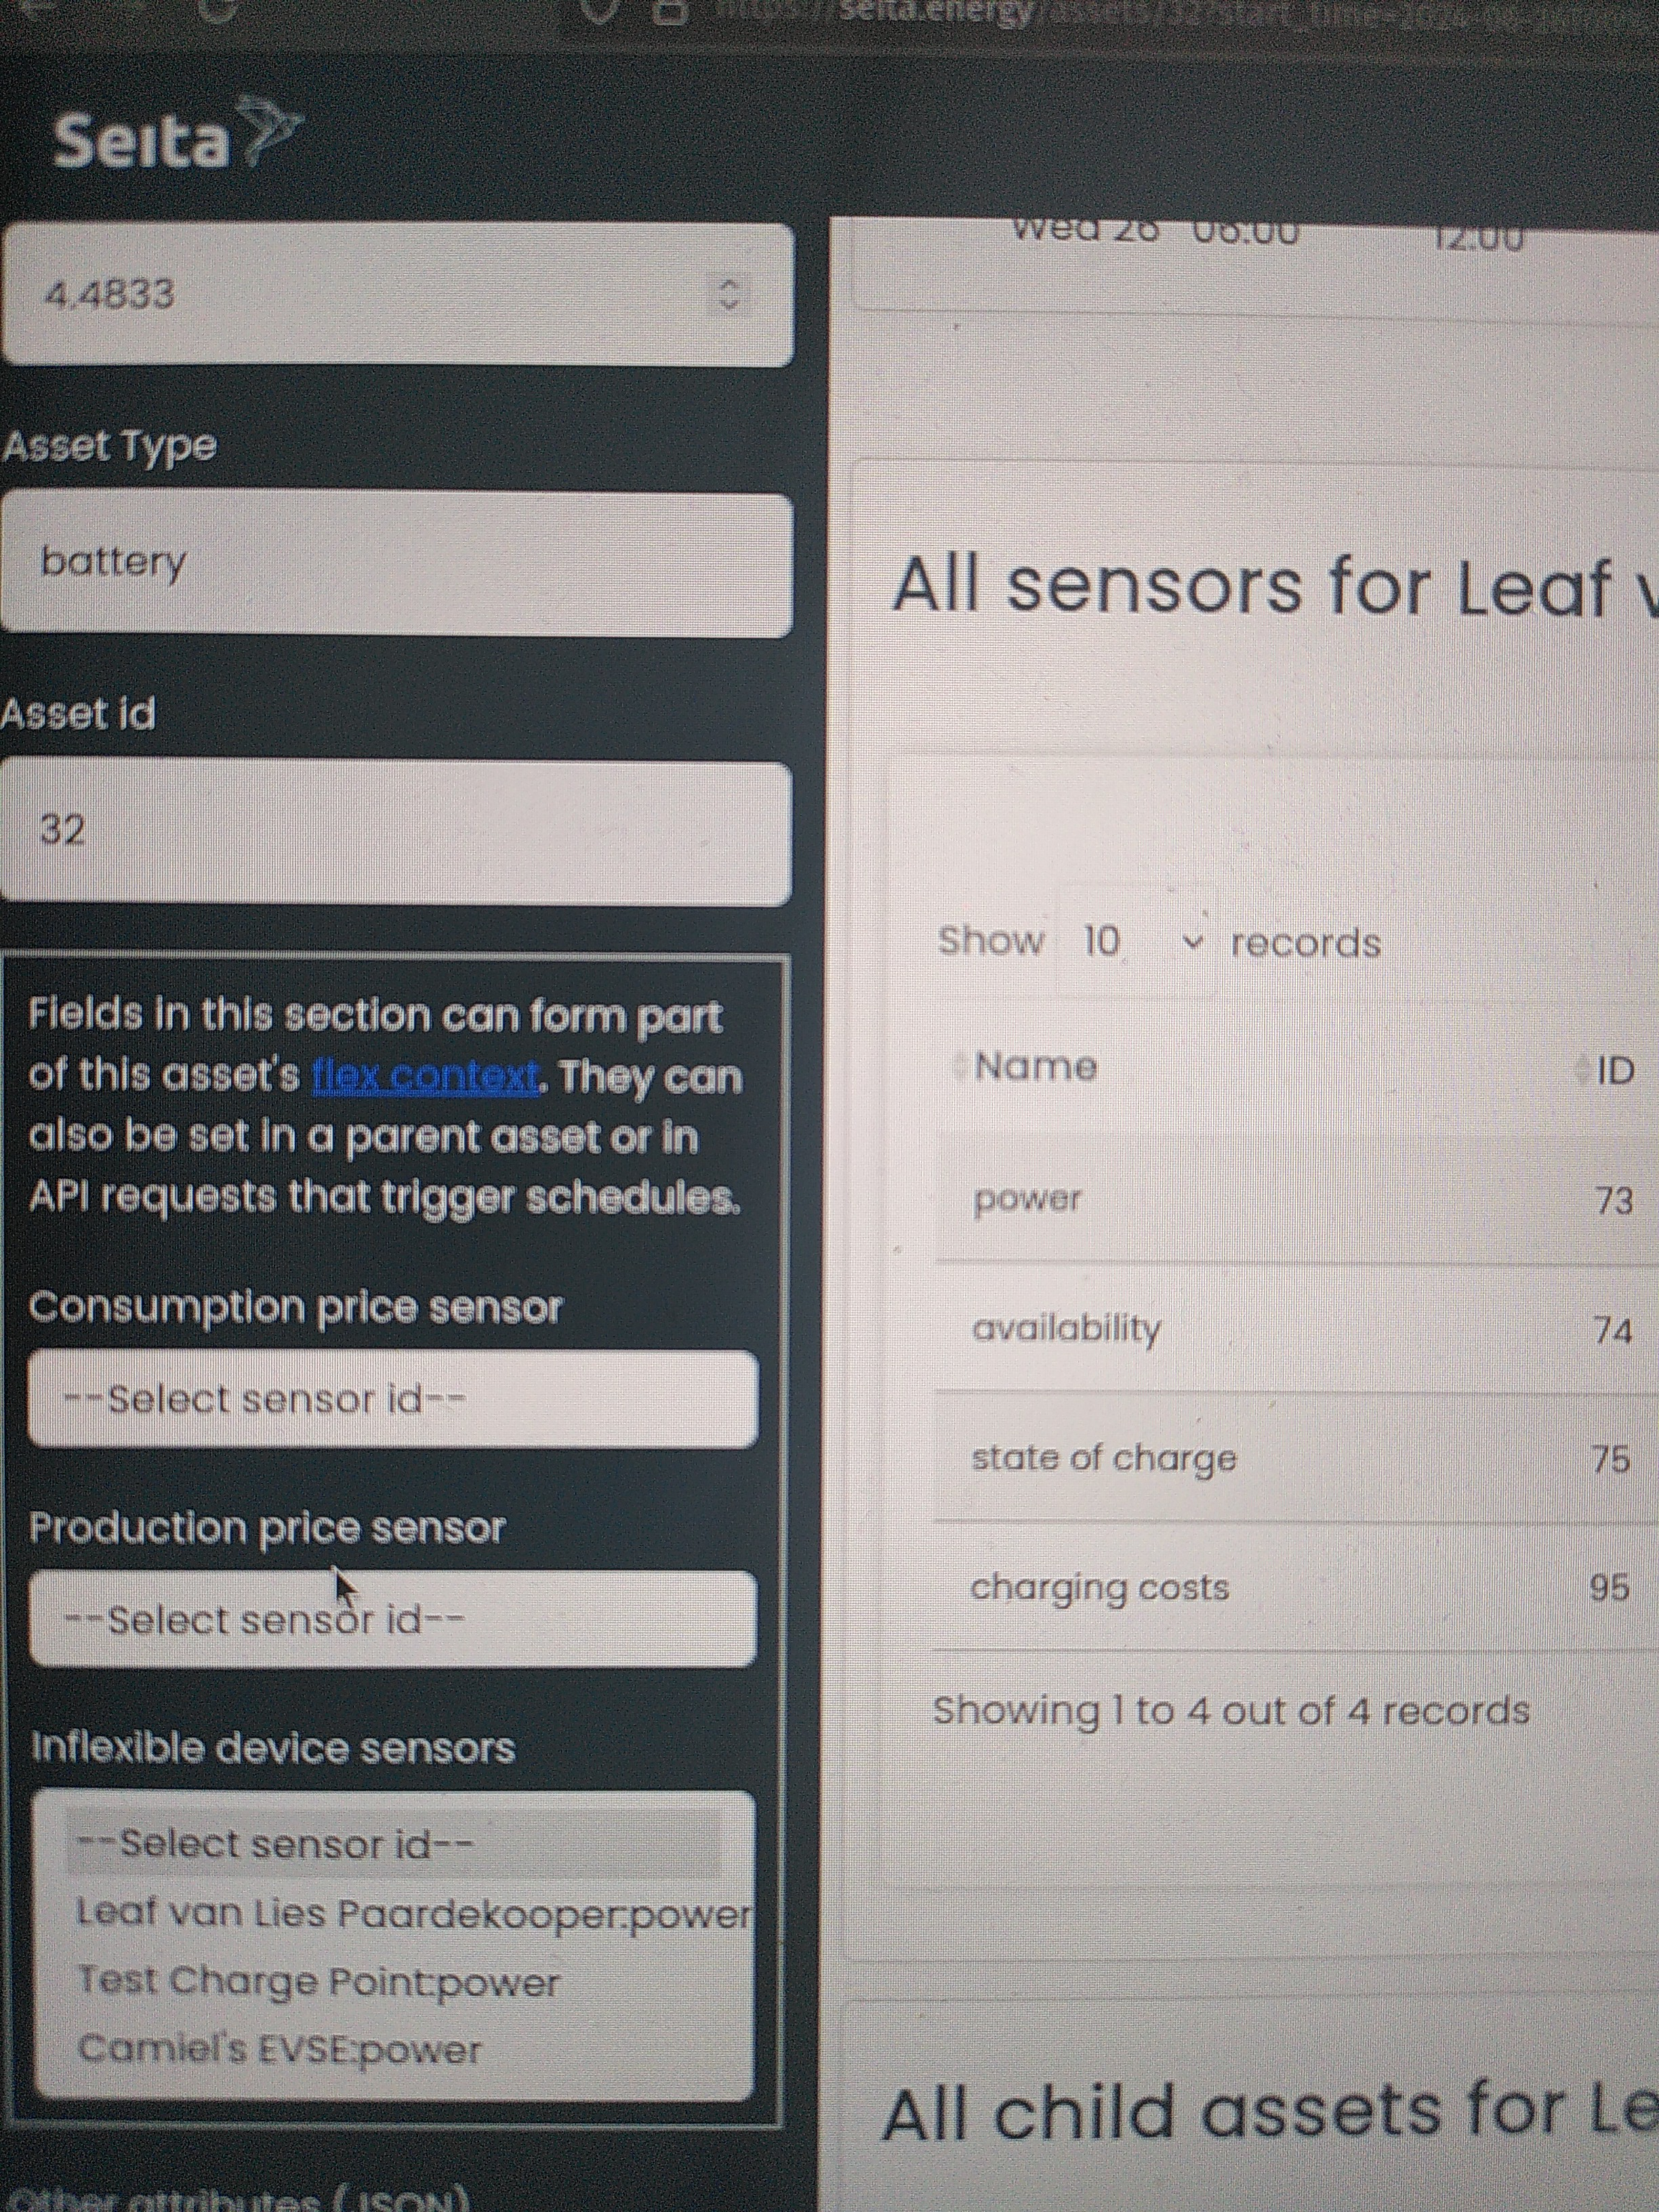
Editing flex context

Slide 9
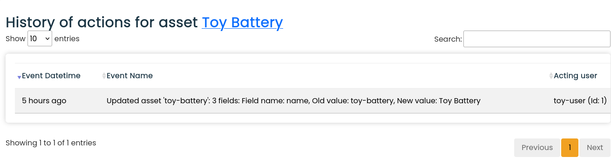
Asset audit log

Slide 10
Scheduling: State of the art
Done
Storage: Battery
Storage: Heat
Processes
Next
Sites (start: PR#855, #1065)
Imbalance
Sector coupling
Grid services
VPP

Slide 11
Ideas for version 0.23
Focus (currently):
More information on sensor page (and histogram
Speed up asset and account pages (#988)
RelaxedStorageScheduler
(see also https://github.com/FlexMeasures/flexmeasures/milestone/49)

Slide 12
Ideas for milestone v1.0
Site optimization (multi-asset). Why? Fulfill crucial milestone of mission. Current solution? Optimize flexible assets in sqeuence. Progress? Good, needs projects/testing.
Editable flex-model and context. Why? Ease of use & maintenance for non-developers. Current solution? Send all info in API. Progress? PoC for flex-context (prices) but big design question remains - store on data model (use API & SQL features) or JSON (more flexible in usage and extension, needs own schemas)?

Slide 13
Q&A
What are you working on?
What is unclear?

Slide 14
Roadmap – Big goals
[2022 - mature] Model & pilot e-mobility optimization (price-based, V2G)
[2023 - started] Model & pilot heating optimization (price-based, also with heat buffers)
[2024] Multi-asset scheduling
[2024] Imbalance market support
[2025] Sector coupling (optimize e-mobility and heating in one site)
[2025] Congestion support (e.g. for DSOs in GOPACS)
https://flexmeasures.io/roadmap/

Slide 15
Resources – do get in touch!
https://github.com/FlexMeasures/flexmeasures/
https://www.flexmeasures.io
https://lists.lfenergy.org/g/flexmeasures
https://fosstodon.org/@flexmeasures
LF Energy Slack: #flexmeasures

Slide 16

FlexMeasures - integration

