Slide 1
FlexMeasures Technical Steering
Committee
January 04, 2024

Slide 2
Agenda
Welcome & Short introduction to FlexMeasures
The latest release: v0.18 ― flex model enhancements
Roadmap for v0.19 ― asset structure & monitoring. What more?
Q&A

Slide 3

The matching challenge

Slide 4
FlexMeasures is the intelligent & developer-friendly EMS to support real-time energy flexibility apps.
Go green in daily operations, stay in control.
Smart industry
Smart city

Slide 5

FlexMeasures - simple

Slide 6

Example cases

Slide 7
Version 0.18 is out
Future knowledge in scheduling
UI navigation of complex sites
https://flexmeasures.io/018-better-use-of-future-knowledge/

Slide 8
External in- and output for storage
Often, storage (also) serves an external and crucial purpose. A good example is a hot water tank.
Thus, the expected extraction of energy (as heat) from the storage is an important input to the modeling problem ― it will form a constraint.
New fields in the flex-model (for storage scheduler):
“soc-usage”: [{“sensor”: 12}],
“soc-gain”: [{“sensor”: 13}]

Slide 9
Energy conversion efficiency
Roundtrip-efficiency works well enough for battery problems.
The COP of heat pumps depends on temperature.
New fields in the flex-model (for storage scheduler):
“charging-efficiency”: [{“sensor”: 14}],
“discharging-efficiency”: [{“sensor”: 15}]

Slide 10
Consumption and production capacities
Until now, only one kind of maximal capacity was possible (for example, to describe a limit to the grid connection). We used the field power-capacity, and it had to have one constant value, e.g. 25 kW.
New fields in the flex-model:
“consumption-capacity”: [{“sensor”: 16}],
“production-capacity”: “25 kW”

Slide 11
Scheduling: State of the art
Done
Storage: Battery
Storage: Heat
Processes
Next
Sites (start: PR#855)
Sector coupling
Grid services
Order books
VPP

Slide 12
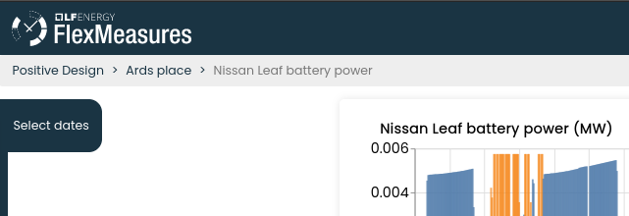
Breadcrumps

Slide 13
Ideas for version 0.19
Focus (currently): Asset status
Documentation improvements (#763)
Document attributes (#853)
(see also https://github.com/FlexMeasures/flexmeasures/pulls?q=is%3Aopen+is%3Apr+milestone%3A0.19.0)

Slide 14
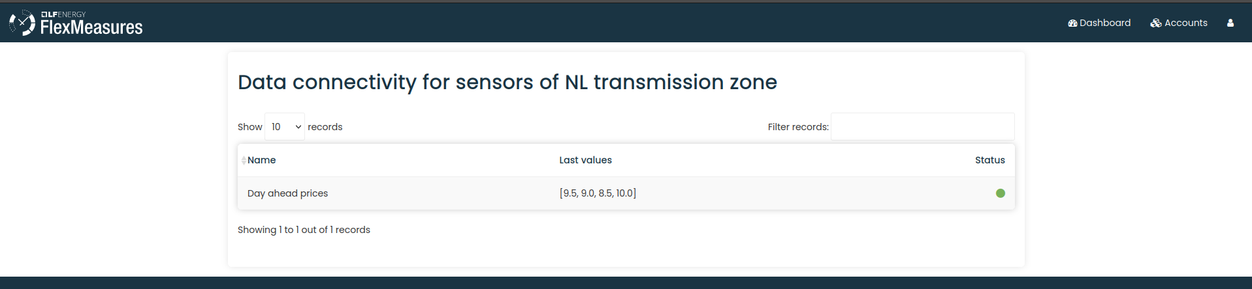
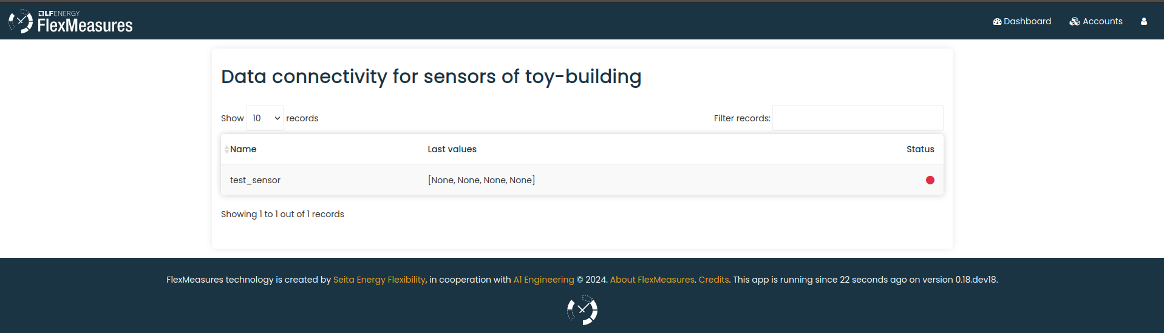
WIP: asset status

Slide 15
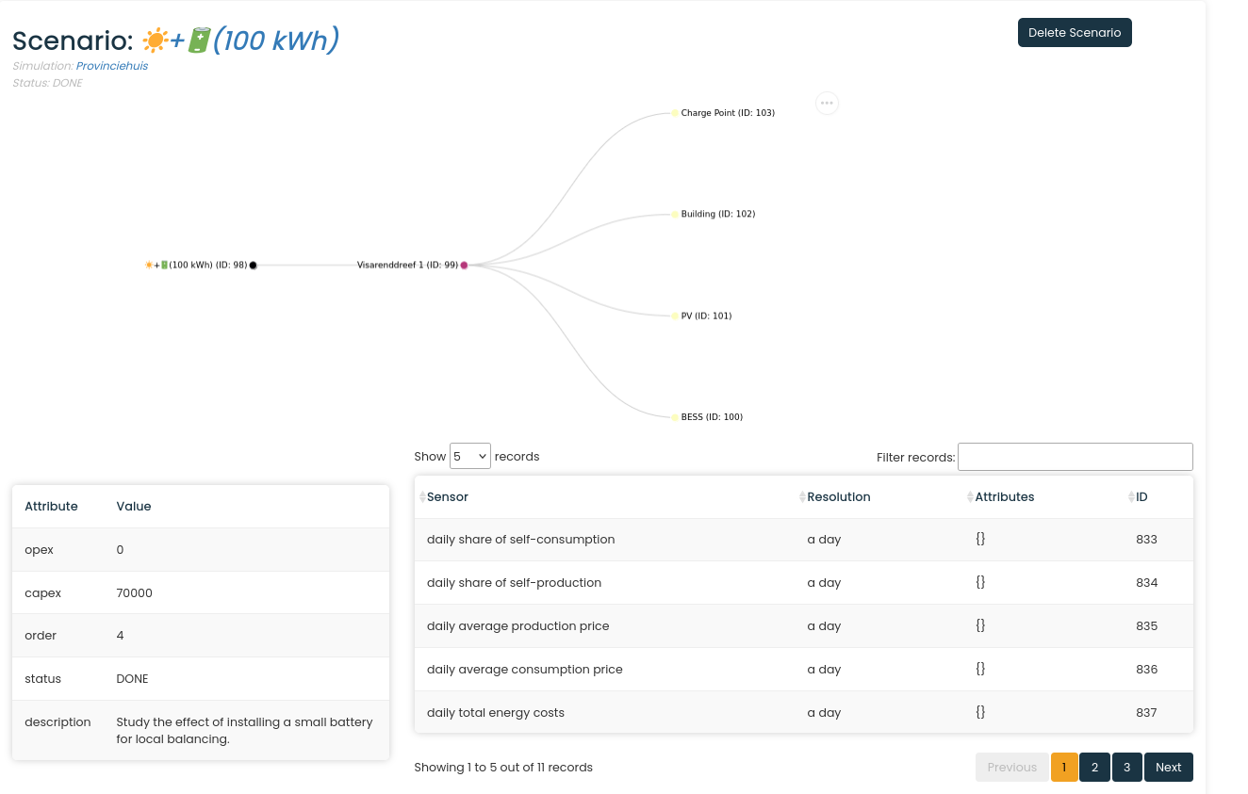
WIP: asset structure

Slide 16
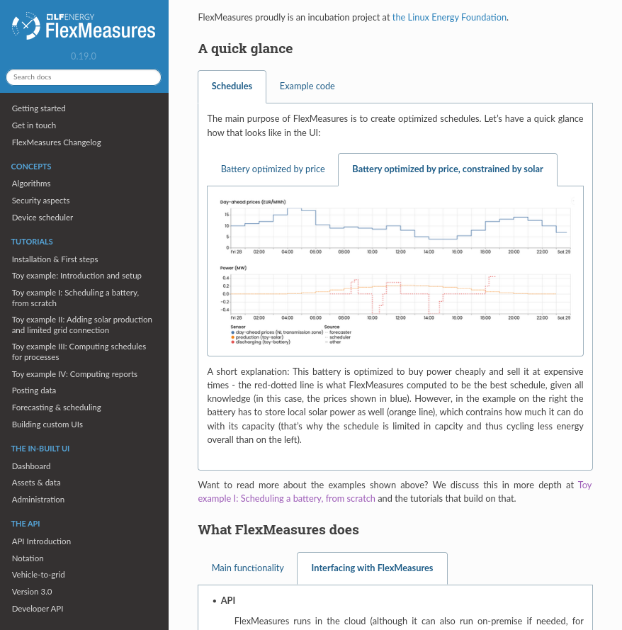
WIP: more helpful docs

Slide 17
Q&A
What are you working on?
What is unclear?

Slide 18
Roadmap – Big goals
[2022 - mature] Model & pilot e-mobility optimization (price-based, V2G)
[2023 - started] Model & pilot heating optimization (price-based, also with heat buffers)
[2023] Sector coupling (optimize e-mobility and heating in one site)
[2024] Congestion support (e.g. for DSOs in GOPACS)
[2024] VPP (optimize multiple sites towards one market)
https://flexmeasures.io/roadmap/

Slide 19
Resources – do get in touch!
https://github.com/FlexMeasures/flexmeasures/
https://www.flexmeasures.io
https://lists.lfenergy.org/g/flexmeasures
https://fosstodon.org/@flexmeasures
LF Energy Slack: #flexmeasures

Slide 20

FlexMeasures - integration

