Slide 1
FlexMeasures Technical Steering
Committee
February 15, 2024

Slide 2
Agenda
Welcome & Short introduction to FlexMeasures
What’s new in v0.19?
Roadmap for v0.20 ― rate limiting? What more?
Q&A

Slide 3

The matching challenge

Slide 4
FlexMeasures is the intelligent & developer-friendly EMS to support real-time energy flexibility apps.
Go green in daily operations, stay in control.
Smart industry
Smart city

Slide 5

FlexMeasures - simple

Slide 6

Example cases

Slide 7
Version 0.19 is (almost) out
Asset structure visualization
SoC-minima and maxima as ranges
Support Flask 2.3
Support for ARM-based processors (e.g. Macbooks)
Faster database queries of time series data
Support SQLAlchemy 2.0
https://docs.sqlalchemy.org/en/20/changelog/migration_20.html
https://blog.miguelgrinberg.com/post/what-s-new-in-sqlalchemy-2-0

Slide 8
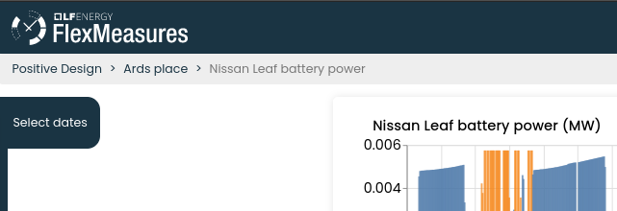
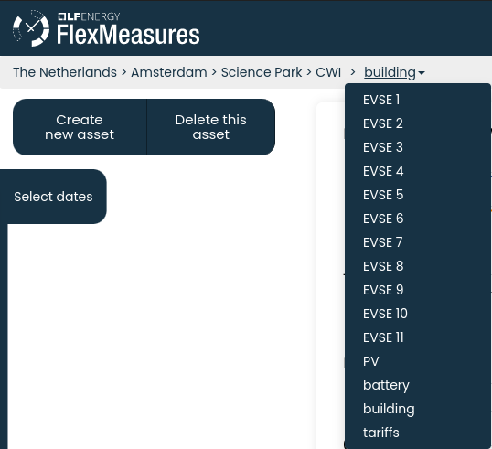
Asset structure visualization

Slide 9
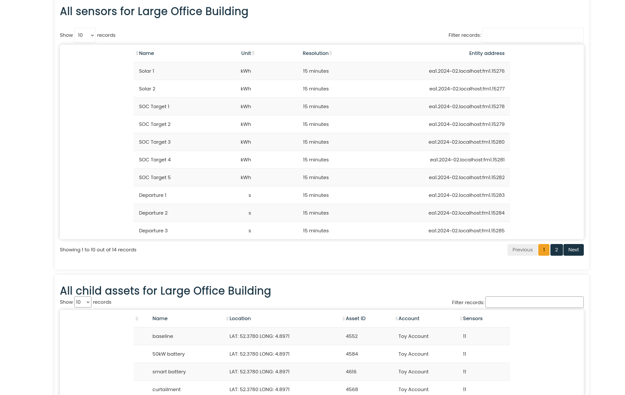
Asset structure visualization

Slide 10
SoC-minima and maxima as ranges
{
"flex-model": {
"soc-maxima": [
{
"value": 50,
"datetime": "2024-02-05T11:00:00+01:00",
},
{
"value": 51,
"start": "2024-02-05T12:00:00+01:00",
"end": "2024-02-05T13:30:00+01:00"
},
{
"value": 52,
"start": "2024-02-05T15:00:00+01:00",
"duration": "PT1H"
},
{
"value": 53,
"duration": "PT15M",
"end": "2024-02-05T18:30:00+01:00"
}
]
}
}

Slide 11
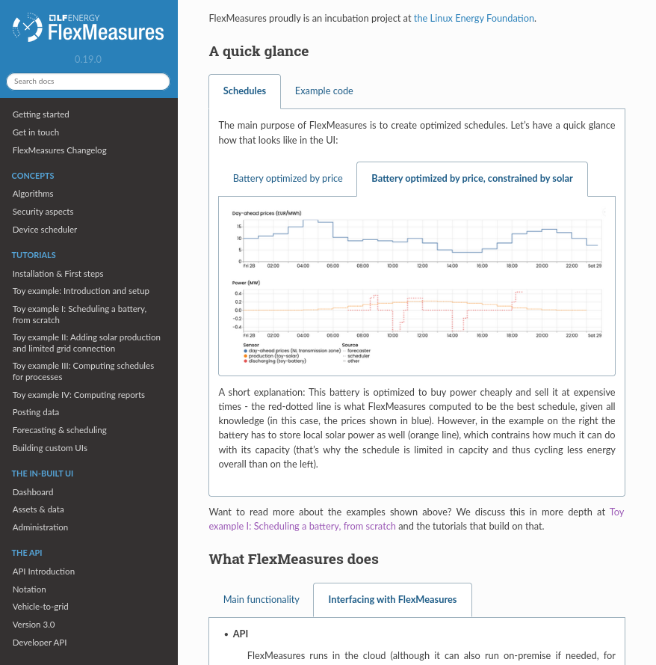
WIP: more helpful docs

Slide 12
Scheduling: State of the art
Done
Storage: Battery
Storage: Heat
Processes
Next
Sites (start: PR#855)
Sector coupling
Grid services
Order books
VPP

Slide 13
Ideas for version 0.20
Focus (currently):
Rate limiting
RelaxedStorageScheduler
CLI: ability to provide dynamic SoC values
(see also https://github.com/FlexMeasures/flexmeasures/milestone/44)

Slide 14
Q&A
What are you working on?
What is unclear?

Slide 15
Roadmap – Big goals
[2022 - mature] Model & pilot e-mobility optimization (price-based, V2G)
[2023 - started] Model & pilot heating optimization (price-based, also with heat buffers)
[2023] Sector coupling (optimize e-mobility and heating in one site)
[2024] Congestion support (e.g. for DSOs in GOPACS)
[2024] VPP (optimize multiple sites towards one market)
https://flexmeasures.io/roadmap/

Slide 16
Resources – do get in touch!
https://github.com/FlexMeasures/flexmeasures/
https://www.flexmeasures.io
https://lists.lfenergy.org/g/flexmeasures
https://fosstodon.org/@flexmeasures
LF Energy Slack: #flexmeasures

Slide 17

FlexMeasures - integration

