Slide 1
FlexMeasures Technical Steering
Committee
August 10 2023

Slide 2
Agenda
Welcome & Short introduction to FlexMeasures
The latest release: v0.15 ― a quick tour
Roadmap: What should be in v0.16?
Q&A

Slide 3
FlexMeasures is the intelligent & developer-friendly EMS to support real-time energy flexibility apps.
Go green in daily operations, stay in control.
Smart industry
Smart city

Slide 4

The matching challenge

Slide 5

FlexMeasures - simple

Slide 6

Example cases

Slide 7
Version 0.15 is out
schedule energy processes
a new data visualization: Daily activity heatmap
Sensor CRUD API
https://flexmeasures.io/015-process-scheduling-heatmap/

Slide 8
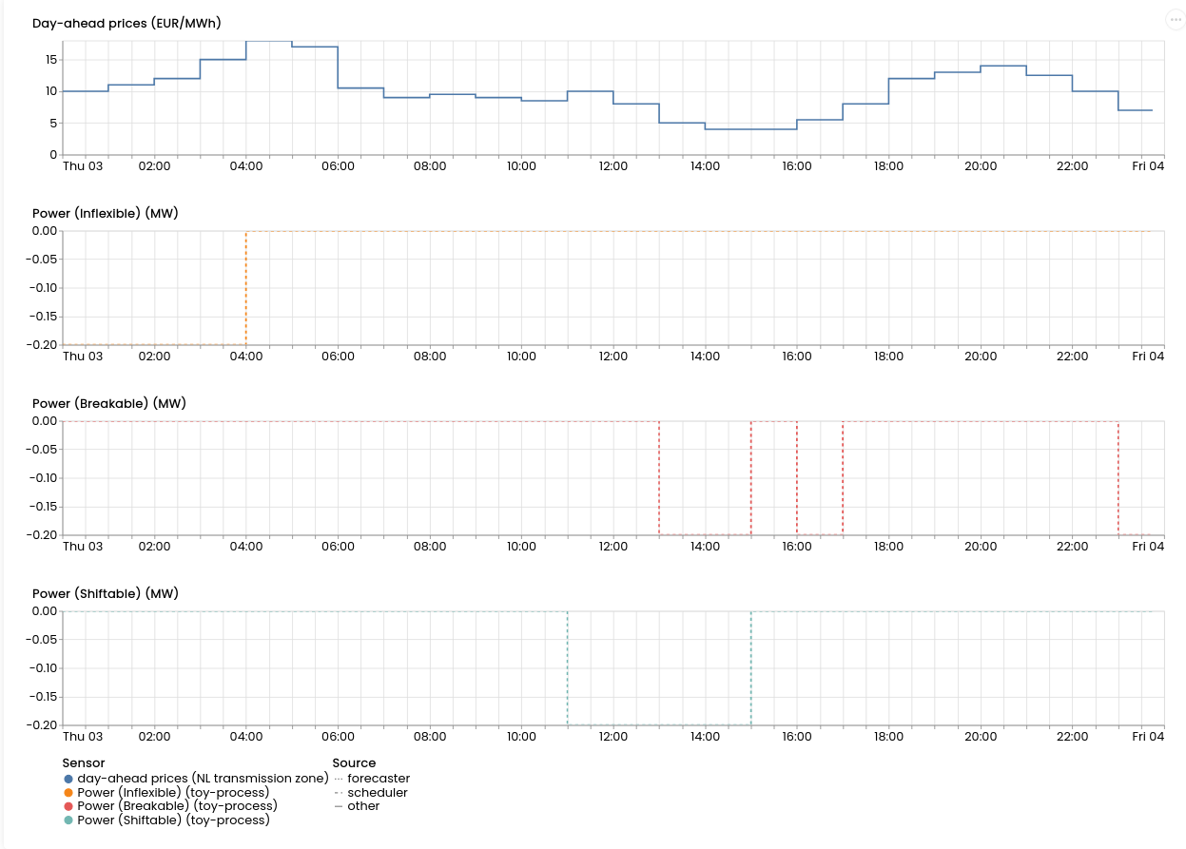
Schedule processes

Slide 9
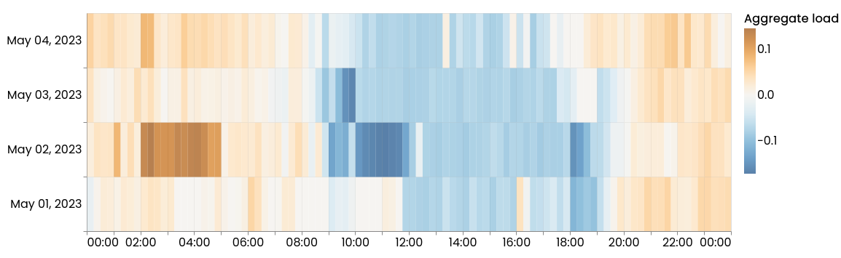
Daily activity heatmap

Slide 10
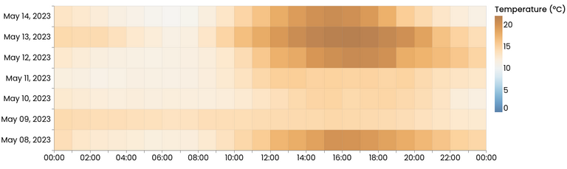
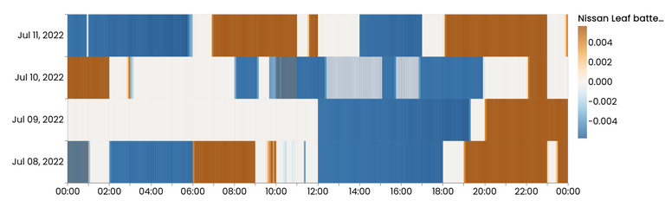
Daily activity heatmap

Slide 11
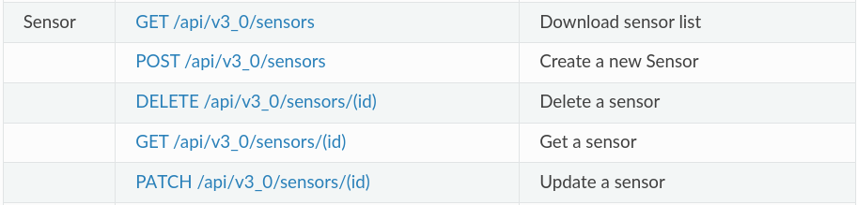
Sensor CRUD API

Slide 12
Ideas for version 0.16
Documentation improvements
More granular authentication system (ability for super-accounts to administer their customer accounts)
Forecasting
API modernization (OpenAPI, less legacy dependencies)
Scheduling multiple devices: group different devices under unique constraints
Capacity constraints as time series

Slide 13
Q&A
What are you working on?
What is unclear?

Slide 14
Roadmap – Big goals
[2022 - mature] Model & pilot e-mobility optimization (price-based, V2G)
[2023 - started] Model & pilot heating optimization (price-based, also with heat buffers)
[2023] Congestion support (e.g. for DSOs in GOPACS)
[2023] Sector coupling (optimize e-mobility and heating in one site)
[2024] VPP (optimize multiple sites towards one market)
https://flexmeasures.io/roadmap/

Slide 15
Roadmap – projects
[Q1 2023] More powerful algorithm configurations, to support more use cases and more custom situations (e.g. research). For scheduling, as well as for forecasting. [work has started in Q4 2022]
[Q2 2023] KPIs support (e.g. reporting of daily totals), customizable
[Q2 2023] Scheduling algorithm for heat buffering
[Q2 2023] Allow for annotations on time series, e.g. to model processes and operator feedback. [work has started in 2022]
[Q4 2023] Build out the flexibility modelling, by supporting Fraunhofers Energy Flexibility Data Model (EDFM) and TNO's S2
[tbd] Authorization model for allowing "super-accounts" to manage other accounts (e.g. for ESCos) or add data to them (e.g. meter data companies).
[tbd] Smarter monitoring.
[tbd] Scheduler compatible with ShapeShifter (based on USEF flex trading protocol)
[tbd] Better plotting support (via API/vega-lite), for plugins to define their own plots which are then made available in the FlexMeasures API (usable in custom frontends).
[tbd] Better tooling to work well at scale (e.g. support load balancing, db sharding etc). Also using Docker to scale up more flexibly (e.g. in Kubernetes).
https://flexmeasures.io/roadmap/

Slide 16
Resources – do get in touch!
https://github.com/FlexMeasures/flexmeasures/
https://www.flexmeasures.io
https://lists.lfenergy.org/g/flexmeasures
https://fosstodon.org/@flexmeasures
LF Energy Slack: #flexmeasures

Slide 17

FlexMeasures - integration

