Slide 1
FlexMeasures Technical Steering
Committee
November 07, 2024

Slide 2
Agenda
Welcome & Short introduction to FlexMeasures
What’s new in v0.24?
Roadmap for v0.25 and 1.0
Q&A

Slide 3

The matching challenge

Slide 4
FlexMeasures is the intelligent & developer-friendly EMS to support real-time energy flexibility apps.
Go green in daily operations, stay in control.
Smart industry
Smart city

Slide 5

FlexMeasures - simple

Slide 6

Example cases

Slide 7
Version 0.24 is not out yet
Editing of dashboard graphs
Multiple commitments in scheduler
Separate legends per-graph
Faster account overview & editing page
Small fixes (see link below)
https://github.com/FlexMeasures/flexmeasures/milestone/50

Slide 8
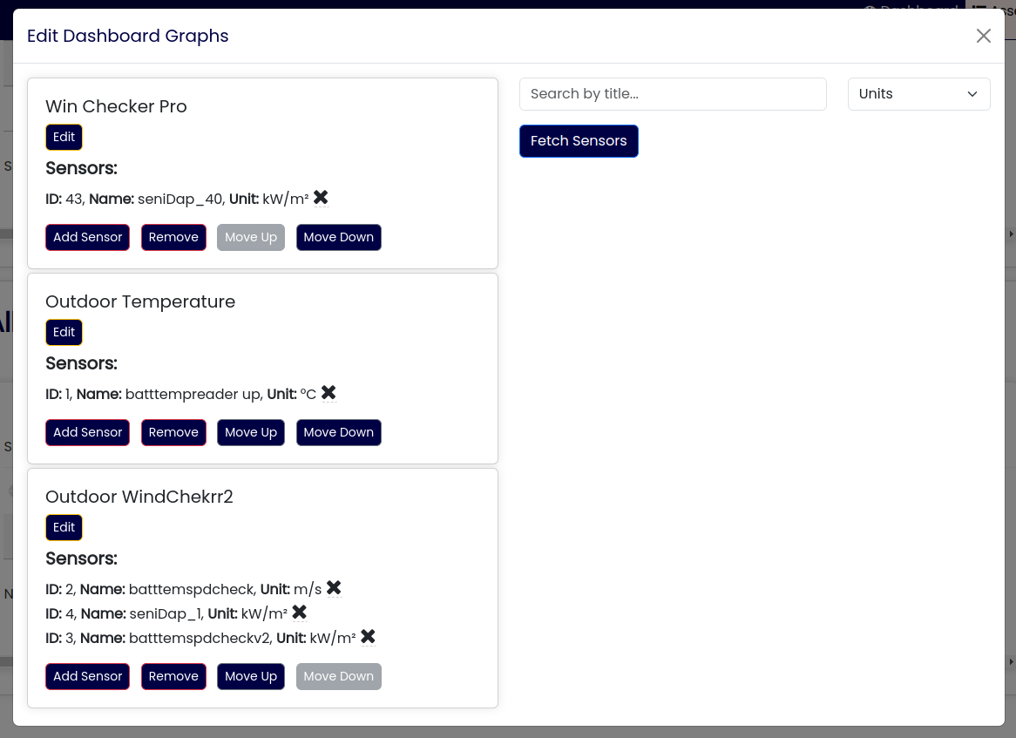
Dashboard graph editing

Slide 9
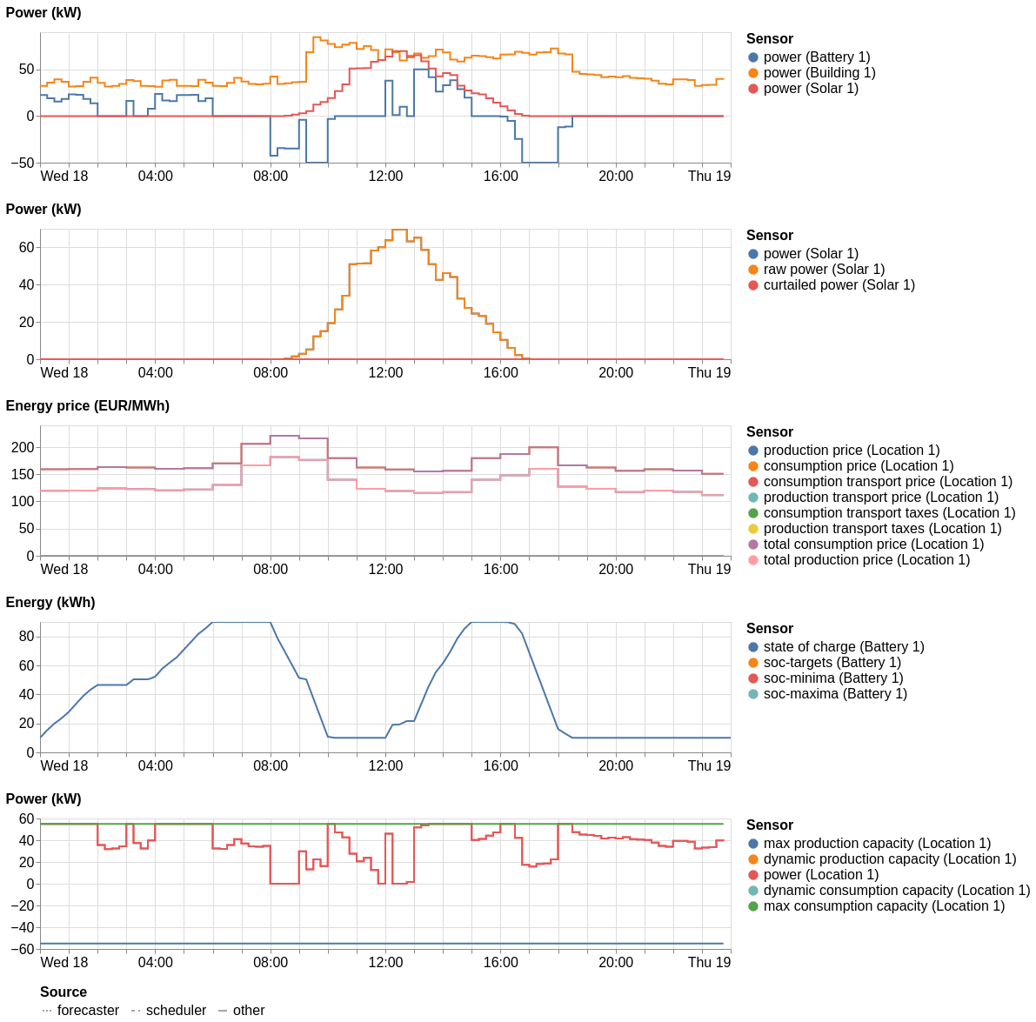
Separate legends per-graph

Slide 10
Multiple commitments in scheduler
Challenge addressed:
There exist more reasons to adjust power flow, next to hard constraints (e.g. grid capacity) and optimization goal (e.g. price).
Three use cases:
A second market / contract / incentivation scheme
Penalty for breaching capacities (useful so the scheduler tries its best)
One-time costs for peaks (a pricing feature DSOs use, on a monthly basis)
This PR (#1444) revised the commitments framework used in our linear problem formulation, so multiple commitments (in addition to one optimization signal) are possible.
New fields:
site-consumption-breach-price: if set, site-consumption-capacity becomes a soft constraint. Also: site-production-breach-price
Site-peak-consumption, site-peak-production: record the highest peak
Site-peak-consumption-price and site-peak-production-price: A one-time price for the highest recorded peak.

Slide 11
Scheduling: State of the art
Done
Storage: Battery
Storage: Heat
Processes
Next
Sites (start: PR#855, #1065)
Imbalance
Sector coupling
Grid services
VPP

Slide 12
Ideas for version 0.25
Focus (currently):
Relaxed storage scheduler
Editing flex-context & flex-model
(see also https://github.com/FlexMeasures/flexmeasures/milestone/51)

Slide 13
Ideas for milestone v1.0
Site optimization (multi-asset). Why? Fulfill crucial milestone of mission. Current solution? Optimize flexible assets in sequence. Progress? Good, needs projects/testing.
Editable flex-model and context. Why? Ease of use & maintenance for non-developers. Current solution? Send all info in API. Progress? PoC for flex-context (prices) but big design question remains - store on data model (use API & SQL features) or JSON (more flexible in usage and extension, needs own schemas)?
Support all energy units in the API Why? Diversity in data per project/site. Current solution? Might be fixed now, recently still needed MW in some places, needs work on docs. Progress? #1007 & #386 are done now. #483 worth doing?

Slide 14
Q&A
What are you working on?
What is unclear?

Slide 15
Roadmap – Big goals
[2022 - mature] Model & pilot e-mobility optimization (price-based, V2G)
[2023 - started] Model & pilot heating optimization (price-based, also with heat buffers)
[2024] Multi-asset scheduling
[2024] Imbalance market support
[2025] Sector coupling (optimize e-mobility and heating in one site)
[2025] Congestion support (e.g. for DSOs in GOPACS)
https://flexmeasures.io/roadmap/

Slide 16
Resources – do get in touch!
https://github.com/FlexMeasures/flexmeasures/
https://www.flexmeasures.io
https://lists.lfenergy.org/g/flexmeasures
https://fosstodon.org/@flexmeasures
LF Energy Slack: #flexmeasures

Slide 17

FlexMeasures - integration

