Slide 1
FlexMeasures Technical Steering
Committee
May 16, 2024

Slide 2
Agenda
Welcome & Short introduction to FlexMeasures
What’s new in v0.21?
Roadmap for v0.22
Q&A

Slide 3

The matching challenge

Slide 4
FlexMeasures is the intelligent & developer-friendly EMS to support real-time energy flexibility apps.
Go green in daily operations, stay in control.
Smart industry
Smart city

Slide 5

FlexMeasures - simple

Slide 6

Example cases

Slide 7
Version 0.21 is out
Status page
Audit log
Linking to a custom time range of data
https://flexmeasures.io/021-service-better-status-and-audit/

Slide 8
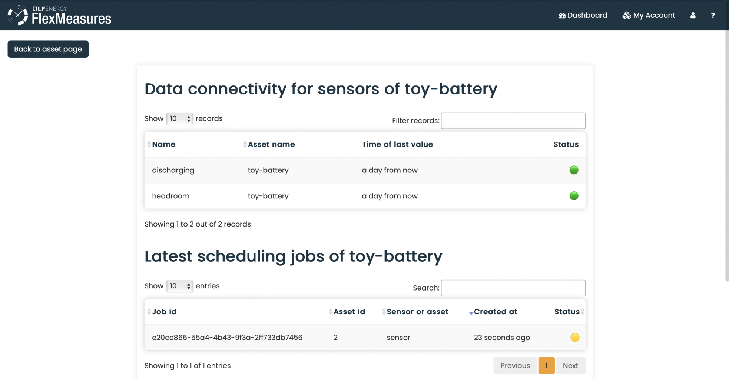
Status page

Slide 9
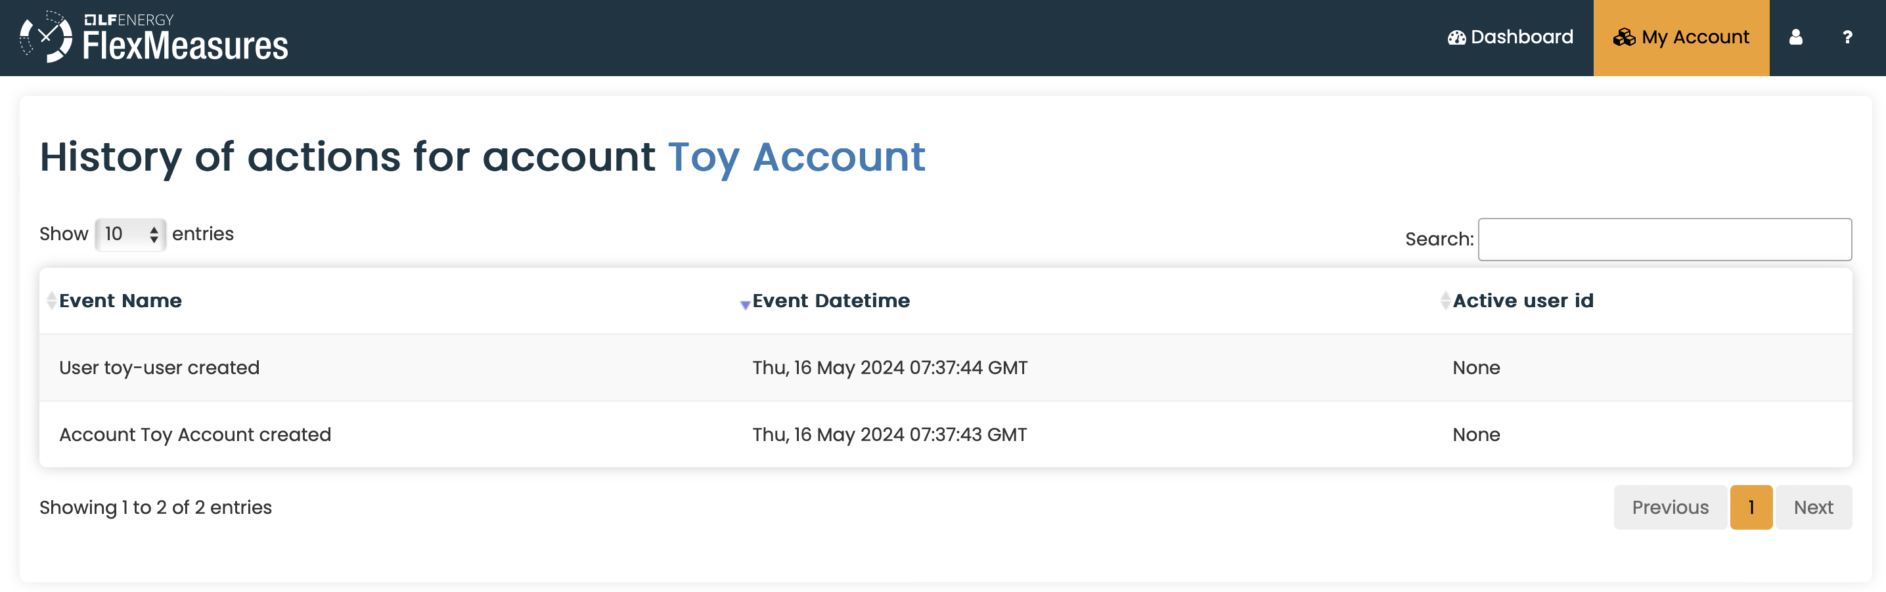
Audit log

Slide 10
Scheduling: State of the art
Done
Storage: Battery
Storage: Heat
Processes
Next
Sites (start: PR#855)
Imbalance
Sector coupling
Grid services

Slide 11
Ideas for version 0.22
Focus (currently):
Edit flex context
Upgrade Boostrap from 3 to 5
RelaxedStorageScheduler
(see also https://github.com/FlexMeasures/flexmeasures/milestone/48)

Slide 12
Q&A
What are you working on?
What is unclear?

Slide 13
Roadmap – Big goals
[2022 - mature] Model & pilot e-mobility optimization (price-based, V2G)
[2023 - started] Model & pilot heating optimization (price-based, also with heat buffers)
[2024] Multi-asset scheduling
[2024] Imbalance market support
[2025] Sector coupling (optimize e-mobility and heating in one site)
[2025] Congestion support (e.g. for DSOs in GOPACS)
https://flexmeasures.io/roadmap/

Slide 14
Resources – do get in touch!
https://github.com/FlexMeasures/flexmeasures/
https://www.flexmeasures.io
https://lists.lfenergy.org/g/flexmeasures
https://fosstodon.org/@flexmeasures
LF Energy Slack: #flexmeasures

Slide 15

FlexMeasures - integration

