Slide 1
FlexMeasures Technical Steering
Committee
January 3rd 2023

Slide 2
Agenda
Welcome & Short introduction to FlexMeasures
Version 0.12 is done (release in progress)
Roadmap
Q&A

Slide 3
FlexMeasures is the intelligent & developer-friendly EMS to support real-time energy flexibility apps.
Go green in daily operations, stay in control.
Smart industry
Smart city

Slide 4

The matching challenge

Slide 5

Example cases

Slide 6

FlexMeasures - simple

Slide 7
Developer support
I need help with integrating real-time data and continuously computing new data
It’s hard to correctly model data with different sources, resolutions, horizons and even uncertainties
I want to build new features quickly, not spend days solving basic problems

Slide 8
Architecture vision: Out-of-the-box use cases vs power users
Out of the box – the 90 % cases
Battery/EV + solar (self-consumption)
Battery/EV + solar + congestion (also grid support)
Solar + Heat pump (self-consumption & comfort)
...
FM: Pre-made schedulers, Setup wizard, excellent tutorials
Power users – bring your own
Simulations (researchers, investment decision moments)
New services (e.g. startups) with custom scheduling
Microgrids
Industry
FM: Examples, support

Slide 9
Version 0.12 is done
Customisable scheduling & scheduling API
Replay button
Improvements on data import/export
Forecasts visually distinguished

Slide 10
v0.12: Customisable schedules
Use case:
Power users building their own solution
E.g. researchers, startups
Write their own scheduler class and flex model

Slide 11
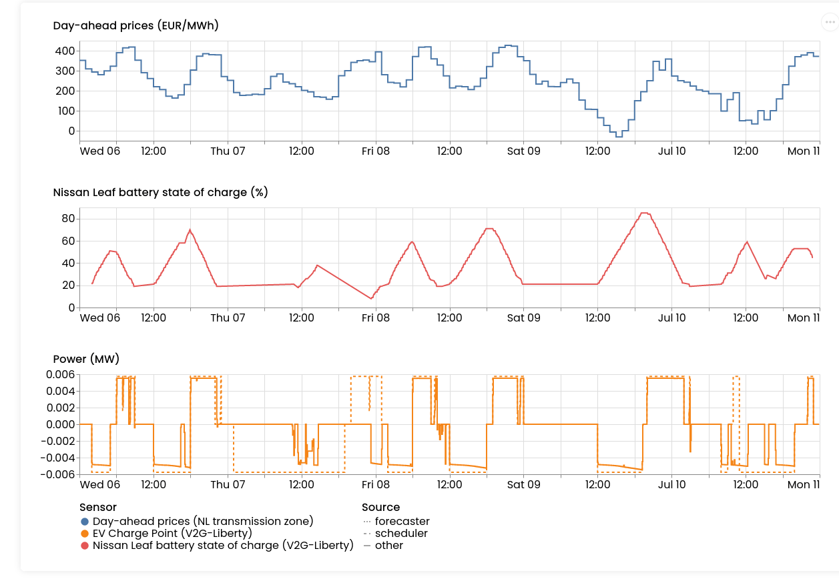
v0.12: Replay

Slide 12
v0.12: Data I/O
flexmeasures show beliefs:
showing beliefs data in a custom resolution and/or timezone
saving the shown beliefs data to a CSV file
handle showing (and saving) instantaneous sensor data and non-instantaneous sensor data together
flexmeasures add beliefs:
drop duplicate records with warning
allow configuring which column contains explicit recording times for each data point (use case: import forecasts)
localize timezone naive data
support reading in datetime and timedelta values
remove rows with NaN values
filter by values in specific columns

Slide 13
Roadmap
Quicker Dockerization with custom (plugin) code
Non-linear solver support
Heat-Buffering and Shiftable algorithms
Support for Flex Standards (S2 by TNO, EFDM by Fraunhofer)
https://flexmeasures.io/roadmap/

Slide 14
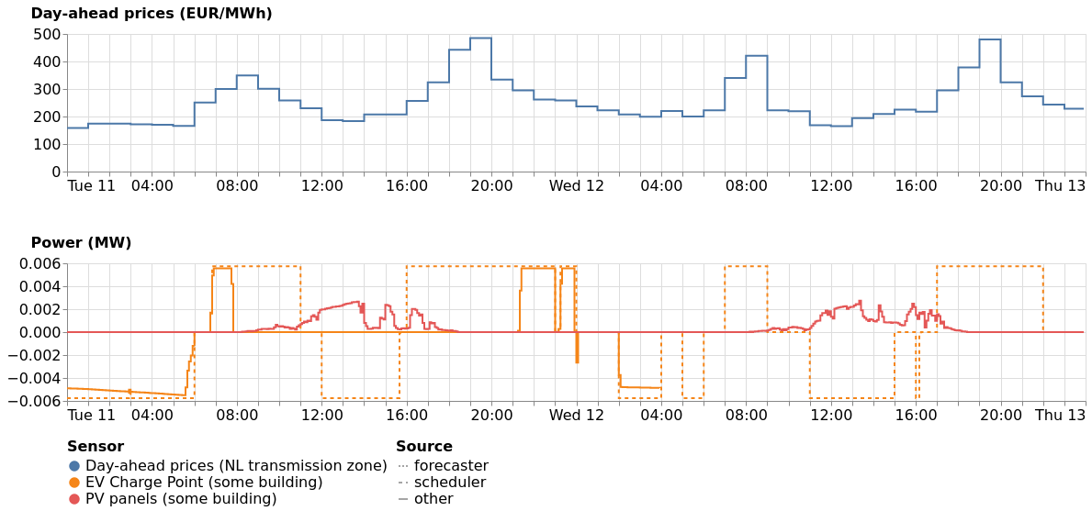
v0.13: Showing multiple power sensors together in one graph
Compare power levels across devices more easily.
Use case:
Battery
Solar power
(network constraint)
TODO: Tutorial

Slide 15
Q&A
What are you working on?
What is unclear?

Slide 16
Resources – do get in touch!
https://github.com/FlexMeasures/flexmeasures/
https://www.flexmeasures.io
https://lists.lfenergy.org/g/flexmeasures
https://twitter.com/flexmeasures
LF Energy Slack: #flexmeasures

Slide 17

FlexMeasures - integration

