Slide 1
FlexMeasures Technical Steering
Committee
June 22 2023

Slide 2
Agenda
Welcome & Short introduction to FlexMeasures
The latest release: v0.14
A quick tour of the new reporting architecture
The new FlexMeasures-Client (Python)
An update on current work on heating optimization
Q&A

Slide 3
FlexMeasures is the intelligent & developer-friendly EMS to support real-time energy flexibility apps.
Go green in daily operations, stay in control.
Smart industry
Smart city

Slide 4

The matching challenge

Slide 5

FlexMeasures - simple

Slide 6

Example cases

Slide 7

Version 0.14 is out
new reporting capabilities
begin supporting optimization of heat storage
a bunch of developer support features
https://flexmeasures.io/014-reporting-power/

Slide 8
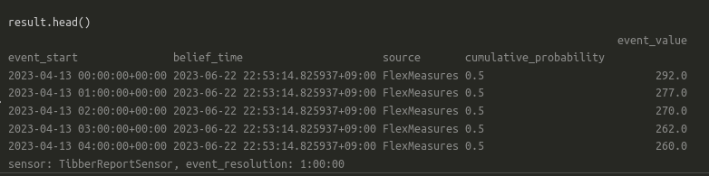
The new reporting architecture
Benefits:
- minimize code repetition
- propagate code re-use
- standard interface for data computations
Commands:
flexmeasures add report
flexmeasures show reporters
Reporter
Configuration
Reporter
Inputs
Report
- start
- end
- resolution
…
Classes
Reporter
PandasReporter
TibberReporter
AggregatorReporter
Next steps:
- YAML
- Reporters are DataSources
- Separate reporters from reports

Slide 9
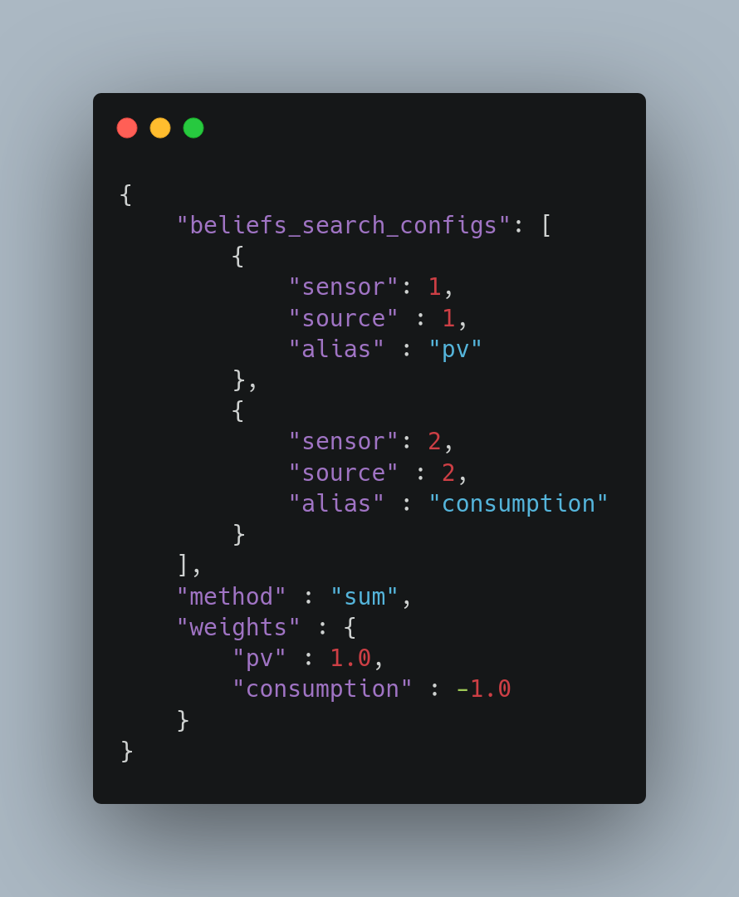
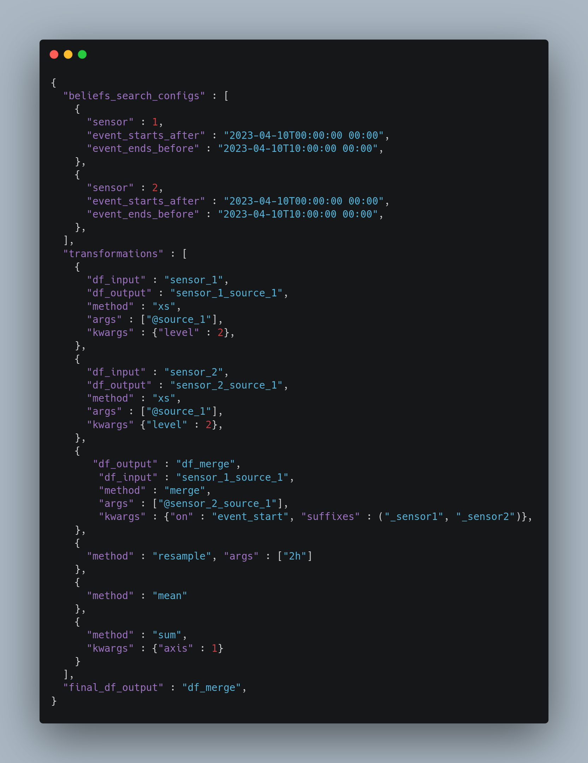
AggregatorReporter
PandasReporter
Sum the power flows of the PV (sensor #1)
and consumption (sensor #2).
Sum the values of sensors 1 & 2 for each time period
and resample to 2h resolution.

Slide 10
The new flexmeasures-client
An async client to communicate with the Flexmeasures API and save local EMS developers time
Current functionality:
Authentication
Listing available sensors
Listing assets
Adding measurements to sensors
Triggering and retrieving schedules
Built-in behaviour:
Polling (e.g. while Flexmeasures is calculating schedules)
Automatic reauthorization when the access token expires
Next steps:
creating assets, sensors
logging and improved error handling

Slide 11
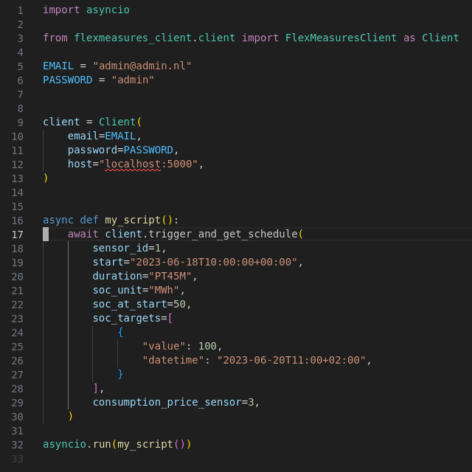

Slide 12
Ongoing: heating optimization
Storage scheduler supports losses over time (#679) → new storage-efficiency parameter
S2 protocol implementation in FlexMeasures client
Multiple maxima and minima constraints in scheduling (#680) → usage forecasts can be modelled for scheduling (heat) buffers

Slide 13
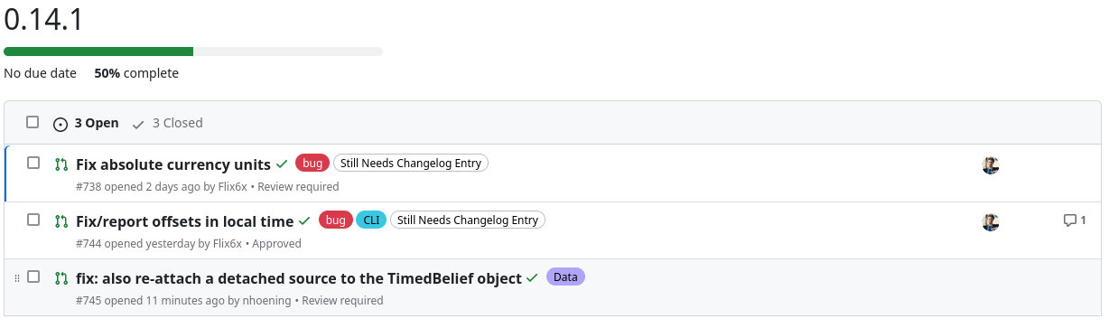
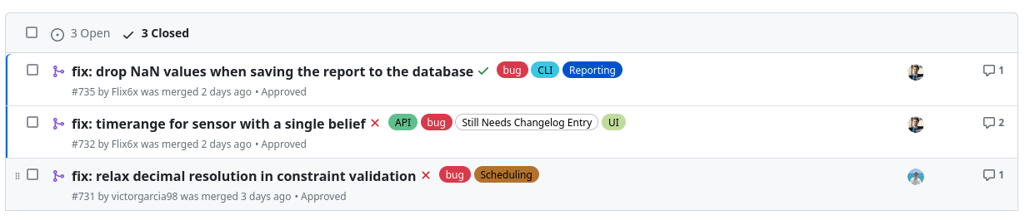
Version 0.14.1 is on the way

Slide 14
Q&A
What are you working on?
What is unclear?

Slide 15
Roadmap – Big goals
[2022 - mature] Model & pilot e-mobility optimization (price-based, V2G)
[2023 - started] Model & pilot heating optimization (price-based, also with heat buffers)
[2023] Congestion support (e.g. for DSOs in GOPACS)
[2023] Sector coupling (optimize e-mobility and heating in one site)
[2024] VPP (optimize multiple sites towards one market)
https://flexmeasures.io/roadmap/

Slide 16
Roadmap – projects
[Q1 2023] More powerful algorithm configurations, to support more use cases and more custom situations (e.g. research). For scheduling, as well as for forecasting. [work has started in Q4 2022]
[Q2 2023] KPIs support (e.g. reporting of daily totals), customizable
[Q2 2023] Scheduling algorithm for heat buffering
[Q2 2023] Allow for annotations on time series, e.g. to model processes and operator feedback. [work has started in 2022]
[Q4 2023] Build out the flexibility modelling, by supporting Fraunhofers Energy Flexibility Data Model (EDFM) and TNO's S2
[tbd] Authorization model for allowing "super-accounts" to manage other accounts (e.g. for ESCos) or add data to them (e.g. meter data companies).
[tbd] Smarter monitoring.
[tbd] Scheduler compatible with ShapeShifter (based on USEF flex trading protocol)
[tbd] Better plotting support (via API/vega-lite), for plugins to define their own plots which are then made available in the FlexMeasures API (usable in custom frontends).
[tbd] Better tooling to work well at scale (e.g. support load balancing, db sharding etc). Also using Docker to scale up more flexibly (e.g. in Kubernetes).
https://flexmeasures.io/roadmap/

Slide 17
Resources – do get in touch!
https://github.com/FlexMeasures/flexmeasures/
https://www.flexmeasures.io
https://lists.lfenergy.org/g/flexmeasures
https://twitter.com/flexmeasures
LF Energy Slack: #flexmeasures

Slide 18

FlexMeasures - integration

