Slide 1
FlexMeasures Technical Steering
Committee
September 19, 2024

Slide 2
Agenda
Welcome & Short introduction to FlexMeasures
What’s new in v0.23?
Roadmap for v0.24 and 1.0
Q&A

Slide 3

The matching challenge

Slide 4
FlexMeasures is the intelligent & developer-friendly EMS to support real-time energy flexibility apps.
Go green in daily operations, stay in control.
Smart industry
Smart city

Slide 5

FlexMeasures - simple

Slide 6

Example cases

Slide 7
Version 0.23 is out
More info on sensor page
White-labeling
More expressiveness in flex-model and flex-context
Faster assets index page
Small fixes (see link below)
https://github.com/FlexMeasures/flexmeasures/milestone/49

Slide 8
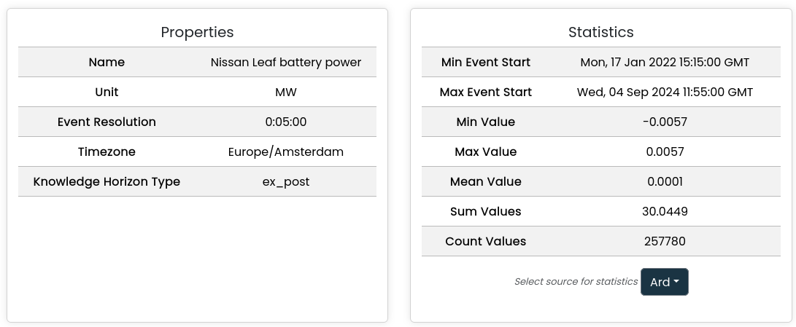
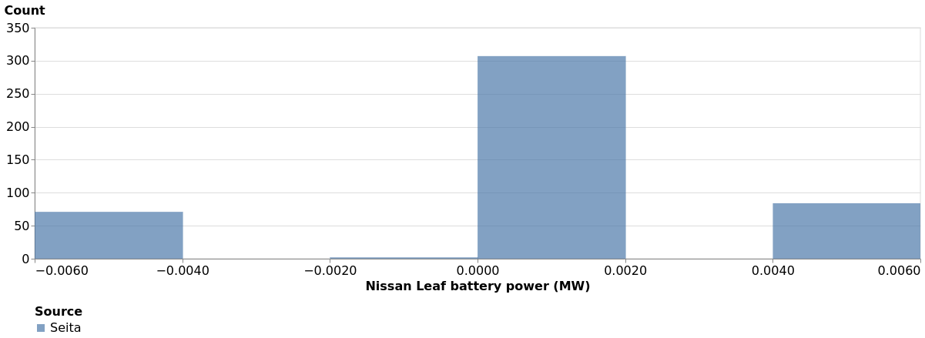
More info on sensor page

Slide 9
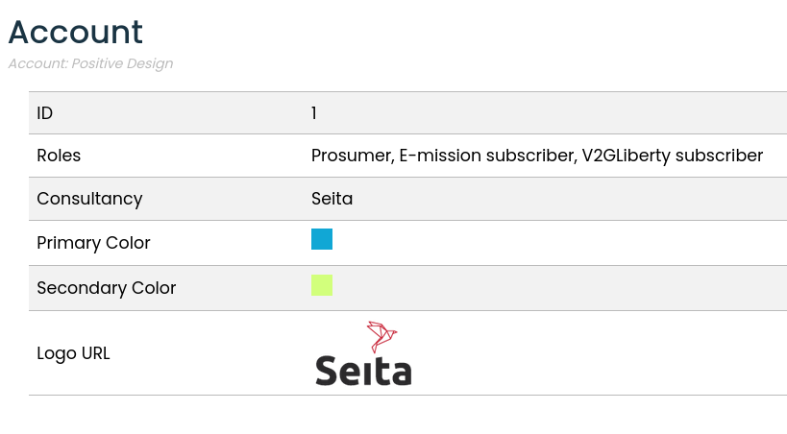
White labeling

Slide 10
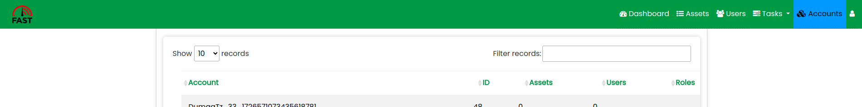
White labeling

Slide 11
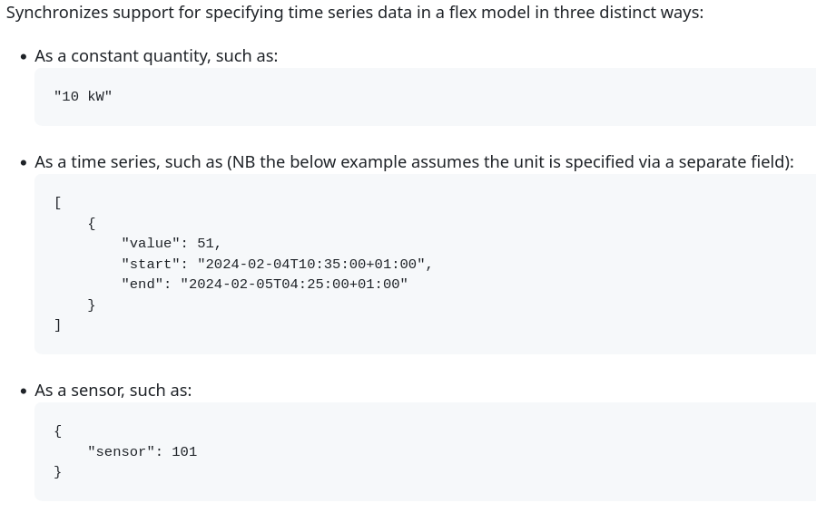
More expressive flex-context & model

Slide 12
Scheduling: State of the art
Done
Storage: Battery
Storage: Heat
Processes
Next
Sites (start: PR#855, #1065)
Imbalance
Sector coupling
Grid services
VPP

Slide 13
Ideas for version 0.24
Focus (currently):
Relaxed storage scheduler & multi-commitment
Data dashboard: Editing, separate legends
Some dev improvements
(see also https://github.com/FlexMeasures/flexmeasures/milestone/51)

Slide 14
Ideas for milestone v1.0
Site optimization (multi-asset). Why? Fulfill crucial milestone of mission. Current solution? Optimize flexible assets in sequence. Progress? Good, needs projects/testing.
Editable flex-model and context. Why? Ease of use & maintenance for non-developers. Current solution? Send all info in API. Progress? PoC for flex-context (prices) but big design question remains - store on data model (use API & SQL features) or JSON (more flexible in usage and extension, needs own schemas)?
Support all energy units in the API Why? Diversity in data per project/site. Current solution? Might be fixed now, recently still needed MW in some places, needs work on docs. Progress? #1007 & #386 are done now. #483 worth doing?

Slide 15
Q&A
What are you working on?
What is unclear?

Slide 16
Roadmap – Big goals
[2022 - mature] Model & pilot e-mobility optimization (price-based, V2G)
[2023 - started] Model & pilot heating optimization (price-based, also with heat buffers)
[2024] Multi-asset scheduling
[2024] Imbalance market support
[2025] Sector coupling (optimize e-mobility and heating in one site)
[2025] Congestion support (e.g. for DSOs in GOPACS)
https://flexmeasures.io/roadmap/

Slide 17
Resources – do get in touch!
https://github.com/FlexMeasures/flexmeasures/
https://www.flexmeasures.io
https://lists.lfenergy.org/g/flexmeasures
https://fosstodon.org/@flexmeasures
LF Energy Slack: #flexmeasures

Slide 18

FlexMeasures - integration

